Slide 1
Black-Litterman
Asset Allocation Model
QSS Final Project
Midas Group Members
Bo Jiang, Tapas Panda, Jing Lin, Yuxin Zhang
Under the Guidance of Professor Campbell Harvey
April 27, 2005

Slide 2
Agenda
Part 1: Motivation and Intuition
Part 2: Analytics
Part 3: Numerical Example
Part 4: BL in Practice
Part 5: Test the Model
Epilogue: 3 Recommendations

Slide 3
Part 5: Test the Model
The best way to test the model is…

Slide 4

Introspection…

Slide 5
Part 1: Motivation & Intuition

Slide 6
The Problems of Markowitz Optimization
Highly-concentrated portfolios
  Extreme portfolios
Input-sensitivity
  unstable
  Estimation error maximization
Unintuitive
  No way to incorporate investor’s view
  No way to incorporate confidence level
  No intuitive starting point for expected return.
  Complete set of expected return is required.

Slide 7
Black-Litterman Model
B-L model uses a Bayesian approach to combine the subjective views of an investor regarding the expected returns of one or more assets with the market equilibrium vector of expected returns (the prior distribution) to form a new mixed estimate of expected returns (the posterior distribution).

Slide 8
How does BLM work?
Start with the market returns using reverse optimization and CAPM.
Apply your own unique views of how certain markets are going to behave.
The end result includes both a set of expected returns of assets as well as the optimal portfolio weights.

Slide 9
Intuition of BLM
If you do not have views, you hold the market portfolio (the benchmark).
Your views will tilt the final weights away from the market portfolio, the degree to which depending on how confident you are about your views.

Slide 10
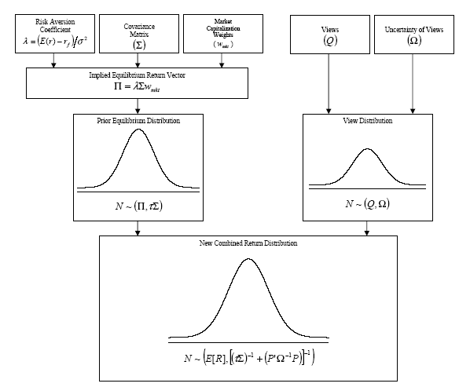
Road Map

Slide 11
Part 2: Analytics

Slide 12
Equilibrium Returns (1)
Equilibrium Return
=current Market collective forecasts of next period returns; i.e., the market’s collective view on future returns
=reverse optimized returns
this Market View is to be combined with Our View; and the combination (using GLS) will take the estimation error of either views into consideration.

Slide 13
Equilibrium Returns (2)
Assume Market has the following attributes
  N assets
  Expected Return vector μ[Nx1]
  Expected covariance Matrix ∑[NxN]

Slide 14
Equilibrium Returns (3)
Today when the trades took place, market collectively reached the equilibrium (supply = demand).
To do this it had ran the Markowitz mean-variance optimization and reached the optimized weights w[Nx1] – which are the current market capitalization weights

Slide 15
Equilibrium Returns (4)
Max [w’μ – (λ/2)w’∑w]
  Note: This is derived from the utility theory and multivariate normal distribution – Financial Economics 101
  λ = risk aversion coefficient (E(M) –rf)/σ(mkt)^2)
  E(M) = Expected market or benchmark total return
  λ is found from historical data (approx = 3.07)
  Solve δw’μ /δw - δ((λ/2)w’∑w)/ δw = 0
  They got μ = λ ∑w
    Note: two most important matrix derivation formula δw’μ /δw = μ and δ(w’∑w)/ δw = 2∑w

Slide 16
Equilibrium Returns using Implied Beta
Equilibrium Returns can be calculated by using the “implied Beta” of assets.
  μ = β(implied)*(risk premium of market )
  Implied β = ∑*w(mkt)/(w(mkt)T*∑w(mkt))
  The denominator is basically the variance of market portfolio. The numerator is the covariance of the assets in the market portfolio. Asset weights are the equilibrium weights. Covariance matrix ∑ is historical covariance.

Slide 17
What is the estimation error of the Equilibrium Returns?
A controversial issue in BL model.
Since the equilibrium returns are not actually estimated, the estimation error cannot be directly derived.
But we do know that the estimation error of the means of returns σ_{E[r(i,t+1)]} should be less than the covariance of the returns.
A scalar τ less than 1 is used to scale down the covariance matrix (Σ) of the returns.
Some say that “τ =0.3 is plausible”.

Slide 18
Forming Our View (1)
Our view is:
Q=Pu+η, μ~Φ(0,Ω)
Note: same as Pu=Q+η, because η~Φ(0,Ω) ⬄ - η~Φ(0,Ω)
u is the expected future returns (a NX1 vector of random variables).
Ω is assumed to be diagonal (but is it necessary?)

Slide 19
Forming Our View (2)
What does this Q=P*u+η, Or equivalently P*u=Q+ η mean?
Look at P*u:
each row of P represents a set of weights on the N assets, in other words, each row is a portfolio of the N assets. (aka “view portfolio”)
u is the expected return vector of the N assets
P*u means we are expressing our views through k view portfolios.

Slide 20
Forming Our View (3)
Our Part 3 Numerical Example will show some examples of the process of expressing views.
The Goldman Sachs Enigma is how they express views quantitatively.

Slide 21
Forming Our View (4)
Why is expressing views so important?
Because the practical value of BL model lies in the View Expressing Scheme; the model itself is just a publicly available view combining engine.
  Our view is the source of alpha.
  Expressing views quantitatively means efficiently and effectively translate fundamental analyses into Views

Slide 22
Forming Our View (5)
We will try to decode Goldman Sachs Enigma in Part 4 “Applications”.

Slide 23
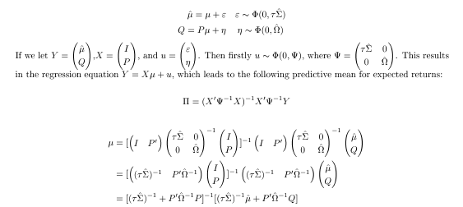
Combining Views (1)
{
Generalized Least Square Estimator of μ
μ^{Comb}
μ^{Comb}

Slide 24
Combining Views (1)
{
Generalized Least Square Estimator of μ
μ^{Comb}
μ^{Comb}

Slide 25
Combining Views (2)
Var(μ^{Comb})

Slide 26
Now we have a combined forecast of the expected returns.

Slide 27
The next step is to do Markowitz Mean-Variance Optimization.
By using the combined forecasted means
and the forecasted covariance matrix ∑.
So we start with Markowitz (reverse optimization) and CAPM (implied beta).
Go though Black-Litterman View Combining engine.
And end up with Markowitz again with predictive means, (and forward looking return covariance matrix.)

Slide 28
Part 3: Numerical Example

Slide 29
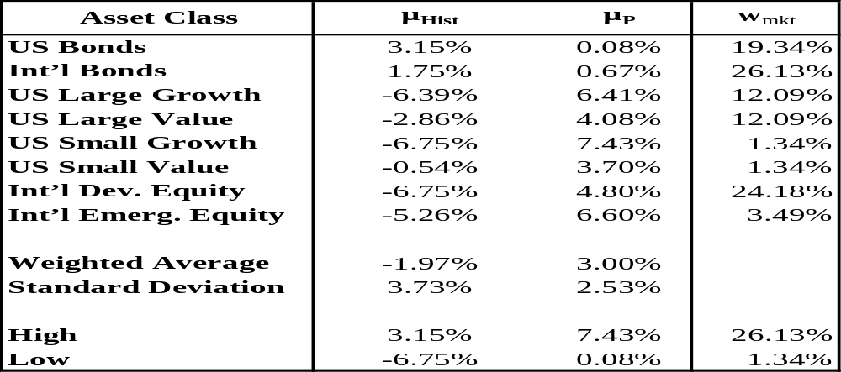
An Eight Assets Example…
μ_{Hist} is historical mean asset returns
μ_{p} is calculated relative to the market cap. weighted portfolio using implied betas and CAPM model.
Market portfolio weights w_{mkt} is based on market capitalization for each of the assets

Slide 30
Market Returns П(nx1)
Market returns are derived from known information using Reverse Optimization:
П = ג ∑w_{mkt}
  П (nx1) is the excess return over the risk free rate
  ג is the risk aversion coefficient
  ∑(nxn) is the covariance matrix of excess returns
  W_{mkt} (nx1) is the market capitalization weight of the assets

Slide 31
Risk Aversion Coefficient ג
More return is required for more risk
ג=(E (r) – r_{f} )/σ²=Risk Premium/Variance
Using historical risk premium and variance, we got a ג of aprrpoximately 3.07

Slide 32
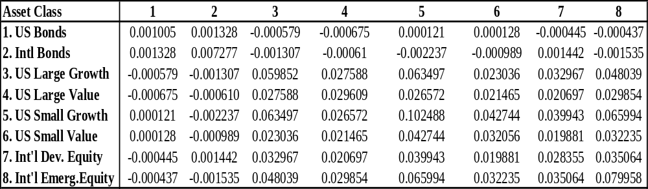
Coviriance Matrix ∑
Coviriance Matrix ∑(nxn)

Slide 33
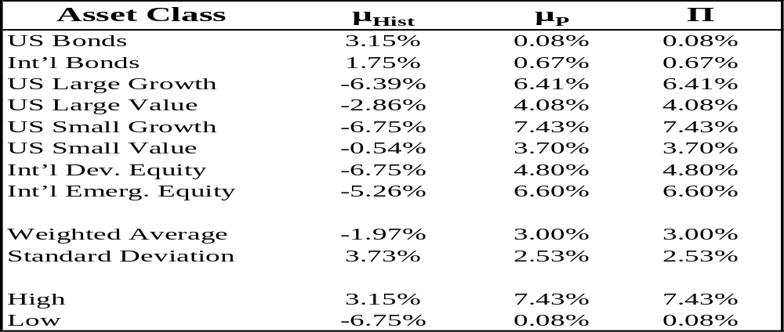

Market Returns П(nx1)
Π = λΣw_{mkt}

Slide 34




The Black – Litterman Model
The Black – Litterman Formula
E[R] (nx1) is the new Combined Return Vector
τ is a scalar
∑ (nxn) is the covariance matrix of excess returns
P (kxn) is the view matrix with k views and n assets
Ω (kxk) is a diagonal covariance matrix of error terms from the expressed views
Π (nx1) is the implied market return vector
Q (kx1) is the view vector

Slide 35
What is a view?
Opinion: International Developed Equity will be doing well
Absolute view:
  View 1: International Developed Equity will have an absolute excess return of 5.25% (Confidence of view = 25%)
Relative view:
  View 2: International Bonds will outperform US bonds by 25 bp (Confidence of view = 50%)
  View 3: US Large Growth and US Small Growth will outperform US Large Value and US Small Value by 2% (Confidence of View = 65%)

Slide 36
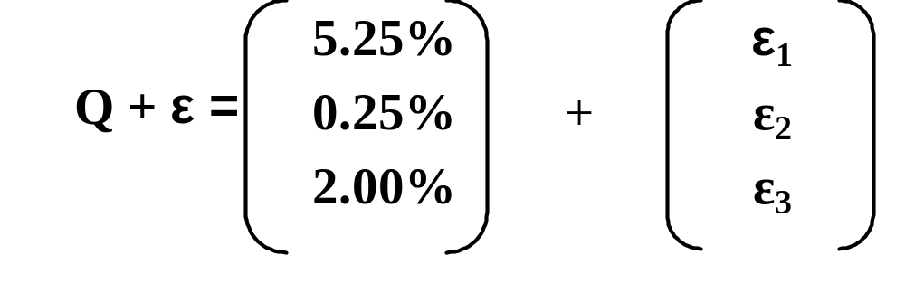
What Is The View Vector Q Like?
Unless a clairvoyant investor is 100% confident in the views, the error term ε is a positive or negative value other than 0
The error term vector does not enter the Black – Litterman formula; instead, the variance of each error term (ω) does.

Slide 37
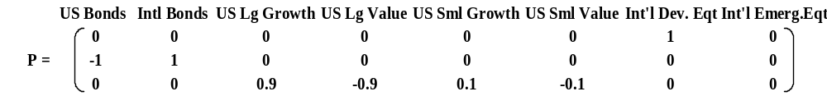
What Is The View Matrix P Like?
View 1 is represented by row 1. The absolute view results in the sum of row equal to 1
View 2 & 3 are represented by row 2 & 3. Relative views results in the sum of rows equal to 0
The weights in view 3 are based on relative market cap. weights, with outperforming assets receiving positive weights and underperforming assets receiving negative weights

Slide 38
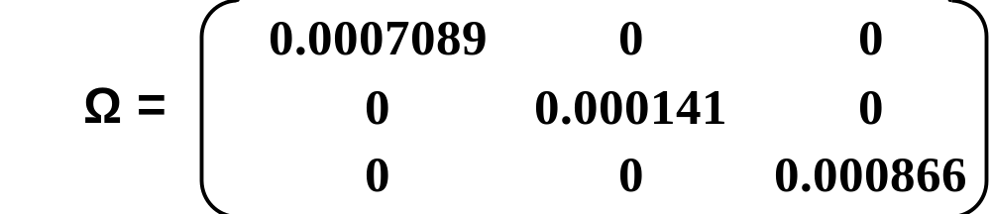
Finally, The Covariance Matrix Of The Error Term Ω
Ω is a diagonal covariance matrix with 0’s in all of the off-diagonal positions, because the model assumes that the views are independent of each other
This essentially makes ω the variance (uncertainty) of views

Slide 39



Go Back to B-L Formula…
First bracket “[ ]” (role of “Denominator“) : Normalisation
Second bracket “[ ]” (role of “Numerator“) : Balance between returns Π (equilibrium returns) and Q (Views). Covariance (τ Σ)⁻¹ and confidence P’ Ω⁻¹P serve as weighting factors, and
P’ Ω⁻¹Q = P’ Ω⁻¹P P⁻¹ Q
Extreme case 1: no estimates ⇔ P=0: E(R) = Π i.e. BL-returns = equilibrium returns.
Extreme case 2: no estimation errors ⇔ Ω ⁻¹→ ∞: E(R) = P ⁻¹Q i.e. BL-returns = View returns.

Slide 40
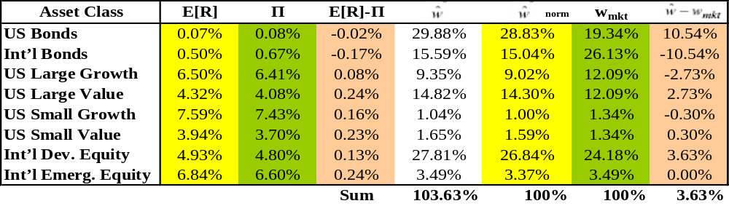


Return Vector & Resulting Portfolio Weights
w =(λΣ) ⁻¹E[R]
Π = λΣw_{mkt}

Slide 41
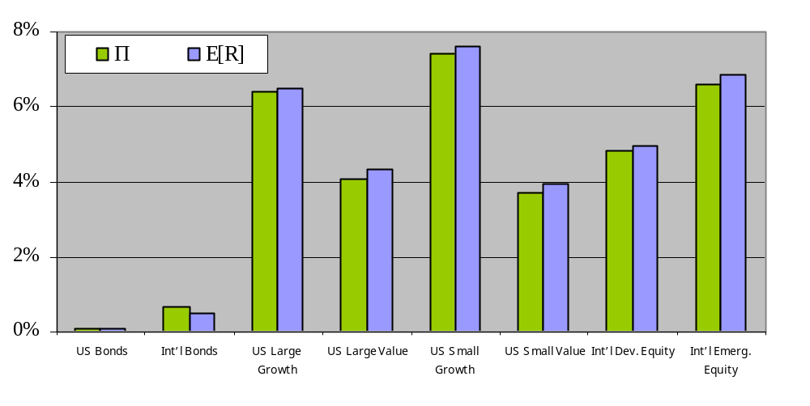
Combined Return E[R] vs. Equil. Return Π

Slide 42
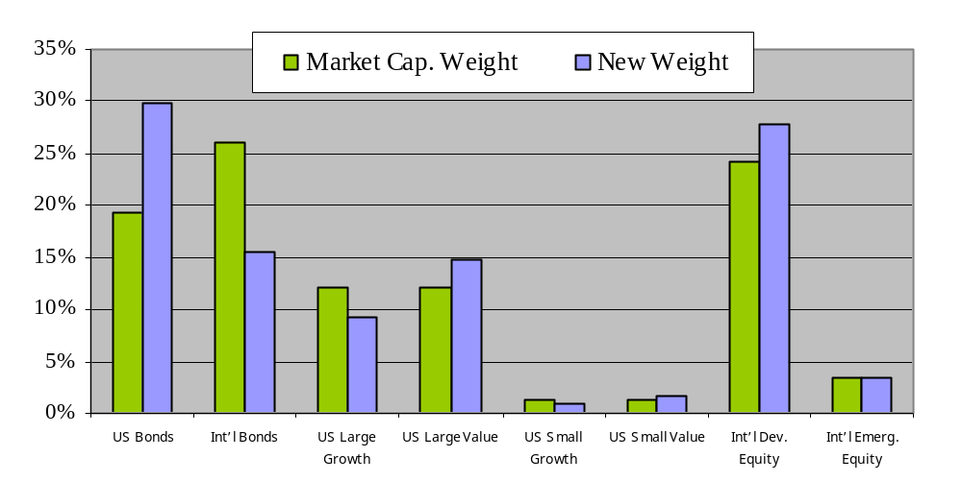
Resulting Asset Allocations Changed A Lot…
View 1 – Bullish view on Int’l Dev. Equity increases allocation.
View 2: Int’l bonds will outperform US bonds less than market implied.
View 3 – Growth tilt towards value

Slide 43
Part 4: BL in Practice

Slide 44
Applications
Just now we presented unconstrained optimization.
Of course constraints can be added to the optimizer.
Also, the market portfolio can be replaced with any benchmark portfolio, and the Mean-Variance objective function can be replaced by any other risk models (maximize risk adjusted returns.)
Littleman, “The real power of the BL model arises when there is a benchmark, a risk or beta target, or other constraints, or when transaction costs are taken into consideration. In these more complex contexts, the optimal weights are no long obvious or intuitive”.
Wai Lee, “The model can be used to combine different models or signals, ”such as valuation model and technical analysis.

Slide 45
BL Limitation
What we presented is still in the mean-variance optimization framework, which cannot deal with higher moments.
For ideas of handling both estimation error and higher moments, see “Portfolio Selection With Higher Moments: A Bayesian Decision Theoretic Approach”, by our professor Campbell Harvey.

Slide 46
Attempt to decode GSQE (1)
Return generating model is the source of alpha.
Ideally, views and their estimation error should be generated quantitatively.
That’s what Goldman Sachs Quantitative Equity does.
How the heck do they actually do it?

Slide 47
Attempt to decode GSQE (2)
Credit Swisse’ sort of confirmed our decoding of GSQE. Previously we thought there was 30% chance that we have decoded GSQE; now we are 80% sure.
The two companies are doing virtually the same thing in terms of generating views quantitatively.

Slide 48
Attempt to decode GSQE (3)
R_{i,t+1} =f(z_{1,}z_{2,}z_{3,}z_{4,}z_{5,}z₆), z is firm attributes.
The factor loading is just partial derivative.
Credit Swisse uses long-short to get this partial derivative (5 long-short portfolios)
Goldman Sachs has another scheme to do it: a special kind of Characteristic Portfolio (6 view portfolios).
Whatever, the essence is still to get the partial derivative for each factor.

Slide 49
Epilogue:
3 Recommendations

Slide 50
1st:
To Our Professor and Fuqua

Slide 51

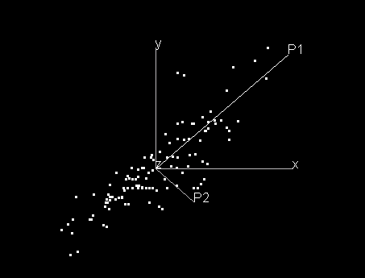
Fuqua Course 999: “Quantitative Beauty Selection”
Mahalanobis Distance
By the way, this is your long list.

Slide 52
2nd:
To Corporate America

Slide 53
Quantitative Employee Selection
Better Get Rid Of Cover Letters and Interviews !!
unless …

Slide 54
3rd:
To Ourselves

Slide 55
You can quantify pretty much everything in the pragmatic world, but
Do not ‘calculate’:
Compassion
Friendship and Love
Aesthetic Value
Intellectual Curiosity
Respect for Individuality

