Slide 1
Weather App Weather made simple — anytime, anywhere.

Slide 2
Team Details
Name :
Lakshmi Biju Panicker
Registration Number :
20BDS0340

Slide 3
Introduction
Project Overview:
This project is a mobile-based weather forecasting application built on Android using Jetpack Compose. It allows users to fetch accurate and timely weather updates based on any city name or state code, with a focus on user experience, accessibility, and clean UI.
Core Objectives:
Build a lightweight, fast, and responsive weather application
Address gaps in UI, accessibility, and language support in typical weather apps
Ensure multi-device and multi-user inclusiveness

Slide 4
Real-World Issues Addressed
Limited Access to Weather Data: In many rural or developing areas, users have limited options for reliable, fast-loading weather apps.
Performance Issues: Many apps consume high bandwidth, drain battery, or are incompatible with older devices.
Complex User Interfaces: The average user struggles with cluttered designs and information overload.
Air Quality Awareness: Rising air pollution is a growing health threat, yet most weather apps ignore AQI (Air Quality Index).
Language Barriers: Lack of multilingual interfaces excludes non-English speakers from using essential services.
Theme and Accessibility: Apps that ignore dark/light modes create discomfort and accessibility issues for users with visual sensitivities.

Slide 5
Proposed Solution
Vision Statement:
To deliver a clean, elegant, and functional weather application that makes localized weather and air quality information accessible to all, regardless of device capability or language preference.
Solution Overview:
A Kotlin-powered app using Jetpack Compose for a modern, native Android experience.
5-day forecast, with updates every 3 hours for better planning and accuracy.
Global location search, accepting both city names and state codes.
Air quality index & pollutant info displayed clearly and concisely.
Theme toggles for light and dark modes to suit all lighting environments.
Arabic and English language support for better reach and inclusiveness.
Suggested cities section for quick checks on common travel or home locations.

Slide 6
Technologies Used
Languages & Frameworks:
Kotlin – A modern, expressive, and safe language for Android
Jetpack Compose – Declarative UI toolkit for building native apps faster
Architecture:
MVVM (Model-View-ViewModel) – For clean separation of UI, logic, and data
LiveData & ViewModel – For reactive and lifecycle-aware updates
Libraries & Tools:
Retrofit – For fetching weather data via REST APIs
Coil – For lightweight image loading
Material Design 3 – For consistency and modern aesthetics
Navigation Component – For smooth in-app transitions
API Services:
OpenWeatherMap (or similar): For real-time forecasts and air quality data

Slide 7
Key Features
5-Day Forecasts: Updated every 3 hours for reliable future planning
Global Search Functionality: Supports city names or region codes worldwide
Smart Suggestions: Recommended popular cities for quick access
Air Quality Index (AQI): View pollutant levels like PM2.5, NO₂, and O₃
Dark & Light Mode: Easy on the eyes, responsive to system theme
Multilingual Interface: English and Arabic support
Responsive UI: Jetpack Compose enables faster rendering and smooth animations
Performance Optimized: Low memory and power consumption, suitable for mid-range devices

Slide 8
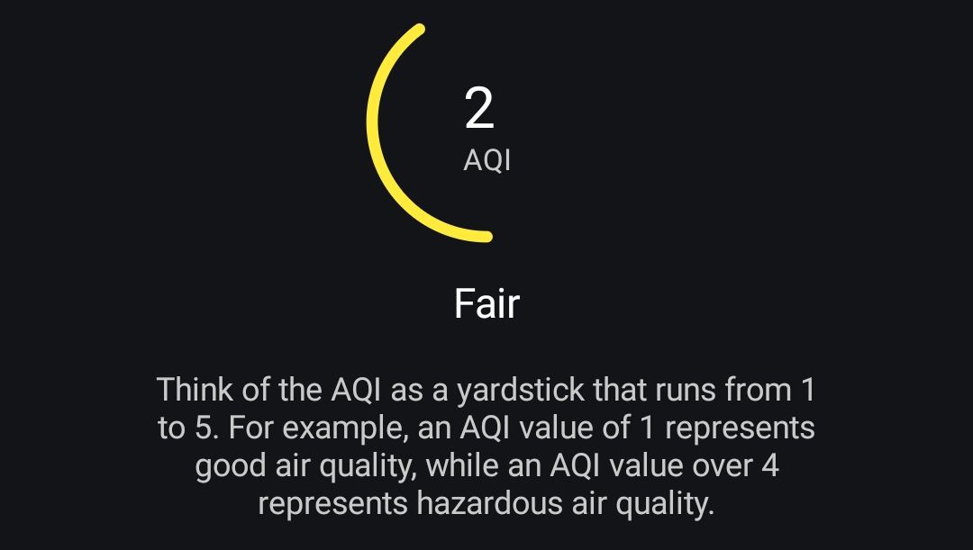
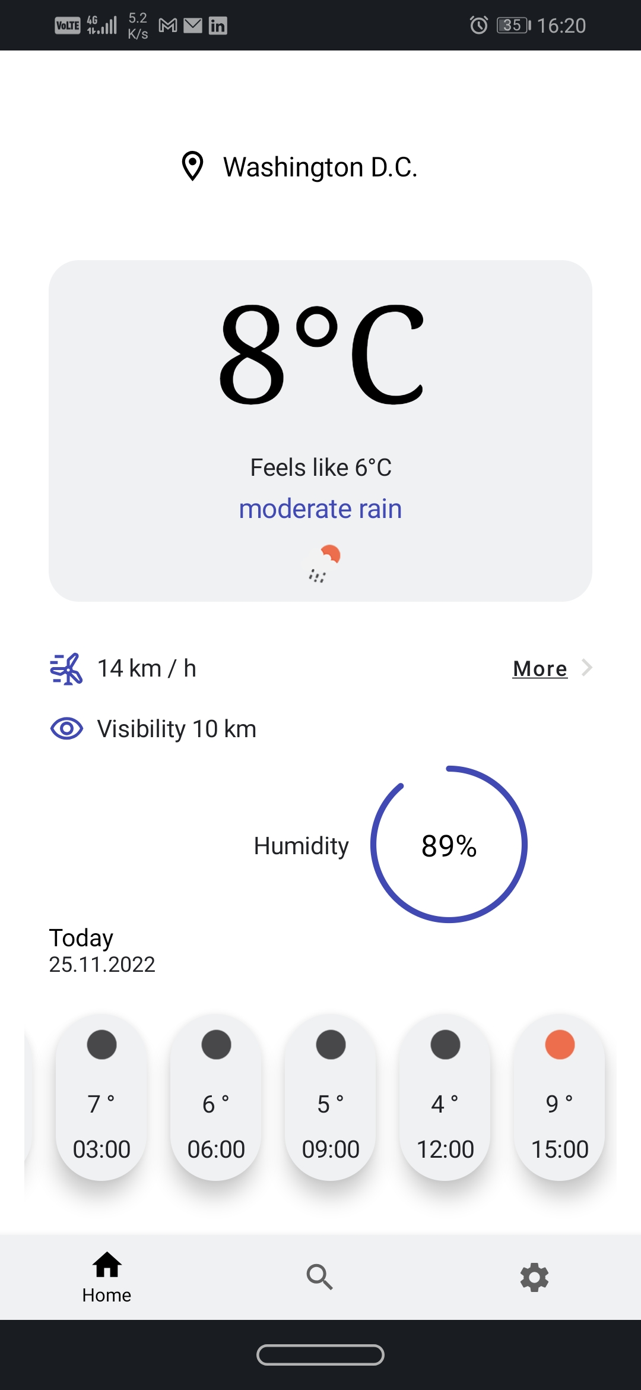
App Preview Screenshots
UI Highlights: Home & Air Quality

Slide 9
Thank You.

