Slide 1
DevOps Projects live implementation
Project- Job searching portal – Cloud Deployment using Sonar & VM.
A Modern, Scalable Job searching portal Application on Azure.
By Prasanna Kumar (DevOps Technologies)
Technologies: Sonar | Vm | React&expressjs | Terraform | Azure devops.

Slide 2
Top 10 DevOps Projects live implementation
It software company portal using swa.
Bank portal financial calculators using swa, api gateway, container service &swaggerfile.
E-commerce portal using aks&acr.
Hospital booking portal using aks,acr, mysql.
Insurance aggregator using swa, app gateway, aks, acr.
Car rental services project using nexus&vm.
Job searching portal using sonar&vm.
Hr employee leave portal using ansible &vm.
Features:-
1. Using terraform for azure infra automation.
2. Azure devops pipelines.
3.Using frontend,backend, database.
4.Tech stack: reactjs&express, springboot, python.
Features:-
5. Devops tools: dockerfile, k8s manifest, ansible playbooks,helm, bash scripts, linux commands, tools setup &config.
6. Documentation, video lecturer.
Bus booking portal using swa& functions.
University student enroll portal using swa, app service,mysql &keyvault.

Slide 3
1.Welcome & Course Overview
Project Title: Job searching portal
Overview:
The project provides a simple and web based Job portal where user can search the skills and apply the jobs.
Goal:
To project showcases how to build , test and deploy a scable web application on azure using terraform, azure devops.

Slide 4
Azure Services & DevOps Tools Used
Key Highlights:
Frontend: User-friendly interface for job seekers.
Backend: job details will update.
SonarQube: code quality and security features.
Vm: secure the application server.
Vnet : we will use vnet to secure the connections.
Azure devops: we use azure repo and azure pipelines will trigger.
Terraform: provision the azure infra.

Slide 5
What you will achieved at the end:
Develop and Deploy a frontend application(reactjs) on VM
Develop and Deploy a backend application(expressjs) on VM.
Write Terraform scripts to provision cloud infrastructure.
Setup the sonarqube server and config of frontend/backend.
Establish the connection between frontend to backend.
Build an Azure Pipeline for CI/CD automation, infra&cleanup.
Gain a real-world DevOps project for their portfolio.

Slide 6
About Instructor – Prasanna kumar
Im having 15 years of experience in IT industry.
Worked in multiple Devops roles.
I have working in top MNCs.
I have experience in working in different projects like banking, automobile, travel&transportation, medical, telecom, Auditing etc.
I’m a aws devops certified, azure certified and so on.

Slide 7
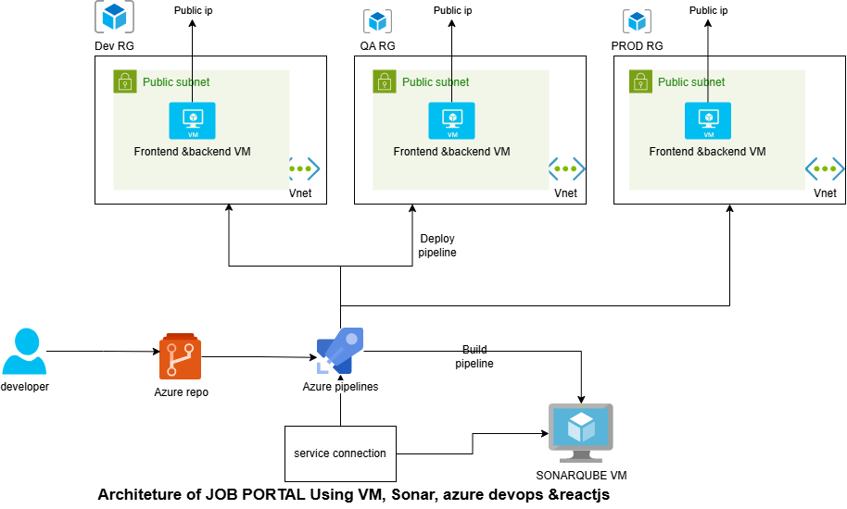
2.Architecture &
Tech Stack Walkthrough

Slide 8
Walk-through
Overview:
End-to-end CI/CD and infrastructure workflow using Azure DevOps Pipelines, Nexus, VM.
🔹 1. Build & Push
Developers commit code (React) to repo
Azure Pipeline builds the application.
Flow: Dev → Pipeline → Build → Push → Nexus
🔹 2. sonar Setup
Vm created via Terraform/ui with VNet integration & allow to public.
Config the sonar aetup.
🔹 3. VM Setup -Onetime setup
Vm created via Terraform with VNet integration & allow to public.
Config the Nginx and backend setup.
Routes traffic:/ → Frontend Service
/api → Backend Service
🔹 4. Application Deployment
CD pipeline deploys ci artifacts to VM server
Application deploy and config for frontend and backend inside VM
Flow: Pipeline → sonar → Deploy Application
🔹 End-to-End Flow
💻 Developer → 🧱 CI/CD Pipeline → 🐳 sonar →VM- 🌐 NGINX → public

Slide 9
2. Environment Setup
Prerequisites.
Azure subscription(Pay-as-you-go)- must need azure portal access.
Azure DevOps Organization.
Local tools setup:-
node js- latest version needs to install for frontend.
VS Code – Code editor.
Git- Version control tool.
Azure pipeline agent(optional)- need pipeline agent preferable VM ubuntu setup, You need to install necessary tools in the azure pipeline agent.
Azure service principle & service connection.

Slide 10
Setting up Project Repository & Folder Structure.
Create Azure DevOps Repo.
Create (frontend, backend, IaaC folders).
Standard naming conventions.
Terraform backend setup.

Slide 11
3. frontend, backend, db development
Git clone the repo.
Front end development.
npx create-react-app my-app.
Backend development.
npm install express
sonar setup and configuration.
Nginx setup for frontend.
Backend expressjs setup.

Slide 12
4. Infrastructure as Code (Terraform)
We will write the terraform code for provisioning the azure infra.
IaaC project structure explanation.
We need to configure the terraform backend.
We need to get the azure service principle and establish the service connection and utilize in the pipelines.
We can deploy using azure pipelines (infra pipeline).
Verify deployed services (VM, sonar).

Slide 13
5. CI/CD Pipeline with Azure DevOps
Setting up YAML-based Azure Pipelines.
Infra pipeline – provision the infra resources using terraform tasks.
CI pipeline – build and publish the artifacts.
CD pipeline – deploy to Artifacts to dev vm server.
Cleanup pipeline– cleanup the all resources.

Slide 14
6. Application Deployment & Integration
Once infra pipeline is completed, verify the RG and cross check all resources.
Deploy backend (express js) to VM.
Deploy frontend (ReactJS) to VM.
Integrate frontend, backend.
End-to-end testing of portal in the browser (test logs of frontend and backend)

Slide 15
7. Monitoring & Observability
Configure Azure Monitor, Log Analytics, and App Insights.
Troubleshoot failed builds or deployments, view logs.
Cleanup- pipeline.

Slide 16
Wrap-up & Next Steps
Developed frontend and backend application.
Terraform automation.
Azure pipeline.
Azure services (VM, Vnet)
sonar setup and nginx configution, expressjs config.

Slide 17
Thank you
Instructor- Prasanna Kumar.
DevOps Technologies.

