Slide 1
JAVA OOP PROJECT · RUNGTA INTERNATIONAL SKILLS UNIVERSITY · SESSION 2025–26
ATM
SIMULATION
Automated Teller Machine · Core Java & Object-Oriented Programming
Submitted By Luxmi Gupta (RU-25-11676)
Under the Guidance of Mr. Santanu Sasmal · IBM SME & Expert
B.Tech CSE (AI & ML) · School of Computer Science & Engineering · April 2026

Slide 2
Java Project Presentation
ATM Simulation
Using OOPs
With Java
ATM
A console-based banking simulation demonstrating encapsulation, classes, objects, methods, and exception handling.
Object-Oriented Programming Concepts

Slide 3
ATM Simulation Using OOPs With Java
02
Introduction
The project simulates basic ATM operations through a Java console application.
Authenticates the user using a fixed PIN.
Displays a menu for withdrawal, balance check, and exit.
Project Aim
Uses separate classes for application startup, ATM behavior, and account data.
To show how real-world banking actions can be represented as objects, methods, and controlled state changes.
Handles invalid amount and insufficient balance using custom exceptions.

Slide 4
ATM Simulation Using OOPs With Java
03
OOP Design in the Project
ATMApplication
ATM
Account
main()
Creates Scanner, Account, and ATM objects.
Starts the program.
PIN authentication
Menu handling
Withdrawal processing
Balance display
private balance
getBalance()
withdraw(amount)
Encapsulates account state
Custom Exceptions
InvalidAmountException
InsufficientBalanceException
Encapsulation keeps balance private, while methods define controlled interactions between ATM and Account.

Slide 5
ATM Simulation Using OOPs With Java
04
Working of the Project
Enter PIN
Authenticate
Show Menu
Select Option
Output
If the user chooses withdrawal, the program validates the amount, checks balance, updates the Account object, and prints success or error message.
Loop continues until the user selects Exit.

Slide 6
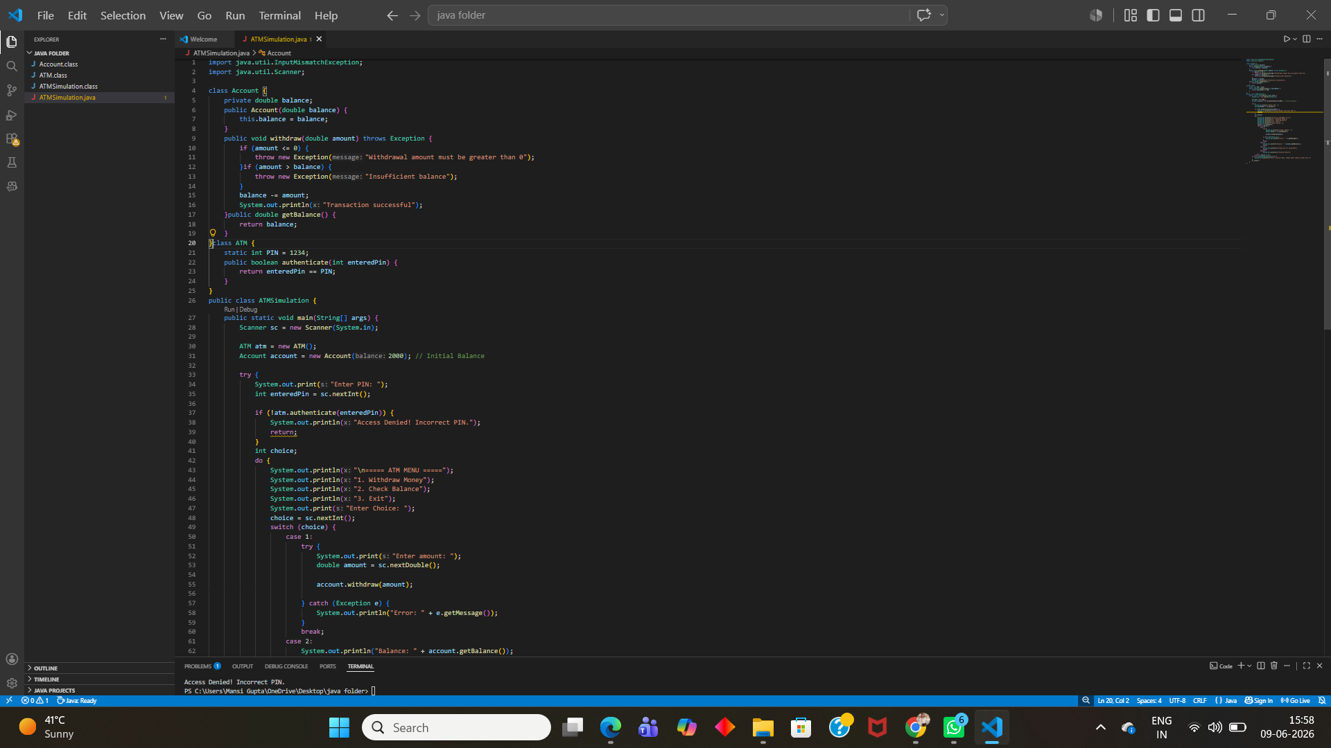
Source Code Screenshot: Account and ATM Classes
07

Slide 7
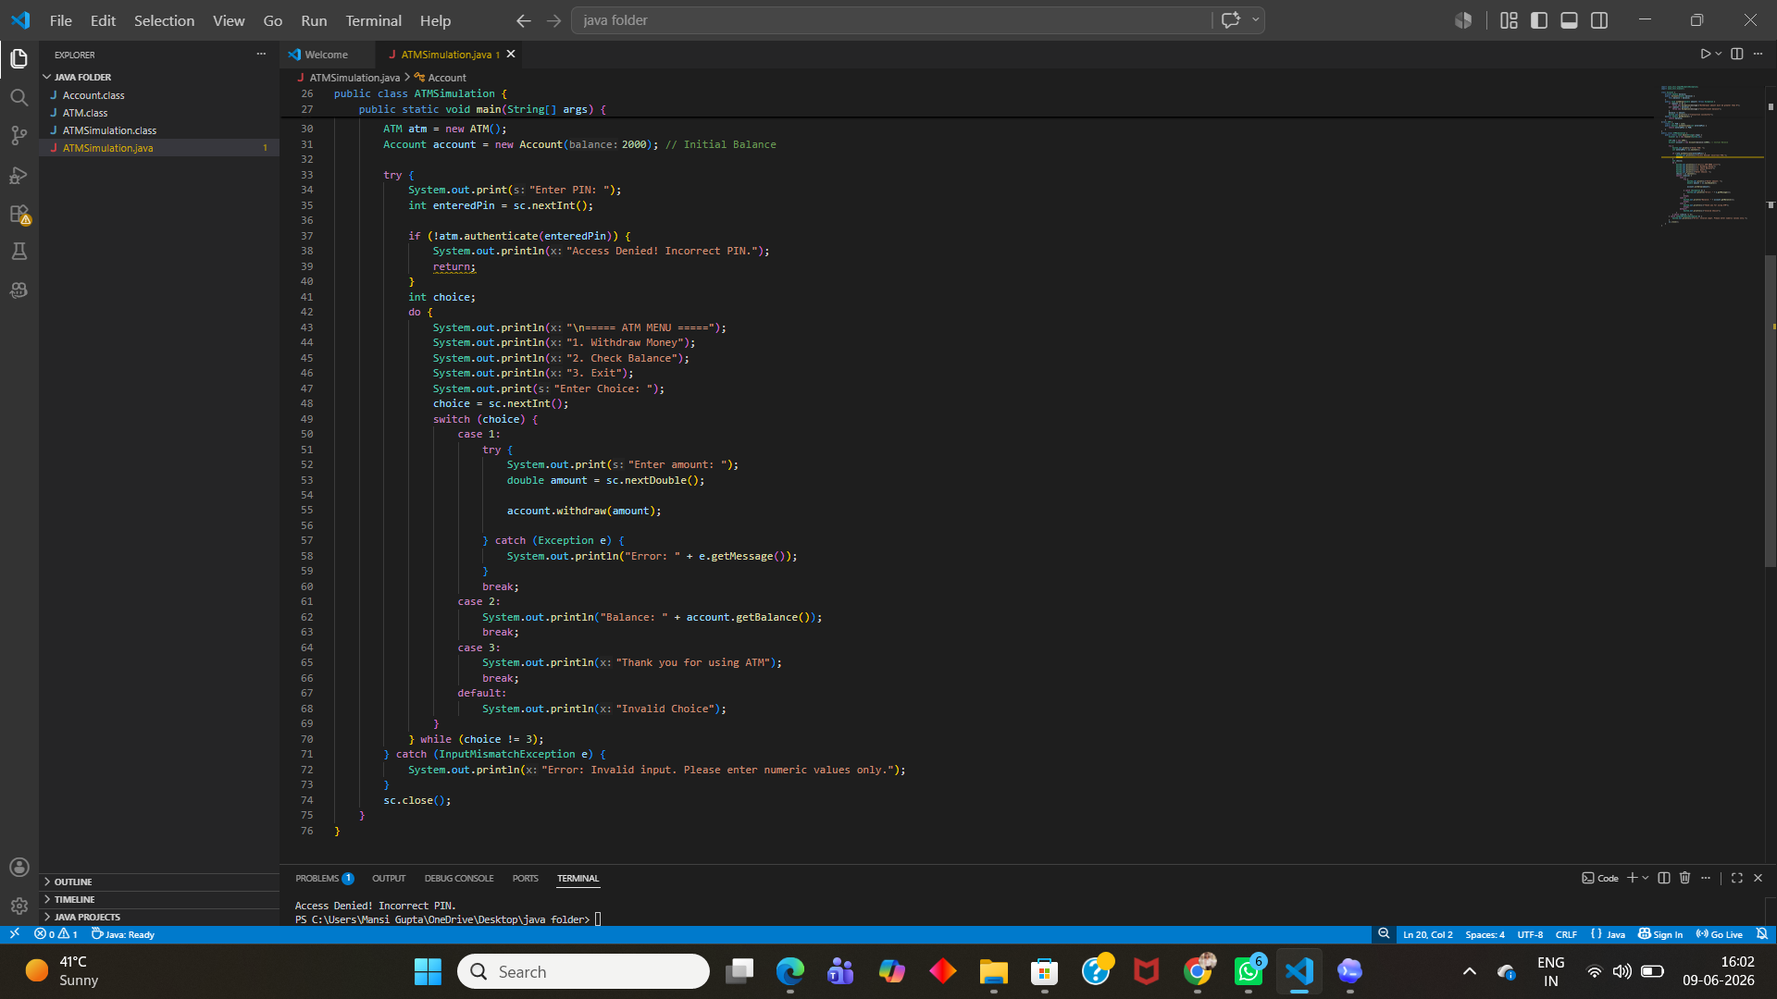
Source Code Screenshot: Menu and Exception Handling
08

Slide 8
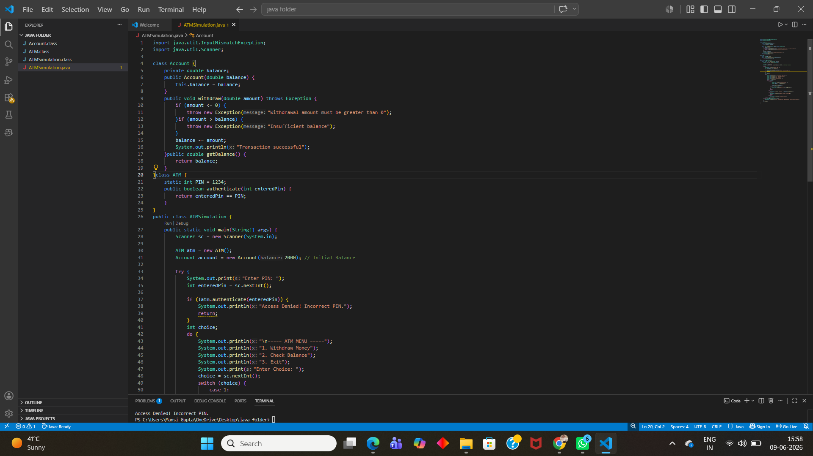
Output Screenshot: Incorrect PIN
09

Slide 9
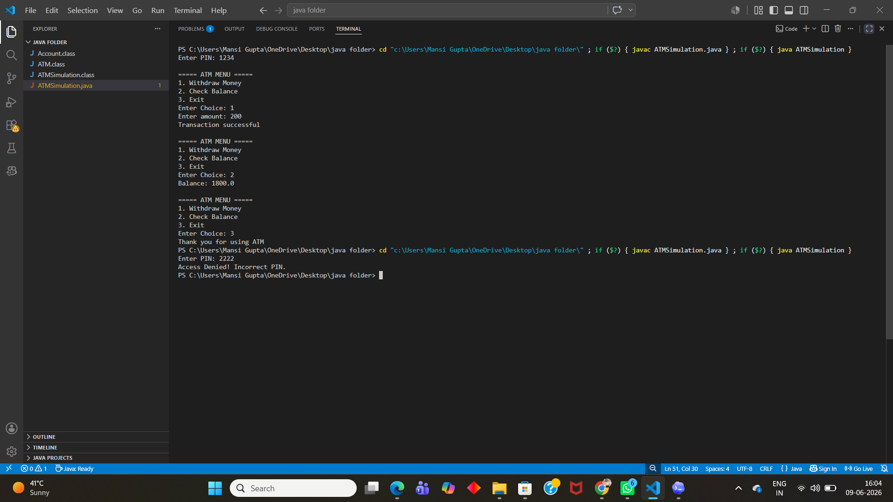
Output Screenshot: Withdrawal and Balance Check
10

Slide 10
ATM Simulation Using OOPs With Java
06
Conclusion and Future Scope
Conclusion
Future Scope
ATM operations were implemented with clear class responsibilities.
Add deposit, PIN change, and transaction history features.
OOP concepts made the project modular and easy to understand.
Connect the app with database storage for multiple users.
Exception handling improved reliability for invalid transactions.
Build a GUI using JavaFX or Swing for a better user experience.
Thank You

