Slide 1
OFFICIAL CAMPUS RECRUITMENT PORTAL
STUDENT PLACEMENT AND
TRAINING MANAGEMENT SYSTEM
FIELDWISE | Centralized Campus Recruitment & Skill Development Portal
Python Flask 3.0
MongoDB & PyMongo
HTML5 / CSS3 / JS
Bootstrap 5.3
Chart.js Analytics
B.Tech Full Stack Web Development | External Practical Capstone Examination
Roles: Administrator | Student Candidate | Corporate Recruiter

Slide 2
SYSTEM GENESIS & ARCHITECTURE
Project Overview & Problem Statement
The Existing Challenges
• Fragmented Information:
Placement notices scattered over emails, WhatsApp groups, and notice boards leading to missed deadlines.
• Manual Eligibility Checks:
Placement cells manually filtering hundreds of Excel sheets for CGPA, backlogs, and branch criteria.
• Unstructured Skill Bootcamps:
Lack of synchronized tracking for pre-placement training schedules and seat registrations.
• Unverified Resumes:
Recruiters receiving non-standard resumes without verified academic credential checks.
• Missing Historical Analytics:
Difficulties generating departmental placement stats and salary tier analytics for accreditation.
The FIELDWISE Solution
✔ Role-Based Ecosystem:
Separate, tailored dashboards for Admin, Student Candidates, and Corporate Recruiters.
✔ Automated Eligibility Engine:
Dynamic validation of CGPA, standing backlogs, eligible branches, and PDF resume status before application.
✔ Duplicate Application Shield:
Compound uniqueness indexing preventing accidental or duplicate submissions.
✔ Integrated Training Portal:
Pre-placement bootcamps in Full Stack, DSA, Cloud, and Soft Skills with seat management.
✔ Auto-Synced Placement Records:
Selecting a candidate automatically creates verified placement records and updates student status to 'Placed'.

Slide 3
DESIGN & IMPLEMENTATION
Technology Stack & Layered Architecture
Frontend Tier
HTML5, CSS3, Vanilla JS, Bootstrap 5.3
Clean, responsive UI with royal blue theme, sidebar navigation, modal dialogs, and Chart.js interactive data visualizations.
Application Tier
Python Flask 3.0 & Werkzeug
Modular blueprints (auth, admin, student, company, jobs, training, placements), session management, PBKDF2 password hashing.
Database Tier
MongoDB 7.0+ & PyMongo Driver
NoSQL document store with 8 collections, BSON ObjectIds, compound uniqueness indexes, and resilient mock fallback.
Security & Storage
RBAC & Secure PDF Uploads
Role-based decorators (@login_required, @role_required), file sanitization with secure_filename, strictly .pdf validation.

Slide 4
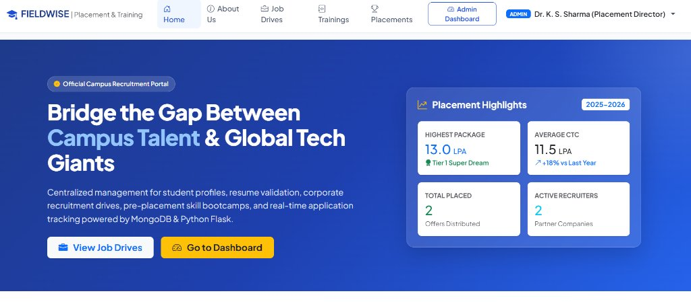
LIVE USER INTERFACE SHOWCASE
Home & Landing Page Portal
Portal Landing Interface
• Hero Banner:
Direct branding for 'FIELDWISE | Placement & Training' connecting campus talent with global recruiters.
• Placement Highlights Card:
Live dynamic counters showing Highest Package (13.0 LPA), Average CTC (11.5 LPA), Total Placed (2 Offers), and Active Recruiters (2 Partners).
• Quick Portal Navigation:
One-click access to View Job Drives, Role Dashboards, and quick login links.
• Responsive Layout:
Built on Bootstrap 5 flexbox grid adapting seamlessly to mobile, tablet, and desktop screens.
Figure 1: Home Page Hero Section & Dynamic Placement Highlights Counter

Slide 5
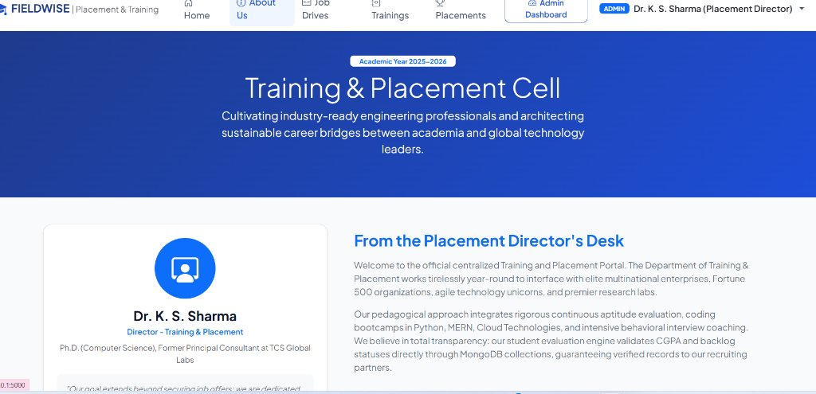
LIVE USER INTERFACE SHOWCASE
Training & Placement Cell (About Us)
Institutional Transparency
• Director's Desk Message:
Official message from Dr. K. S. Sharma (Placement Director) outlining campus recruitment strategies and industry partnerships.
• 100% Verified Profiles:
Mandatory academic verification ensuring that candidates applying for drives have authentic credentials.
• Vision & Mission:
Cultivating multidisciplinary engineering professionals and architecting sustainable corporate bridges.
• Campus Infrastructure:
Highlights of high-speed online testing terminals, dedicated corporate interview suites, and auditorium halls.
Figure 2: About Us Portal & Placement Director's Desk Message

Slide 6
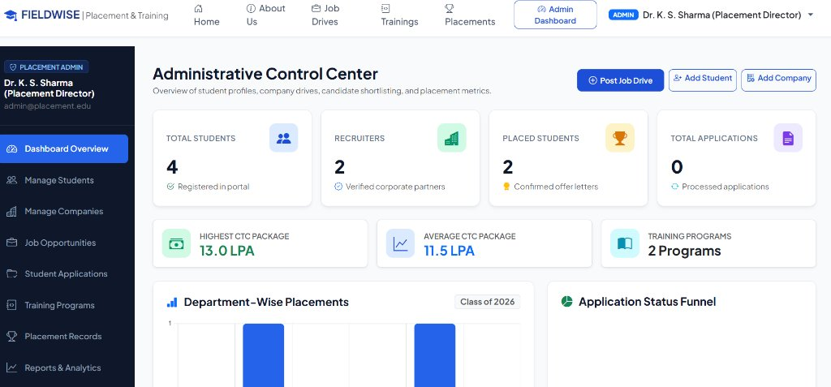
LIVE USER INTERFACE SHOWCASE
Administrative Control Center & Metrics
Centralized Admin Control
• Comprehensive Sidebar:
Direct access to Student Management, Company Management, Job Drives, Applications, Trainings, Placements, and Reports.
• Real-Time KPI Cards:
Instant metrics for Total Students (4), Recruiters (2), Placed Students (2), Applications (0), Highest CTC (13.0 LPA), Average CTC (11.5 LPA), and Trainings (2).
• Quick Action Buttons:
Convenient shortcuts to Post Job Drive, Add Student, and Add Company directly from the top banner.
• Role Badge Indicator:
Clear security badge confirming authenticated administrator identity with Dr. K. S. Sharma.
Figure 3: Admin Dashboard with Key Performance Indicators (KPIs) & Quick Actions

Slide 7
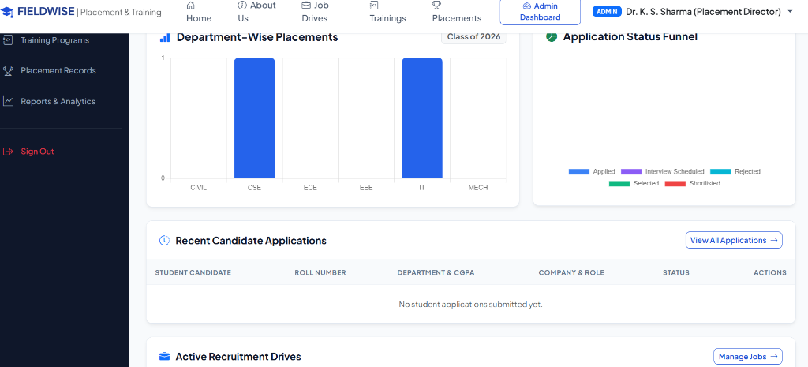
LIVE USER INTERFACE SHOWCASE
Visual Analytics & Recruitment Funnel
Data-Driven Visual Insights
• Department-Wise Bar Chart:
Chart.js visualization tracking placed students across CSE, IT, ECE, EEE, MECH, and CIVIL (showing 1 CSE, 1 IT placed).
• Application Funnel Chart:
Doughnut chart illustrating candidate status breakdown: Applied, Shortlisted, Interview Scheduled, Selected, and Rejected.
• Recent Candidate Stream:
Live table tracking candidate applications, roll numbers, academic scores, and recruiters.
• Active Drive Monitor:
Table monitoring current active drives and direct shortcuts to edit or manage positions.
Figure 4: Chart.js Departmental Placements Bar Graph & Pipeline Status Funnel

Slide 8
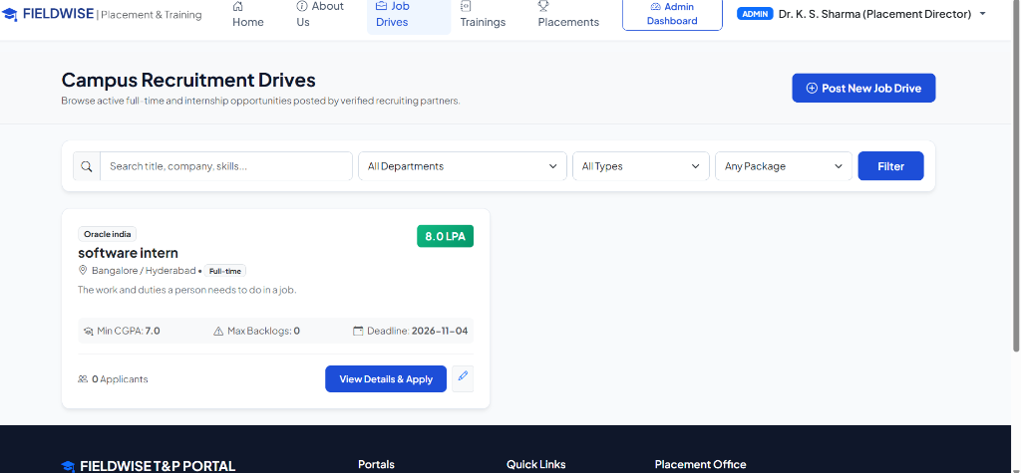
LIVE USER INTERFACE SHOWCASE
Job Drives & Multi-Criteria Filtering
Job Opportunity Portal
• Multi-Parameter Filter Bar:
Instant search across job titles, companies, and skills with dropdown filters for Department, Job Type, and Min CTC.
• Rich Job Opportunity Cards:
Displays company name (Oracle India), role ('software intern'), CTC badge ('8.0 LPA'), location, and description.
• Eligibility Cutoff Badges:
Explicit indicators showing Min CGPA cutoff (7.0), Max Backlogs (0), and Application Deadline (2026-11-04).
• Applicant Count & Action:
Real-time count of candidate applications and 1-click 'View Details & Apply' button.
Figure 5: Active Campus Recruitment Drives with Criteria Filters & Job Cards

Slide 9
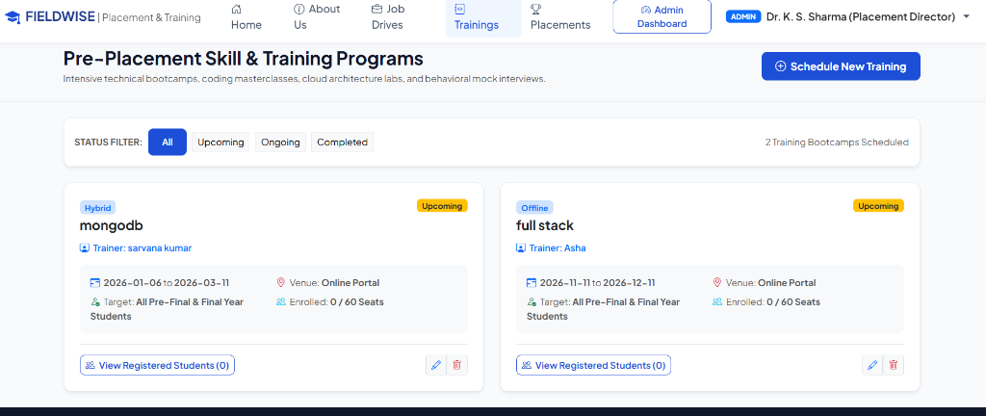
LIVE USER INTERFACE SHOWCASE
Pre-Placement Skill & Training Programs
Student Skill Enablement
• Status Filter Chips:
Quick toggle filters for All, Upcoming, Ongoing, and Completed training sessions.
• Program Highlights:
Features technical bootcamps such as 'mongodb' (Trainer: sarvana kumar) and 'full stack' (Trainer: Asha).
• Delivery Mode & Venue:
Clearly indicates Online, Offline, or Hybrid modes with date ranges and classroom/lab venue details.
• Seat Capacity & Roster:
Tracks enrollment quotas (0 / 60 seats) with dedicated 'View Registered Students' roster modal for administrators.
Figure 6: Pre-Placement Technical Bootcamps with Seat Quotas & Registration

Slide 10
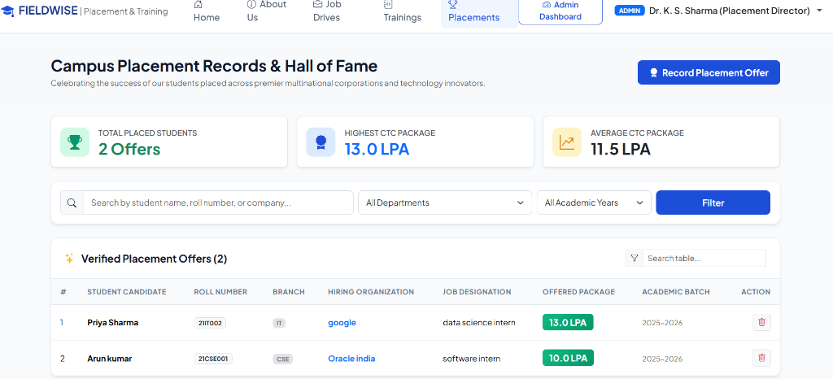
LIVE USER INTERFACE SHOWCASE
Placement Records & Hall of Fame
Verified Placement Archive
• Institutional Hall of Fame:
Celebrates successfully placed students with top metric cards (Total Placed: 2 Offers, Highest: 13.0 LPA, Average: 11.5 LPA).
• Verified Offers Table:
Documents Priya Sharma (21IT002 - IT) placed at Google as Data Science Intern (13.0 LPA) and Arun kumar (21CSE001 - CSE) placed at Oracle India as Software Intern (10.0 LPA).
• Package Classification:
Color-coded CTC badges classifying dream offers and compensation packages.
• Record Placement Modal:
Placement officers can record verified off-campus or on-campus offers directly into the system.
Figure 7: Campus Placement Records & Verified Student Offer Letters Table

Slide 11
BACKEND LOGIC & ENGINEERING
Core Technical Algorithms & Innovations
Automated Eligibility Engine
Dynamic 4-Point Validation
✔ Evaluates student CGPA >= job.min_cgpa.
✔ Checks student backlogs <= job.max_backlogs.
✔ Validates student department in job.departments (or 'All').
✔ Verifies genuine PDF resume is uploaded before application.
Duplicate Prevention Shield
MongoDB Compound Unique Index
✔ Index: (job_id, student_id) unique constraint.
✔ Guarantees that a student cannot submit duplicate applications.
✔ Provides instant user-friendly feedback alert.
✔ Ensures zero database clutter and clean candidate rosters.
Automatic Placement Sync
Pipeline to Record Automation
✔ Triggered when recruiter marks candidate status as 'Selected'.
✔ Automatically inserts document into 'placements' collection.
✔ Sets student status from 'Eligible' to 'Placed'.
✔ Live sync with dashboard metrics and departmental charts.
Secure PDF Resume Engine
Strict Format Validation & Serving
✔ Restricts uploads strictly to '.pdf' files up to 16 MB.
✔ Sanitizes filenames via Werkzeug secure_filename.
✔ Streams files securely via send_from_directory.
✔ Direct PDF viewing and download for authorized recruiters.

Slide 12
DATABASE: 'PLACEMENT_MANAGEMENT'
MongoDB Database Architecture
Collection Name | Key Document Fields | Index Configuration | Relationship / Reference
users | email, password_hash, role, status, created_at | email (Unique) | Primary authentication entity
students | user_id, name, roll_no, email, cgpa, backlogs, skills, resume | user_id, roll_no, email (Unique) | Linked to users._id
companies | user_id, company_name, email, industry, location, website | user_id (Unique), company_name | Linked to users._id
jobs | company_id, title, salary_package, min_cgpa, max_backlogs, status | company_id, status, created_at | References companies._id
applications | job_id, student_id, company_id, applied_date, status, remarks | (job_id, student_id) UNIQUE | Links student to job & company
trainings | title, trainer_name, mode, venue, start_date, max_seats, status | status, start_date | Independent bootcamp catalog
training_registrations | training_id, student_id, student_name, student_roll, date | (training_id, student_id) UNIQUE | Prevents duplicate enrollment
placements | student_id, roll_no, company_id, job_id, package, academic_year | student_id, company_id, academic_year | Synchronized placement records

Slide 13
QUALITY ASSURANCE & RESULTS
Automated Verification & 14-Rubric Test Suite
100% Pass Rate
14 / 14 Unit Tests Passed
Executed via Python unittest suite against Flask client and PyMongo engine.
• Test Execution Time:
6.28 seconds
• Failures / Errors:
0 / 0 (Zero Bugs)
• Database Assertions:
CRUD, RBAC & Indexes
• Role Coverage:
Admin, Student & Recruiter
Automated Test Case Execution Breakdown
✔ Test 01: Public Landing and About Us Pages Loading
✔ Test 02: Administrator Authentication and Dashboard Routing
✔ Test 03: Student Registration with Roll No & Password Validation
✔ Test 04: Corporate Partner Registration and Login Flow
✔ Test 05: Student Full CRUD Operations (Add, Edit, View, Delete)
✔ Test 06: Company Full CRUD Operations (Add, Edit, View, Delete)
✔ Test 07: Job Opportunity Creation, Text Search, and Criteria Filtering
✔ Test 08: PDF Resume Upload, Extension Check, and File Streaming
✔ Test 09: Job Application Submission and Duplicate Prevention Guard
✔ Test 10: Eligibility Enforcement (CGPA cutoff & Backlog rejection)
✔ Test 11: Candidate Shortlist/Select Status & Auto-Placement Synchronization
✔ Test 12: Pre-Placement Training Program Registration and Cancellation
✔ Test 13: Institutional Analytics and Chart Reports Generation
✔ Test 14: Role-Based Access Control (RBAC) & Unauthorized Route Guarding

Slide 14
CONCLUSION & FUTURE ROADMAP
Summary of Project Achievements
✔ Delivered a complete, fully functional, 100% runnable web portal using Python Flask and MongoDB.
✔ Created all 18 required pages with modern blue, white, and slate grey styling.
✔ Implemented 3 separate user roles: Admin, Student, and Corporate Recruiter with strict RBAC security.
✔ Built automated eligibility verification and duplicate application prevention engines.
✔ Provided live pre-placement training scheduling, seat quotas, and automated placement record synchronization.
Future Roadmap & Enhancements:
🚀 AI-Powered Resume Matcher: Semantic NLP scoring to rank student resumes against job descriptions.
🚀 Automated Notifications: Real-time SMS and Email alerts via Twilio & SendGrid for interview schedules.
🚀 Integrated Coding Assessment: In-browser code compiler for online technical screening rounds.

