Slide 1
The Chipathon 2026
Proposal Review: Group 1 A1-A25
IEEE Solid-State Circuits Society
Technical Committee on the Open Source Ecosystem (TC-OSE)
12 June 2026
Notes:
Welcome everyone, and thank you for joining the Chipathon 2026 kickoff.
My name is Mehdi Saligane, and I’m serving as Chair of the IEEE Solid-State Circuits Society Technical Committee on the Open Source Ecosystem, or TC-OSE.
Today is really about setting the tone for this year’s Chipathon: what we are trying to build as a community, what we learned from previous years, what is new in 2026, and what we expect from participants and teams.
The main message for this year is simple: Build, Test, Publish. We want to move beyond designs that only live in simulation, or cannot be reproduced and work toward open-source silicon that is built, measured, documented, and shared with the community.

Slide 2
[A10] CryptoAccel
ASCON AEAD128 based Cryptographic Hardware Accelerator with AXI Interface
as a plug and play hardware co-processor for various applications.
Team members
Discord name | Affiliation | Experience | Role
lakvlsi_90908 | IIT, Bombay | Ph.D. Research Scholar | Team Lead / Presenter
zysteresis | MIT, Manipal / STMicroelectronics | Undergraduate (III) | Team Member
tarun_rs05 | IIIT, Bangalore | Undergraduate (II) | Team Member
harshi070852 | PESIT, Bangalore | Undergraduate (IV) | Team Member

Slide 3
PROJECT INFORMATION
GOAL:
Design and implement a lightweight ASCON-AEAD128a cryptographic hardware accelerator with an AXI-Lite interface using GF180MCU technology node
Enable seamless integration of the accelerator with a wide range of processors and System-on-Chip (SoC) platforms that support the AXI protocol.

Slide 4
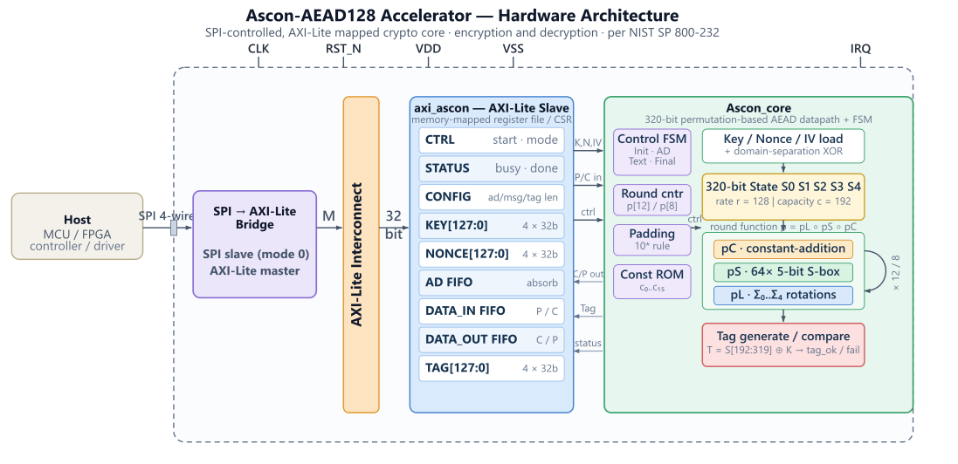
DESIGN:
Encryption:
1. Configure and key the engine (SPI writes)
2. Start (SPI write)
3. Feed the associated data (SPI writes)
4. Stream plaintext and collect ciphertext (SPI writes + reads, interleaved)
5. Finish and read the tag (SPI reads)
ARCHITECTURE
Decryption:
1. Configure and key the engine (SPI writes)
2. Start (SPI write)
3. Feed the associated data (SPI writes)
4. Stream ciphertext and collect plaintext (SPI writes + reads)
5. Verify (SPI read)

Slide 5
APPLICATIONS:
Internet of Things (IoT) devices: authenticated encryption and data integrity protection for sensor nodes, edge devices, and embedded controllers operating under strict area and power constraints.
Serve as a hardware Root of Trust for secure boot applications by verifying the authenticity and integrity of firmware during system startup.
SPECIFICATIONS
Technology | GF180MCU
Supply Voltage | 3.3V
Frequency | 50MHz
AREA | <0.65 µm²
PIN COUNT | ~ 15 PINS

Slide 6
REFERENCES
[1] M. Sönmez Turan, K. McKay, J. Kang, J. Kelsey, and D. Chang, "Ascon-Based Lightweight Cryptography Standards for Constrained Devices: Authenticated Encryption, Hash, and Extendable Output Functions," NIST Special Publication 800-232, Aug. 2025.
[2] K. -D. Nguyen, T. -K. Dang, B. Kieu-Do-Nguyen, C. -K. Pham and T. -T. Hoang, "Live Demonstration: ASIC Implementation of ASCON Lightweight Cryptography for IoT Applications," 2025 IEEE International Symposium on Circuits and Systems (ISCAS), London, United Kingdom, 2025, pp. 1-1, doi: 10.1109/ISCAS56072.2025.11044102.
[3] J. Kaur, A. C. Canto, M. M. Kermani, and R. Azarderakhsh, "A Comprehensive Survey on the Implementations, Attacks, and Countermeasures of the Current NIST Lightweight Cryptography Standard," Electronics, vol. 13, no. 22, Art. no. 4550, 2024.
[4] OpenTitan Project, "EarlGrey and Darjeeling Architectures,“ [Online]. Available: https://opentitan.org/book/doc/productarchitecture.html
[5] Khan, S., Inayat, K., Muslim, F.B. et al. Securing the IoT ecosystem: ASIC-based hardware realization of Ascon lightweight cipher. Int. J. Inf. Secur. 23, 3653–3664 (2024). https://doi.org/10.1007/s10207-024-00904-1

