Slide 1
A DATA-DRIVEN DYNAMIC AND ADAPTIVE HONEYPOT DEPLOYMENT FOR SECURITY IOT NETWORKS USING DEEP REINFORCEMENT LEARNING
Guide:
Mr.M.Vijay kumar
Sr.Asst.Professor
Presented by
Kusam Lakshmi Prasanna
Shaik Ismail Jabiulla
Tommandru Mahesh Babu

Slide 2
OUTLINE
Abstract
Problem Statement
Literature Survey
Objective & Scope
Existing Dataset vs Our Dataset
Existing System
  Disadvantages
Proposed System
  Advantages

Slide 3
ABSTRACT
This project proposes a data-driven, dynamic, and adaptive honeypot deployment system to secure IoT networks against evolving cyber threats. A software-based honeypot orchestrator acts as an autonomous agent and employs Deep Reinforcement Learning (DRL) using a Deep Q-Network (DQN) to learn optimal deployment strategies from simulated network interactions. The system continuously balances attack detection effectiveness with network Quality of Service and resource efficiency by making optimal deployment decisions based on real-time network conditions.

Slide 4
PROBLEM STATEMENT
The rapid growth of IoT networks has increased exposure to dynamic and sophisticated cyber attacks, making traditional static security mechanisms ineffective. Existing honeypot deployment strategies lack adaptability to changing attack patterns and network conditions, leading to either poor attack detection or degradation of network Quality of Service. Additionally, the limited availability of real-world IoT security datasets restricts effective evaluation of intelligent defense mechanisms. Therefore, an adaptive, data-driven honeypot deployment approach is required to balance security, network performance, and resource efficiency in IoT environments.

Slide 5
LITERATURE SURVEY
Paper Title | Year | Author(s) | Methods / Models Used | Key Contribution | Accuracy
Strategic Honeypot Deployment in Ultra-Dense Beyond 5G Networks | 2024 | P. Radoglou- Grammatikis et al. | Q-Learning & epsilon-Greedy | Uses AI to find the perfect balance between high security and fast network speed. | ~85.00%
AI-Driven Evolutionary Honeypots for Polymorphic Threats | 2025 | N. Kamatkar & C. Kamble | Transformers & Reinforcement Learning | Predicts the hacker’s next move and updates the trap to stay ahead. | 81.68%
AI-Driven Honeypots: Detecting Attack Patterns in Real Time | 2025 | Dr. M. H. Nebagiri & Pushpa. D | Machine Learning Classification | Instantly identifies and blocks malicious activity while it is happening. | ~95.00%
AI-Driven Adaptive Honeypots for Dynamic Threats | 2025 | Shafeena K I & Sreeji K B | Automated Anomaly Detection | Automatically changes the decoy setup to match new and unknown attacks. | ~92.00%

Slide 6
LITERATURE SURVEY
Paper Title | Year | Author(s) | Methods / Models Used | Key Contribution | Accuracy
Effectiveness of AI-Based Adaptive Honeypots | 2025 | L. H. Purnama & D. H. Prasetyo | Meta-Analysis of 36 Studies | Provides a massive summary proving that AI makes honeypots much more effective. | 90.50%
Adaptive Honeypot System with Behaviour Analysis | 2024 | Mrs. Latha P et al. | K-Means Clustering | Groups hackers by their behavior to find the most dangerous threats quickly. | ~94.00%
HoneyIoT: Adaptive High-Interaction Honeypot for IoT | 2023 | Chongqi Guan et al. | Reinforcement Learning | Mimics real IoT devices so well that even smart hackers get tricked. | ~88.00%

Slide 7
OBJECTIVE
Detect and monitor cyber attacks in real time.
Dynamically deploy and manage honeypots based on network conditions.
Capture and analyze attacker activities and attack patterns.
Provide a real-time dashboard for monitoring and reporting.
Optimize network security while reducing resource utilization.

Slide 8
SCOPE
Intelligent decision-making using reinforcement learning.
Monitor network traffic and detect suspicious activities in real time.
Automated collection and analysis of attacker behavior.
Collection and storage of attack logs for analysis.
Intelligent adaptive deployment of honeypots based on attack patterns.

Slide 9
Existing Dataset vs Our Dataset
EXISTING DATASET
OUR DATASET
1.Dataset is a real network / honeypot-style log data collected from system interactions.
2.Dataset with 4485 records and these features. Features Used in Our Dataset
Source IP address
Destination IP address
Request type (GET / HTTP request)
URL accessed
Response status code
Timestamp (date and time)
Country of origin
Malicious flag (True / False)
3.The dataset includes both normal and malicious interactions.
4. Each record represents a network request made to the system or honeypot.
1).The base paper relies on simulation-based data, which is artificially generated and does not fully represent real-world network traffic. The attack behavior in the simulation is predefined and assumed.
2) The dataset lacks wireless network and packet-level features such as IP addresses, source generated by model, limiting detailed traffic analysis.
3) Only a limited number of attack scenarios are modeled. Did not real attack logs and deploy real networks.

Slide 10
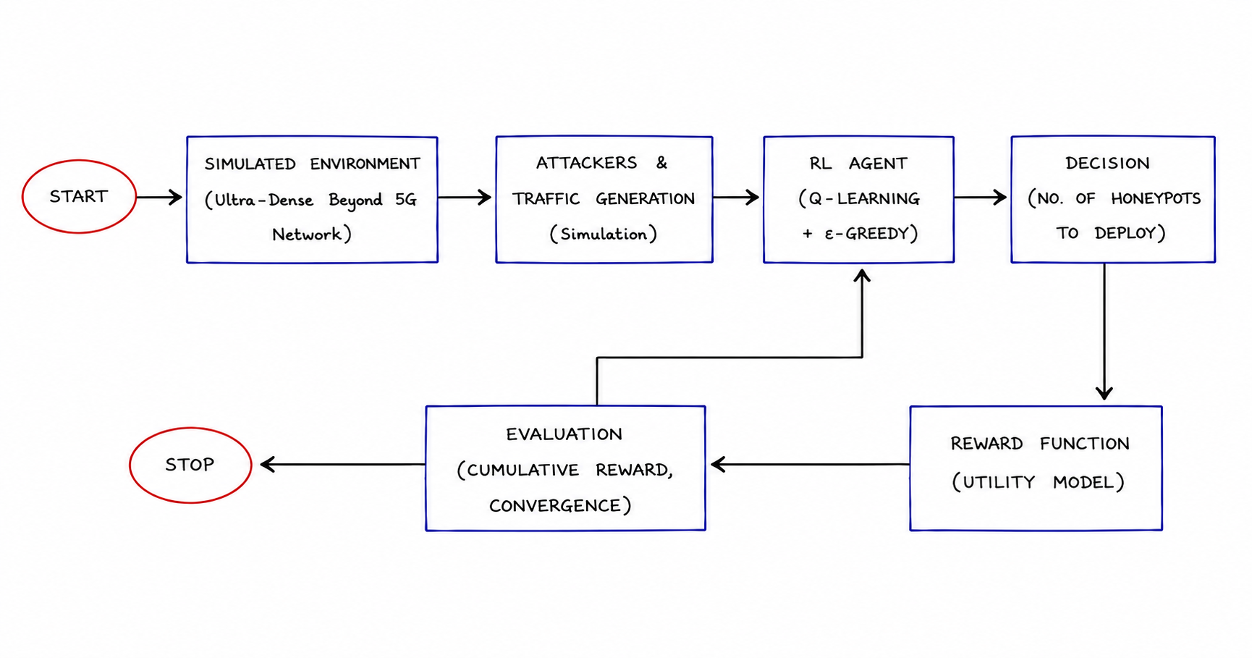
EXISTING SYSTEM

Slide 11
DISADVANTAGES OF EXISTING SYSTEM
Simulation-based approach only; no real-world implementation.
Uses only Q-Learning, which may not scale well for large and complex environments.
Does not include real honeypot deployment or attack logging.
No attack classification or anomaly detection mechanism
Lacks a real-time monitoring dashboard and alert system.

Slide 12
PROPOSED SYSTEM
Proposed System:
An RL-based Security Agent that serves as a Honeypot Orchestrator.
  Phase 1 (Server): Network Monitoring
  Phase 2 : Deploy honeypots dynamically based on network conditions
  Phase 3: Attack Capture
  Phase 4 (AI Agent): Q-Learning updates defense strategies after every security event (Attack Classification, Anomaly Detection.
  Phase 5 (Dashboard): Visualizes rewards, risks, and optimal decoy deployment.
Advantages:
  Protects real servers by diverting attackers to honeypots.
  Optimized Performance: Maximizes protection while preventing network outages.
  Dynamic Deception: Automatically changes to keep attackers engaged longer.
  Scalable and efficient, making it suitable for modern network environments.

Slide 13
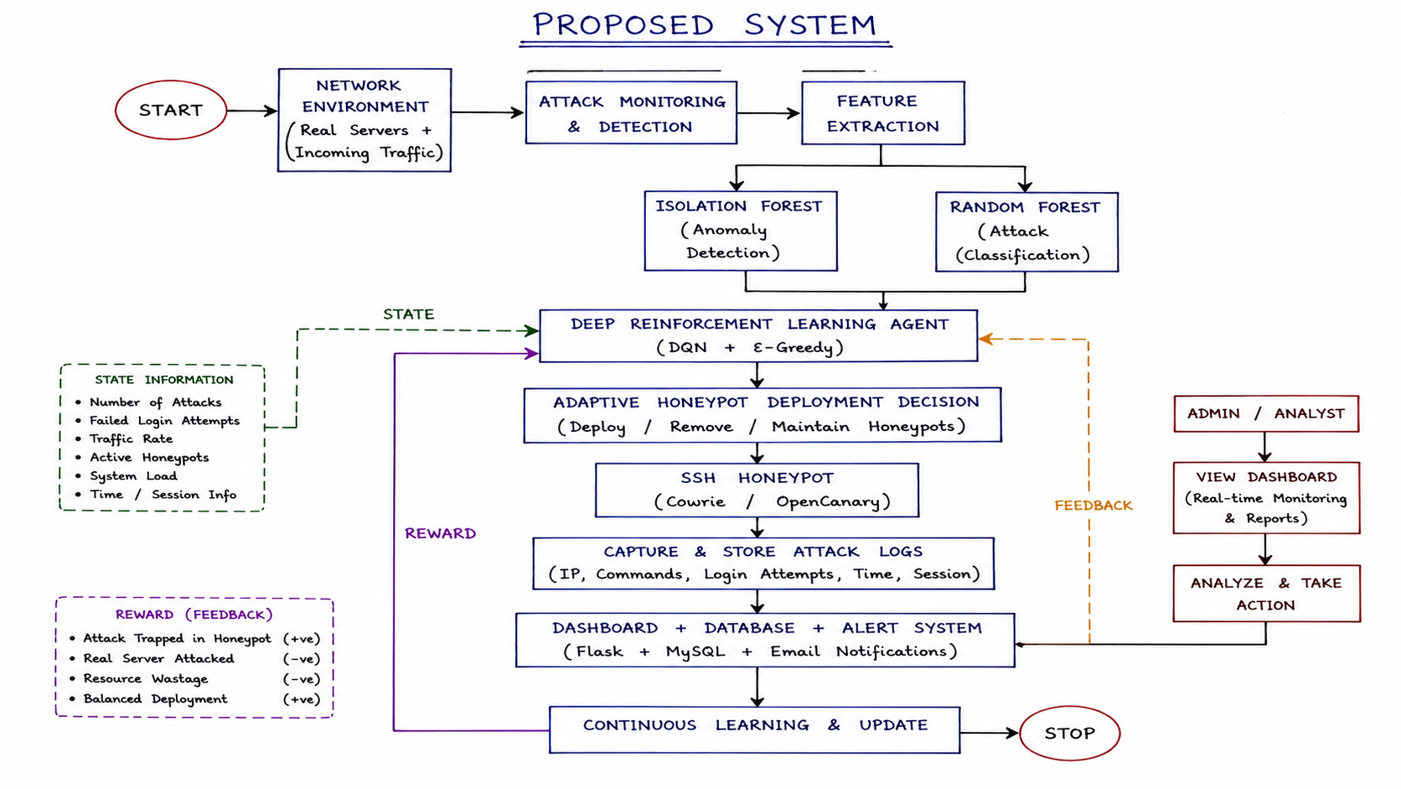
PROPOSED SYSTEM

Slide 14
CONCLUSION
The proposed ai-driven adaptive honeypot deployment system enhances iot network security by intelligently detecting and diverting attackers to honeypots while protecting real systems. By using deep reinforcement learning (DQN), the system dynamically optimizes honeypot deployment based on network conditions, improving attack detection, resource utilization, and overall cybersecurity.

Slide 15
REFERENCES
Strategic Honeypot Deployment in Ultra-Dense Beyond 5G Networks: A Reinforcement Learning Approach (2024) * Browser Link (IEEE Xplore)
AI-Driven Evolutionary Honeypots for Polymorphic Cyber Threats (2025) * Browser Link (IRE Journals)
AI-Driven Honeypots: Detecting and Classifying Attack Patterns in Real Time (2025) * Browser Link (IJMRSET)
AI-Driven Adaptive Honeypots for Dynamic Cyber Threats (2025) * Browser Link (ResearchGate)
Effectiveness of Artificial Intelligence-Based Adaptive Honeypots in Cyber Threat Detection: A Systematic Literature Review (2025) * Browser Link (ResearchGate)
Adaptive Honeypot System with Behaviour Analysis for Web Security (2024) * Browser Link (IJARCCE)
HoneyIoT: Adaptive High-Interaction Honeypot for IoT Devices Through Reinforcement Learning (2023) * Browser Link (ACM Digital Library)

Slide 16
Thankyou…!

