Slide 1
A DATA-DRIVEN DYNAMIC AND ADAPTIVE HONEYPOT DEPLOYMENT FOR SECURITY IOT NETWORKS USING DEEP REINFORCEMENT LEARNING
BATCH No:31
Presented by
Kusam Lakshmi Prasanna
Shaik Ismail Jabiulla
Tommandru Mahesh Babu
Guide:
Mr.M.Vijay kumar
Sr.Asst.Professor

Slide 2
OUTLINE
Abstract
Problem Statement
Literature Survey
Objective & Scope
Existing Dataset vs Our Dataset
Existing System
  Disadvantages
Proposed System
  Advantages

Slide 3
ABSTRACT
This project proposes a data-driven, dynamic, and adaptive honeypot deployment system for IoT network security. The proposed approach monitors network traffic, detects suspicious activities, and uses a Deep Q-Network (DQN) based AI agent to make optimal honeypot deployment decisions. Software-based honeypots act as controlled decoys to capture attacker interactions and logs. The system analyzes attack behavior while balancing security, QoS, and resource efficiency, with the results monitored through a dashboard.

Slide 4
PROBLEM STATEMENT
IoT networks are vulnerable to intrusions and cyberattacks because, attackers can directly target exposed network services. Without a honeypot, suspicious attackers may interact with real services. Traditional security mechanisms may also struggle to adapt to continuously changing attack conditions. Therefore, an intelligent and adaptive honeypot deployment system is needed to detect suspicious activity, provide controlled decoy environments, capture attacker behavior, and improve IoT network security while maintaining QoS and resource efficiency.

Slide 5
LITERATURE SURVEY
Paper Title | Year | Author(s) | Methods / Models Used | Key Contributions | Limitations | Accuracy
Strategic Honeypot Deployment in Ultra-Dense Beyond 5G Networks | 2024 | P. Radoglou- Grammatikis et al. | Q-Learning & epsilon-Greedy | OptimizesWireless Honeypot deployment using Q-Learning. | Limited attacker-behavior analysis. | 93.00%
AI-Driven Evolutionary Honeypots for Polymorphic Threats | 2025 | N. Kamatkar & C. Kamble | Transformers & Reinforcement Learning | Predicts attacker moves and adapts the honeypot. | Limited RL training data and simulation-based evaluation. | 91.68%
AI-Driven Honeypots: Detecting Attack Patterns in Real Time | 2025 | Dr. M. H. Nebagiri & Pushpa. D | Machine Learning Classification | Detects malicious activity in real time using ML. | Requires significant computation and labeled data.. | 82.77%
AI-Driven Adaptive Honeypots for Dynamic Threats | 2025 | Shafeena K I & Sreeji K B | Automated Anomaly Detection | Automatically adapts decoys to changing attacks. | Needs further integration and real-world testing. | 86.88%

Slide 6
LITERATURE SURVEY
Paper Title | Year | Author(s) | Methods / Models Used | Key Contributions | Limitations | Accuracy
Effectiveness of AI-Based Adaptive Honeypots | 2025 | L. H. Purnama & D. H. Prasetyo | Meta-Analysis of 36 Studies | Shows the effectiveness of AI-based adaptive honeypots. | Review-based study; no new deployable system. | 89.50%
Adaptive Honeypot System with Behaviour Analysis | 2024 | Mrs. Latha P et al. | K-Means Clustering | Groups attackers based on behavior using K-Means | Limited resource-aware deployment. | ~88.00%
HoneyIoT: Adaptive High-Interaction Honeypot for IoT | 2023 | Chongqi Guan et al. | Reinforcement Learning | Provides adaptive high-interaction honeypots for IoT devices. | Requires device-specific attack traces and responses. | ~78.00%

Slide 7
OBJECTIVE
Detect and monitor cyber attacks in real time.
Dynamically deploy and manage honeypots based on network conditions.
Capture and analyze attacker activities and attack patterns.
Provide a real-time dashboard for monitoring and reporting.
Optimize network security while reducing resource utilization.

Slide 8
SCOPE
Intelligent decision-making using reinforcement learning.
Monitor network traffic and detect suspicious activities in real time.
Automated collection and analysis of attacker behavior.
Collection and storage of attack logs for analysis.
Intelligent adaptive deployment of honeypots based on attack patterns.

Slide 9
Existing Dataset vs Our Dataset
EXISTING DATASET
OUR DATASET
1).The base paper relies on simulation-based data, which is artificially generated and does not fully represent real-world network traffic. The attack behavior in the simulation is predefined and assumed.
2) The dataset lacks wireless network and packet-level features such as IP addresses, source generated by model, limiting detailed traffic analysis.
3) Only a limited number of attack scenarios are modeled. Did not real attack logs and deploy real networks.
1.Dataset Name: CICIoT2023 (Canadian Institute for Cybersecurity, UNB)
2. Data Scale: ~46.7 Million total flow records distributed across 309 CSV files
3. Feature Dimensionality:46 extracted statistical flow features (flow duration, rate, packet size metrics, TCP flags, header lengths))
3.The dataset includes both normal and malicious interactions.
4.Target Attack Classes: 33 attack variants classified into 7 primary categories (DDoS, DoS, Mirai Botnet, PortScan, Brute Force, Spoofing, Web Attacks) + Benign traffic
5. Each record represents a network request made to the system or honeypot.

Slide 10
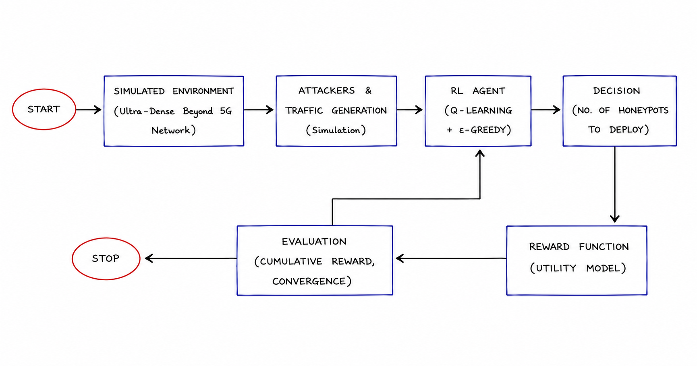
EXISTING SYSTEM

Slide 11
DISADVANTAGES OF EXISTING SYSTEM
Focuses mainly on deployment
The approach is designed around Wireless Honeypots, less directly applicable to a general IoT/software-service environment
Uses only Q-Learning, which may not scale well for large and complex environments.
Does not include real honeypot deployment or attack logging.
No attack classification or anomaly detection mechanism
No complete monitoring/dashboard layer

Slide 12
PROPOSED SYSTEM
  Phase 1 : DATA & Network Monitoring(traffic and conditions)
  Phase 2: Attack Detection(Analyze network activity)
  Phase 3 : DQN Decision Making( Deploy honeypots dynamically based on network conditions, Select suitable honeypot action)
  Phase 4 (AI Agent): Dynamic Honeypot Deployment (Attack Classification, Anomaly Detection.
  Phase 5: Attacker Interaction & Analysis(Divert suspicious activity to the honeypot)
  Phase 6 (Dashboard): FEEDBACK & Monitoring visualizes rewards.

Slide 13
Advantages of PROPOSED SYSTEM
  Protects real servers by diverting attackers to honeypots.
  More suitable for a software/IoT network environment, that can imitate services such as SSH/HTTP.
  system doesn't only decide honeypot deployment; it also considers what is happening in the network.
  DQN is better suited to handling more complex state representations than a simple tabular Q-learning approach.
  Optimized Performance: Maximizes protection while preventing network outages.
  Dynamic Deception: Automatically changes to keep attackers engaged longer.
  Attacker interaction logging.
  Scalable and efficient, making it suitable for modern network environments.

Slide 14
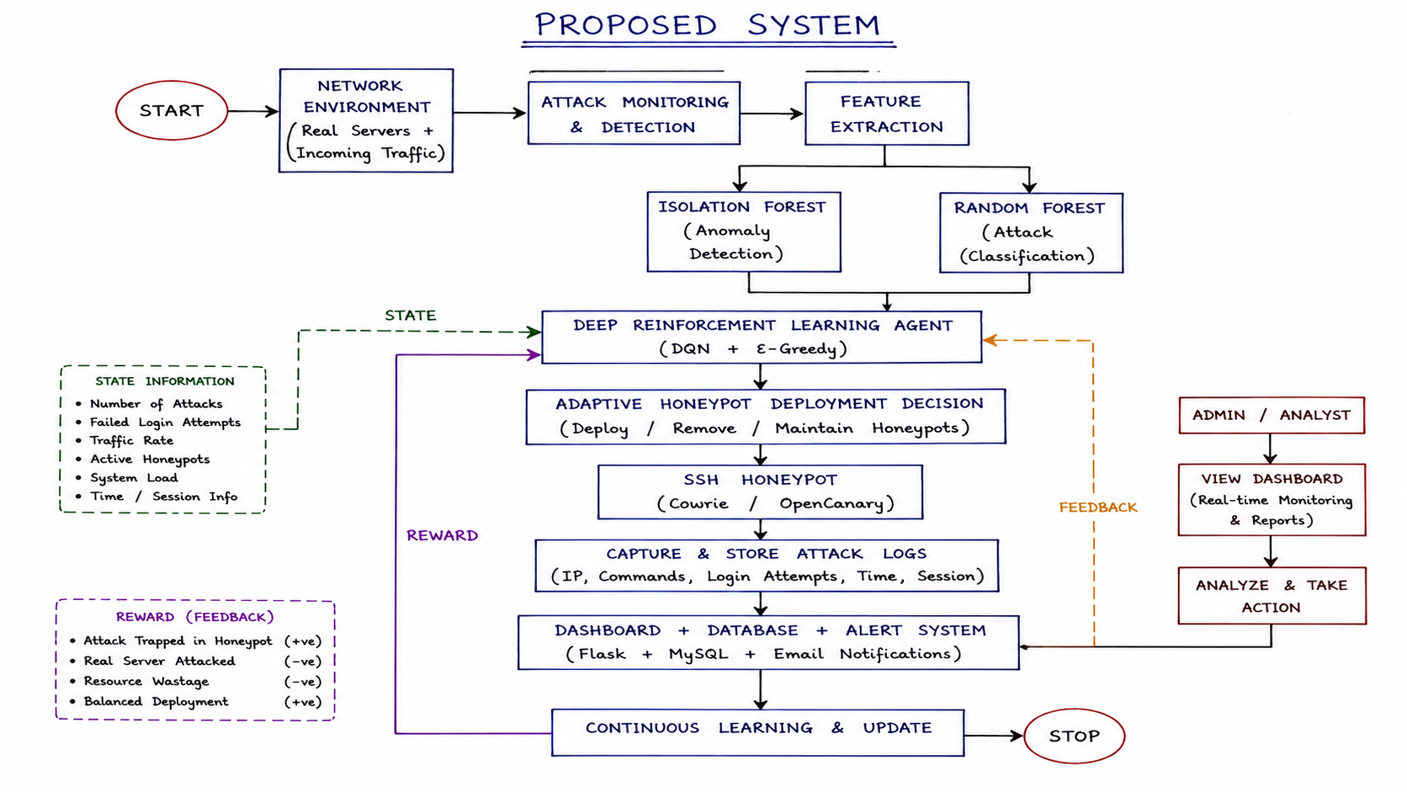
PROPOSED SYSTEM

Slide 15
CONCLUSION
The proposed AI-driven adaptive honeypot deployment system enhances IoT network security by detecting suspicious activities and dynamically deploying software-based honeypots as controlled decoys. Using Deep Reinforcement Learning (DQN), the system adapts honeypot deployment according to changing network conditions. It captures attacker activities while aiming to improve attack detection, resource utilization, QoS, and overall network security.

Slide 16
REFERENCES
Strategic Honeypot Deployment in Ultra-Dense Beyond 5G Networks: A Reinforcement Learning Approach (2024) * Browser Link (IEEE Xplore)
AI-Driven Evolutionary Honeypots for Polymorphic Cyber Threats (2025) * Browser Link (IRE Journals)
AI-Driven Honeypots: Detecting and Classifying Attack Patterns in Real Time (2025) * Browser Link (IJMRSET)
AI-Driven Adaptive Honeypots for Dynamic Cyber Threats (2025) * Browser Link (ResearchGate)
Effectiveness of Artificial Intelligence-Based Adaptive Honeypots in Cyber Threat Detection: A Systematic Literature Review (2025) * Browser Link (ResearchGate)
Adaptive Honeypot System with Behaviour Analysis for Web Security (2024) * Browser Link (IJARCCE)
HoneyIoT: Adaptive High-Interaction Honeypot for IoT Devices Through Reinforcement Learning (2023) * Browser Link (ACM Digital Library)

Slide 17
Thankyou…!

