Slide 1

Customer Churn Prediction & Analysis
CSE443 : SEMINAR ON SUMMER TRAINING
👨‍🎓 Presented By
Suvarnam Lakshmi Mallesh
Registration No: 12400532
B.Tech CSE (Data Science)
Lovely Professional University
August 2026

Slide 2
Problem Statement & Objectives
Why It Matters
Project Objectives
26.5%
1
Predict At-Risk Customers
Build a model to identify customers likely to churn
of customers in the dataset have churned
Early identification enables proactive retention — before revenue is lost.
2
Analyze Key Drivers
Surface factors that most influence churn behavior
3
Deliver Actionable Insights
Power BI dashboard for real-time churn monitoring

Slide 3


Dataset & Data Preparation
Dataset Overview
7,043
20
Customers
Features
Demographic, service & billing
73.5%
26.5%
No Churn
Churn
Preprocessing Steps
01
02
Missing Values
Type Correction
11 NaN in TotalCharges (tenure = 0) → filled with 0
TotalCharges: object → float64
03
04
Feature Removal
Encoding
customerID dropped (non-predictive identifier)
Categorical variables encoded via LabelEncoder

Slide 4
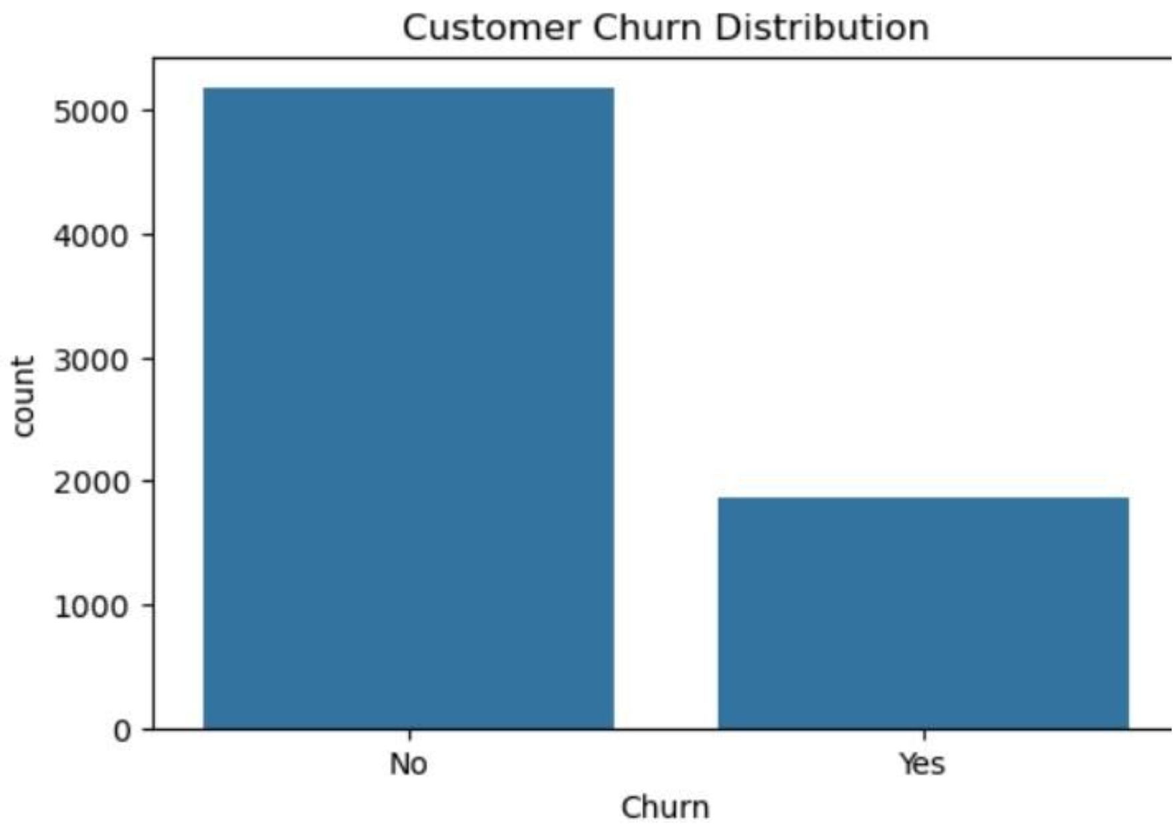
Exploratory Data Analysis
Key Findings
Tenure
Churned: median 10 months vs. retained: 38 months
Contract Type
Month-to-month: 43% churn · Two-year: 3% churn
Internet Service
Fiber optic: 41.9% churn · DSL: 19% churn
Payment Method
Electronic check: 45% · Auto payments: 16%

Slide 5
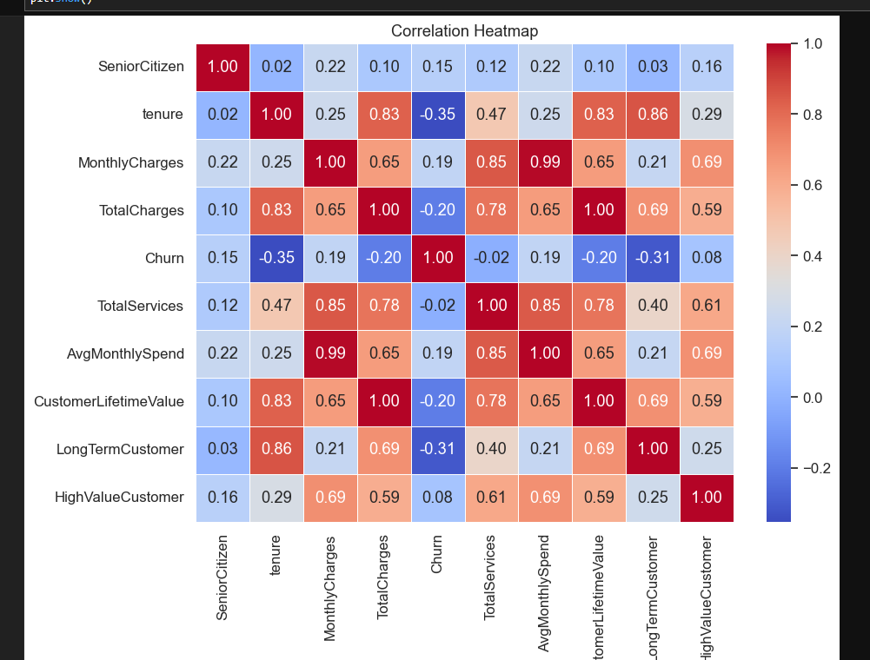
Correlation Analysis & Feature Engineering
Key Correlations
Engineered Features
TotalServices — count of subscribed services
AvgMonthlySpend — TotalCharges ÷ Tenure
CustomerLifetimeValue — MonthlyCharges × Tenure
LongTermCustomer — tenure ≥ 24 months (binary)
HighValueCustomer — charges ≥ 75th percentile (binary)
Tenure ↔ TotalCharges: 0.83
MonthlyCharges ↔ AvgMonthlySpend: 0.99
Tenure ↔ Churn: −0.35
Strong positive — longer tenure accumulates higher charges
Longer tenure reduces churn risk
Validates the engineered feature

Slide 6
Machine Learning Models
Train / Test Split
Models Evaluated
Stratified split applied to maintain class distribution.
Logistic Regression
Decision Tree
Evaluation Metrics
Linear baseline for binary classification
Captures non-linear relationships
Accuracy · Precision · Recall · F1-Score · ROC-AUC · Confusion Matrix
Random Forest
Ensemble of 200 trees for robustness
Training Set
Test Set
5,634 samples — 80%
1,409 samples — 20%

Slide 7
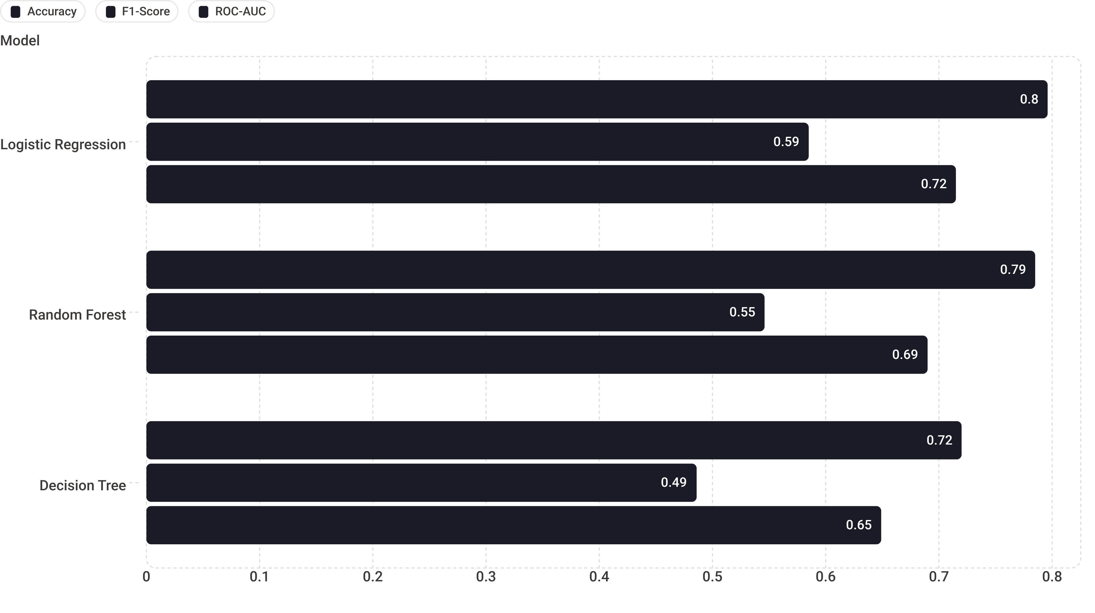
Model Comparison & Selection
Logistic Regression selected — highest Accuracy (0.796), F1-Score (0.585), and ROC-AUC (0.715). Best balance between precision and recall for this business use case.

Slide 8
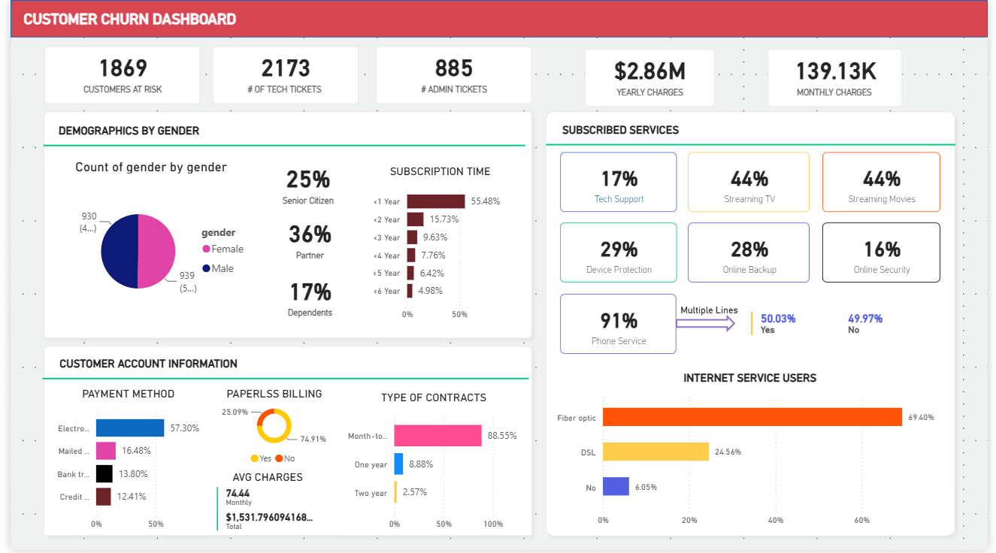
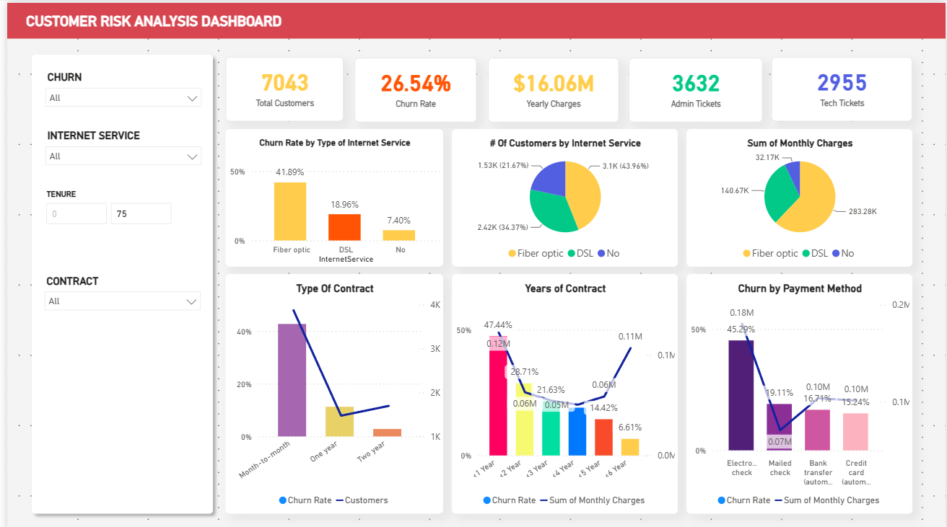
Power BI Dashboard & Business Insights
Key Business Insights
14×
2.2×
Month-to-month contracts are 14× riskier than two-year contracts
Fiber optic customers churn 2.2× more than DSL customers
45%
50%
Electronic check payment correlates with 45% churn rate
Customers with tenure < 6 months account for 50% of all churners
With Interactive filters for customer segmentation

Slide 9
Recommendations & Conclusion
Retention Strategies
Conclusion
Contract Incentives
Logistic Regression model: 79.8% accuracy, 0.721 ROC-AUC
Primary churn drivers: tenure, contract type, payment method
Interactive Power BI dashboard for real-time monitoring
Model enables data-driven retention and revenue protection
Offer discounts for upgrading from month-to-month to annual plans
Early Engagement
Onboarding programs for first 6 months — the most critical window
Thank You
Suvarnam Lakshmi Mallesh
Registration No: 12400532
CSE – Data Science
Lovely Professional University
Payment Optimization
Encourage auto-pay adoption; reduce friction for electronic check users
Proactive Outreach
Use model predictions for targeted retention campaigns

