Slide 1

Enhancing Deep Learning Model Robustness Against Adversarial Attacks
Submitted By:
Surendar Mourougan
Lakshmi Manasa Dokku

Slide 2

Deep Learning Overview
Deep learning has emerged as a powerful subset of machine learning, inspired by the structure and function of the human brain's neural networks.
Its ability to automatically learn hierarchical representations of data has led to breakthroughs in various fields, including computer vision, natural language processing, speech recognition, and more.
Examples of deep learning applications include image classification, object detection, sentiment analysis, language translation, medical diagnosis, autonomous vehicles, and recommendation systems.

Slide 3

Adversarial Attacks
Adversarial attacks are techniques designed to fool machine learning models by making imperceptible modifications to input data.
These attacks exploit vulnerabilities in deep learning models, causing them to misclassify or make incorrect predictions with high confidence.
Adversarial examples can be generated using various methods, such as adding carefully crafted noise or perturbations to input data.
Examples of adversarial attacks include the Fast Gradient Sign Method (FGSM), the Carlini & Wagner (C&W) attack, and others.

Slide 4
Significance of Adversarial Attacks
Adversarial attacks pose a significant threat to the reliability and trustworthiness of deep learning systems, especially in critical applications such as autonomous driving, medical diagnosis, and cybersecurity.
Their ability to bypass state-of-the-art models highlights the limitations of current deep learning techniques and the need for more robust and resilient systems.
Addressing the challenge of adversarial attacks is crucial for ensuring the safety, security, and effectiveness of deep learning models in real-world scenarios.

Slide 5

Importance of Defenses
Developing defenses against adversarial attacks is essential for improving the robustness and reliability of deep learning models.
Effective defenses can mitigate the impact of adversarial examples, making models more resilient to attack and increasing their trustworthiness in critical applications.
By enhancing the security and stability of deep learning systems, defenses contribute to the broader adoption and deployment of AI technologies across various domains.

Slide 6
Adversarial Example attacks
FGSM : Fast Gradient Sign Method (FGSM) is used to construct AEs against a given DNN classifier. FGSM generates the AE by performing a one-step optimization on the input image towards the gradient ascent direction.
BIM : Basic Iterative Method (BIM) is an iterative variant of FGSM. Under a certain perturbation budget, instead of optimizing the AE in one step as in FGSM, BIM uses smaller steps and iteratively optimizes the AE.
PGD: Project Gradient Descent (PGD) is a powerful iterative attack method, where the search step starts from a random position in the neighborhood of the clean input. As PGD relaxes the search direction, it can search AEs with subtle perturbations faster. PGD has also been used as a basic building block to construct stronger attacks.
C&W: While the above methods are all variants of FGSM and are based on gradient ascent, C&W attack is the first work that formulates the AE generation process as an optimization problem, and it can successfully construct AEs with much smaller perturbations when compared to earlier techniques.
EAD: EAD enhances the attack transferability, i.e., the ability of AEs generated against one model being able to attack another unseen model successfully.

Slide 7

Main Objective
Identification of Vulnerabilities
We analyzed the vulnerabilities of the VGG16 model to common adversarial attacks, such as FGSM and C&W. Understanding these vulnerabilities is essential for devising targeted defense strategies.
Development of Defense Mechanisms
Based on the identified vulnerabilities, we developed and implemented defense mechanisms tailored to mitigate the impact of adversarial attacks on the VGG16 model.
These defense mechanisms may include adversarial training, input preprocessing techniques, or model modifications aimed at improving robustness.
Evaluation of Robustness
We rigorously evaluated the effectiveness of the proposed defense mechanisms in enhancing the robustness of the VGG16 model against adversarial attacks.
This evaluation involved testing the model's performance on both clean and adversarial inputs and measuring metrics such as accuracy, robustness, and resilience.
Validation and Generalization
Finally, we validated the proposed defense mechanisms through extensive experimentation and analysis across diverse datasets and scenarios.
Additionally, we assessed the generalization capabilities of the defenses to ensure their applicability across different domains and real-world settings.

Slide 8

VGG16 Model
The VGG16 model is a deep convolutional neural network (CNN) architecture proposed by the Visual Geometry Group at the University of Oxford.
It consists of 16 layers, including convolutional layers, max-pooling layers, and fully connected layers.
VGG16 is widely used for image classification tasks and has achieved state-of-the-art performance on benchmark datasets such as ImageNet.
Despite its simplicity compared to more recent architectures, VGG16 remains a popular choice for research and practical applications due to its simplicity and effectiveness.

Slide 9

Methodology
Model Setup
Loading the Pre-trained VGG16 Model
We begin by loading the pre-trained VGG16 model, which is a widely used convolutional neural network (CNN) architecture pre-trained on the ImageNet dataset.
The VGG16 model is known for its effectiveness in image classification tasks.
Preprocessing Input Images
To ensure compatibility with the VGG16 model, we preprocess input images using the VGG16-specific preprocessing function.
This preprocessing step standardizes the input images to meet the model's requirements, such as resizing and normalization.

Slide 10
Adversarial Attack
Implementation of the Fast Gradient Sign Method (FGSM)
We implemented the FGSM, a popular and computationally efficient adversarial attack method.
FGSM perturbs input images by adding imperceptible noise computed based on the sign of the gradient of the loss function with respect to the input.
Evaluation of FGSM Attack Success Rate
After generating adversarial examples using FGSM, we evaluated the success rate of the attack on the VGG16 model.
This involves feeding both original and adversarial images through the model and comparing the predicted labels to assess the attack's efficacy.

Slide 11

Defense Mechanism
Introduction of Input Noise Defense Mechanism
To defend against adversarial attacks like FGSM, we introduce a defense mechanism based on input noise.
This defense approach involves adding carefully crafted noise to input images, aiming to disrupt the adversarial perturbations while minimizing the impact on the model's performance on clean data.
Evaluation of Defense Effectiveness
We evaluated the effectiveness of the input noise defense mechanism against the FGSM attack.
This evaluation includes testing the VGG16 model's performance on adversarial examples generated with FGSM and measuring the model's accuracy and robustness in the presence of adversarial perturbations.

Slide 12

Results
Success Rate of FGSM Attack:
The success rate of the FGSM attack on the VGG16 model is determined by evaluating the percentage of adversarial examples misclassified by the model compared to the original images.
Comparison Before and After Defense:
Before applying the defense mechanism, the FGSM attack achieves a certain success rate in compromising the model's predictions.
After implementing the defense mechanism, we observe a reduction in the success rate of the FGSM attack, indicating improved robustness of the model against adversarial perturbations.

Slide 13
Results
Attack method | Speed | Success rate | Approach
FGSM | Very fast | 1.0 | Performs a one-step optimization on the input image towards the gradient ascent direction.
BIM | Moderate | 0.33 | BIM uses smaller steps and iteratively optimizes the AE.
JSMA | Moderate | 0.33 | Uses feature selection to minimize the number of features modified while causing misclassification
PGD | Moderate | 1.0 | It is powerful iterative attack method, where the search step starts from a random position in the neighborhood of the clean input

Slide 14

Analysis of Defense Rate
The defense rate quantifies the effectiveness of the defense mechanism in mitigating the impact of adversarial attacks. It is calculated as the reduction in the success rate of the attack after applying the defense, relative to the success rate without defense.
A higher defense rate signifies a more effective defense mechanism, indicating better resilience of the model against adversarial attacks.

Slide 15
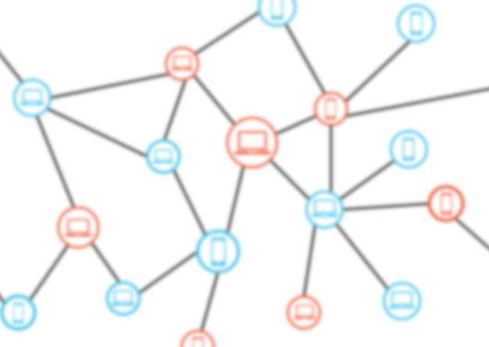
Conclusion
Vulnerability to Adversarial Attacks
The VGG16 model demonstrated vulnerability to adversarial attacks, with both FGSM and PGD methods successfully generating adversarial examples that altered the model's predictions.
Effectiveness of Defense Mechanism
Introducing a defense mechanism by adding input noise helped mitigate the success rate of adversarial attacks.
The defense mechanism demonstrated notable effectiveness in reducing the success rate of both FGSM and PGD attacks.
Significance of Model Robustness
Enhancing the robustness of deep learning models against adversarial attacks is crucial for ensuring the reliability and trustworthiness of AI systems, particularly in applications where security and integrity are paramount.

Slide 16


