Slide 1
Admin flowchart
Homepage Annouce-ment
HOME-1st visit
Homepage
Annouce-ments
ContentAnnouce-ments
Logos
Pages
HA
Annouce-ments
Terms of Use
Privacy Policy
TBD

Slide 2
Pages
Input box
Search Pages
Bulk Actions
Apply
Show all dates
Filter
Edit
Sept. 2012
Move to trash
Oct. 2012
Choose a page:
Author
Date
Homepage
Joe Schmuga
06/03/2013
Last modified
Edit, Trash, View
Content Page
Joe Schmuga
06/01/2013
Last modified
TBD
Notes: Thinking we would create a homepage and then only edit function necessary, not
“create new”.
Orange color=future phase

Slide 3
Error messaging for logo upload
Exceeds 5 mb, show error, “this file is in excess of size limit, please upload another logo.
Use default image. If default image deleted, ???
No image uploaded, default displays.

Slide 4
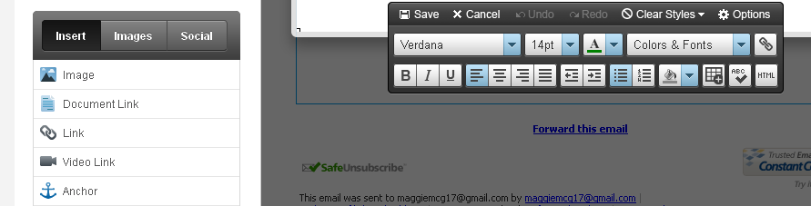
Homepage edits/creation
6
1
6
2
3
4
5
Announcement
7
8
Health Assessment Intro
1
Add a logo –pulls up your library and
ability to insert to the homepage
6
Copy editing features and HTML Editor
7
Add Announcement headline with ability to add external/internal link and read more and start and end date
2
Add a document link to the homepage
3
Add a external/internal link to the homepage
4
8
Add a video link to the homepage??
Add Health Assessment intro announcement with ability to add external/internal link and start and end date
5
Add an anchor link to the homepage??

Slide 5
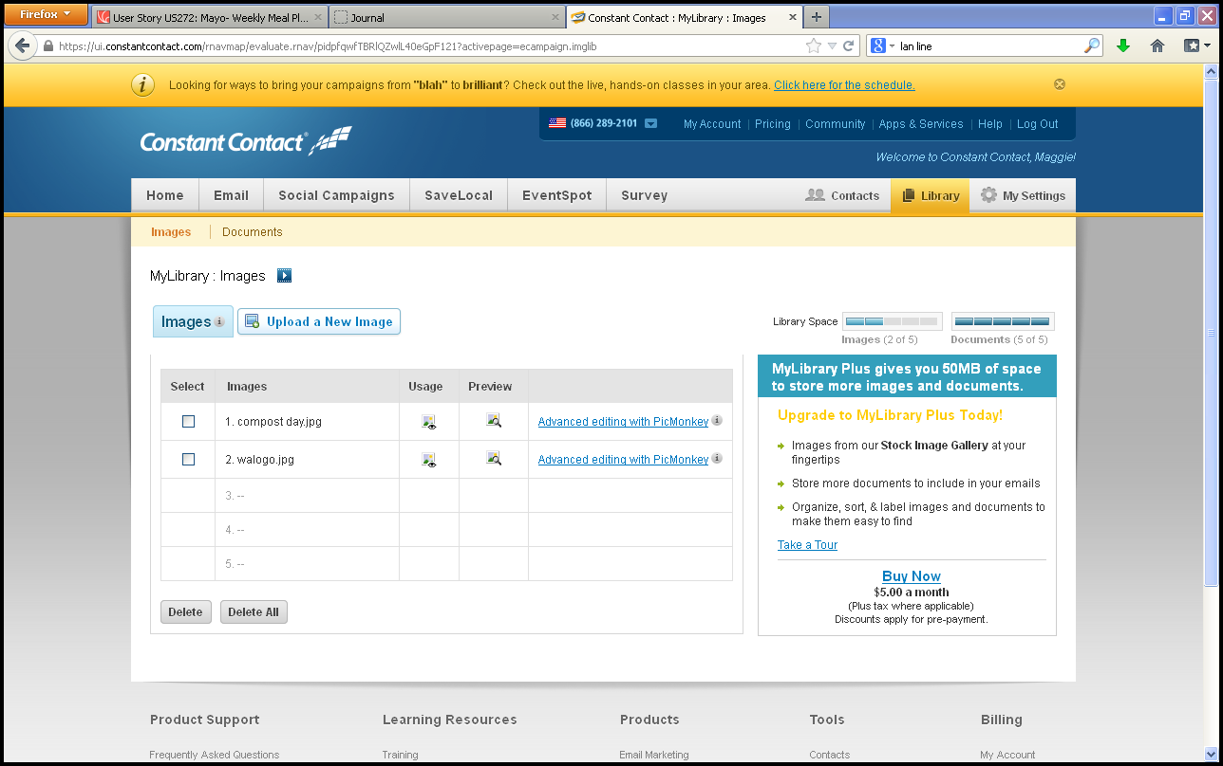
Logos
1
Ability to view
logos already up-
loaded
2
Ability to Select
logos to display, delete or delete all
7
5
3
Ability to upload
logos
3
4
2
6
4
Ability to preview logo
1
5
Logo space limits
6
Advanced image/logo editor (crop, brightness, etc.)
2
7
Have pull-down for primary & secondary logo

Slide 6
Manage logos
Primary logo
Secondary logo
vview
Upload new
Publish
vview
Upload new
Publish

Slide 7
Homepage- Admin
View current homepage
Create a new homepage
Edit homepage
Copy homepage
Save drafts
Create new folder
Folders

Slide 8
Health Assessment set up page/pop-up?

Slide 9
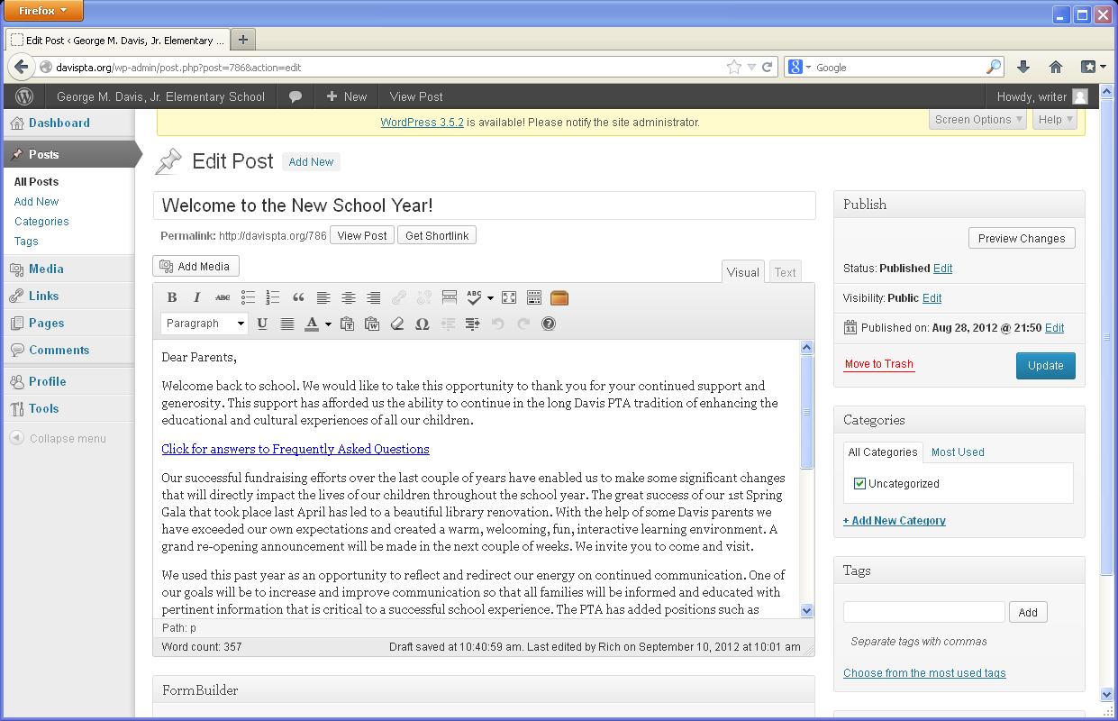
Edit Homepage

Slide 10
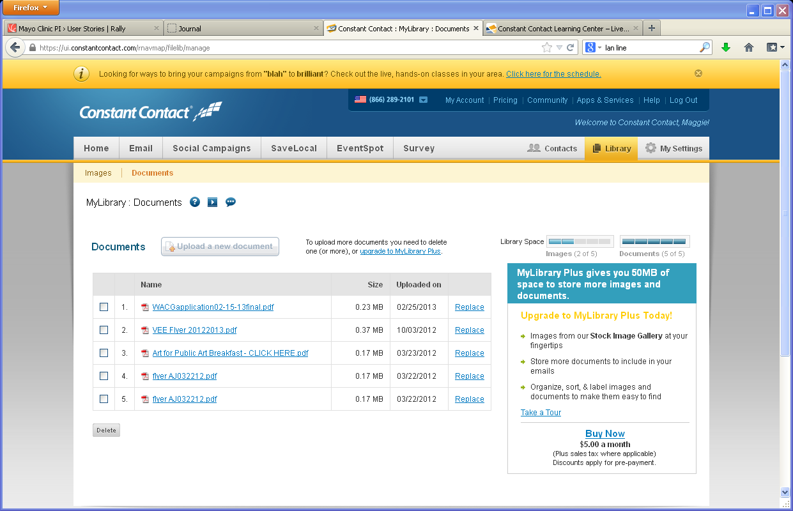
Document
1
Ability to view
documents already
up-loaded, including size& update date
5
7
2
3
Ability to select documents to display or delete
- check box
3
5
6
2
4
1
1
3
4
Ability to upload
Documents
2
4
Ability to replace document/ Document space limits?
5
Help uploading documents?

