Slide 1
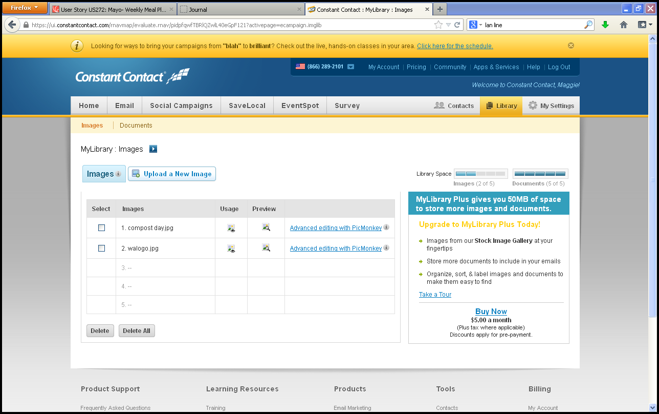
Library- Upload Logos
??Ability to upload images?
1
Ability to view
logos already up-
loaded
8
2
7
3
Ability to select
logos to display
5
6
2
1
3
4
Ability to upload
logos
4
See next page
for Usage
5
Ability to preview logo
6
Advanced image/logo editor (crop, brightness, etc.)
7
Logo space limits?
8
Have pull-down for primary & secondary logo

Slide 2
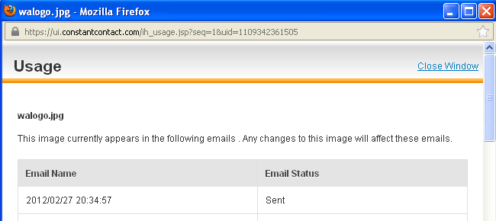
Library Logo Usage
1
2
2
1
Display name of logo
Displays name of page logo appears on. Could appear multiple, so
warning is given.
2

Slide 3
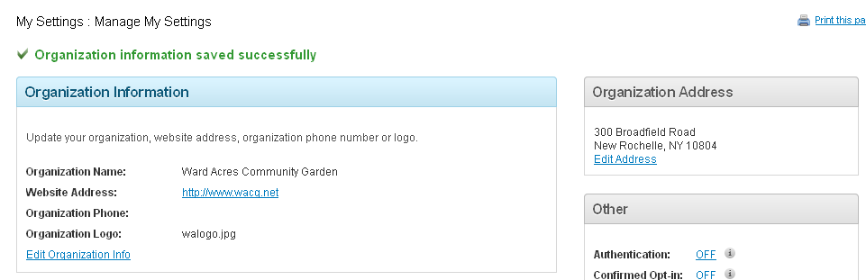
Account Information/Settings
5
1
2
3
4
Company information:
Company name
Website address
Phone?
Company Logo and ability to upload and edit
Company Address and ability to edit
1
2
3
4
5

Slide 4
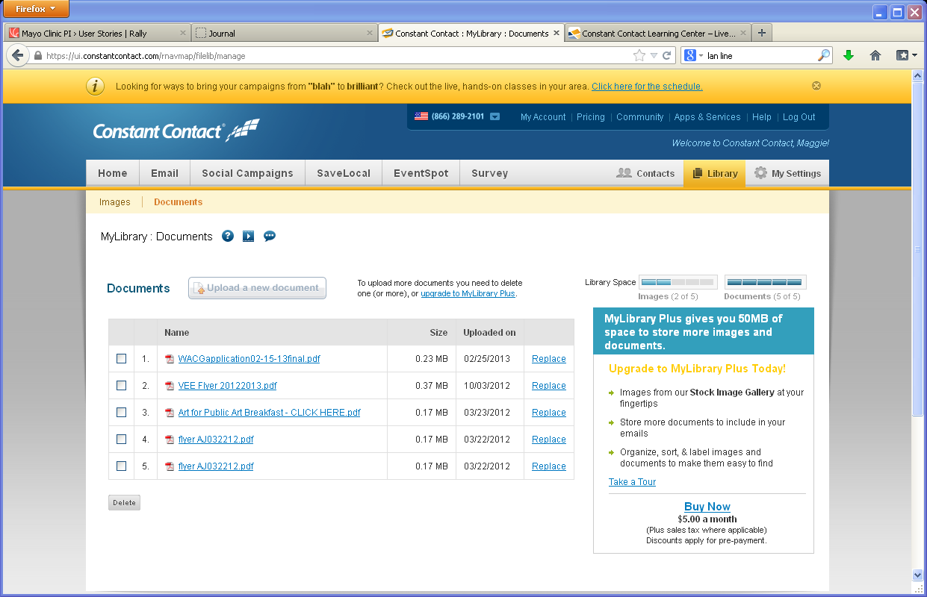
Library- Upload Document
1
Ability to view
documents already
up-loaded, including size& update date
5
7
2
3
Ability to select documents to display or delete
- check box
3
5
6
2
4
1
1
3
4
Ability to upload
Documents
2
4
Ability to replace document/ Document space limits?
5
Help uploading documents?

Slide 5
Homepage- Admin
View current homepage
Create a new homepage
Edit homepage
Copy homepage
Save drafts
Create new folder
Folders

Slide 6
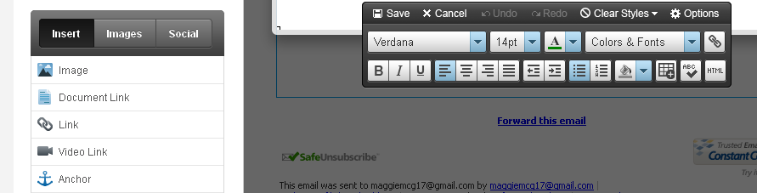
Homepage edits/creation
6
1
6
2
3
4
5
Headline
7
8
Announcement
1
Add a logo/image –pulls up your library and
ability to insert
to the homepage
6
Copy editing features and HTML Editor
2
7
Add headline with ability to add external/internal link
Add a document link to the homepage
3
Add a external/internal link to the homepage
8
Add announcement with ability to add external/internal link and start and end date
4
Add a video link to the homepage??
5
Add an anchor link to the homepage??

Slide 7
Health Assessment set up page/pop-up?

Slide 8
Admin flowchart
HOME
Library
Pages
Users
Settings
Homepage
Recent work
Logos
Health Assessment
Documents/Articles
Images

