Slide 1
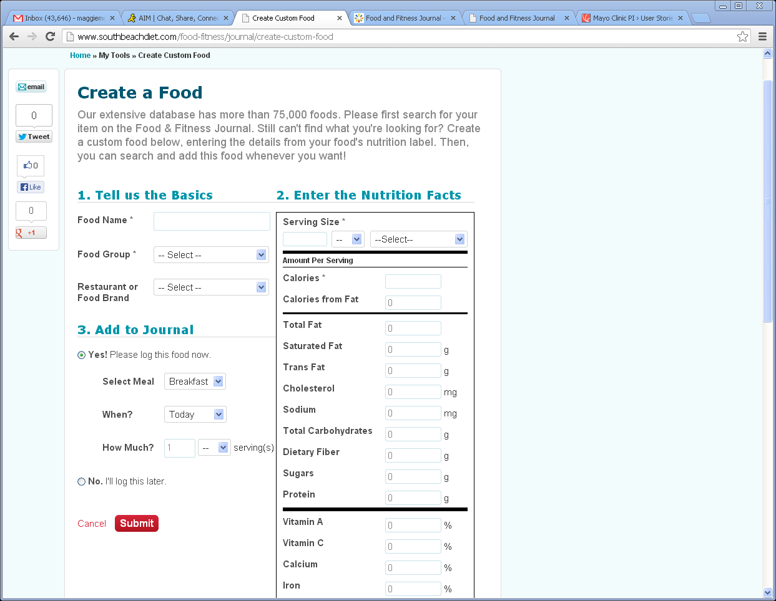
Journal-Create a Food
1
Remove all shares on right
1
2
Same functionality and use the SAME nutrient order as SBD.
2

Slide 2
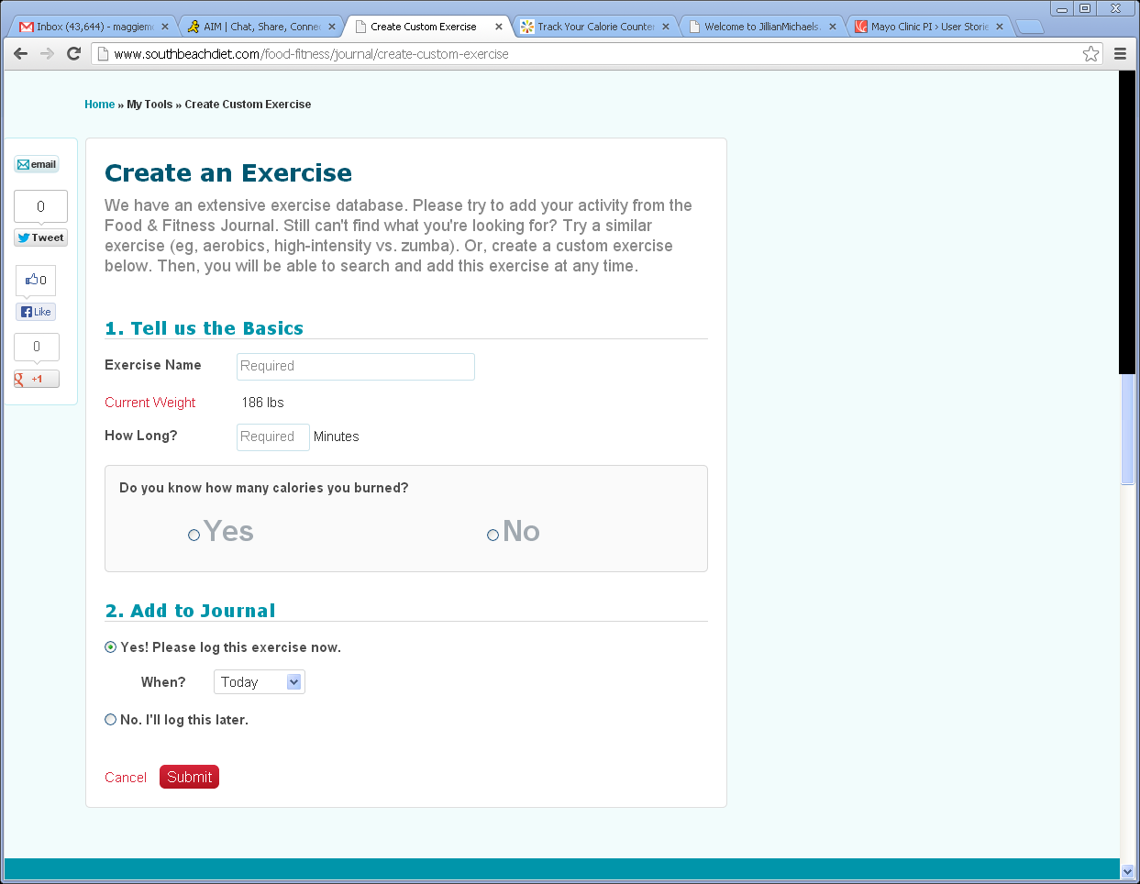
Journal-Create an Exercise
1
Remove all shares on right
1

