Slide 1
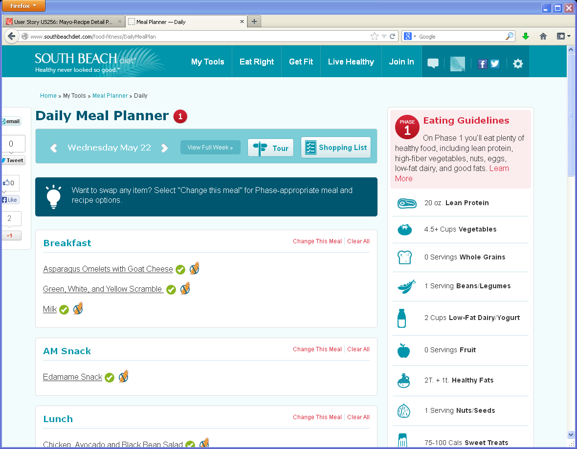
Daily Meal Plan- same functionality as SBD
1
Remove Shares on left
2
Remove phase icons
2
3
2
1
6
3
Remove Tour icon
5
4
Remove Gluten icon, !,
and check marks
4
5
Remove blue message box and replace with Nutrients at a Glance like on Journal
6
Use Mayo Eating Guidelines
(same as Journal)

Slide 2
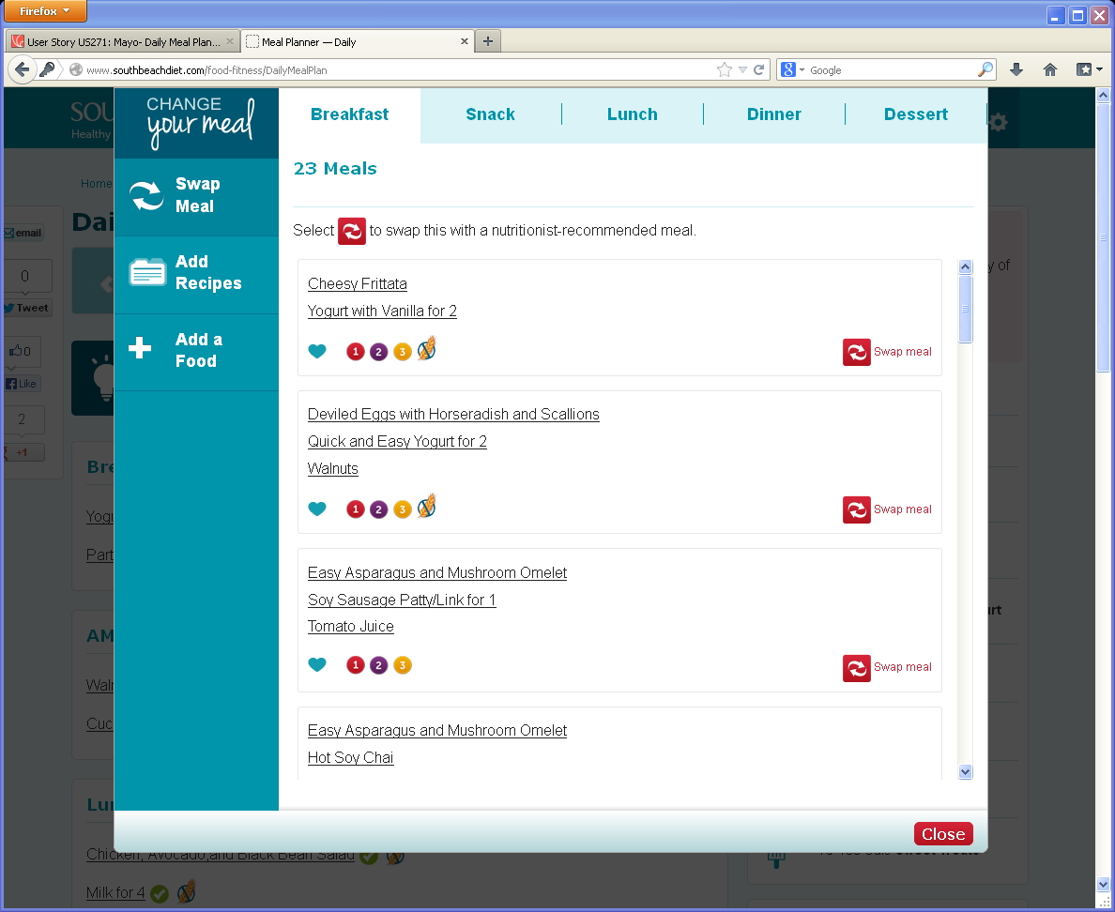
Daily Meal Plan “Change Meal slodal” Swap Meal tab
1
Remove Gluten icons
2
Remove phase icons
4
3
Fave icons change to “star”
3
1, 2
4
Meal types are Breakfast,
Snack, Lunch and Dinner
only

Slide 3
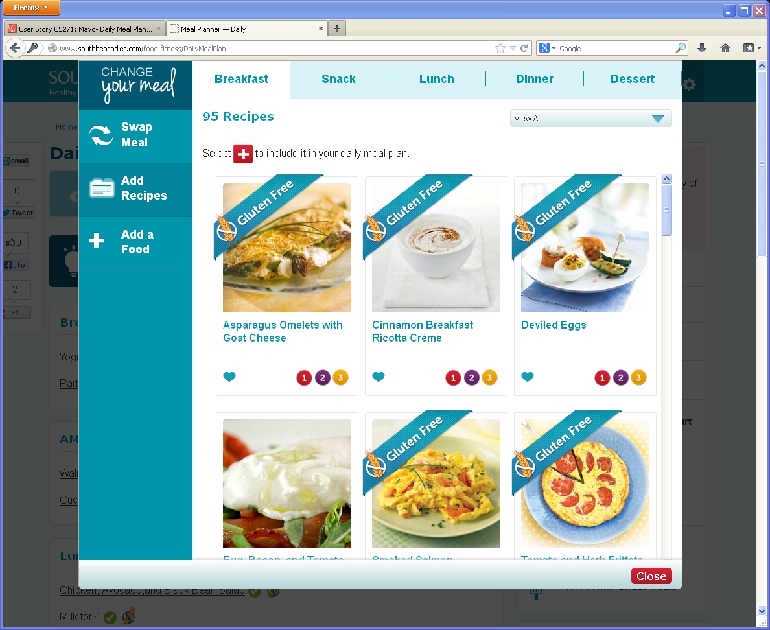
Daily Meal Plan “Change Meal slodal” Add Recipes tab
1
Remove Gluten free
ribbons
4
2
Remove phase icons
under image and replace
With new categories??
(tk)
1
3
Remove favorite heart and replace with star
2
3
4
Meal types are Breakfast,
Snack, Lunch and Dinner
only

Slide 4
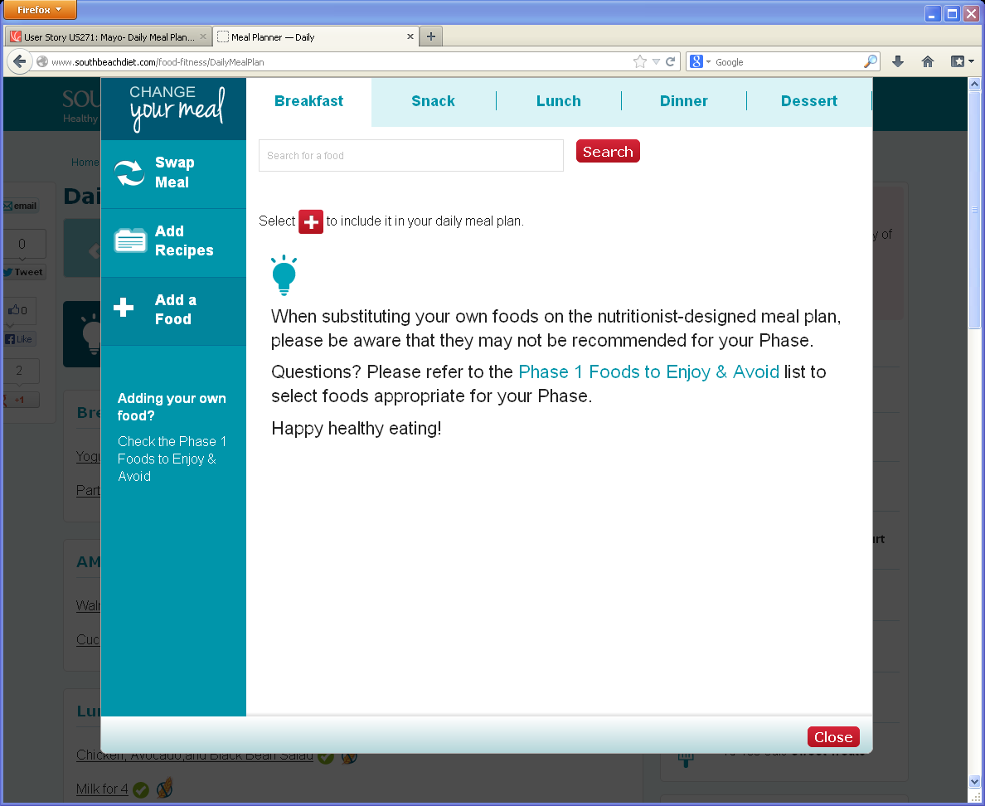
Daily Meal Plan “Change Meal slodal” Add a Food tab
1
Remove light bulb.
See new copy on design
1

