Slide 1
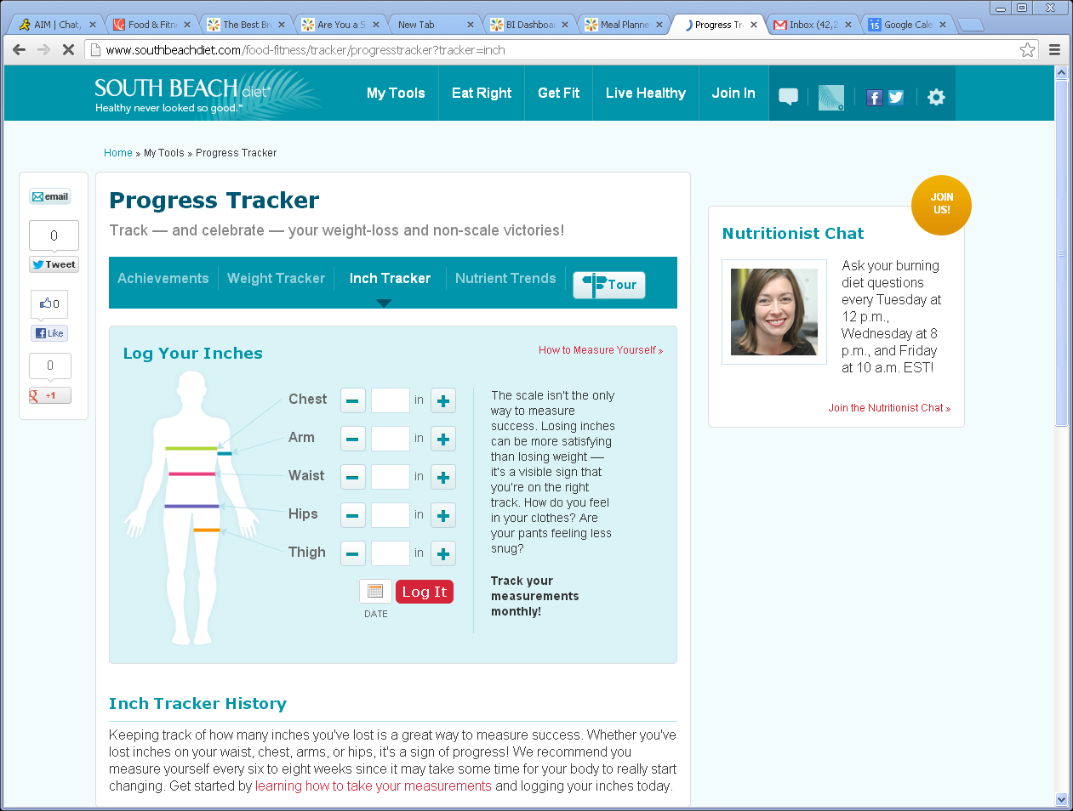
Inch Tracker changes for MAYO
1
Remove Sub nav including Tour
Remove social shares in left nav, keep emaiL
Remove Nutrition Chat in Right nav and insert standard right rail
Change Progress to Inch using same font as “Tracker”
Remove copy under Progress Tracker
Bread Crumb should read Inch Tracker
7
See new design for male/female body
2
Inch
Inch
6
8
3
4
5
Learning how to take your measurements and How to Measure Yourself, links to article (TK)
1
3
8
4
2
9
9
Remove copy
7
5
6
8

Slide 2
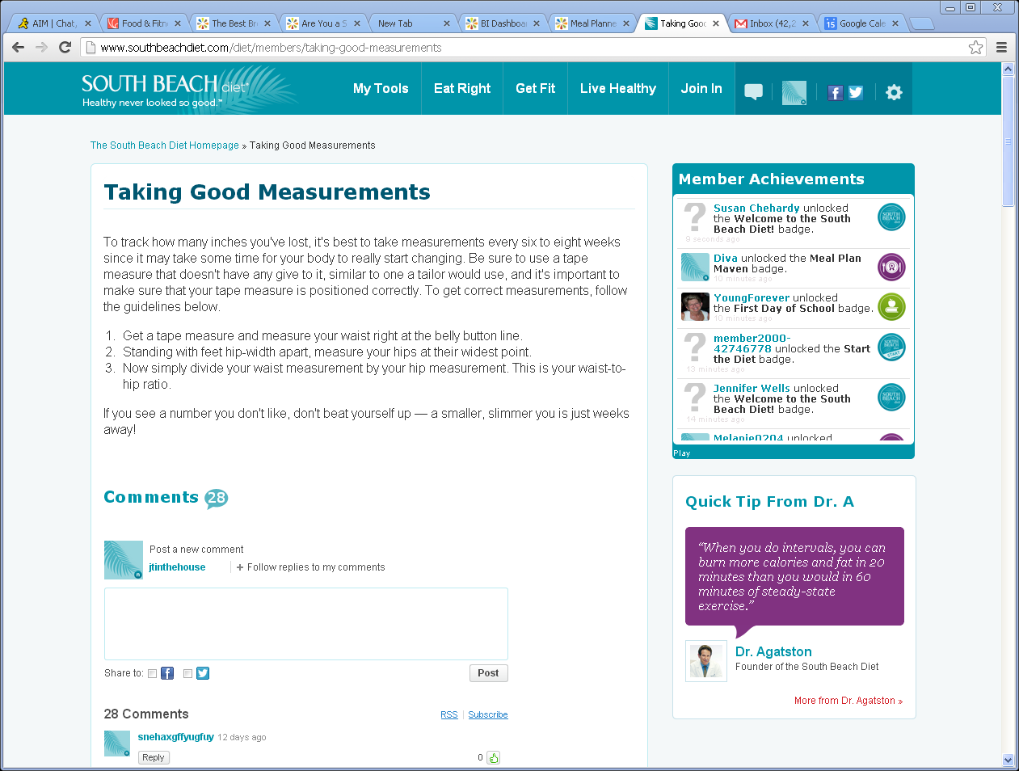
Commenting-Remove all
1
Remove commenting throughout site
Remove right rail and replace with standard right rail
2
2
1
2

