Slide 1
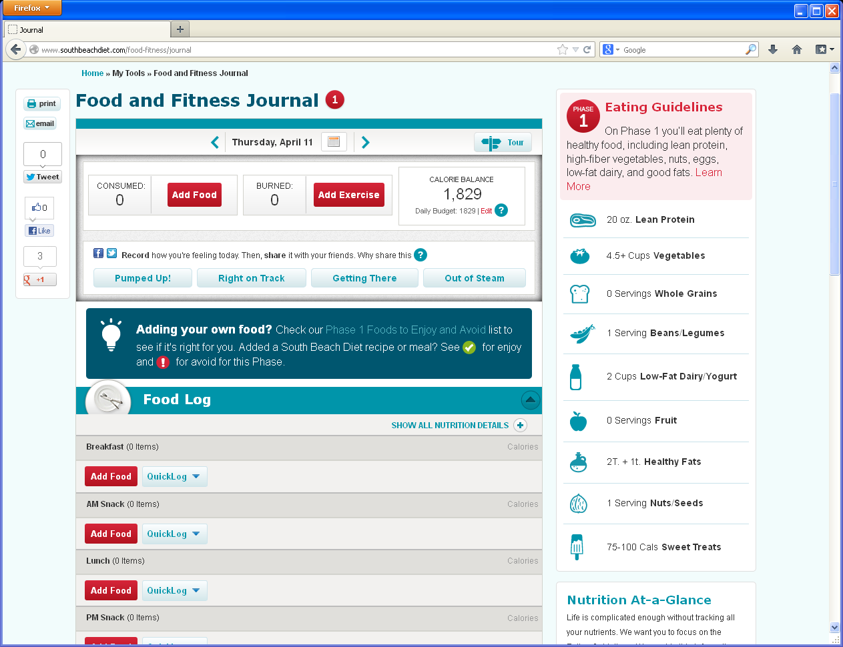
Journal-remove social shares, reactions, phase icons, tour, food/exercise icons
1
Remove Social shares bar on left nav, Keep Print and Email,
Remove all reaction shares, Tour and “Add Food” and “Add Exercise”
Remove Daily Budget and # and insert “Edit Target” New dashboard w/ Nutritions (see new design)
There will be new MAYO Eating Guidelines and new intro copy for some calorie ranges, but not all. New servings too.
Remove all phase icons
Remove blue box with copy and all Gluten icons and ! and √on recipes added.
5
5
7
2
2
Remove Plate icon/sneaker icon for food/exercise and all food/recipe and exercise individual icons and defaults.
2
2
4
1
3
3
2
4
6
7
NOTES: Calories consumed and burned will use new calculations from Maureen.
Design/Dev for desktop and ipad only.
5
6

Slide 2
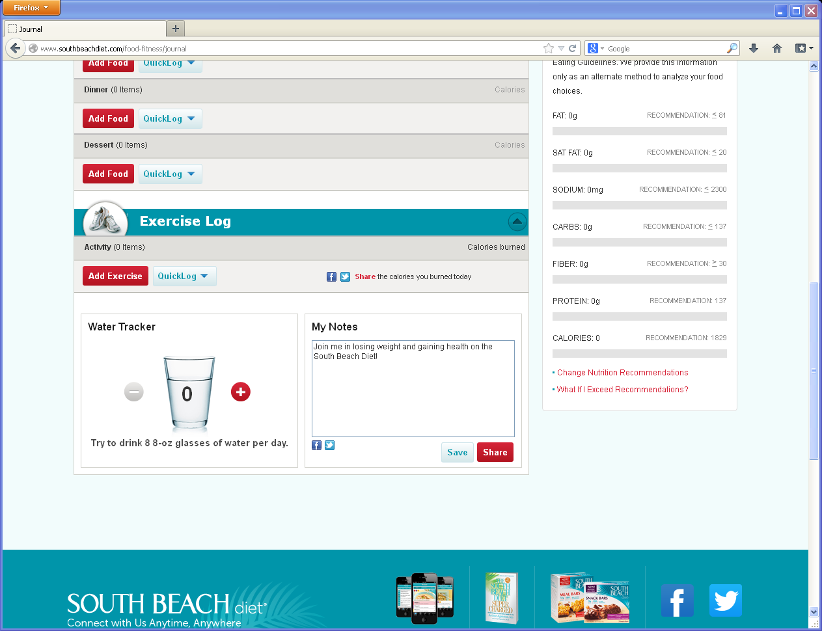
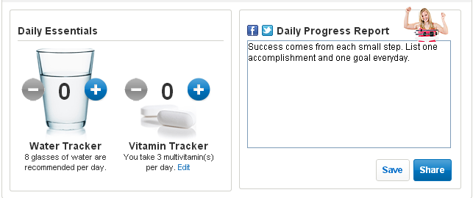
Journal- below the fold--no social share, add vit tracker, nutrition at a glance moves to dashboard,
1
Remove all social sharing.
Nutrition at a Glance, moved to dashboard (see new design) and new recommendations from Maureen
Remove “What if I Exceed Recommendation” and What if I Exceed” links at bottom of Nutrition at a Glance
Add Vitamin Tracker next to Water Tracker. Add tabs (see new design)
Change “Daily Progress Report” to Daily Recap (see new design).
2
2
3
1
5
4
1
Daily Recap
5
3
4
1

Slide 3
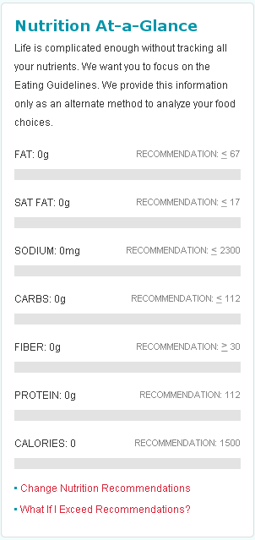
Daily Nutrition in dashboard
Nutrient List order is in new design on dashboard, not on right rail...
CALORIES
FAT
SAT FAT
CHOLESTEROL
SODIUM
CARB
FIBER
PROTEIN

Slide 4
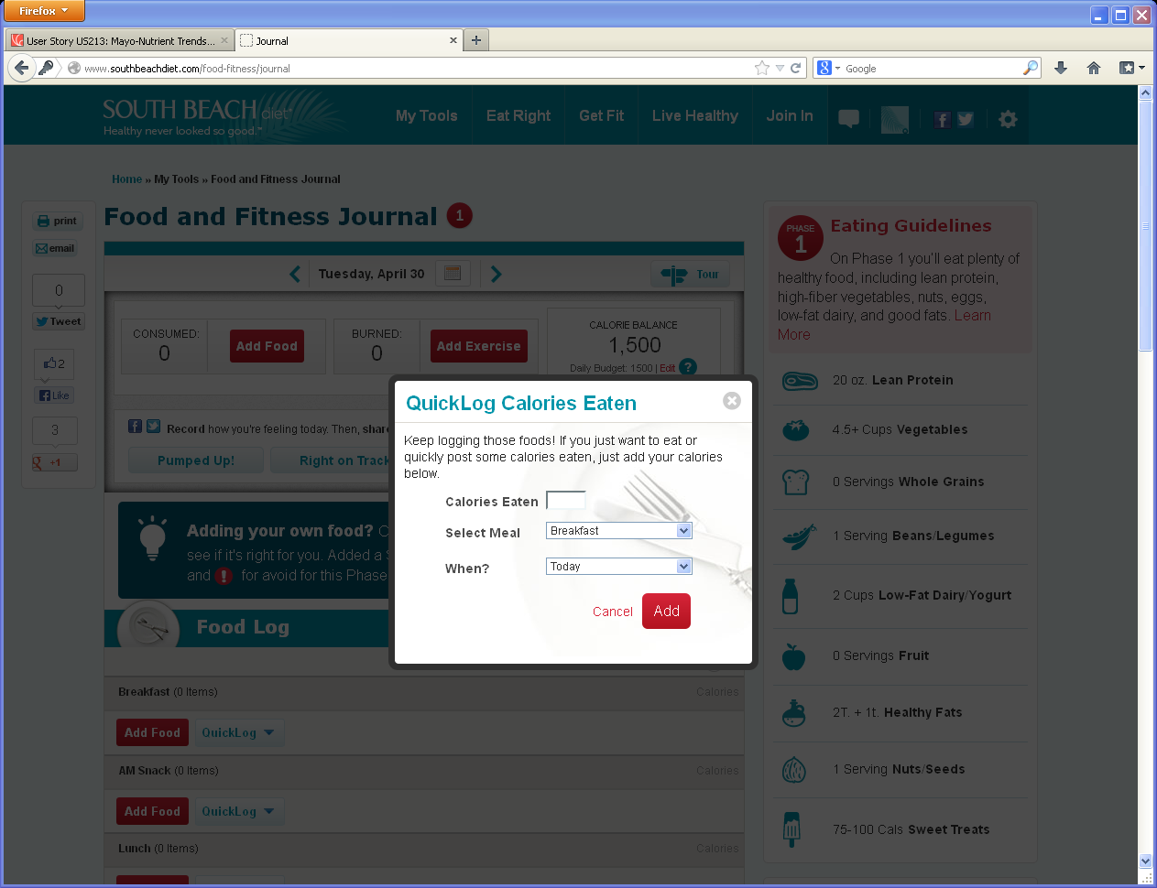
Quick Log-change
Change QuickLog to Quick Log (add space) for Calories Eaten and Calories Burned
See new design
All functionality remains-copy meal, calories eaten

Slide 5
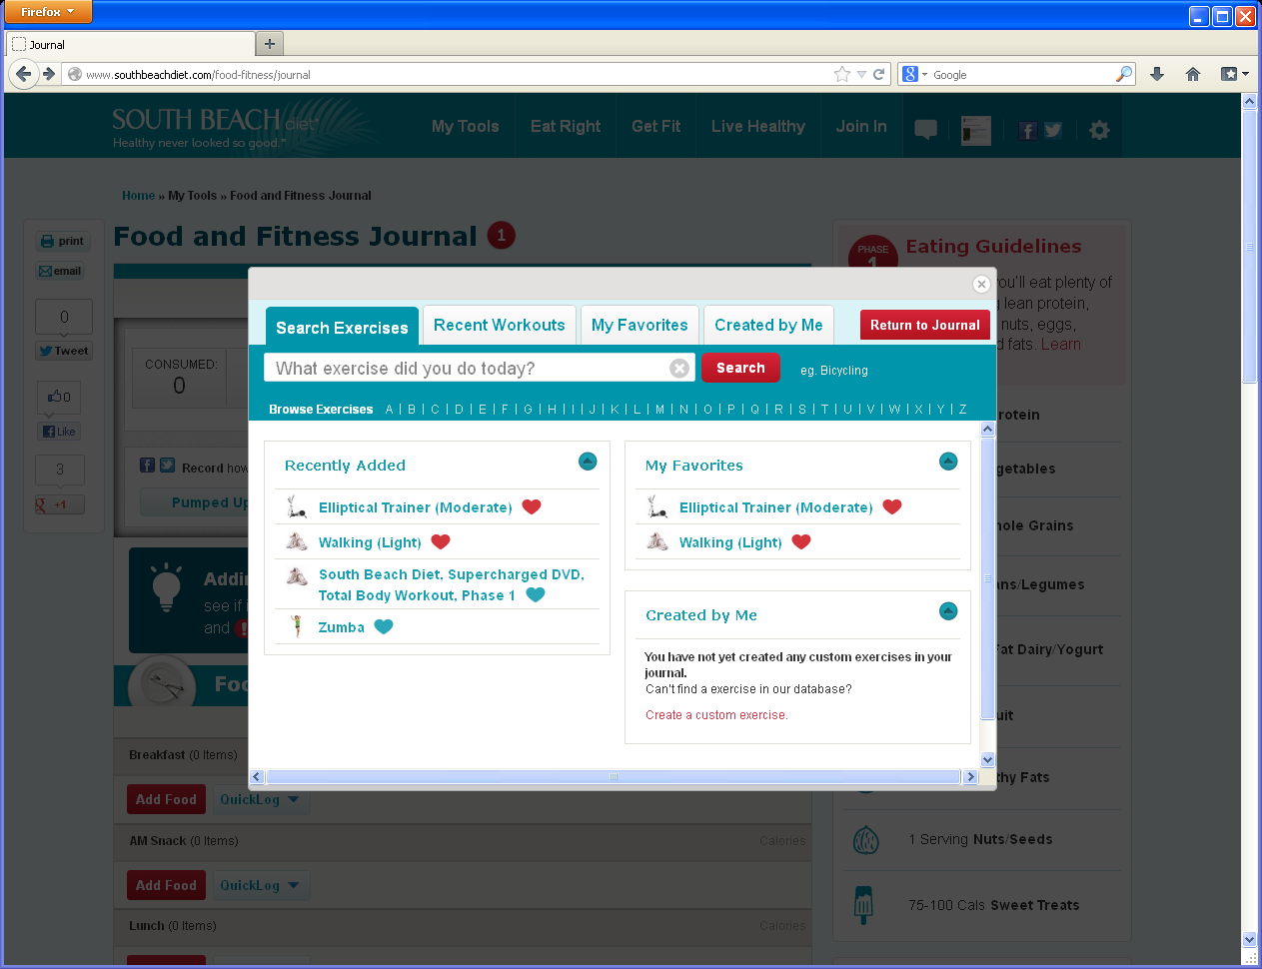
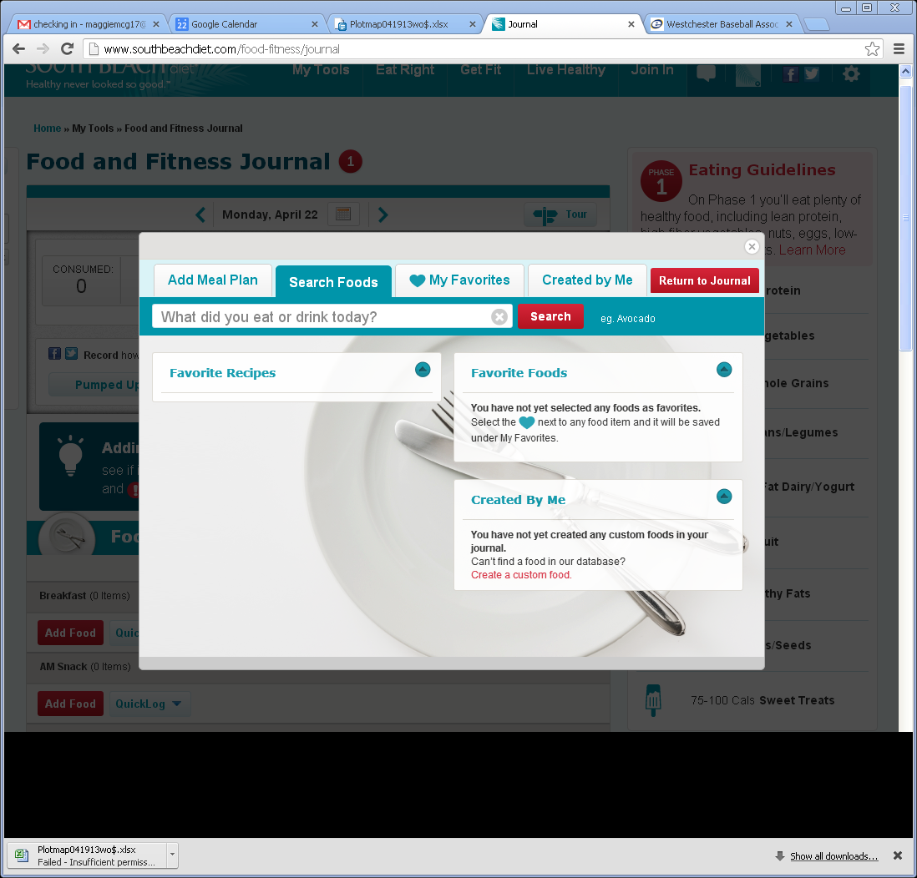
Search Exercise and Search Foods Modal tab
Exercise
1
Change copy to What exercise did you do?
Remove Return to Journal
Remove Exercise icons
2
1
2
3
3
Food
Change copy to What did you eat or drink?
Remove Return to Journal
Switch Add Meal Plan and Search Foods
Remove Food/Recipe icons
1
3
2
2
1
Same functionality
4
3
4

Slide 6
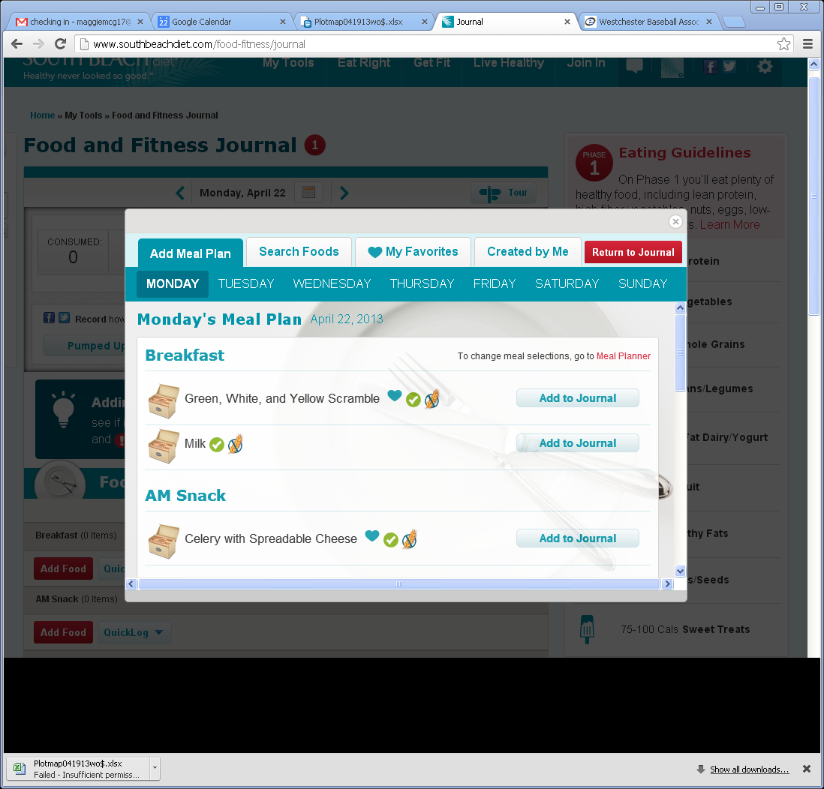
Journal- Add Meal plan tab-Removals
1
Remove All Gluten icons and ! and √on all tab views.
2
Remove Gluten icons
3
3
Remove days of wk and insert Wednesday, April 24 with arrow- see new design for reference
Remove Recipe icons
4
1
2
4

Slide 7
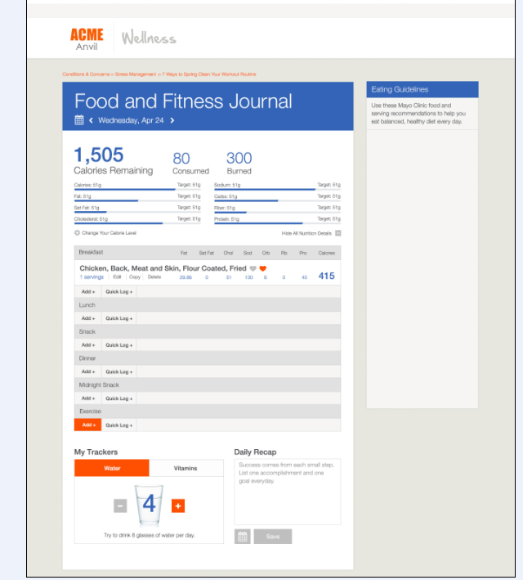
New Journal
Placement of nutrition tracker is in dashboard with new layout. Change your Calorie Level links to settings.
New layout for Calories Remaining, Consumed and Burned.
Add Food and Add Exercise buttons now highlight when user hovers over them.
Daily Recap- Same functionality for input, Save, but added calendar for input into past dates up to X? New copy as default text in box.
My Trackers- 2 tabs, Water and Vitamins, with + and - for adding or subtracting amounts. Same functionality as SBD. No copy under Vitamins

