Slide 1
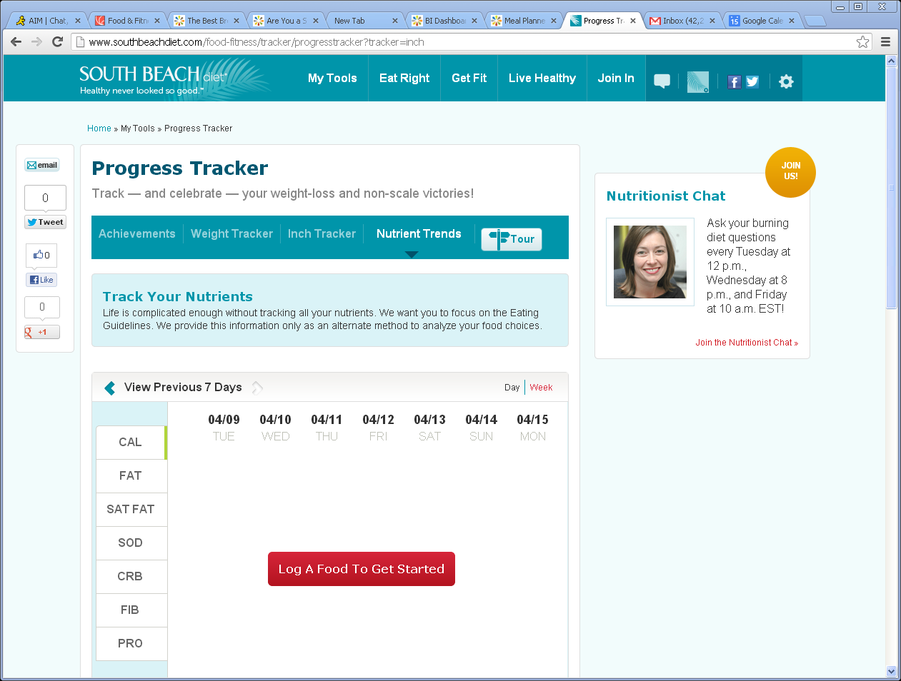
Nutrition Tracker Week view-changes
1
Remove Sub nav including Tour
Remove social shares in left nav, including email
Remove Nutrition Chat in Right nav and insert standard Mayo right rail
Change Progress Tracker to Nutrition Tracker
Remove copy under Progress Tracker and Track your Nutrients copy in blue
Bread Crumb should read Nutrient Trends
2
3
Nutrient Trends
6
Nutrition Tracker
4
4
5
1
3
5
5
2
6
7
7
Add CHOL between SAT FAT and SODIUM- see new design

Slide 2
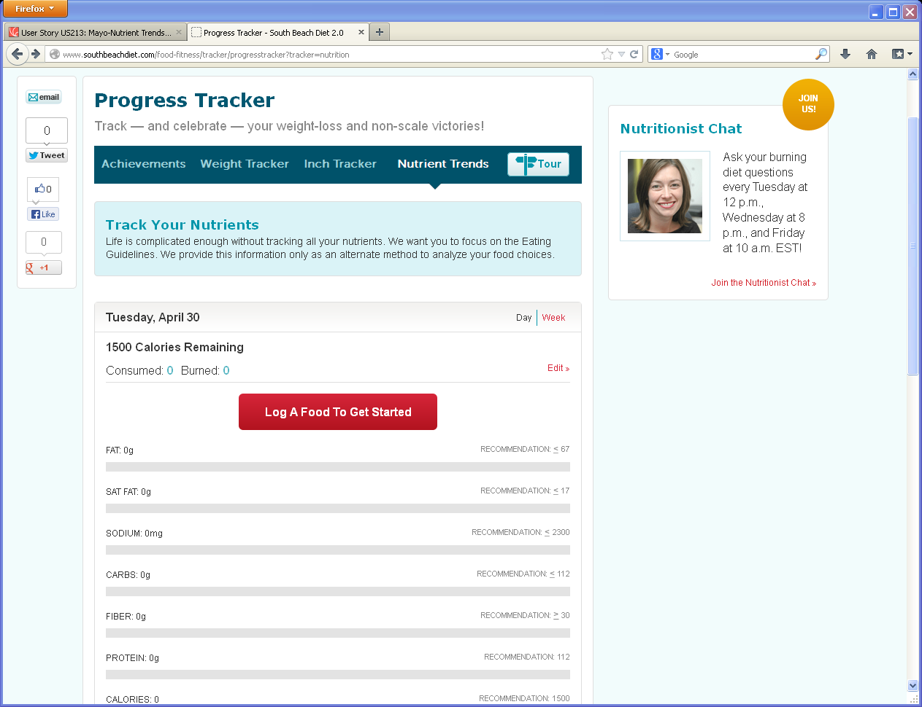
Nutrition Tracker Day view-Remove/changes
1
Remove Sub nav including Tour
Remove social shares in left nav, keep email
Remove Nutrition Chat in Right nav and insert standard Mayo right rail
Change Progress Tracker to Nutrient Trends
Remove copy under Progress Tracker and Track you Nutrients in blue box
Bread Crumb should read Nutrient Trends
7
2
Nutrient Trends
Same list of Nutrients, but add CHOL between SAT FAT and SODIUM
4
6
5
1
3
3
5
4
2
5
6
7

