Slide 1
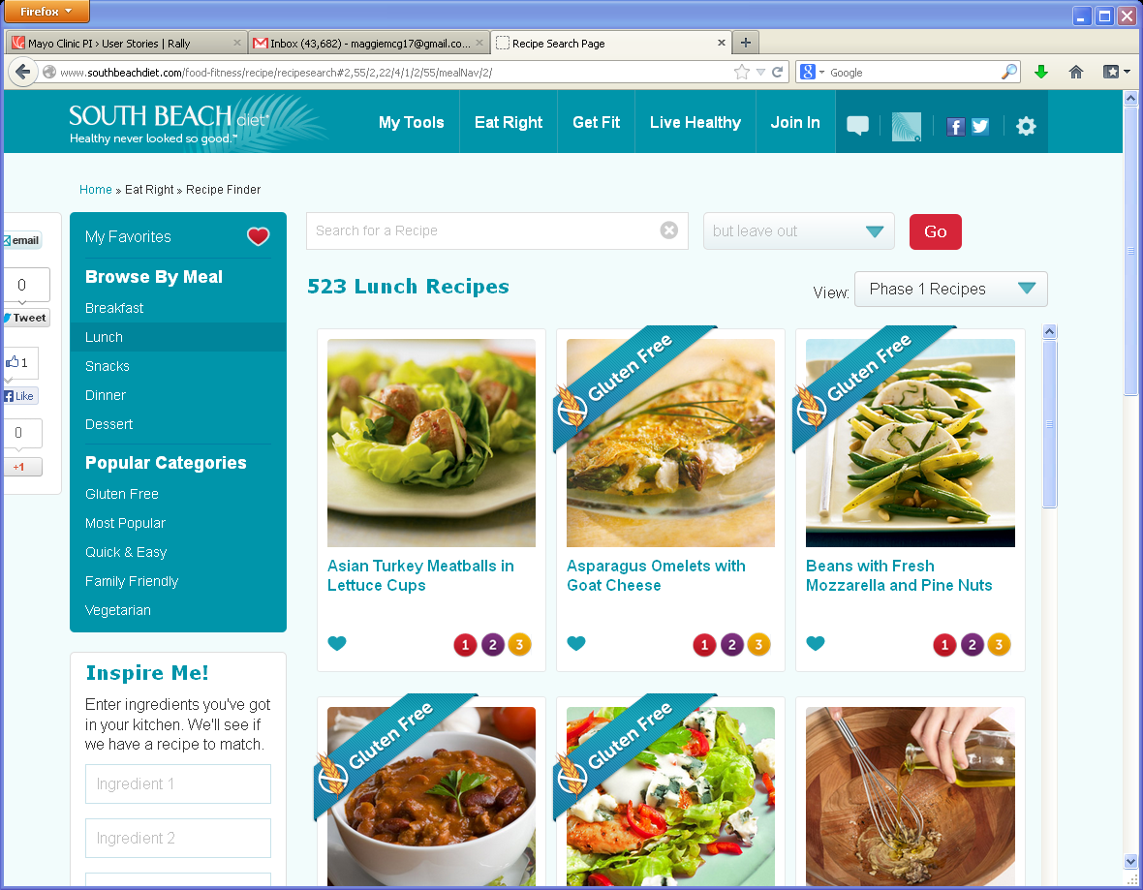
Recipe Finder
1
Remove Shares on left
2
1
3
2
Remove View: Phase filters
3
3
Remove Gluten ribbons &
Phase icons
4
4
Remove Fave Heart icons, replace with Stars

