Slide 1
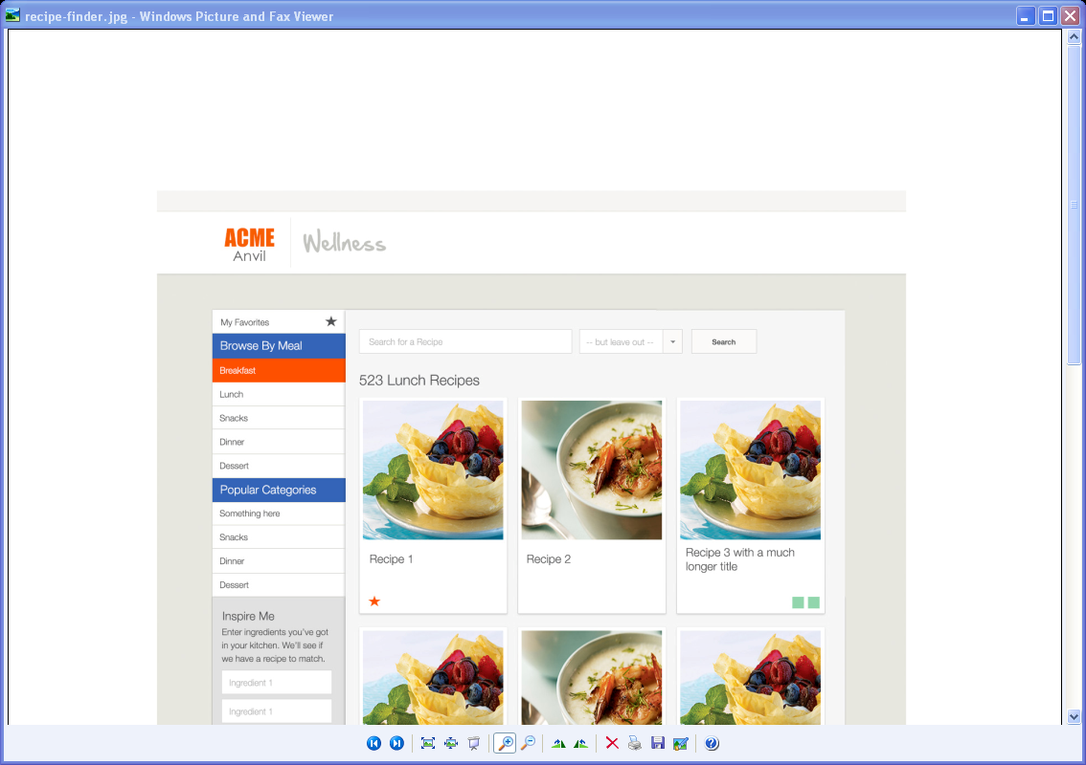
Recipe Finder
4
1
2
3

