Slide 1
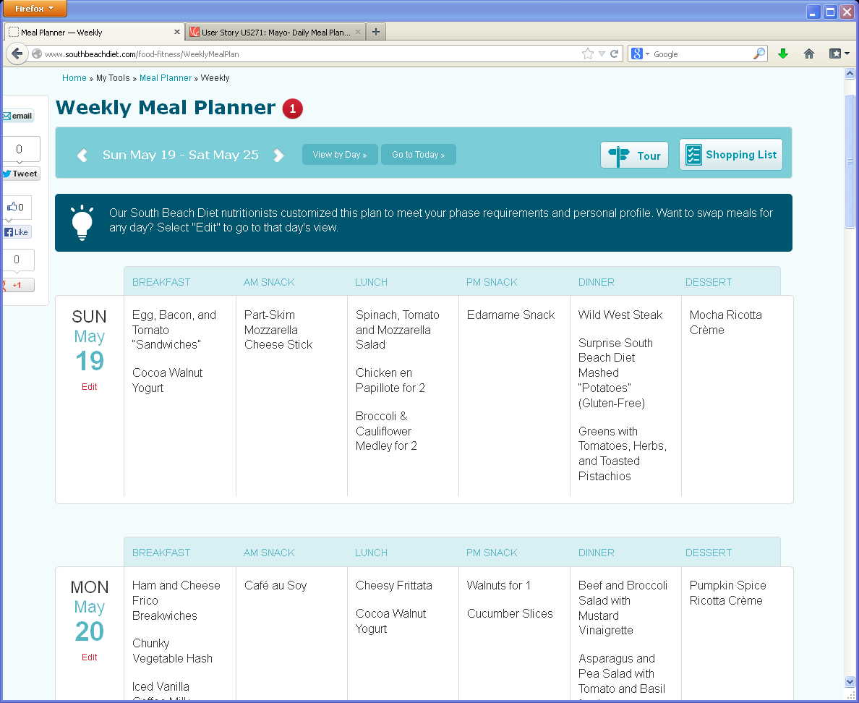
Weekly Meal Plan-same functionality as SBD
1
Remove Shares on left
2
2
1
3
5
Remove Phase icon
4
3
Remove Tour icon
4
Remove blue box message
5
Note: shopping list wil display upon clicking just as on SBD

