Slide 1
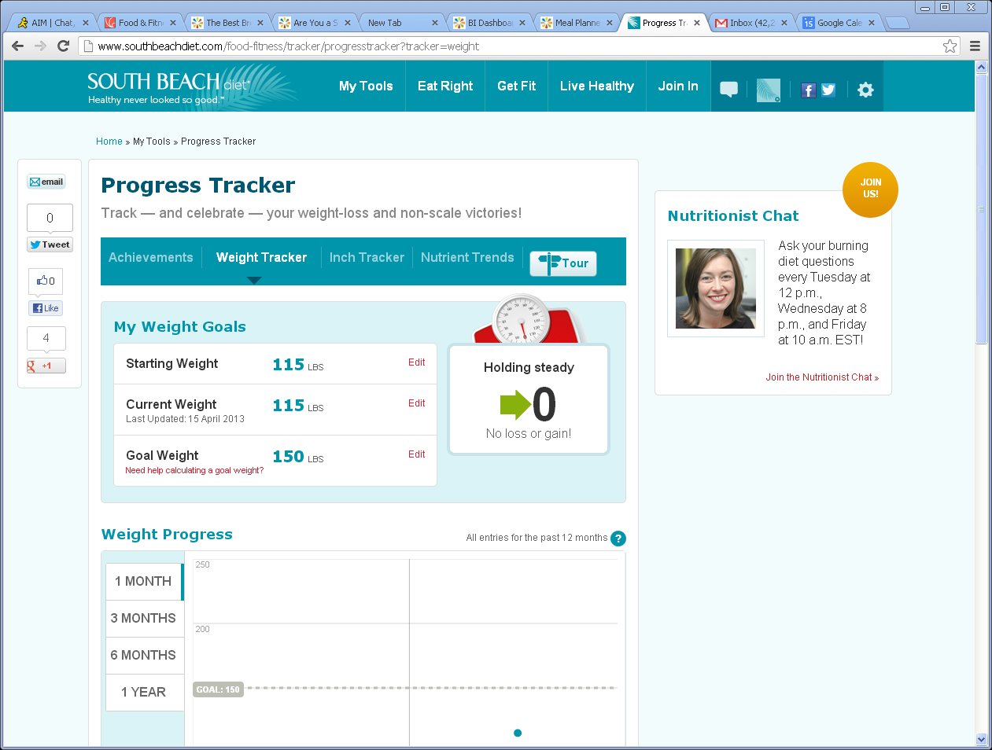
Weight Tracker changes-remove social shares, nutrition chat, tour and sub nav
1
Remove Sub nav including Tour
Remove social shares in left nav, including emai
Remove Nutrition Chat in Right nav and insert standard right rail
Change Progress to say Weight Tracker
Remove copy under Weight Tracker
Bread Crumb should read Weight Tracker, not Progress Tracker
2
6
Weight
4
5
3
2
1
3
8
8
4
8
7
5
6
7
Remove ?, just have text and no flyout
8
Remove header My Weight Goals, Weight Progress and scale, see new design

Slide 2
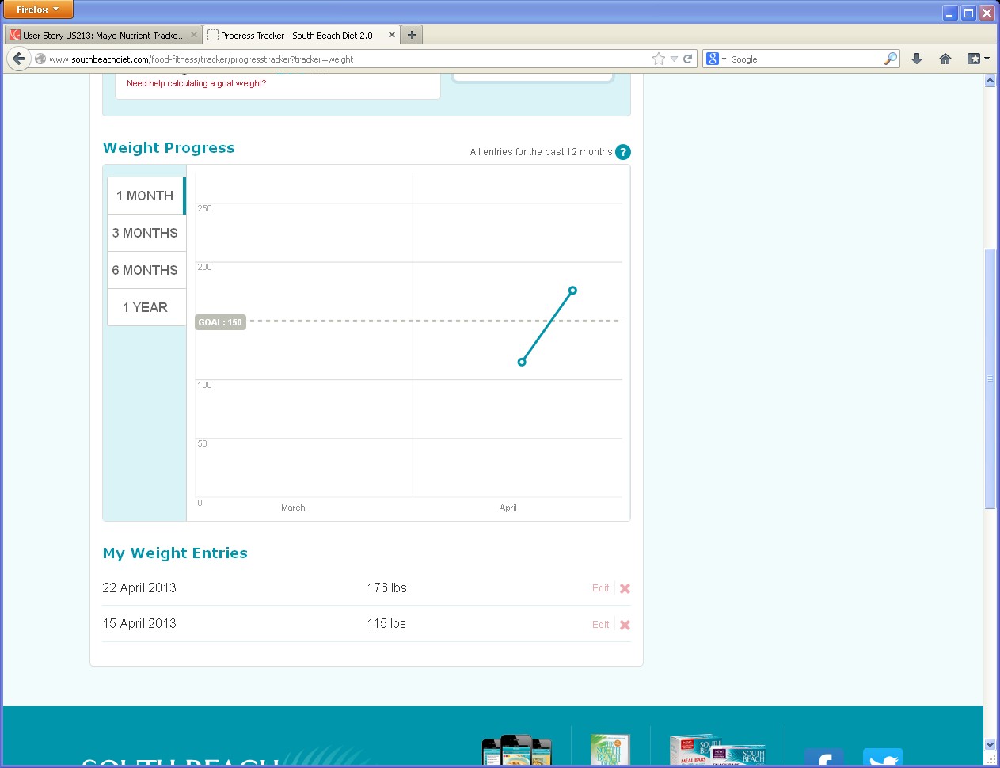
Weight Tracker history-change
Change date to read:
April 22, 2013

Slide 3
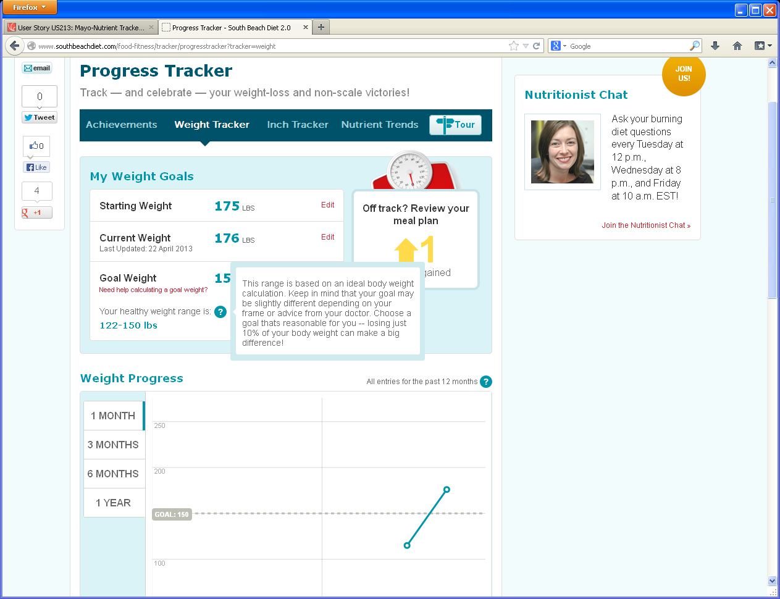
My Weight Goals
New copy from Maureen TBD for BMI

