Slide 1
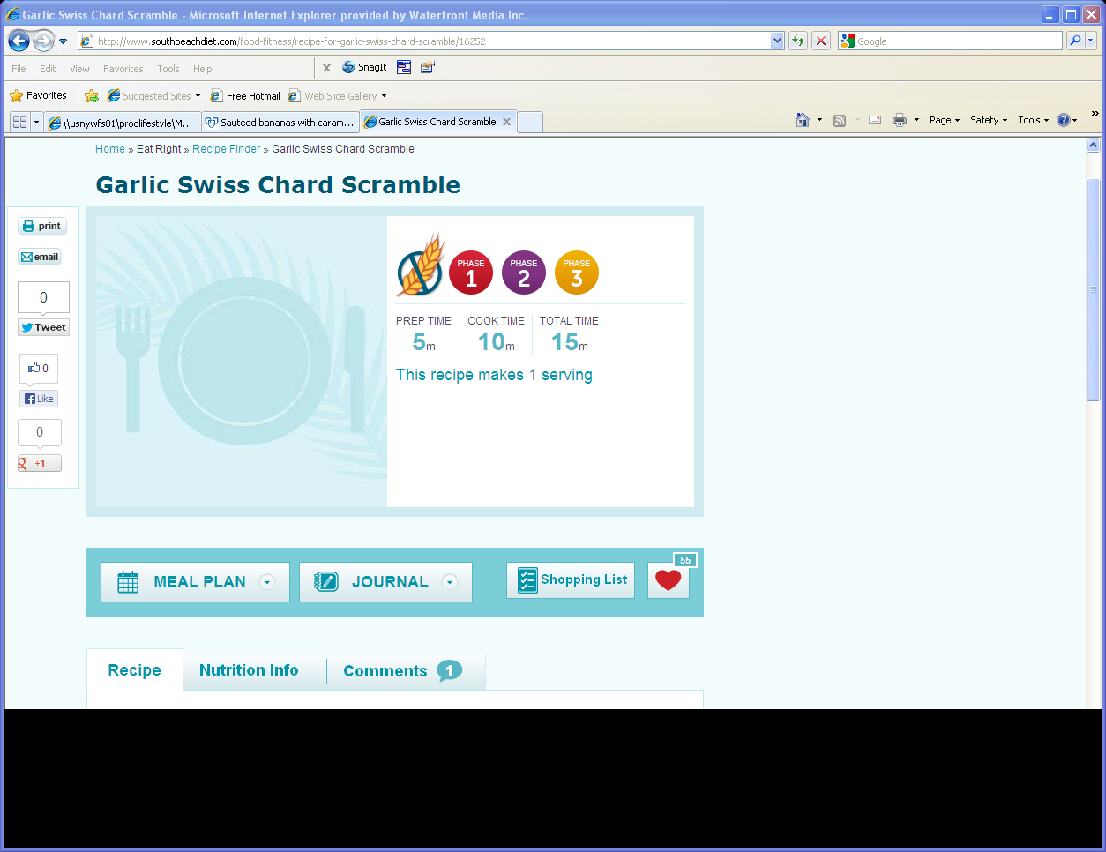
Recipe Detail Page
Remove social share on left nav
1
2
Remove phase icons
3
Remove Prep, Cook and Total time
4
Change to Star
2
1
See new design for new layout and elements on right side of image-nutrients display, etc.
3
5
5
4
7
Change heart (fave) icon to star (see new design)
6
6
Remove tab and display recipe-see new design
7
Print icon here-see new design

