Slide 1
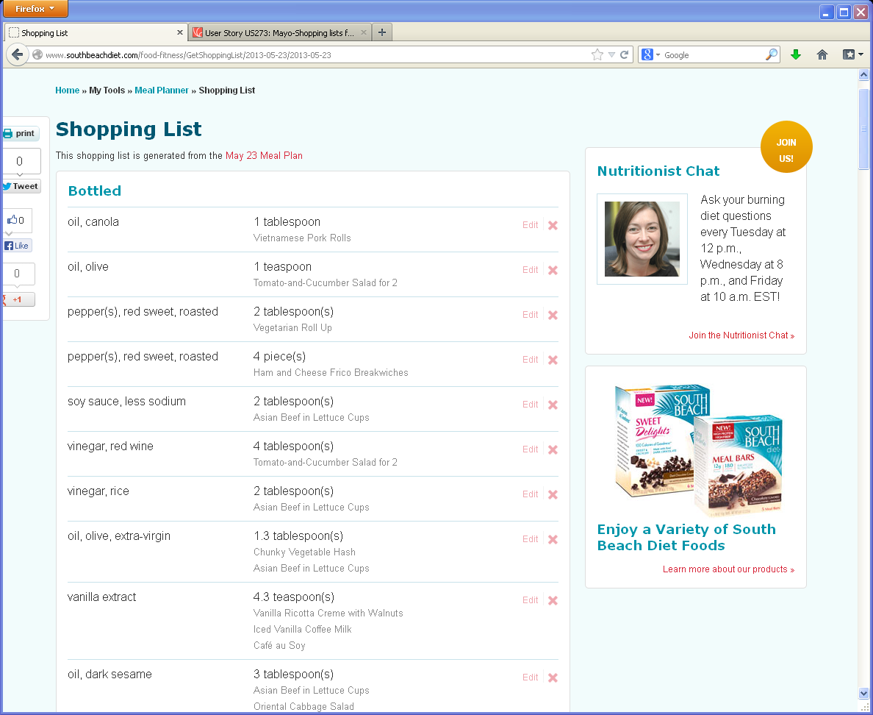
Daily Meal Plan Shopping list
1
Remove Shares on left and move print icon (see new icon and placement on new design
3
4
1
2
2
Remove Nutritionist chat and SBD ad
3
Move Print icon-see new design
2
4
Date of Meal Plan should link back to that day’s meal plan

Slide 2
Recipe Detail Page Shopping list

Slide 3
Weekly MP Shopping list

