Slide 1

CREDIT CARD FRAUD DETECTION USING MACHINE LEARNING AND ANT COLONY OPTIMIZATION
TEAM MEMBERS
Sheik Vahida-17A81A0542
K.K.R Maruthi-17A81A0519
T. Sai Jahnavi-17A81A0547
V. Lakshmi Narayana-17A81A0554
Under the guidance of
Mr. S. Kumar Reddy Mallidi

Slide 2

ABSTRACT
Illegal use of credit card or it’s information without the knowledge of the owner is refer to as credit card fraud.
For credit card fraud detection, we are implementing ACO based wrapper.
ACO is used for feature selection and machine learning algorithms are used for creating a prediction model.

Slide 3
Project Timeline
Stage | Activity | Duration | Review
Problem Statement Identification | 1 Week | Review1
Literature Review | 1 Week
Data Collection | 1 Week
Design and Methodology | 1 Week
 | 1 Weeks | Review2
Testing and Implementation | 3 Weeks
Design Analysis | 2 Weeks
Documentation | 1 Week

Slide 4
LITERATURE SURVEY
To handle the implicit noise in the transaction dataset researchers have used naive bayes algorithm .
The analysis carried out on highly imbalanced data show that KNN shows outstanding performance for sensitivity , specificity and MCC except for accuracy.
Even though PCA is used extensively for feature selection. recent studies shows that implementing bio inspired optimization techniques gives better performance(like bat optimization ,firefly optimization technique used for feature selection and by combining machine learning, wrappers are created) .

Slide 5
OBJECTIVE
To create an ACO based wrapper for classifying credit card frauds in reduced features.
To join ACO with various machine learning algorithms and to compare their performances with respect to number of features selected and the efficiency of the prediction models.

Slide 6
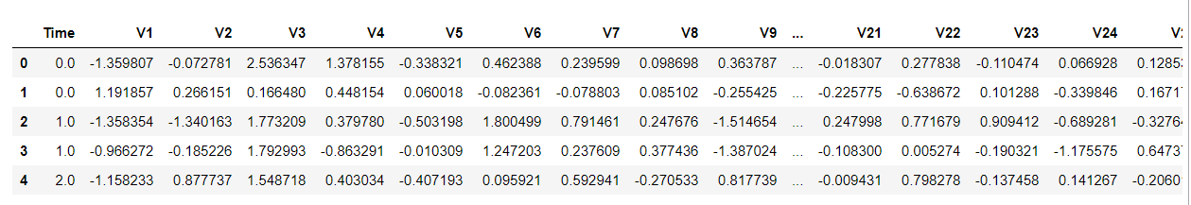
DATASET
We are using existing credit card fraud dataset
The dataset contains approximately 10k genuine transactions and 492 fraud transactions.

Slide 7
INTRODUCTION:MACHINE LEARNING
Machine learning is the study of computer algorithms that improves automatically through experience and by use of data.
Machine learning is mainly classified into two types
-Supervised learning
-Unsupervised learning
CLASSIFICATION
Classification is supervised learning technique that is used to identify the category of new observations on the basis of training data.

Slide 8
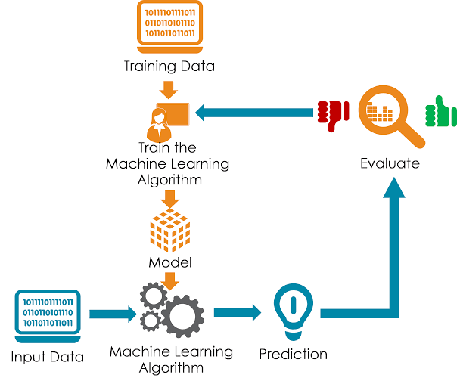

Slide 9
Introduction: Feature Selection
ML models created with data sets with unwanted and redundant features tend to be complex and gives less performance. This is called curse of dimensionality.
Majority of existing works in machine learning used PCA for feature selection.
But now a days, researchers started using Bio-inspired optimization techniques for feature selection as they give better performance than PCA techniques.
ACO is combined with machine learning to create a wrapper with reduced feature set for malware detection.
Bat optimization with machine learning to create a wrapper for android malware detection.

Slide 10
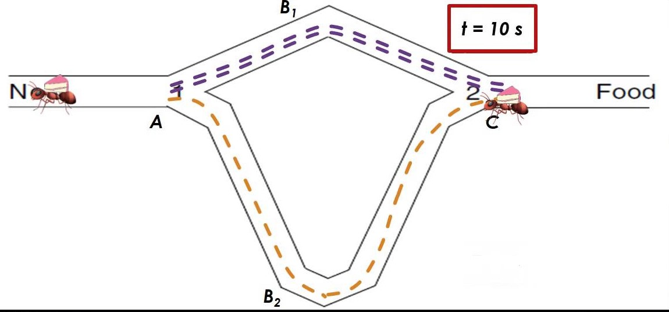
INTRODUCTION:ANT COLONY OPTIMIZATION
Ant colony optimization based on the foraging behaviour of an ant for seeking a path between their colony and source food. it is used for solving different hard optimization problems.
Ants converges to the shortest path from the colony to food based on pheromone deposits as the time goes.
ACO is mainly used for route optimization. Later ACO is also been used in other types of optimization problems including feature selection.

Slide 11
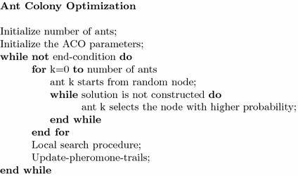
INTRODUCTION: ANT COLONY OPTIMIZATION
Algorithm: ACO for Feature Selection

Slide 12

Proposed Approach
Many researches shows that ACO gives better performance other feature selection approaches.
Hence, Our proposed approach combines ant colony optimization and machine learning to create a wrapper for credit card fraud detection with reduced feature set.

Slide 13
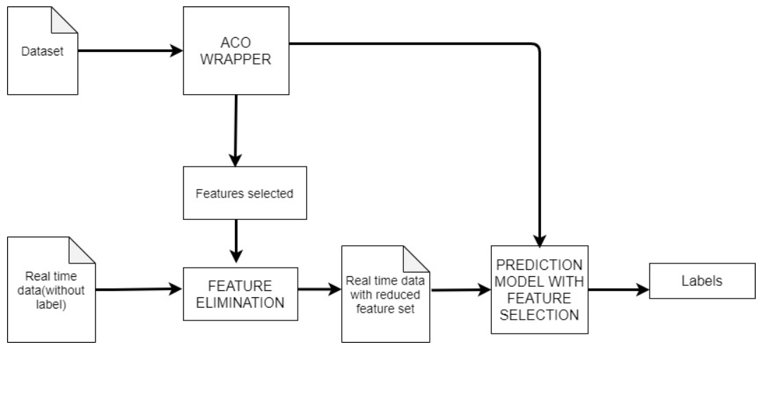

Slide 14
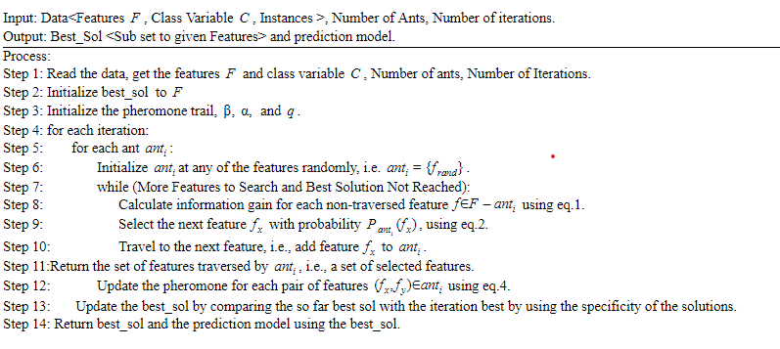
ACO Wrapper

Slide 15
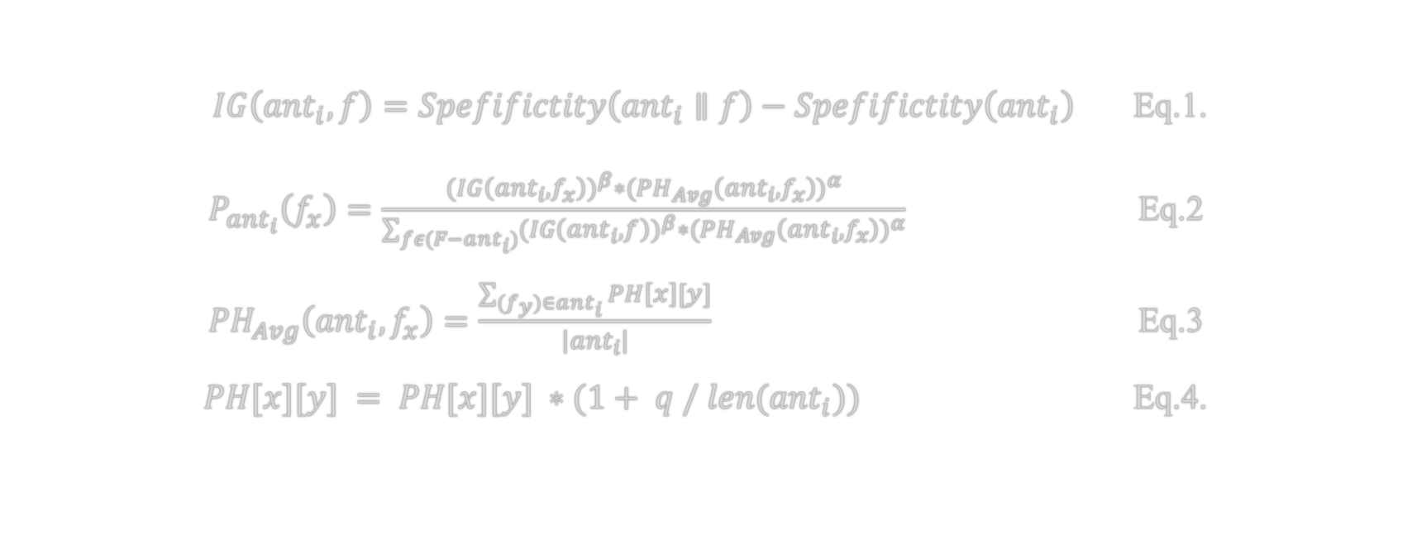
ACO Wrapper
$IG\left({ant}_{i},f\right)=Spefifictity\left({ant}_{i}∥f\right)−Spefifictity\left({ant}_{i}\right)$ Eq.1.
$P_{{ant}_{i}}\left(f_{x}\right)=\frac{(IG{\left({ant}_{i},f_{x}\right))}^{β}∗{(PH}_{Avg}{\left({ant}_{i},f_{x}\right))}^{α}}{\sum_{fε(F−{ant}_{i})}{(IG{\left({ant}_{i},f\right))}^{β}∗{(PH}_{Avg}{\left({ant}_{i},f_{x}\right))}^{α}}}$ Eq.2
${PH}_{Avg}\left({ant}_{i},f_{x}\right)=\frac{\sum_{(f_{y})∈{ant}_{i}}{PH\left[x\right][y]}}{\left|{ant}_{i}\right|}$ Eq.3
$PH[x][y] = PH[x][y] ∗(1+ q / len({ant}_{i}))$ Eq.4.

Slide 16
Result Analysis: Dataset Description
Dataset | Number of features | Number of records | Number of Negative classes
Credit card | 29 | 10000 | 492
Heart | 14 | 1025 | 526
Phishing | 32 | 11054 | 6157

Slide 17
Result Analysis: Heart Dataset*
Algorithm | N | N_{FS} | %FS* | S* | S_{FS}* | D_{S}* | PT* | PT_{FS}* | DF_{T}*
Logistic Regression | 14 | 4 | 21.42 | 88% | 93% | +5% | 0.431 | 0.31 | -0.121
XGBoost | 14 | 9.5 | 64.28 | 94% | 99% | +5% | 0.665 | 0.434 | -0.231
K-Nearest Neighbours | 14 | 4 | 21.42 | 97% | 100% | +3% | 0.414 | 0.301 | -0.113
* : Average of ten iteration
N : Number of Features in the Actual Dataset
N_{FS} : Number of Features selected by ACO Wrapper
%FS : Percentage of Features selected by ACO Wrapper
S : Specificity of the prediction model built using all features
S_{FS} : Specificity of the prediction model built using features selected
D_{S} : Difference in Specificity with full and reduced feature set
PT : Time taken by the prediction process on test data with all features
PT_{FS} : Time taken by the prediction process on test data with selected features
DF_{T} : Difference in time taken by prediction process on test data with all and selected Features

Slide 18
Result Analysis: Phishing dataset*
Algorithm | N | N_{FS} | %FS* | S* | S_{FS}* | D_{S}* | PT* | PT_{FS}* | DF_{T}*
Logistic Regression | 32 | 3.5 | 6.25 | 93% | 99% | +7% | 3.592 | 0.402 | -3.19
XGBoost | 32 | 3 | 9.37 | 91% | 97% | +7% | 3.248 | 1.325 | -1.96
K-Nearest Neighbours | 32 | 5 | 15.6 | 93% | 98% | +6% | 4.063 | 2.114 | -1.95
* : Average of ten iteration
N : Number of Features in the Actual Dataset
N_{FS} : Number of Features selected by ACO Wrapper
%FS : Percentage of Features selected by ACO Wrapper
S : Specificity of the prediction model built using all features
S_{FS} : Specificity of the prediction model built using features selected
D_{S} : Difference in Specificity with full and reduced feature set
PT : Time taken by the prediction process on test data with all features
PT_{FS} : Time taken by the prediction process on test data with selected features
DF_{T} : Difference in time taken by prediction process on test data with all and selected Features

Slide 19
Result Analysis: Credit Card Dataset*
Algorithm | N | N_{FS} | %FS* | S* | S_{FS}* | D_{S}* | PT* | PT_{FS}* | DF_{T}*
Logistic Regression | 29 | 5 | 17.8 | 94% | 96% | +2% | 3.067 | 1.266 | -2.34
XGBoost | 29 | 8 | 27.5 | 76% | 87% | +11% | 6.915 | 1.739 | -5.175
K-Nearest Neighbours | 29 | 12 | 42 | 75% | 91% | +16% | 2.679 | 1.213 | -1.466
* : Average of ten iteration
N : Number of Features in the Actual Dataset
N_{FS} : Number of Features selected by ACO Wrapper
%FS : Percentage of Features selected by ACO Wrapper
S : Specificity of the prediction model built using all features
S_{FS} : Specificity of the prediction model built using features selected
D_{S} : Difference in Specificity with full and reduced feature set
PT : Time taken by the prediction process on test data with all features
PT_{FS} : Time taken by the prediction process on test data with selected features
DF_{T} : Difference in time taken by prediction process on test data with all and selected Features

Slide 20
Conclusion and future work
From the results, we have observed that the datasets with redundant and unnecessary features take more time and performs less while predicting. Hence we created an ant colony optimization(ACO)based wrapper to eliminate unnecessary features and to create a prediction model with the reduced feature set. Since ACO is population-based optimization approach, we have also observed that it can find out a global optimum solution without tending to any local optimum.
The results shows that the prediction model built with the selected reduced feature set perform the same or better than the model built using the full feature set that too in less time. Since the dataset being used are unbalanced, instead of using accuracy as a heuristic parameter, using specificity-based information gain as a heuristic parameter in ACO makes the feature selection process efficient. Since ACO is a time-consuming process, as a future work we are going to implement and test other population-based approaches for feature selection.

Slide 21
THANK YOU

