Slide 1
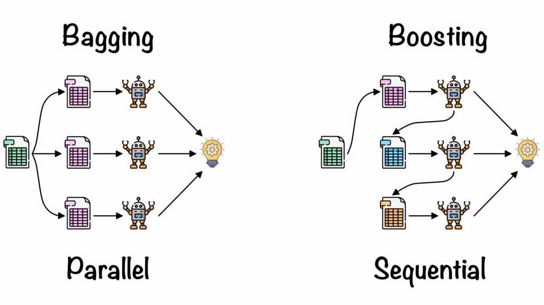
Bagging vs boosting

Slide 2
Bagging vs Boosting
Bagging and Boosting are two popular ensemble learning techniques.
Both aim to improve the performance of weak learners but they differ significantly in their approach and objectives.
Bagging involves training multiple models independently in parallel on different subsets of the data, created using random sampling with replacements
Boosting, on the other hand, trains models sequentially, where each new model focuses on correcting the errors of the previous ones.

Slide 3
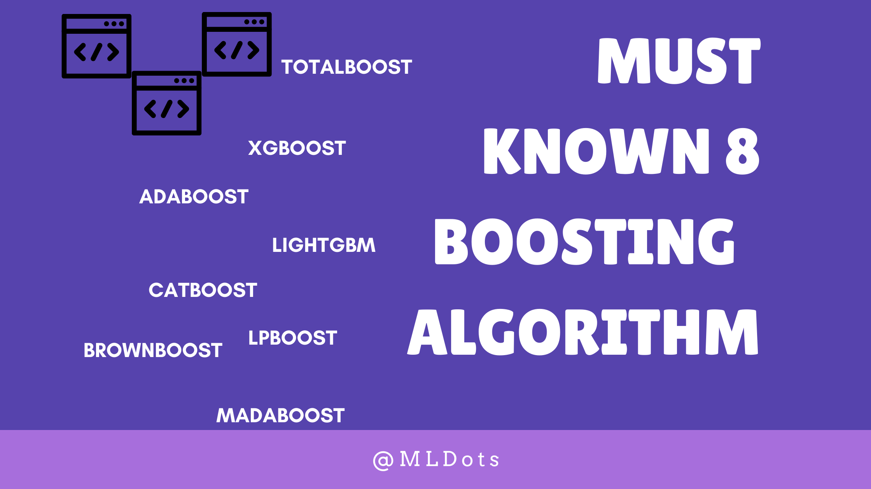
Types of Boosting

Slide 4
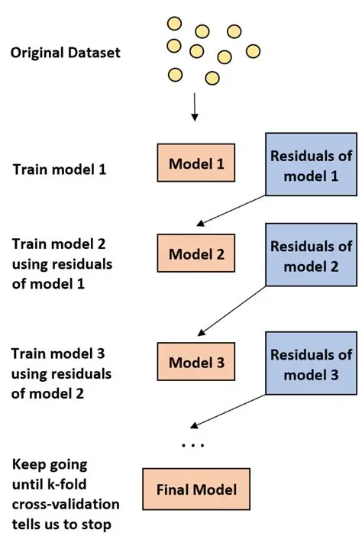
Ada boosting

Slide 5
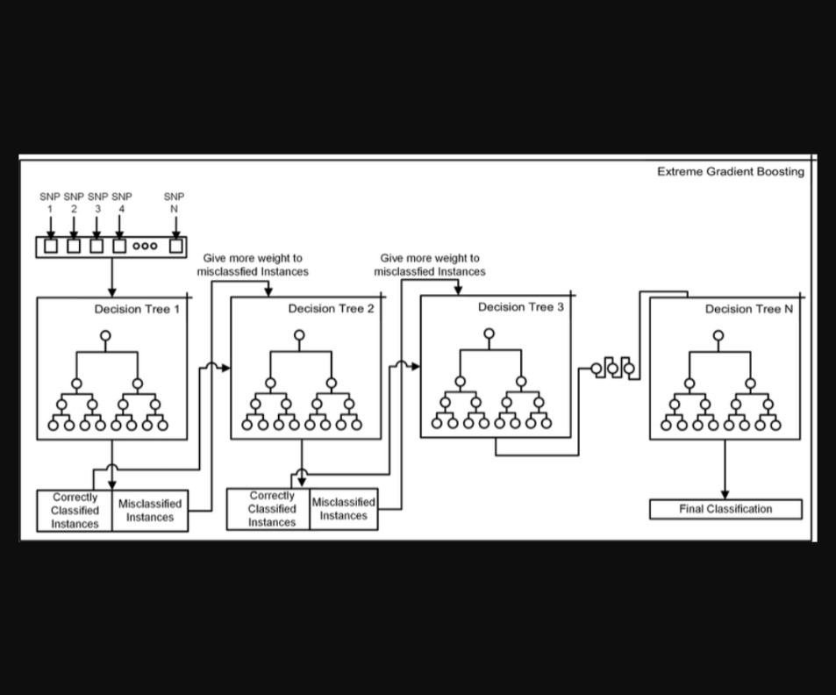
Xg boosting(extreme gradient)

Slide 6
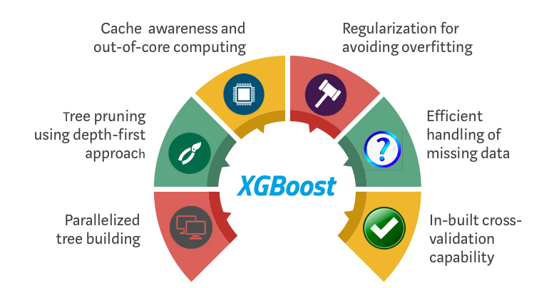
How XG BOOSTING Differs

Slide 7
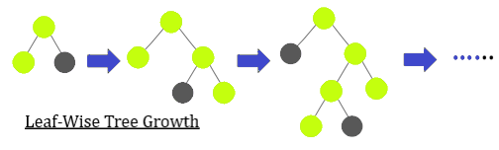
Light boosting

Slide 8
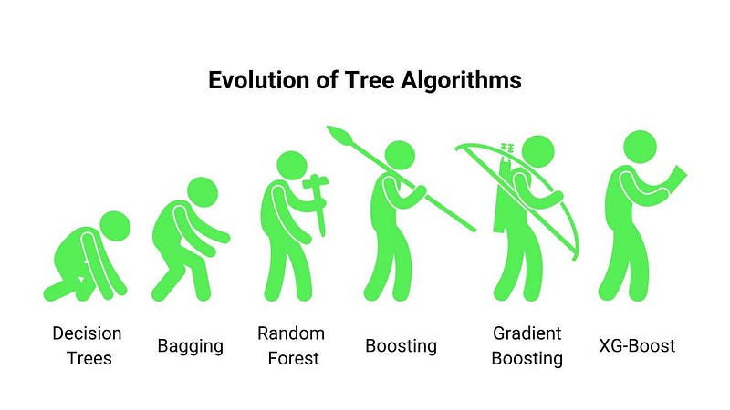
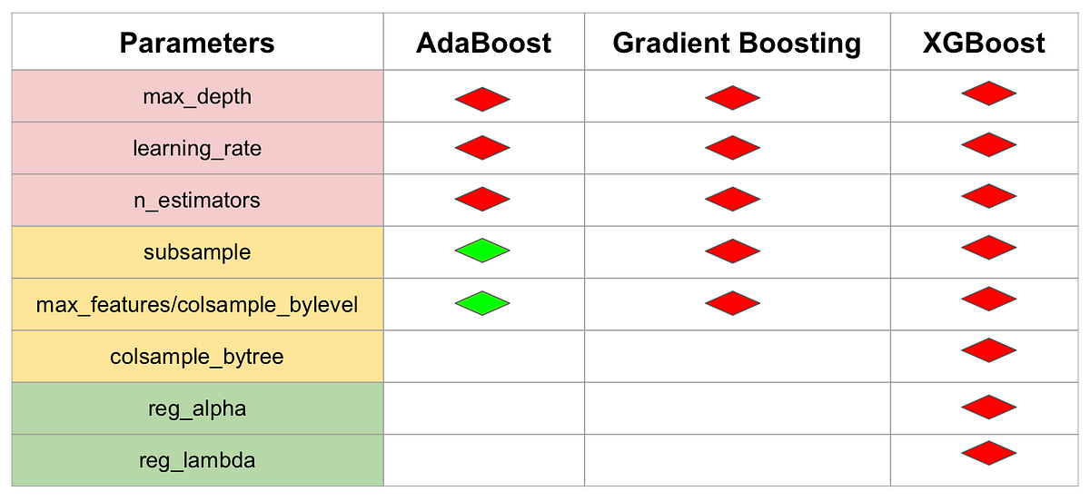
Why choosing XG BOOSTING

