Slide 1
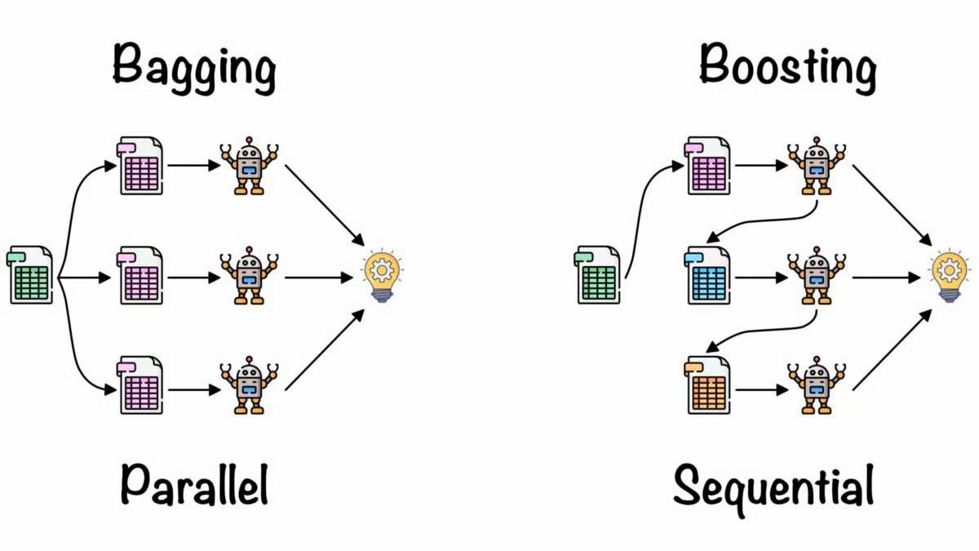
Bagging vs boosting

Slide 2
Bagging vs Boosting
Bagging and Boosting are two popular ensemble learning techniques.
Both aim to improve the performance of weak learners but they differ significantly in their approach and objectives.
Bagging involves training multiple models independently in parallel on different subsets of the data, created using random sampling with replacements
Boosting, on the other hand, trains models sequentially, where each new model focuses on correcting the errors of the previous ones.

Slide 3
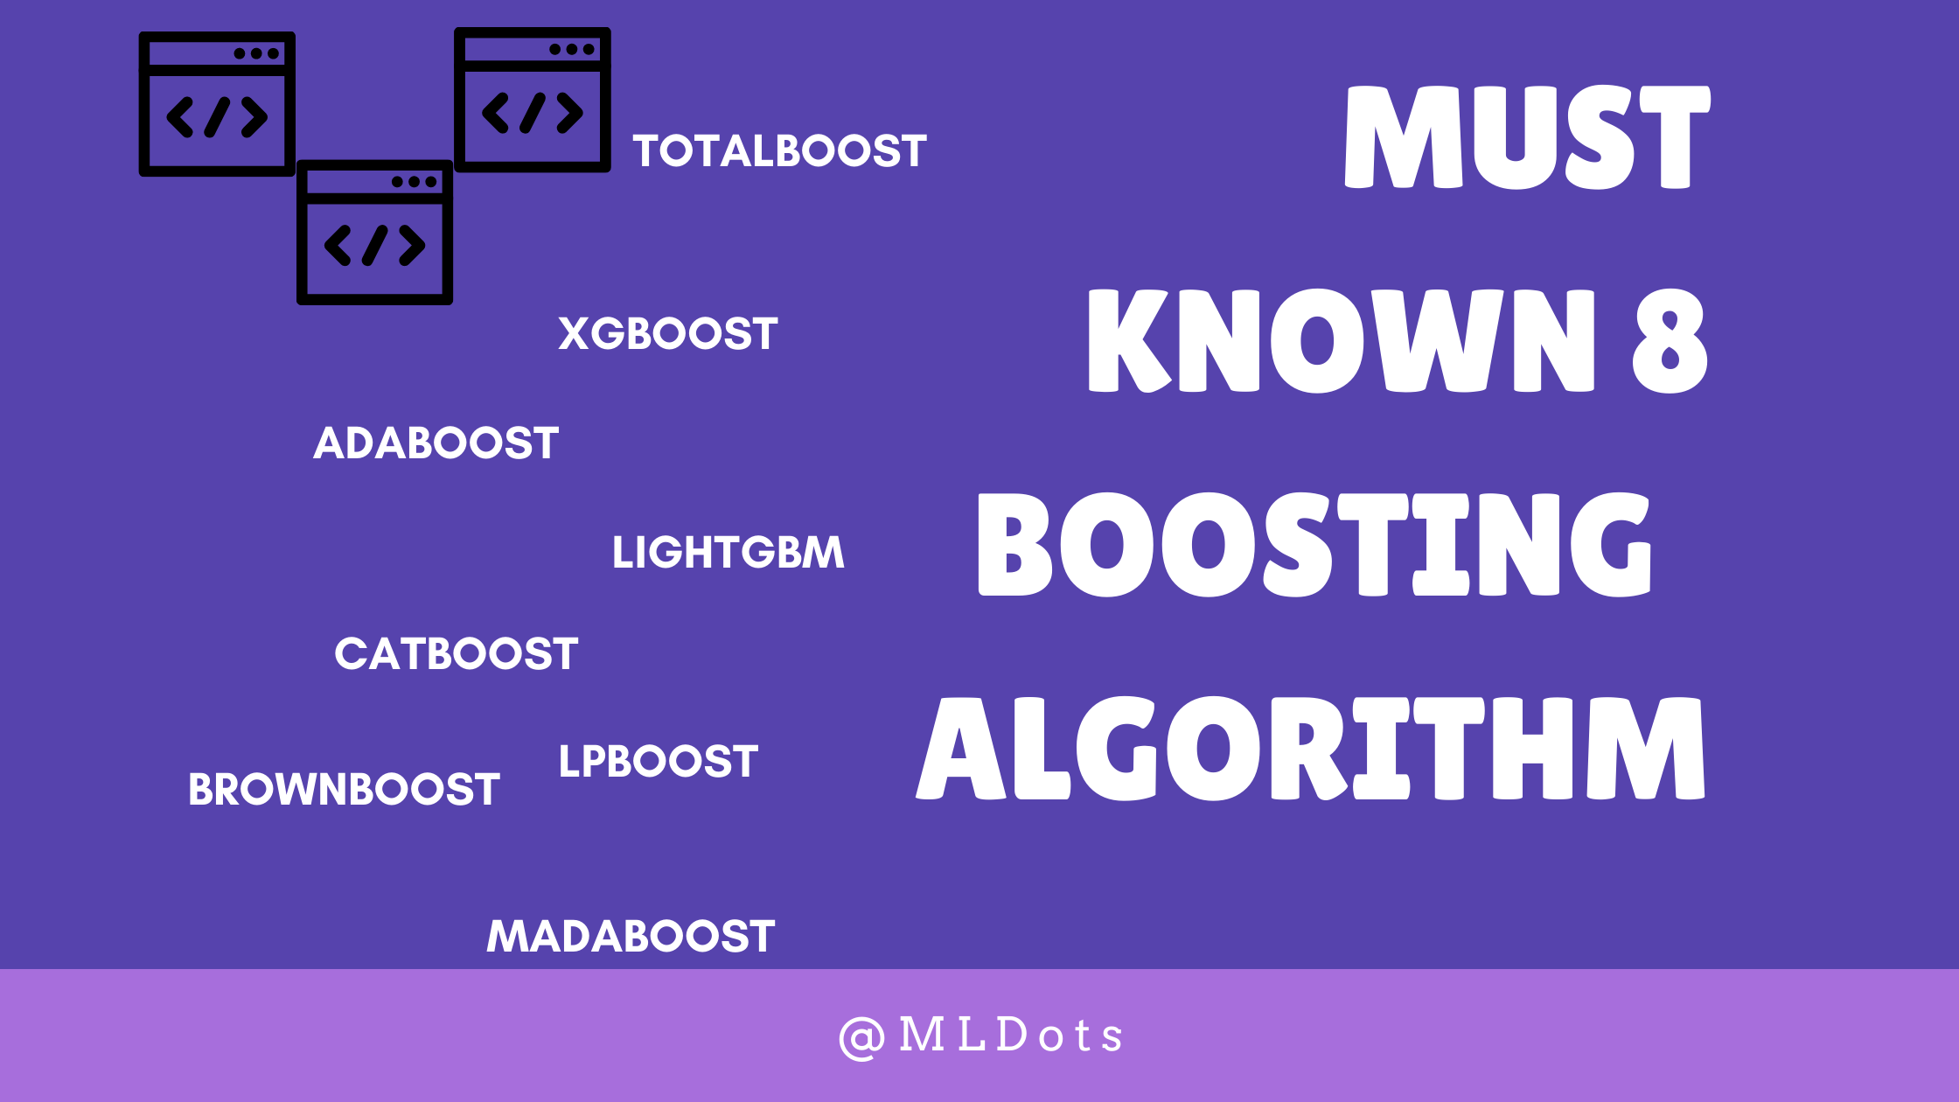
Types of Boosting

Slide 4
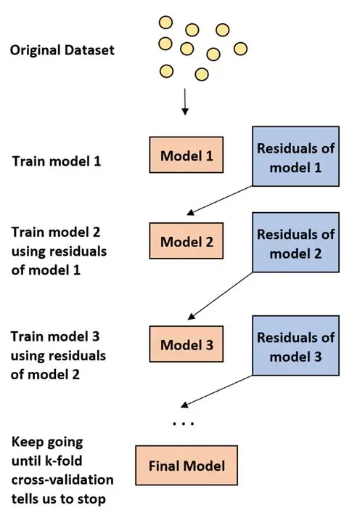
Ada boosting

Slide 5
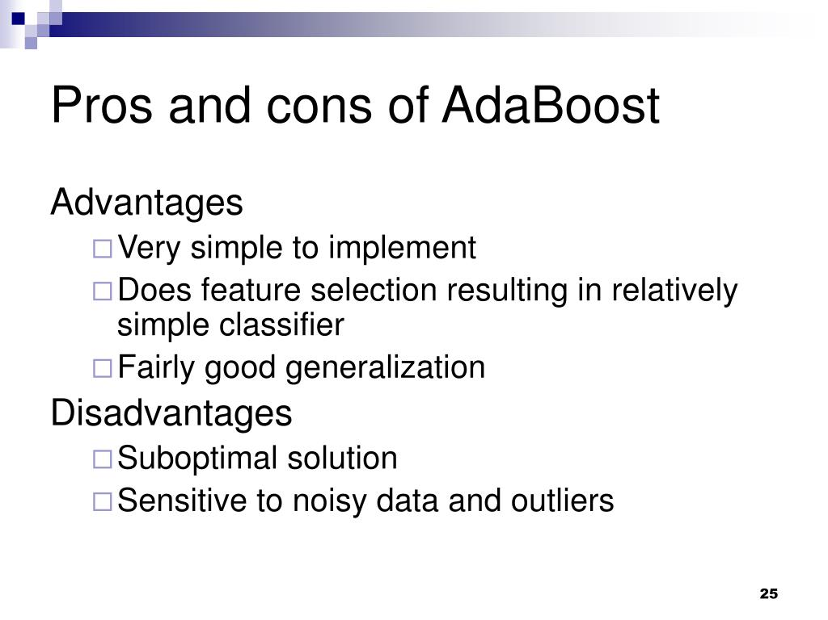

Slide 6
Real time applications
Object detection: It can be used in objects in real time images and videos.
Medical diagonosis: Ada boost can be used to diagnose diseases in real time medical images
Speech Recognition: It can be used to recognise speech in real time audio streams.

Slide 7
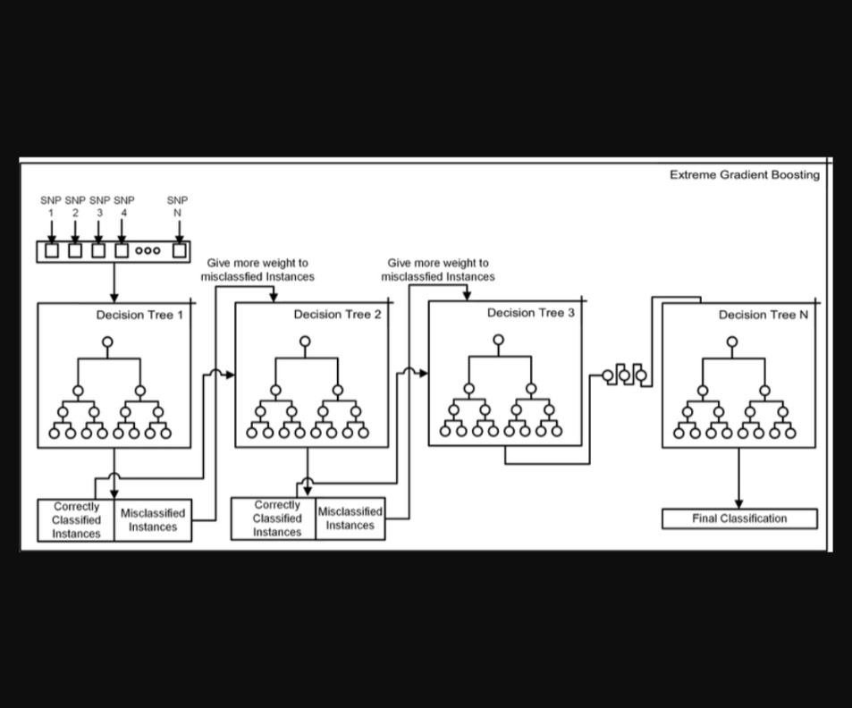
Xg boosting(extreme gradient)

Slide 8
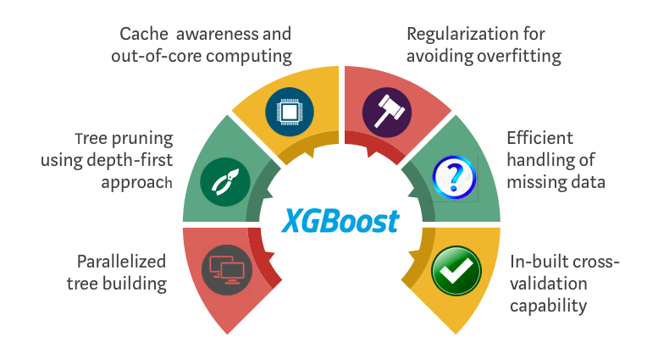
Advantages of XG boosting

Slide 9
May not be best choice XG-Why?
Sensitive to noisy datasets, which can affect its accuracy
May not work with small datsets,as it can overfit

Slide 10
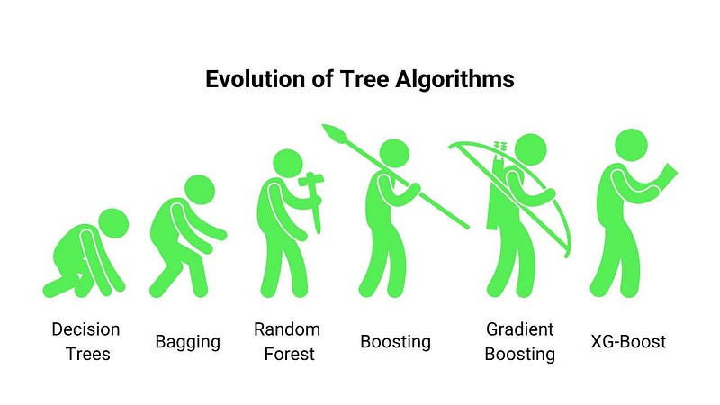
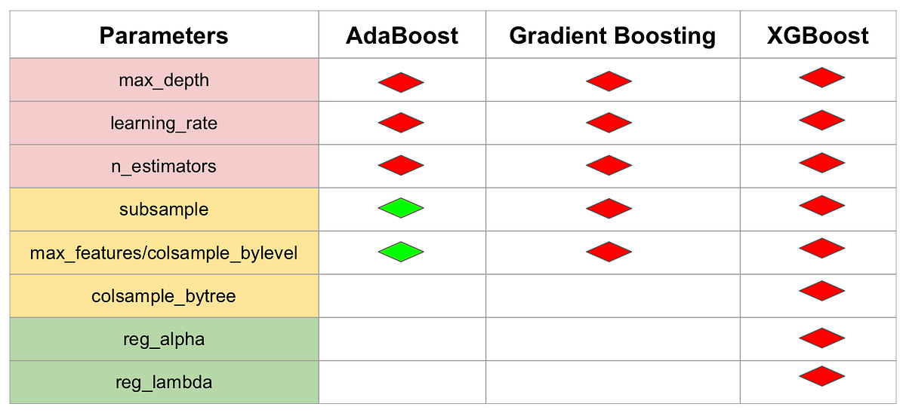
Why choosing XG BOOSTING

Slide 11
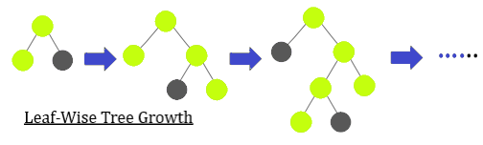
Light boosting

Slide 12
Why lightboosting….
It's designed for efficiency, scalability and high accuracy particularly with large datasets.
It uses decision trees that grow efficiently by minimizing memory usage and optimizing training time.

Slide 13
Limitations of Lightboosting
Can be very slow for small datasets
Needs careful tuning while sensitive to hyperparameters
Its mainly for classification problems limited in Regression

Slide 14
REAL TIME APPLICATIONS
XG BOOSTING
Fraud detections
Recommendation systems to suggest products to customers
LIGHT GRADIENT BOOSTING
Rainfall runoff prediction
Medical data prediction
Urban flood Prediction

