Slide 1
BDD100K Object Detection - Report
Bosch Global Software Tech - Applied CV Coding Assignment

Slide 2
Assignment
From understanding and analyzing a dataset building a model pipeline and deploying in a container evaluating and explaining said pipeline visualizing the performance both quantitatively and qualitatively

Slide 3
Dataset Description
The BDD100K dataset is a large-scale diverse driving dataset consisting of:
100,000 images captured from driving scenes.
Annotations for:
Bounding boxes for objects like car, bus, pedestrian, traffic light, etc.
Attributes like weather, time of day, and occlusion.

Slide 4
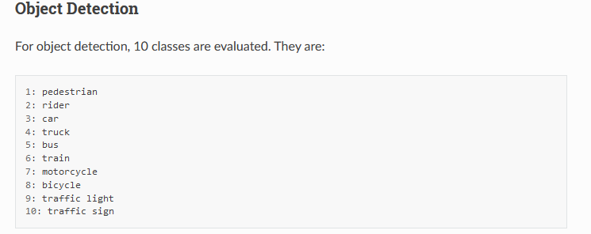

Slide 5
Data Analysis
The objective of this task is to perform a data analysis on the BDD dataset for object detection. The analysis will focus on the 10 detection classes with bounding boxes, such as light, signs, person, and car. Key tasks include:
Analyzing the distribution of training samples across object detection classes.
Examining the train and validation data splits (test set is not required).
Identifying any anomalies or patterns within each object detection class based on the analysis.
Identifying and visualizing unique or interesting samples from different classes.

Slide 6
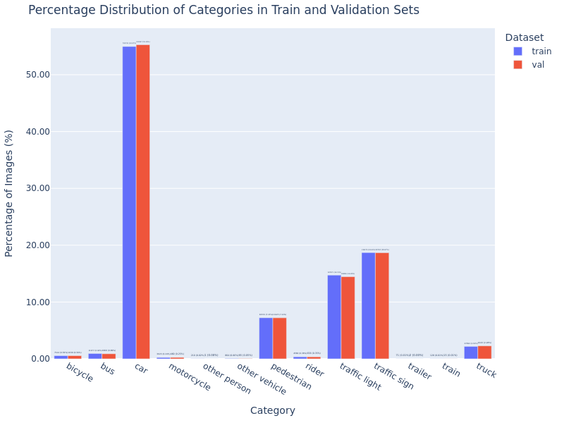

Slide 7
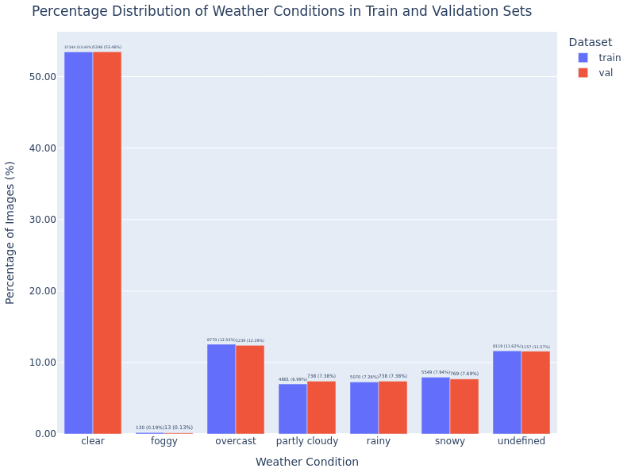

Slide 8
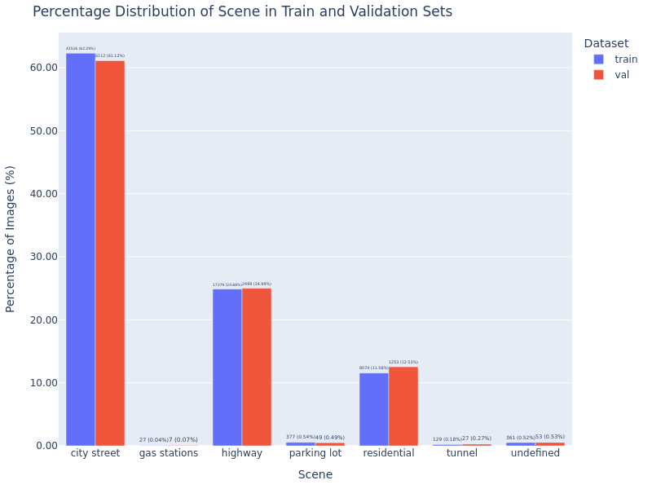

Slide 9
2. Model
In this stage, the goal is to choose and implement a model for object detection using the BDD dataset. We can either select a pre-trained model from the model zoo (specifically trained on the BDD dataset) or train your own model. The reasoning behind the choice of the model should be sound, and the model architecture must be explained clearly.

Slide 10
Model | YOLO V11
Variant | Small
Num Params | 9,417,831(9.4 million params)
Num Layers | 238

Slide 11
Why YOLO?
Speed (Real-time Performance)
YOLO: YOLO is a single-stage detector, meaning it directly predicts bounding boxes and class probabilities in a single pass. This enables it to be faster, making it well-suited for real-time applications like ADAS, where decisions need to be made instantly (e.g., detecting pedestrians or vehicles on the road).
Efficiency and Simplicity
YOLO: YOLO's single-stage approach is more efficient because it performs both classification and localization in one step, simplifying the architecture and reducing the complexity of the model. This results in lower computational overhead and faster inference, which is important for systems that need to run on embedded devices or in real-time.
Better Handling of Multiple Objects
YOLO: YOLO’s grid-based approach allows it to predict multiple objects per grid cell, effectively handling crowded scenes where multiple objects are close together or overlapping. This is particularly important in ADAS scenarios, where multiple objects (vehicles, pedestrians, traffic signs, etc.) might appear in the same field of view.

Slide 12
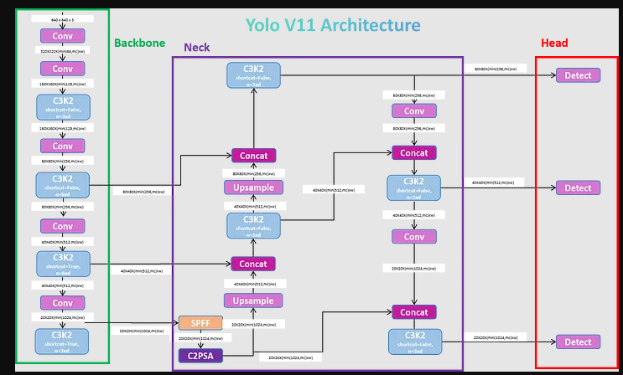
Reference : https://medium.com/@nikhil-rao-20/yolov11-explained-next-level-object-detection-with-enhanced-speed-and-accuracy-2dbe2d376f71

Slide 13
Evaluation and Visualization
The objective is to evaluate the model's performance on the validation dataset, documenting both quantitative and qualitative results. This includes analyzing metrics, visualizing predictions versus ground truth, identifying failure patterns, and suggesting model or data improvements based on the analysis.

Slide 14
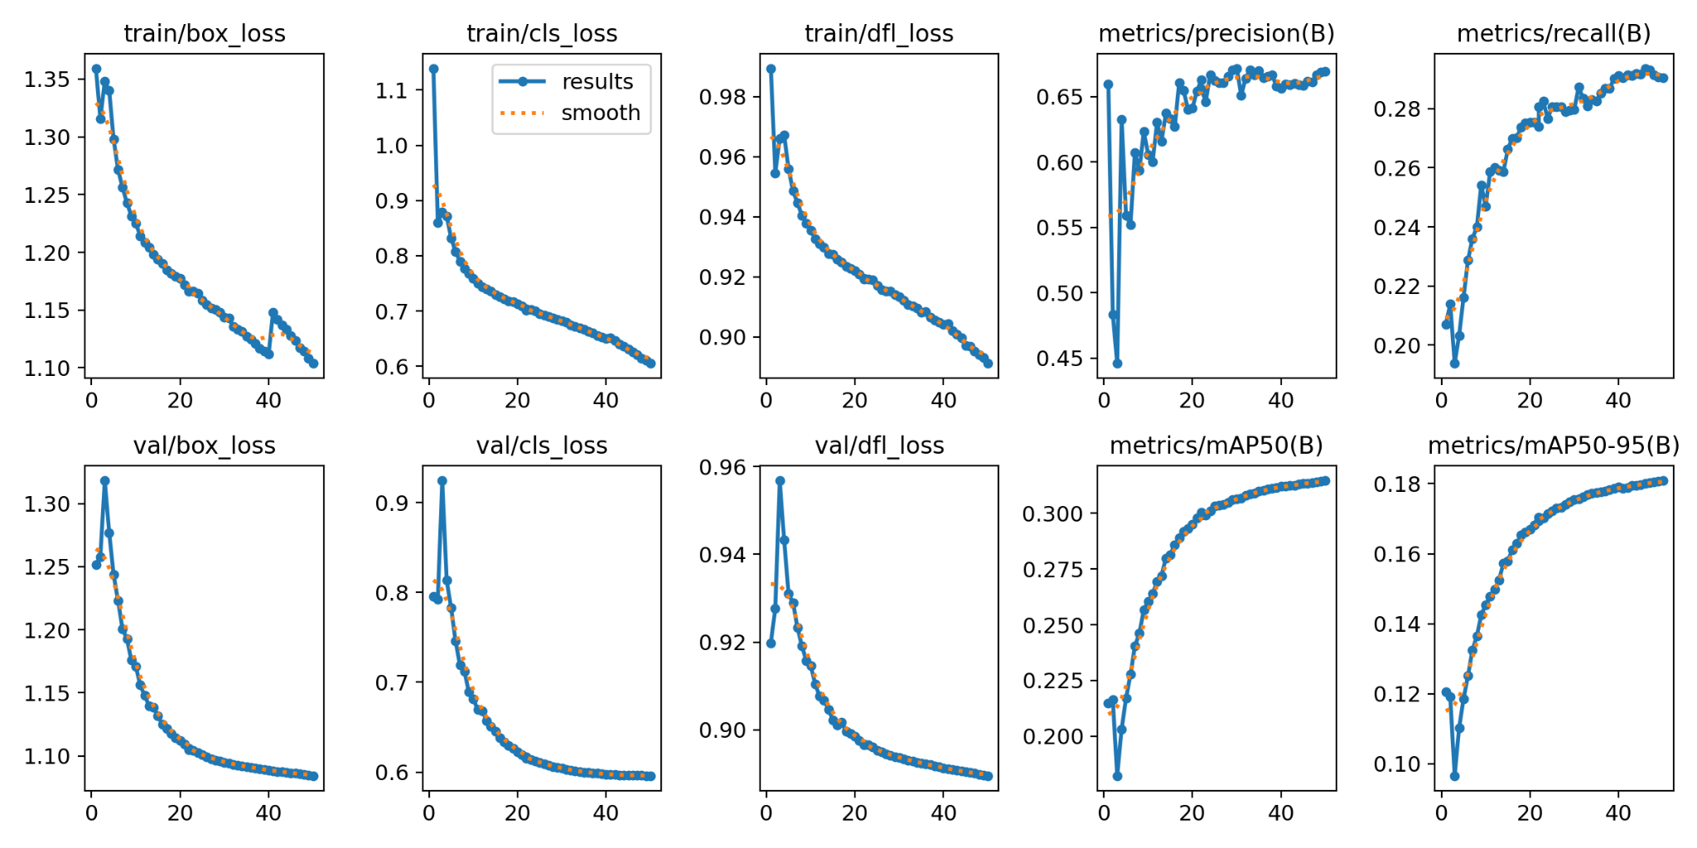

Slide 15
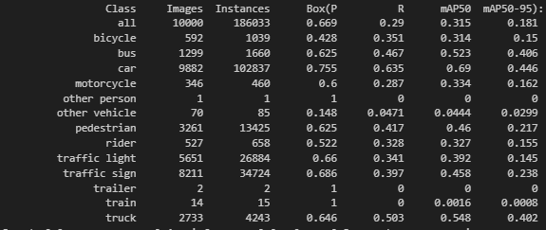

Slide 16
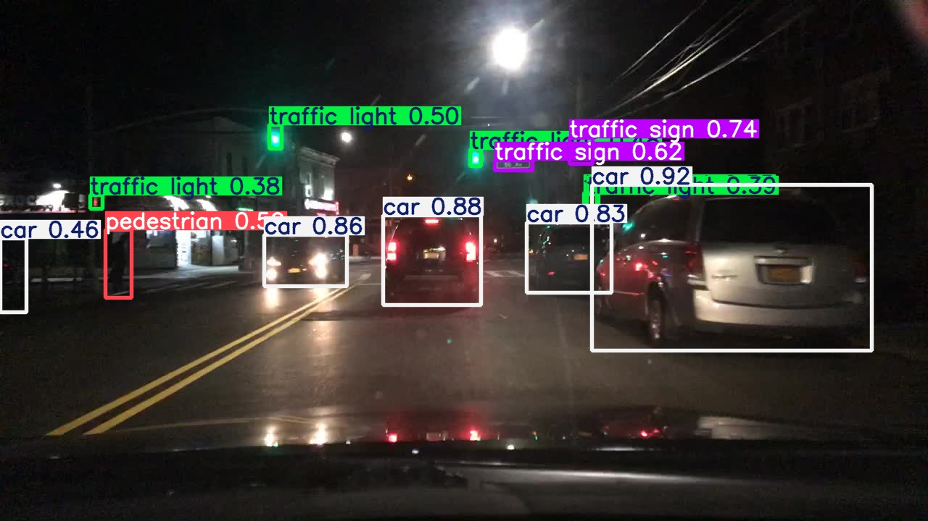

Slide 17
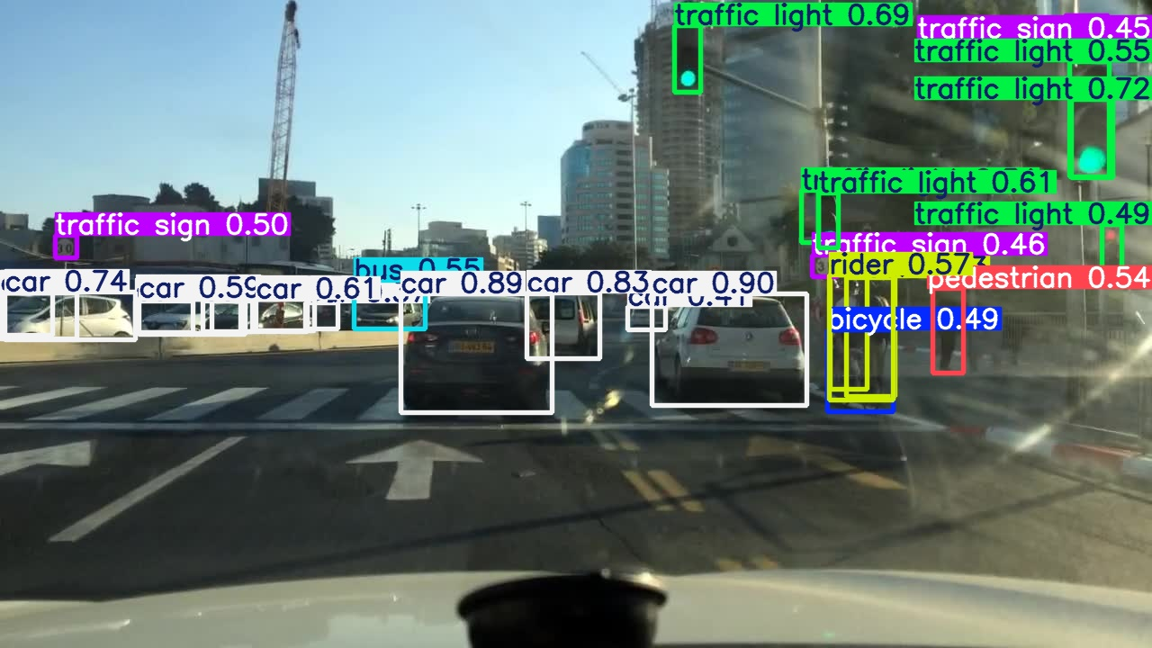

Slide 18
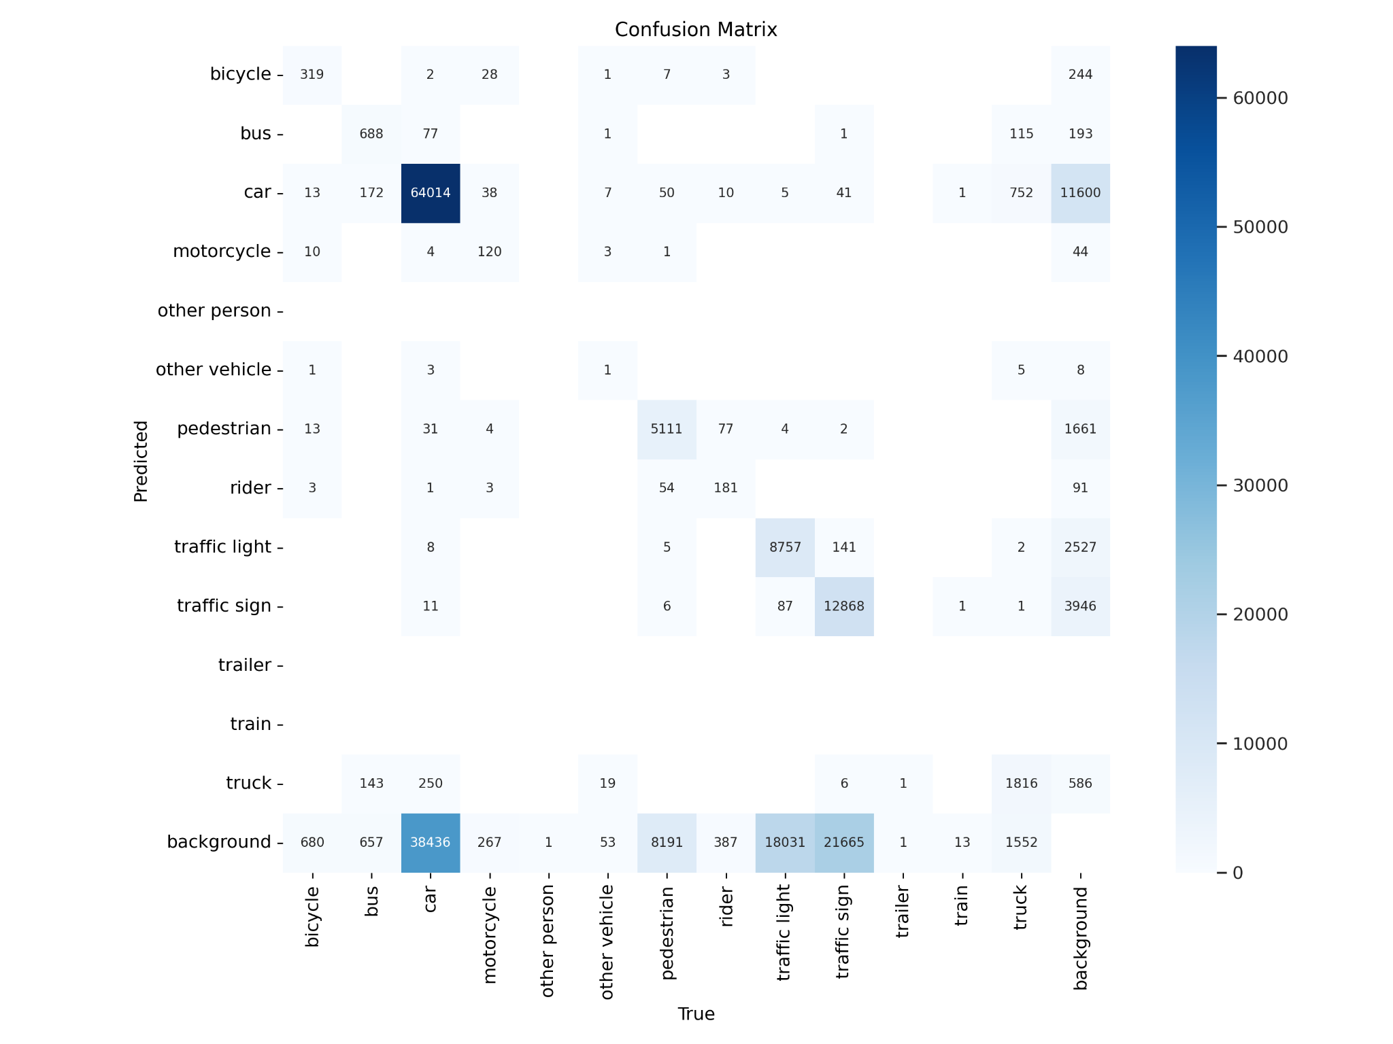

Slide 19
Key Observations
Low recall observed for small objects like traffic signs and pedestrians.
Metrics such as mAP and IoU are poor for small object classes compared to larger ones.
Root Causes
Resolution Issue: Small objects occupy fewer pixels, reducing feature extraction accuracy.
Dataset Limitations: Fewer training samples for small-object classes.

Slide 20
1. Model Improvements
Feature Pyramid Networks (FPN): Enhance multi-scale feature extraction.
Increase Input Resolution: Use higher-resolution images during training.
2. Data Augmentation
Focus on Small Objects: Use zoom-in and crop augmentations.
Synthetic Data Creation: Generate new training samples with CutMix/Mosaic.
3. Training Strategies
Multi-scale training to improve model robustness.
Oversample small-object classes to balance the dataset.
4. Post-Processing Adjustments
Lower IoU thresholds in Non-Maximum Suppression (NMS) to capture overlapping small objects.

