Slide 1

ALLIANCE UNIVERSITY
₹
TEAM MEMBERS
Personal Expense Analytics & Budget Management System
1
Baby Rao Metta
2
Harshita Chhabra
A practical Advanced Python micro-project that turns everyday spending into an easy-to-understand financial dashboard.
3
Rajasree G
OOP
PANDAS
NUMPY
TKINTER
SQLITE
MATPLOTLIB
4
B Lakshmi Priya
Design Project-1 • E1CSA313 / E1ITA306 • Micro-Project Presentation 2026
Notes:
Introduce the project, the team and the stack: OOP, Pandas, NumPy, Tkinter, SQLite and Matplotlib combined into one expense-analytics application.

Slide 2
01 · INTRODUCTION & PROPOSED SOLUTION
The problem is visibility, not spending
1
Scattered data
PROPOSED SOLUTION
Daily expenses live in notes, messages and sheets, so there is no single view of actual spending.
One structured system for every transaction, turned into decisions the user can see.
2
Late discovery
Overspending is noticed only at month-end, when correction is much harder.
ONE RECORD → ONE SOURCE OF TRUTH
3
No clear patterns
The same Transaction object powers storage, analytics, budget checks and the dashboard.
Without category and time analysis, recurring habits stay hidden.
PROCESS FLOW
01 · CAPTURE
02 · STORE
03 · ANALYZE
04 · COMPARE
05 · VISUALIZE
Manual entry or CSV import
Transaction object + SQLite
Category + month aggregation
Actual spending vs budget
Charts + dashboard insights
Personal Expense Analytics & Budget Management System
2 / 7
Notes:
Explain the three problems, then the proposed solution: one structured system. Walk through the five-step process flow from capture to visualization.

Slide 3
02 · OBJECTIVES, OUTCOMES & SOFTWARE REQUIREMENTS
Four objectives, three course outcomes
1
RECORD
2
ANALYZE
SOFTWARE REQUIREMENTS
Python 3
Core language
Capture date, category, amount and description for every expense.
Summarize spending by category and month using structured data.
Tkinter
Desktop GUI
Pandas + NumPy
Data analysis
3
CONTROL
4
VISUALIZE
Matplotlib
Charts
SQLite3
Database storage
Compare spending against user-defined monthly category budgets.
Present patterns through readable dashboards and charts.
csv module
Import / export
CO-1
Object-oriented design for modular, reusable Python applications.
CO-4
Data manipulation and visualization for effective presentation.
CO-5
Full-fledged application with storage and a user interface.
Personal Expense Analytics & Budget Management System
3 / 7
Notes:
Cover the four objectives, the aligned course outcomes CO-1, CO-4 and CO-5, and the software requirements: Python 3 with Tkinter, Pandas, NumPy, Matplotlib, SQLite3 and the csv module.

Slide 4
03 · SYSTEM ARCHITECTURE & DATABASE DESIGN
Layered design with one shared data model
USER INTERFACE
DATABASE DESIGN · SQLITE
1
Tkinter dashboard • forms • navigation • quick actions
transactions
id | INTEGER · primary key, auto
date | TEXT (YYYY-MM-DD)
category | TEXT
amount | REAL
description | TEXT
2
APPLICATION LOGIC
Transaction + Budget classes • validation • workflow
3
ANALYTICS & VISUALIZATION
Pandas + NumPy aggregation • Matplotlib charts
budgets
category | TEXT · primary key
limit_amount | REAL
4
STORAGE
SQLite database • CSV import / export
DESIGN PRINCIPLE
DATA FLOW
High cohesion, low coupling: each module does one clear job and connects through simple data structures.
CSV / manual entry → Transaction → SQLite → DataFrame → Charts
Personal Expense Analytics & Budget Management System
4 / 7
Notes:
Explain the four layers top to bottom, then the SQLite schema: a transactions table and a budgets table. Close with the data flow from CSV to charts.

Slide 5
04 · KEY FEATURES & CONCEPTS USED
Features and the Python behind them
CONCEPTS USED
1
KPI dashboard
2
Quick actions
OOP
Transaction, Budget, Database and ExpenseAnalytics classes with encapsulation
Total, average, largest expense and budget position at a glance.
Add, import, analyze and manage budgets in one click.
Inheritance
ExpenseApp(tk.Tk) and MetricCard(tk.Frame) extend Tkinter
3
Transactions
4
Budget control
Functional
map(), reduce() and lambda for compact data operations
Search, filter and add expenses; CSV import and export.
Monthly limits with Within / Near / Over status per category.
Iterator
TransactionIterator with __iter__() and __next__()
5
Analytics
6
Reports & insights
Monthly, daily and category charts with a month filter.
Monthly CSV report and smart insights from current data.
Data stack
Pandas groupby + NumPy sum, mean and max for analytics
Personal Expense Analytics & Budget Management System
5 / 7
Notes:
Left: the six key features. Right: the Python concepts actually implemented: OOP, inheritance from Tkinter classes, map/reduce with lambda, the custom iterator, and Pandas/NumPy.

Slide 6
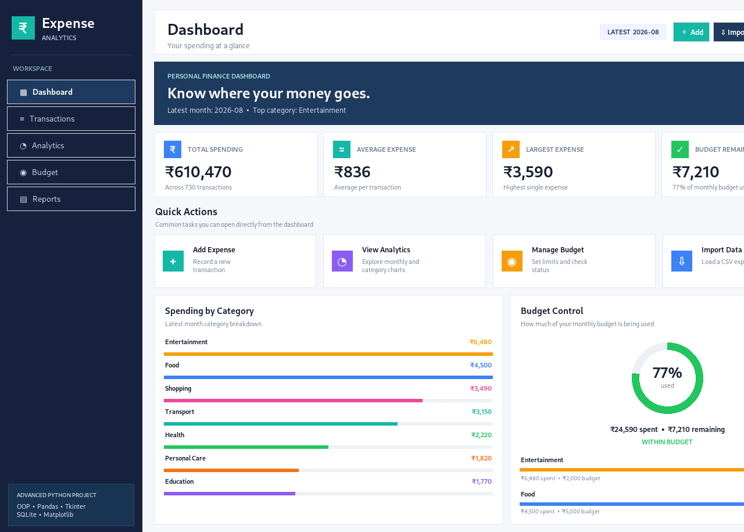
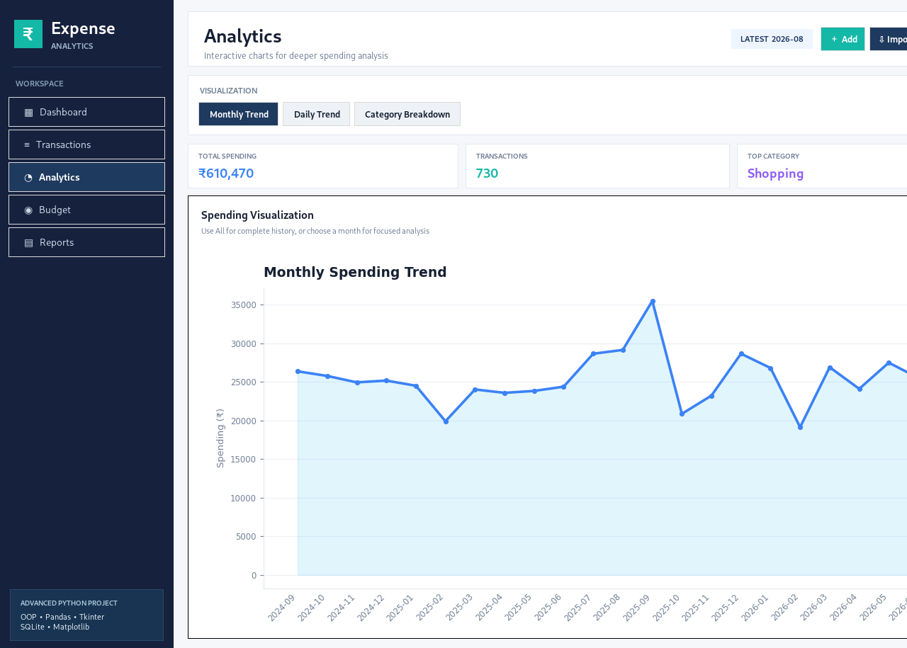
05 · APPLICATION SCREENSHOTS & RESULTS
Built, tested and ready to demo
Dashboard: KPI cards, quick actions, category bars, budget ring
Analytics: monthly, daily and category views
730 daily records
24 monthly periods
₹6.10L total spending
₹836 average expense
Personal Expense Analytics & Budget Management System
6 / 7
Notes:
Show the dashboard and analytics screens, then the prototype validation numbers from the 730-day demo dataset.

Slide 7
06 · CONCLUSION & FUTURE SCOPE
Raw spending → visible decisions
FUTURE SCOPE
One system
1
Smart categorization
Recurring expenses
Records, stores, analyzes, compares and visualizes every expense in a single app.
Auto-suggest a category from past descriptions and patterns.
Detect subscriptions and repeated payments automatically.
Prototype-tested
2
Validated on 730 daily records over 24 months: charts, budgets, CSV import and SQLite storage.
Exportable reports
Budget alerts
Course-aligned
Monthly PDF / Excel reports for review and presentation.
Notify the user when a category nears its limit.
3
Combines OOP, data analysis, visualization, storage and a GUI (CO-1, CO-4, CO-5).
₹
Thank you • Questions & Discussion
Baby Rao Metta • Harshita Chhabra • Rajasree G • B Lakshmi Priya
Personal Expense Analytics & Budget Management System
7 / 7
Notes:
Summarize: one system for record, analyze, control and visualize. Present future scope as extensions, not current features. Thank the audience and invite questions.

Slide 8


