Slide 1

Enhancing the skies: airline satisfaction prediction
Unlocking Insights for an Elevated Passenger Experience

Slide 2

TEAM - K
Group Members
Salunkhe, Akshata Prakash (U37374358)
Dharamsoth, Aryan Arjun(U00013466)
Damodar, Revanth(U43424108)
Chintada, Lakshmi Priya(U63030367)
Prabakarrao, Priyanka(U52145257)

Slide 3
Business Problem
The satisfaction of passengers is crucial for airlines, which aim at maintaining competitiveness, reducing costs, enhancing customer loyalty and providing an exceptional travel experience. This is allowing airlines to make data based decisions, prevent problems and keep up with changing customer preferences in order to contribute positively for the long term success of the industry. So to meet this condition we have to predict the satisfaction of passengers.Understanding and predicting passenger satisfaction is pivotal in the fiercely competitive airline industry, ensuring airlines stay responsive to evolving passenger preferences and maintain a reputation for exceptional service.

Slide 4
INTRODUCTION
Definition of Airline Satisfaction: In the context of our study, airline satisfaction refers to the overall contentment and positive experience of passengers during their journey.
Importance of Airline Satisfaction: High satisfaction leads to loyal customers, positive reviews, and increased business for airlines.
The Role of Data Mining: Data mining helps us uncover patterns and insights within vast datasets, which can be crucial in understanding passenger satisfaction.
Benefits of the Project: By predicting and improving airline satisfaction, we can enhance passenger experiences and drive airline success.

Slide 5
Objectives of the Project
Predict passenger satisfaction based on various factors: Our primary objective is to create a predictive model for passenger satisfaction.
Identify key drivers of passenger satisfaction: Understanding what factors influence satisfaction is essential for making improvements.
Improve airline services and operations: We aim to provide actionable insights that airlines can use to enhance their offerings.
Enhance customer experience and loyalty: By focusing on satisfaction, we strive to improve customer loyalty and long-term relationships.

Slide 6
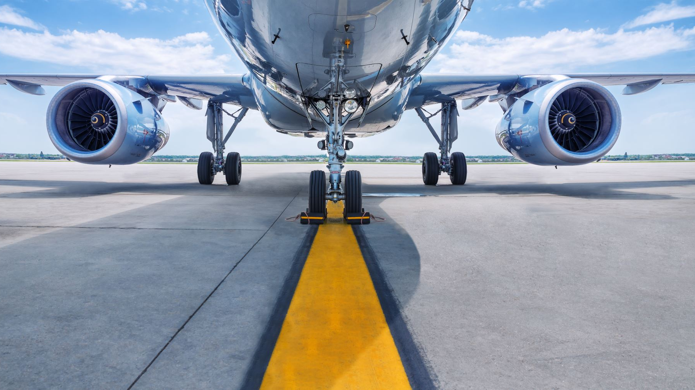
Past approaches
Predicting airline passenger satisfaction through machine learning is a well-established field, with diverse applications within the airline industry. Several approaches have been taken in the past, including:
1. Airlines' Research: Airlines conduct internal research, collecting data from surveys and feedback to improve services.
2. Academic Studies: Researchers apply machine learning to survey data, contributing to academic knowledge.
3. Kaggle Competitions: Data scientists participate in competitions to build predictive models.
And many other like Loyalty Programs, Customer Feedback Analysis, Sentiment Analysis Tools, Airlines' Apps and Websites, Travel Booking Platforms, Customer Experience Software

Slide 7

Airline Satisfaction Prediction through Business Analytics
Enhanced Customer Experience: Business analytics can provide valuable insights into passenger preferences, pain points, and satisfaction drivers.
Operational Efficiency: Airlines can use data mining and predictive analytics to optimize their operations.
Personalized Services: Business analytics can enable airlines to offer personalized services to passengers, such as customized in-flight entertainment options, meal choices, and seat preferences.
Pricing and Revenue Management: Airlines can use data analytics to optimize pricing strategies. By analyzing demand patterns and market conditions, airlines can set dynamic ticket prices that maximize revenue.
Proactive Issue Resolution: Predictive analytics can help airlines anticipate and address potential issues before they negatively impact passenger satisfaction.
Competitive Advantage: Airlines that effectively use business analytics to enhance passenger satisfaction may gain a competitive edge in the industry

Slide 8
Data Collection and Preprocessing
Data sources: We collected data from Dataset collected from Kaggle Datasets.Link: https://www.kaggle.com/teejmahal20/airline-passenger-satisfaction
Data Cleaning: This involved removing duplicates and addressing missing values to ensure data quality.
Data Transformation: Standardization and normalization made data consistent and suitable for analysis.
Data Integration: We combined data from multiple sources to provide a holistic perspective.

Slide 9
Feature Selection
Selecting relevant features: We identified critical features influencing satisfaction, helping reduce the dimensionality.
Reducing dimensionality: This process simplified complex data, making it more manageable.
Techniques used: Our methods included correlation analysis, feature importance ranking, and principal component analysis (PCA).

Slide 10
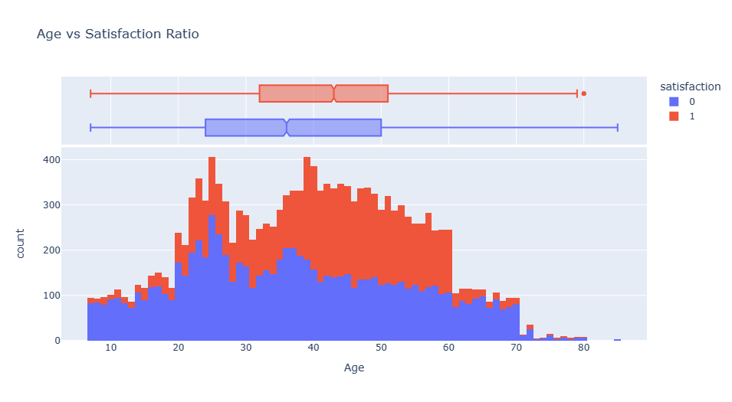
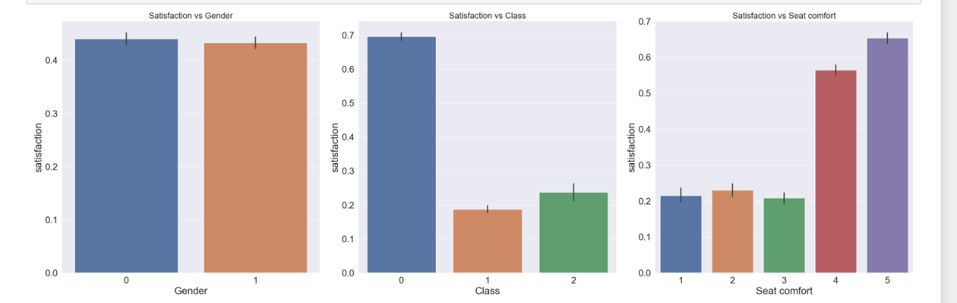
Satisfaction vs Feature

Slide 11
Model Building and Validation
Model Building
Validation
Splitting data into training and testing sets: We divided data for model training and evaluation, ensuring a fair assessment.
Model training and hyperparameter tuning: Fine-tuning models to optimize their performance.
Cross-validation techniques: To test model performance more rigorously, we used cross-validation.
Evaluation metrics: We measured model accuracy, F1-score, and AUC-ROC to assess their effectiveness.

Slide 12

Models we used
Logistic Regression
XGBoot
Decision Tree Classifier
SVC
Random Forest Classifier

Slide 13

Results and Insights
Key findings: We discovered that certain factors significantly influence passenger satisfaction.
Visualizations: We provided visual representations of satisfaction distribution and feature importance.
Highlighting actionable insights: We highlighted specific actions airlines can take based on our findings.
We trained eight different models but choose top three based on the validation scores:
Logistic Regression Classification Model gave us 84.4% accuracy with base and cross validated scoreline.
Random Forest Classification Model gave us 94.1 % accuracy score with base and cross validated scoreline.
Decision Tree Classification Model gave us 91.3 %accuracy score with base and cross validated scoreline.
SVC gave 92 % accuracy score.
XGBoost gave 94% accuracy

Slide 14
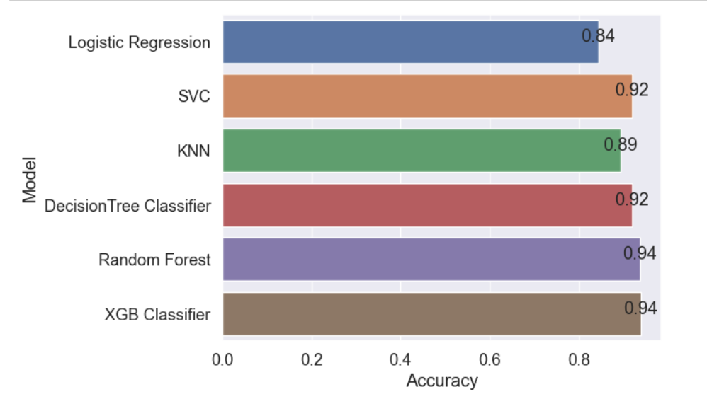
Results

Slide 15
Recommendations
Improvements for airlines: We suggest ways airlines can enhance their services and operations.
Customer service enhancements: Recommendations for improving the passenger experience, especially in terms of service.
Operational changes: Changes that can streamline airline operations and improve overall satisfaction.
Personalized marketing strategies: Tailored marketing approaches to engage passengers more effectively.

Slide 16
Future Prospects
Expanding data sources: By incorporating more data sources, our project can provide richer insights.
Real-time prediction and feedback: The potential for immediate satisfaction prediction and feedback can revolutionize the industry.
Advanced AI and machine learning techniques: Continued advancement in AI and ML will drive more accurate predictions.
Industry-wide collaboration: Collaboration among airlines and stakeholders can lead to industry-wide improvements

Slide 17
Challenges and Limitations
Data privacy and ethics: Ethical considerations are important when working with passenger data.
Data quality issues: Challenges related to data quality and accuracy.
Interpretability of models: The complexity of interpreting model predictions.
Model deployment challenges: Challenges in implementing data mining models in practical airline operations.

Slide 18
Conclusion
We can utilize it for deployment because we obtained over 90% of the predicted numbers correctly. To provide additional boost, we might create a combined score by combining the top three models.
we found out that majority of the passengers ,loyal passengers are unsatisfied/neutral with the airline services. Thats a huge concern for the airline and they needs to upgrade their values and services they also needs to give extra attention to this category.
Business Travel passengers and Eco and Eco Plus Class passengers are satisfied similirly majorlity of Personal Travel passengers seems unsatisfied

Slide 19
Thank you!

