Slide 1



Inequality measures based bitcoin Price Prediction

Slide 2



Agenda
1. Introduction
2. Related work
3. Proposed Bitcoin Prediction Model
3.1. Motivation
3.2. Inequality Measures
3.3. Architecture of the Proposed Model
4. Experimental Analysis
4.1. Dataset Description
4.2. Mean And Standard Deviation
5. Results
5.1. Lorenz Curve
5.2. Gini-Index
5.3. K-Value
6. Conclusion

Slide 3


Introduction
Bitcoin is one such a cryptocurrency that was introduced in 2009 by Satoshi Nakamoto.
It offers lower transaction fees than traditional online payment mechanisms. Due to this most of the people are investing in bitcoin.
But, the bitcoin price is more volatile because of its volatile nature predicting correct price is very difficult.
While investing an intelligent investor always look over the predictions based upon the past data available, before making any prediction.

Slide 4



Introduction contd….
To forecast the price changes of Bitcoin, experts and traders employ a variety of strategies and techniques.
Algorithms for machine learning and deep learning are being used more frequently to predict Bit coin prices.
The objective of our project is to build this prediction model using machine learning using inequality measures as one of the features of the model.
And in this project, we will examine some of the approaches and strategies that can predict the price of the bitcoin more accurately.

Slide 5

Related work
According to Amjad et al. [1] analyzed historical time series pricing data
to predict prices using ARIMA model and develop an exchanging strategy.
Later McNally [3], forecasts the Bit coin price mechanism and compares the outcomes to those produced using autoregressive integrated moving average (ARIMA) models
L. Kristoufek[2], Later analyzed the Bit coin market as being made up entirely by speculative traders without any fundamentalists and determined the relationship between Bit coin and the volume of research on Wikipedia and Google Trends.
From the aforementioned related works, we have observed that the primary difficulty with the bitcoin exchange rate is its fast pace of price volatility. Because of the high price volatility.,
To overcome this problems to some extent in our project we have considered the inequality measures of the price difference of the bitcoins in a time series.

Slide 6
Proposed bitcoin price prediction model
Motivation
Bitcoin, being the first and most well-known crypto currency, has attracted significant attention from individuals, investors, and researchers.
Because of its volatile nature and potential for large fluctuations in price, bitcoin has grown in popularity among traders and investors.
Researchers can utilise the project to forecast and study changes in the price of bitcoin by using various machine learning approaches, such as regression, time series analysis, or deep learning
The Bitcoin market is an unrestricted market; hence the currencies which are not regulated will follow a certain pattern in their inequality measures to improve the accuracy of machine learning prediction.

Slide 7
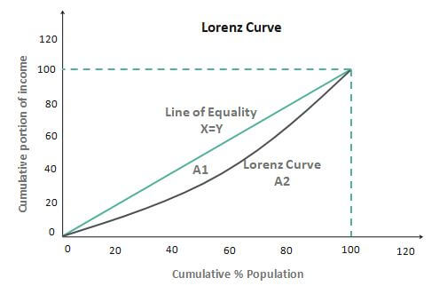
Proposed bitcoin price prediction model contd..
Inequality measures : Lorenz curve
A Lorenz curve is known as a graphical representation of the distribution's inequalities.
Lorenz curve is often plotted between the cumulative
price on the vertical axis and the cumulative
population on the horizontal axis.
Lorenz curve is accompanied by a straight line with slope 1, that describes that the observations are perfectly equally distributed.

Slide 8
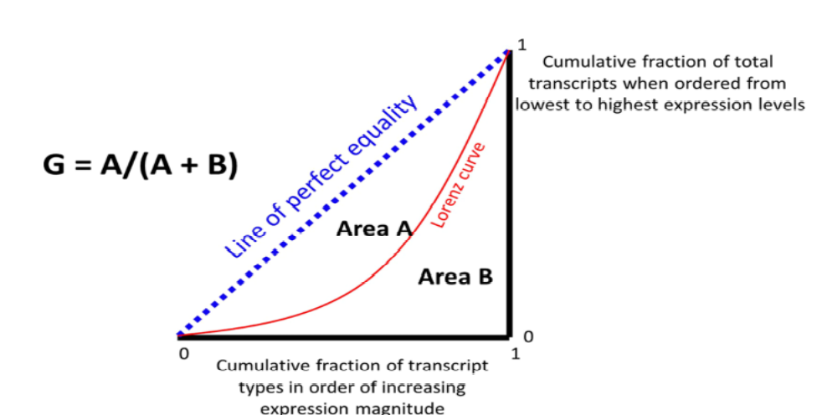
Proposed bitcoin price prediction model contd..
Inequality Measures : Gini-Index
The Gini coefficient uses information from the entire price distribution and is independent of the size of the population.
The Gini coefficient values range from 0 to 1, where
0 is perfect equality, and 1 is perfect Inequality.
The Gini index is determined as the ratio of the area
between the perfect equality line and the Lorenz curve
(A) divided by the total area under the perfect equality
line (A + B).

Slide 9
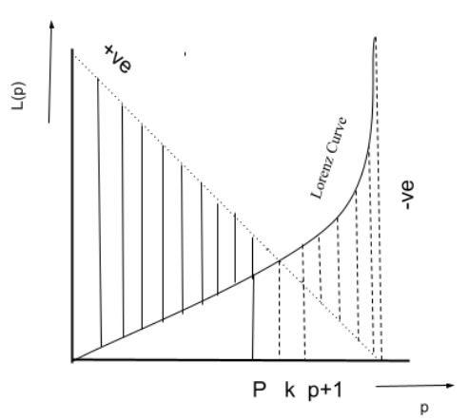

Proposed bitcoin price prediction model contd..
Inequality measures : K-Value
K-Value is also an inequality value that is calculated from the Lorenz Curve.
The formula to calculate k-value is ,
$$k=\frac{P_{i}+{(P}_{i}+1)}{2}$$
A $1−k$fraction of an event has a $k$ fraction of value
in It.
When a Gini Coefficient and K-Value meet each other,
then that situation is known as a stable market
condition.

Slide 10
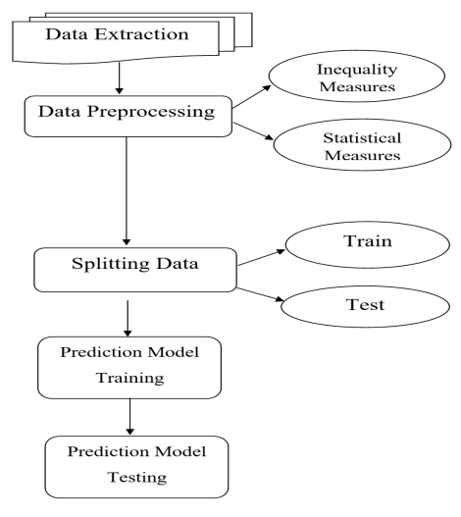
Proposed Bitcoin Prediction Model Continued
Architecture
The imported data is processed by removing all null values from the dataset and adding the extra features, such as inequality measures and statistical measures, to provide predictions that are more accurate.
After adding the Measures to the processed data, we will split the data into training and testing and give 75% data as training and 25% data as testing to machine learning models

Slide 11
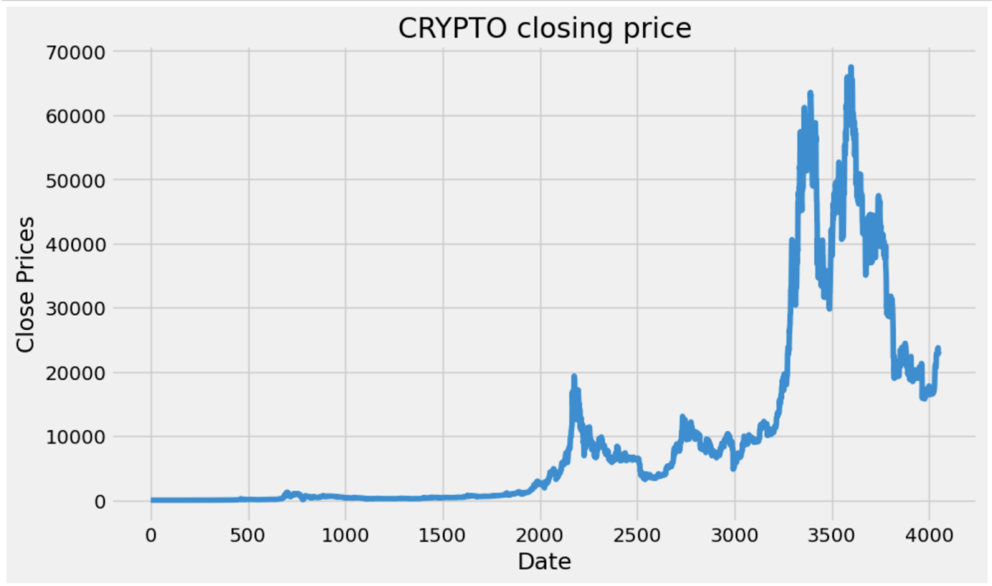
Experimental analysis
Dataset description
Visualizing the price distribution over the Date
we have collected the data between the years January 2012 to January 2023 from Investing.com[4]. The data consists of features such as the date, price, open price, highest value, lowest value, and change in percentage, volume.
we have calculated the inequality measures & statistical measures as additional features such as the Gini Index, K-Value, Mean, Standard Deviation, and Kurtosis.

Slide 12
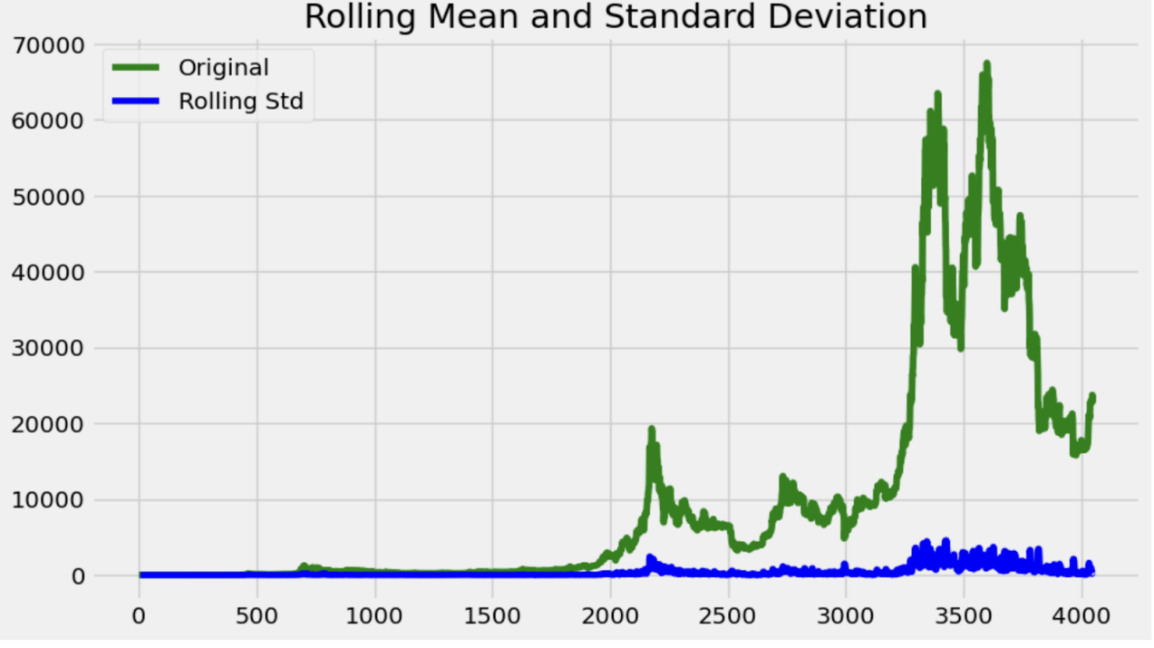
Experimental analysis contd…
Mean and standard deviation
Rolling Mean & Standard Deviation among data
Rolling mean is examined over time, it becomes easier to identify long-term trends and changes in the data.
Future values can be predicted using the rolling mean as a base.
A statistical measure known as the standard deviation can be used to determine how much variation or dispersion there is in a set of data.

Slide 13
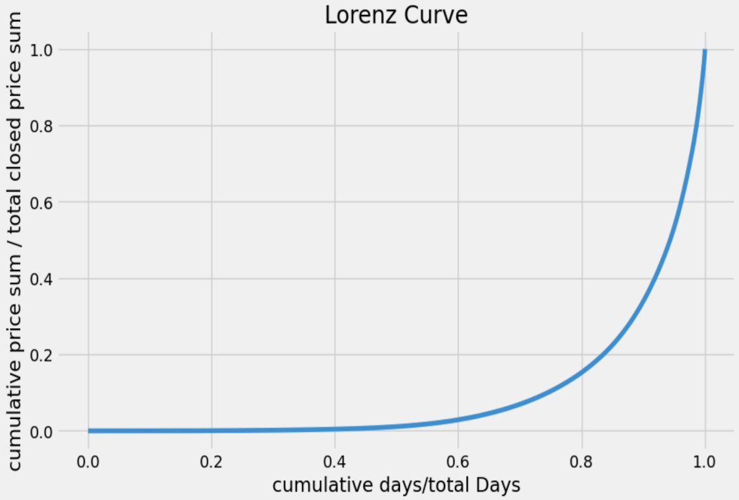
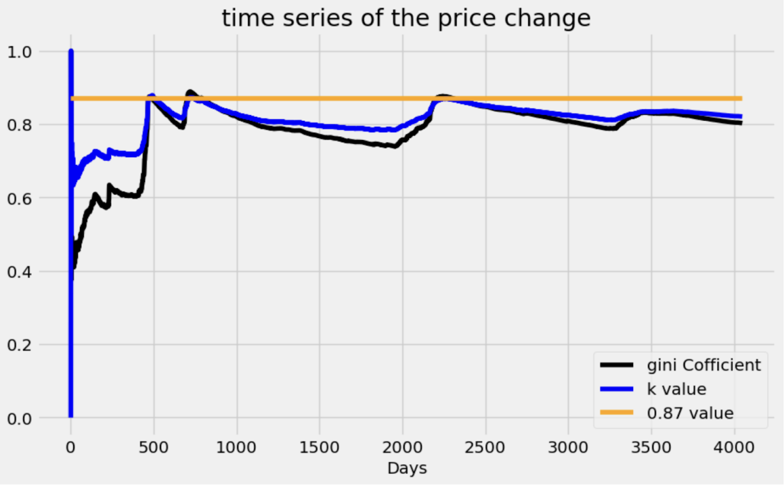
Experimental analysis contd…
Results
Lorenz curve
Gini-Index and K-Value

Slide 14
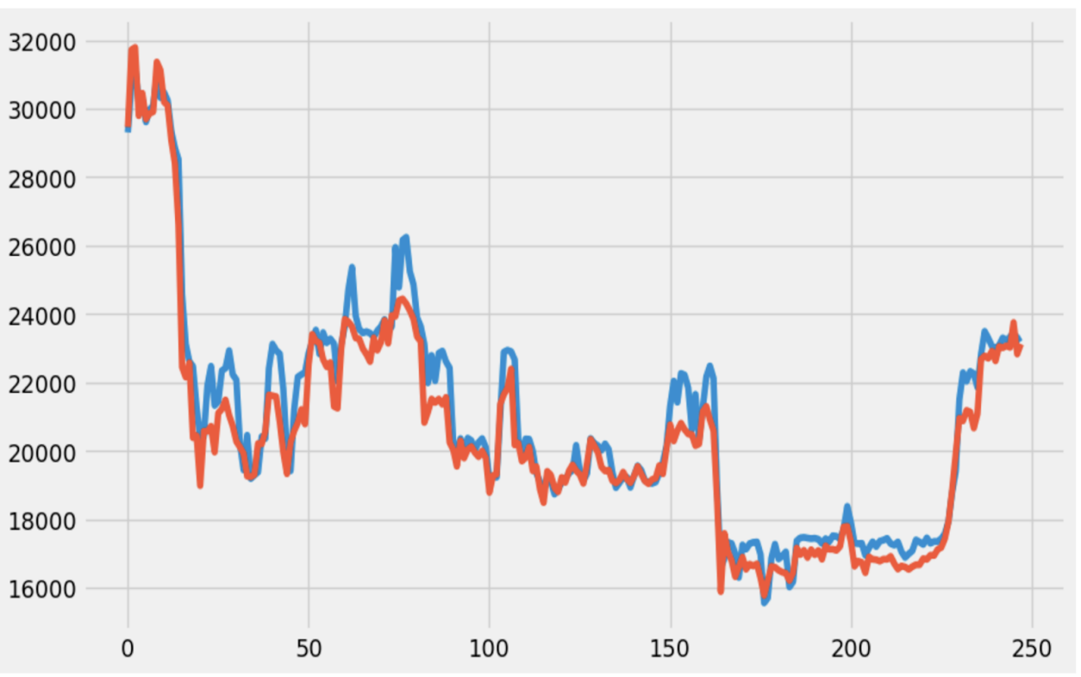
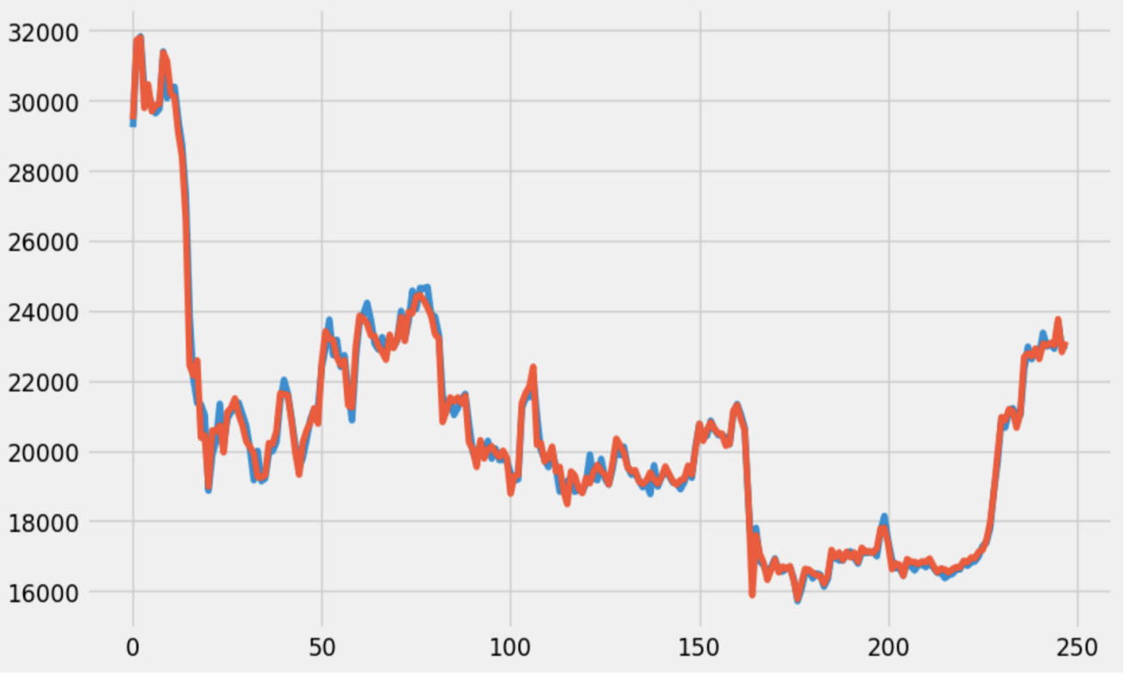
Experimental analysis contd…
Results
Random Forest Regressor Model with 93% Accuracy
Linear Regression accuracy with 99%

Slide 15
Conclusion
Bit coin is the most volatile entity in the world. Already Existing machine learning models are there but all those models are not giving much accuracy in predicting the bitcoin price due to different factors might affects on bitcoin price and volatile nature of bitcoin .
we proposed a machine learning model which uses inequality measures as well as statistical measures to predict the bitcoin price. we observed that our proposed model is predicting the bitcoin price more accurately than already existing models.
In future, We are planning to apply our models to other cryptocurrency such as Ethereum, doge coin and also planning to compare how the inequality measures will be for different currencies.

Slide 16
References
[1]M. Amjad and D. Shah, "Trading Bit coin and Online Time Series Prediction," in NIPS 2016 Time Series Workshop, 2017.
[2] L. Kristoufek, Bit coin meets Google trends and Wikipedia: quantifying the relationship between phenomena of the internet era, Sci. Rep. 3 (2013) 3415.
[3] S. McNally, J. Roche and S. Caton, "Predicting the price of Bitcoin using machine learning," in 26th Euro micro International Conference on Parallel, Distributed and Network-based Processing (PDP), 2018
[4]https://in.investing.com/crypto/bitcoin
[5] MVM, , AP, , BJ, , MK, & , RS (2021). Bitcoin price prediction using machine learning. International Journal of Engineering Technologies and Management Research, 8(5), 20. doi: 10.29121/ijetmr.v8.i5.2021.953
[6] Farris, Frank. (2010). The Gini Index and Measures of Inequality. American Mathematical Monthly. 117. 851-864. 10.4169/000298910X523344.

Slide 17

-

