Slide 1
Employee Data Analysis using Excel
STUDENT NAME: Lakshmi priya. J
REGISTER NO: 312216783
DEPARTMENT: B.com (Accountant and Finance)
COLLEGE: Shri Krishnaswamy college for women

Slide 2
PROJECT TITLE
Employee Performance Analysis using Excel

Slide 3


AGENDA
Problem Statement
Project Overview
End Users
Our Solution and Proposition
Dataset Description
Modelling Approach
Results and Discussion
Conclusion
3/21/2024 Annual Review

Slide 4

PROBLEM STATEMENT
Employee performance analysis involves evaluating various metrics such as
Productivity, efficiency, and output quality to assess individual and team performance.
By leveraging data analytics, organizations can identify top performers, areas for improvement,
Areas for improvement, and potential training needs. Performance of its
employees through Performance evaluations and provides them with
recognition for their Contributions to the company’s success and growth.

Slide 5

PROJECT OVERVIEW
Employee performance analytics is the act of analyzing HR data to measure
How to your employees are performing against KPIs. These KPIs are role-specific
Performance goals, metrics, or standards that are tied to your larger business
Goals.

Slide 6

WHO ARE THE END USERS?
The end users for employee performance analysis may include:
1. Human resources department: HR professionals use employee performance analysis to identify
Strengths and weaknesses in employee performance, plan training and development programs, and make decisions
Related to promotions, rewards, and disciplinary actions.
2. Managers and supervisors: Managers and supervisors use performance analysis to evaluate
The performance of their team members, provide feedback and coaching, and set goals for improvement.
3. Executives and senior: Executives and senior leaders use performance analysis to assess the overall performance of the organization and make strategic decisions related to resource allocation, budgeting and
Workforce planning.
4. Employees themselves: Employees use performance analysis to receive feedback on their performance, set personal goals and track their own progress and improvement over time.
5. External stakeholders: External stakeholders, such as investors, customers, and partners, may also be
Interested in employee performance analysis as it can provide insights into the organization’s overall effectiveness
And competitiveness.

Slide 7

OUR SOLUTION AND ITS VALUE PROPOSITION
Conditional formatting – missing
Filter – remove
Formula –performance
Pivot – summary
Graph – data visualization

Slide 8
Dataset Description
Employee=-Kaggle
26 features
9 features
Emp id – num
Name – text
Emp type
Performance level
Gender – male female
Employee rating – num

Slide 9

THE "WOW" IN OUR SOLUTION
Performance Level =IFS(Z8>=5,”VERY HIGH”,Z8>=4,”HIGH”,Z8>=3,”MED”,
TRUE,”LOW”)
3/21/2024 Annual Review
9

Slide 10
MODELLING
Data collection
Gathering information that allows you to evaluate how well employees are meeting job expectations
Contributing to the organization, and where they might need improvement.
Feature collection
Personal & Demographic Information
Work Performance Metrics
Behavioral & Engagement Metrics
Data cleaning
Understand the Dataset
Handle Missing Data
Correct Data Types
Remove Duplicates
Standardize Formats
Performance level
Outstanding/Exceptional Performance
Exceeds Expectations
Needs Improvement
10

Slide 11
MODELLING
Visulaization
Performance Rating Distribution (Bar Chart)
Performance vs. Goal Achievement (Scatter Plot)
Trend Analysis (Line Chart)

Slide 12
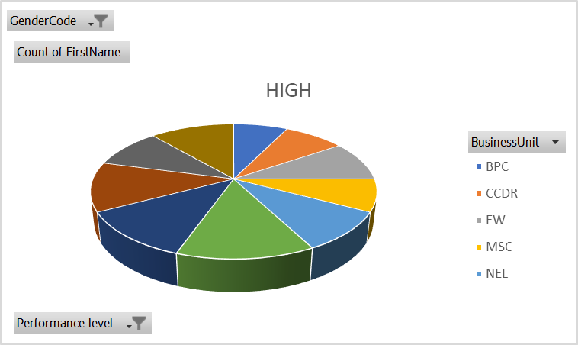
RESULTS
12

Slide 13
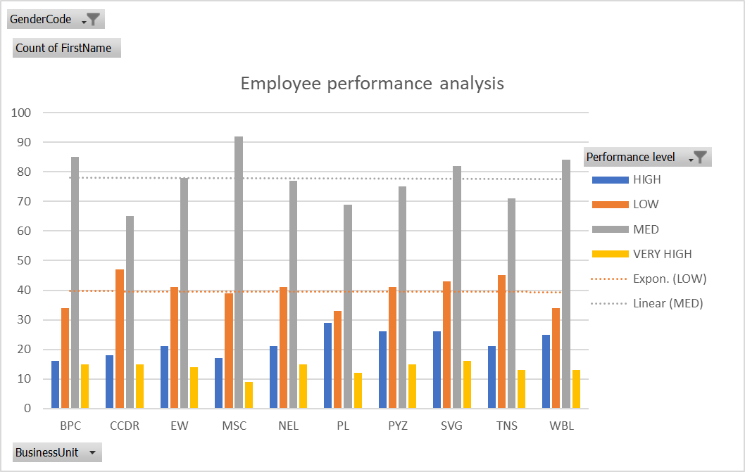
RESULTS

Slide 14
conclusion
In conclusion, employee performance analysis is a vital tool for organizations striving to
optimize their workforce and achieve strategic goals. By systematically evaluating
employee strengths, weaknesses, and overall contributions, companies can make informed
decisions that drive productivity, enhance employee engagement, and ensure
alignment with organizational objectives. Regular performance analysis not only fosters a
culture of continuous improvement but also supports fair and objective management
practices. Ultimately, this process contributes to a more motivated, efficient, and effective workforce,
which is crucial for long-term business success.

