Slide 1

Tata Power Smart Energy Control 360°
POWER BI & MYSQL ANALYTICS PROJECT
Plants · Grid · Smart Meters · EV Mobility · Risk Intelligence
Presented By
K LAKSHMI PRIYA
AF05323408
Data and Business Analytics with AI
Anudip IT Foundation, Pallavaram, Chennai
Notes:
Welcome. This project builds a 360-degree energy control centre for Tata Power using MySQL and Power BI.

Slide 2








Agenda
01
02
03
04
Project Overview
Problem & Objectives
Analytics Stack
Data Model
05
06
07
08
SQL Code
Cleaning, Visuals & DAX
4 Dashboards
Insights & Conclusion
Notes:
Eight parts: overview, objectives, tools, data model, SQL, preparation and DAX, dashboards, conclusions.

Slide 3
Project Overview
Tata Power Smart Energy Control 360° is a real-time style analytics solution that connects MySQL to Power BI.
16
4
Database tables
Dashboard pages
Brings plants, grid zones, substations, smart meters, EV charging and billing into one view
Covers 6 fuel types: thermal, hydro, solar, wind, gas and pumped storage
Covers 5 zones: Ajmer, Delhi, Jamshedpur, Mumbai and Odisha
Tracks generation mix, load factor, outages and alerts
Helps teams spot risk early and act faster
14
5
Power plants
Grid zones
Notes:
Key facts: 16 tables, 4 dashboards, 14 plants and 5 grid zones (Ajmer, Delhi, Jamshedpur, Mumbai, Odisha).

Slide 4

Problem & Objectives
The Challenge
Our Objectives
Plant, grid, billing and EV data sit in separate places
Outages and grid stress are hard to spot early
No single view of generation, demand, supply and revenue
Readings arrive every 15 minutes, too many to review by hand
Manual reporting slows decisions
Build one MySQL data model of 16 tables
Monitor plants and grid health live
Analyse billing, smart meters and EV charging revenue
Flag outage, substation and alert risk in one place
Track CO2 and clean energy share across the fleet
Notes:
Left: the pain points. Right: what the project sets out to deliver.

Slide 5
Challenges & Solutions
1
Blank sensor values in CSV files
NULLIF turns blanks into NULL during the load
2
Duplicate time-stamped readings
Composite primary keys (Timestamp + ID)
3
Slow time-based queries
Indexes on plant, zone and alert time
4
Dashboards need the latest status
Views such as v_plant_latest and v_open_alerts
5
Many related tables to manage
Star schema: 6 dimensions and 10 facts
Notes:
Each SQL design choice solves a specific data problem.

Slide 6
The Analytics Stack
SQL
ETL
PBI
DAX
GIT
MySQL
Power Query
Power BI
DAX
GitHub
Structured relational storage across 16 linked tables
Data preparation and transformation layer
Modelling, DAX calculations, KPIs & interactive visuals
Calculated measures & columns behind every KPI
Version control for PBIX, scripts & documentation
Ready for live refresh: indexes and views such as v_plant_latest, v_fleet_latest and v_open_alerts are built for DirectQuery and time filters.
Notes:
Tools used: MySQL for storage, Power Query for preparation, Power BI for modelling and visuals, DAX for measures, GitHub for version control.

Slide 7
Data Model: 6 Dimensions, 10 Facts
DIMENSION TABLES (6)
FACT TABLES (10)
dim_plant
dim_zone
plant_live
fleet_live
plant_daily
outage_log
dim_substation
dim_smartmeter
grid_live
substation_health
dim_ev_station
dim_date
smartmeter_live
ev_sessions
billing
alerts
Every table has a primary key. Live fact tables use a composite key of Timestamp + ID.
Notes:
Dimensions describe plants, zones, substations, meters, EV stations and dates. Facts hold readings, outages, sessions, bills and alerts.

Slide 8
SQL: Database & Dimension Table
1. Database and dimension table: dim_plant
What it does
-- Tata Power Smart Energy Control 360 - MySQL schema (MySQL 8.x)
CREATE DATABASE IF NOT EXISTS tata_power_360 CHARACTER SET utf8mb4;
USE tata_power_360;
DROP TABLE IF EXISTS dim_plant;
CREATE TABLE dim_plant (
`PlantID` VARCHAR(50) NOT NULL,
`Plant_Name` VARCHAR(100) NOT NULL,
`Fuel_Type` VARCHAR(50) NOT NULL,
`Segment` VARCHAR(50) NOT NULL,
`Region` VARCHAR(50) NOT NULL,
`State` VARCHAR(50) NOT NULL,
`Latitude` DOUBLE NOT NULL,
`Longitude` DOUBLE NOT NULL,
`Capacity_MW` INT NOT NULL,
`Ownership` VARCHAR(50) NOT NULL,
`Base_PLF` DOUBLE NOT NULL,
`Emission_Factor_tCO2_per_MWh` DOUBLE NOT NULL,
`Temp_Limit_C` INT NOT NULL,
`Data_Note` VARCHAR(100) NOT NULL,
PRIMARY KEY (`PlantID`)
);
Creates the project database in UTF-8
DROP TABLE IF EXISTS lets the script re-run cleanly
dim_plant describes each of the 14 plants
Holds fuel type, region, state, capacity and location
Base_PLF and emission factor are stored per plant
PlantID is the primary key used in joins
Notes:
Full dim_plant table from the project SQL file. Each plant has one row.

Slide 9

Cleaning, Visualization & DAX
Data Cleaning
Data Visualization
DAX Measures
NOT NULL rules and primary keys block bad rows
Blank sensor values converted to NULL with NULLIF
Correct types: DATETIME, DATE, DOUBLE, INT
Tables named Dim_ and Fact_ in Power BI
Relationships checked on ZoneID, PlantID, StationID
KPI cards for headline numbers
Donut, treemap, waterfall and combo charts
Maps for plants, zones and EV stations
Slicers: state, zone, date range, severity
Dark Tata-themed design with hover details
Total Billed = SUM(Fact_Billing[Amount_INR])
Collection Efficiency % = DIVIDE(Paid, Total Billed)
Active Smart Meters = DISTINCTCOUNT of meters
EV Sessions = COUNT of SessionID
EV Energy kWh = SUM(kWh_Delivered)
Notes:
Cleaning in SQL and Power Query, visuals in Power BI, DAX for KPI measures. DAX formulas are shown in simplified form.

Slide 10
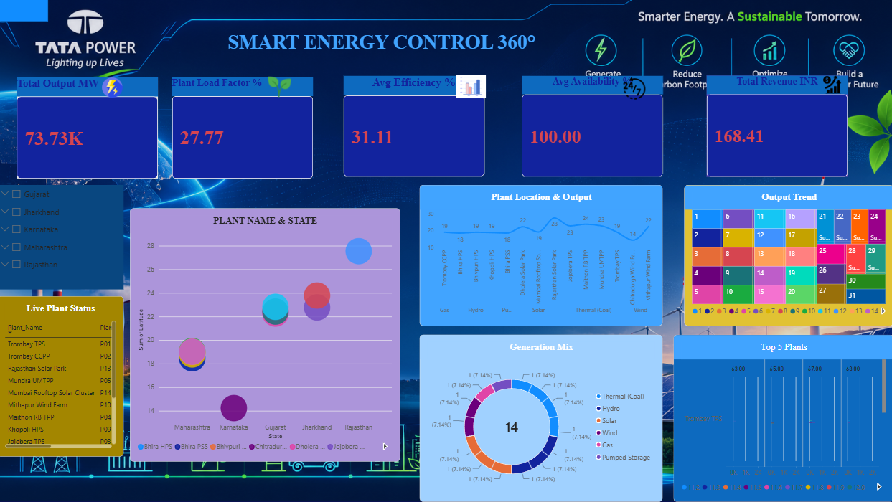
Dashboard 1 · Plant Overview
KEY KPIs
Total Output: 73.73K MW
Plant Load Factor: 27.77
Avg Efficiency: 31.11
Avg Availability: 100.00
Total Revenue: 168.41
VISUALS
Generation mix across 14 plants
Plant location and output
Output trend treemap and Top 5 plants
Live plant status with state slicer
Page 1 of 4: Smart Energy Control 360°
Takeaway: Availability is 100% but PLF is 27.77%, so there is room to raise utilisation.
Notes:
Plant-level view: output, PLF, efficiency, availability and revenue.

Slide 11
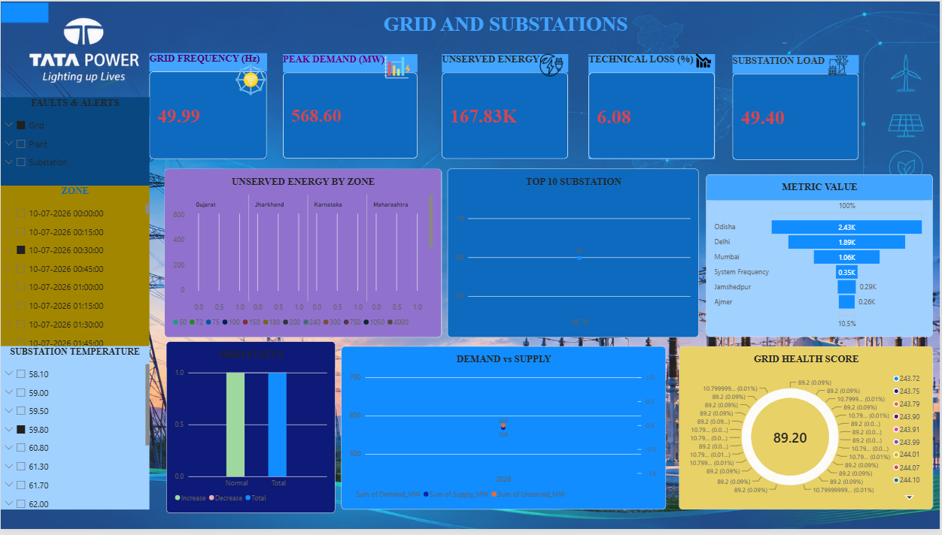
Dashboard 2 · Grid & Substations
KEY KPIs
Grid Frequency: 49.99 Hz
Peak Demand: 568.60 MW
Unserved Energy: 167.83K
Technical Loss: 6.08%
Substation Load: 49.40
VISUALS
Demand vs supply and unserved energy by zone
Grid health score: 89.20
Top 10 substations and grid status
Slicers for faults, zone and temperature
Page 2 of 4: Grid and Substations
Takeaway: Frequency of 49.99 Hz and a grid health score of 89.20 point to a stable grid.
Notes:
Grid stability view: frequency, demand, supply, losses and substation load.

Slide 12
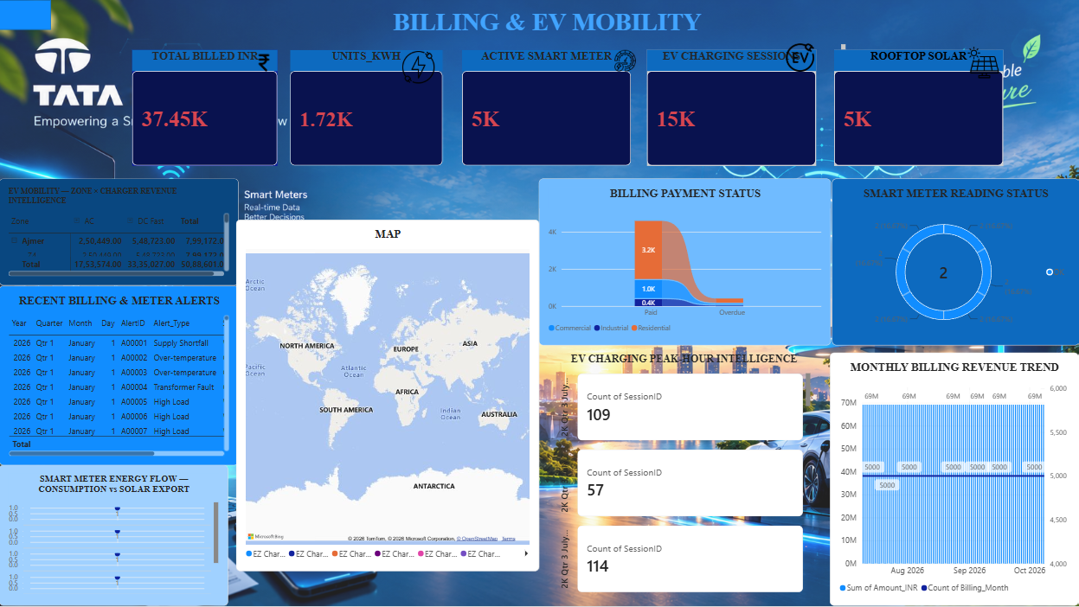
Dashboard 3 · Billing & EV Mobility
KEY KPIs
Total Billed: 37.45K INR
Units: 1.72K kWh
Active Smart Meters: 5K
EV Charging Sessions: 15K
Rooftop Solar: 5K
VISUALS
EV revenue by zone: AC vs DC fast
Billing payment status by category
Monthly billing revenue trend
Meter reading status and billing alerts
Page 3 of 4: Billing & EV Mobility
Takeaway: Residential bills dominate, and 15K EV sessions show strong charging demand.
Notes:
Customer and EV view: billing, payments, smart meters and charging revenue.

Slide 13
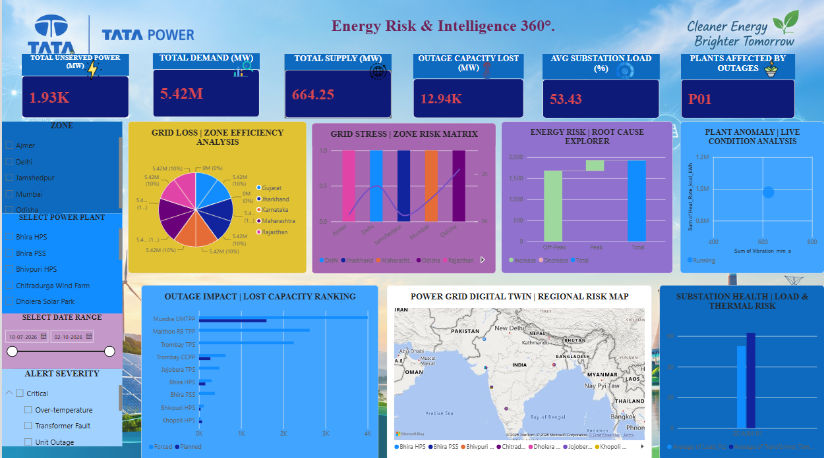
Dashboard 4 · Energy Risk 360°
KEY KPIs
Unserved Power: 1.93K MW
Total Demand: 5.42M MW
Total Supply: 664.25 MW
Outage Capacity Lost: 12.94K MW
Avg Substation Load: 53.43%
VISUALS
Grid stress zone risk matrix
Root cause waterfall and plant anomaly
Outage impact: forced vs planned
Digital twin map and substation health
Page 4 of 4: Energy Risk & Intelligence 360°
Takeaway: Mundra UMTPP leads lost capacity; Trombay TPS (P01) is the plant flagged as affected.
Notes:
Risk view: outages, grid stress, anomalies and root causes.

Slide 14




Key Insights
Availability reads 100% but PLF is 27.77%: capacity is ready but under-used.
Grid frequency holds at 49.99 Hz, close to the 50 Hz nominal.
Mundra UMTPP ranks first for lost capacity in the outage impact view.
Residential customers account for the largest share of paid bills.
Technical loss stands at 6.08% across the grid.
Odisha has the highest value in the zone metric view, then Delhi and Mumbai.
Notes:
Insights read directly from the dashboards. The dataset is generated for the project, so values are illustrative.

Slide 15




Business Benefits
Faster decisions
Early risk detection
Revenue clarity
One live view replaces scattered reports
Outages, overloads and alerts surface quickly
Billing, collections and EV income in one place
Cleaner energy tracking
EV growth insight
Single source of truth
Generation mix and CO2 monitored together
Charging sessions and peak hours by zone
One MySQL model feeds every page
Notes:
Six benefits for plant, grid and customer teams.

Slide 16
Conclusion & Future Scope
Conclusion
Future Scope
MySQL and Power BI work together as one 360° control centre
16 tables feed 4 dashboards covering plants, grid, billing, EV and risk
Clean data and DAX measures give trusted KPIs
The model is ready for live DirectQuery refresh
Connect to real-time plant and grid feeds
Predict equipment faults with machine learning
Forecast demand and solar output with AI
Send automatic alerts by email or Teams
Add a mobile view for field teams
Notes:
Conclusion on the left, ideas for future improvement on the right.

Slide 17
Thank You
Questions & Discussion
K LAKSHMI PRIYA
Data and Business Analytics with AI · Anudip IT Foundation, Pallavaram, Chennai
Notes:
Thank the audience and invite questions.

