Slide 1
OPIM-5512-Data Science using Python
Data Science and STEM Salaries
Team 6
Alpa Panchal
Lakshmi Ramya
Rupam Tyagi
Saqib
Notes:
Good Evening Everyone! My name is Alpa Panchal and my team will be presenting our project on Data Science and Stem Salaries.
My Team members are Laxmi, Rupam & Saqib

Slide 2

Agenda
Introduction
Literature
Business Question
Data Transformation
Data Exploration
Data Modeling
Insights
Conclusion
2
Notes:
Introduction: very quick review of question and background
Literature: what others have done on the same topic (if any); what is new in your project
Data transformations performed –brief overview; list Pandas methods used
Data Description: source, size, format, table summarizing input and target variables, basic stats of data (e.g., min, max, mean, standard deviation, scatter plot, histogram)
Data Exploration: regression, clustering, association analysis, time series plots, etc. (do what you feel is appropriate –no need to do all analyses)

Slide 3
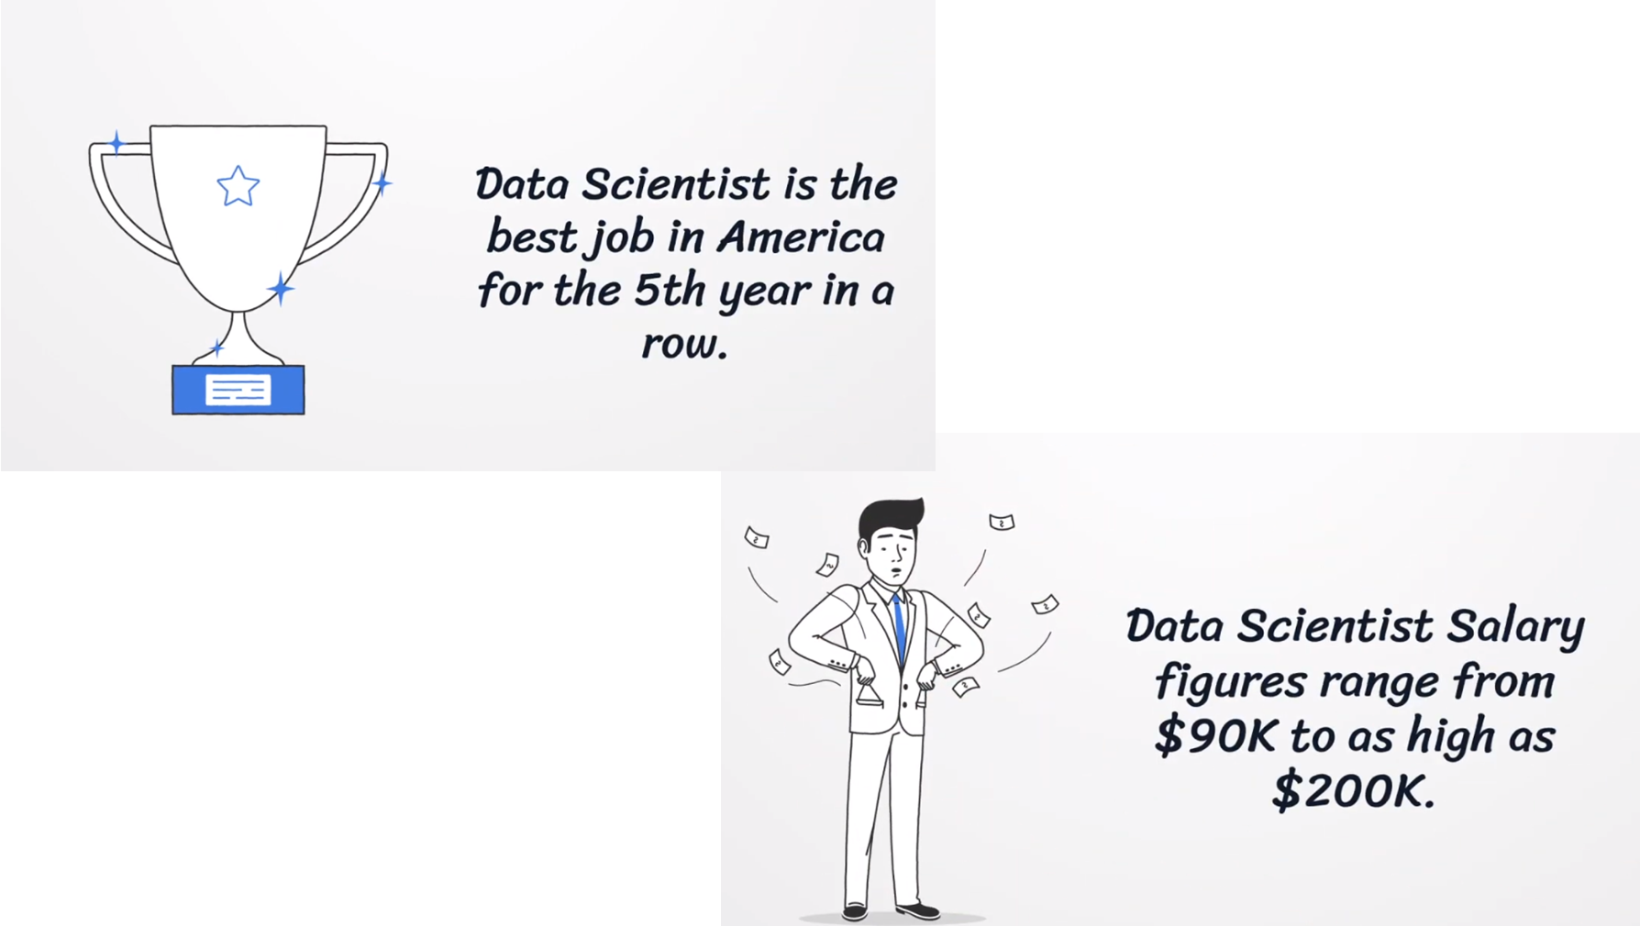
3
Notes:
Glassdoor report ranks Data Scientist job as the “Best Job in America ” based on career opportunities rating, number of open data science jobs, and average salaries earned by data scientists. There has been a hype about the data professions from last 5 years and we all are following such insights and are here to take advantage of such opportunity.
As this topic is highly in conversation between the students of our program we wanted to bring out some deeper insights that would help us make the best decision around our careers.

Slide 4
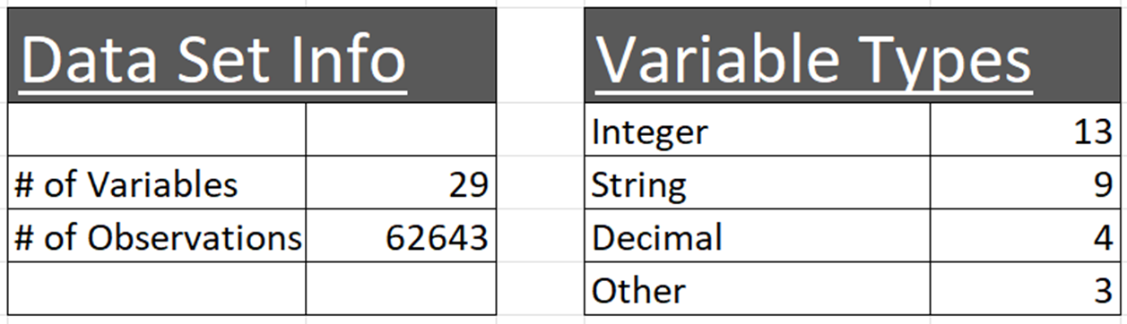
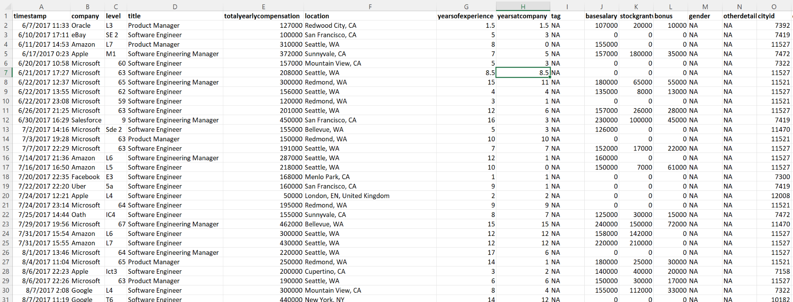
Introduction to Dataset
Data source: Kaggle.com
(Levels_Fyi_SalaryData)
4

Slide 5
Literature
Previous work in this area:
Predicting salaries from job posts
Smaller data sets
Lack of verified salary
Marketing gimmick
Levels_fyi data set:
Data from June 2017 to August 2019
> 1000 companies
15 unique job titles
Salary - base + bonus + benefits
Location - city, state & country
5

Slide 6
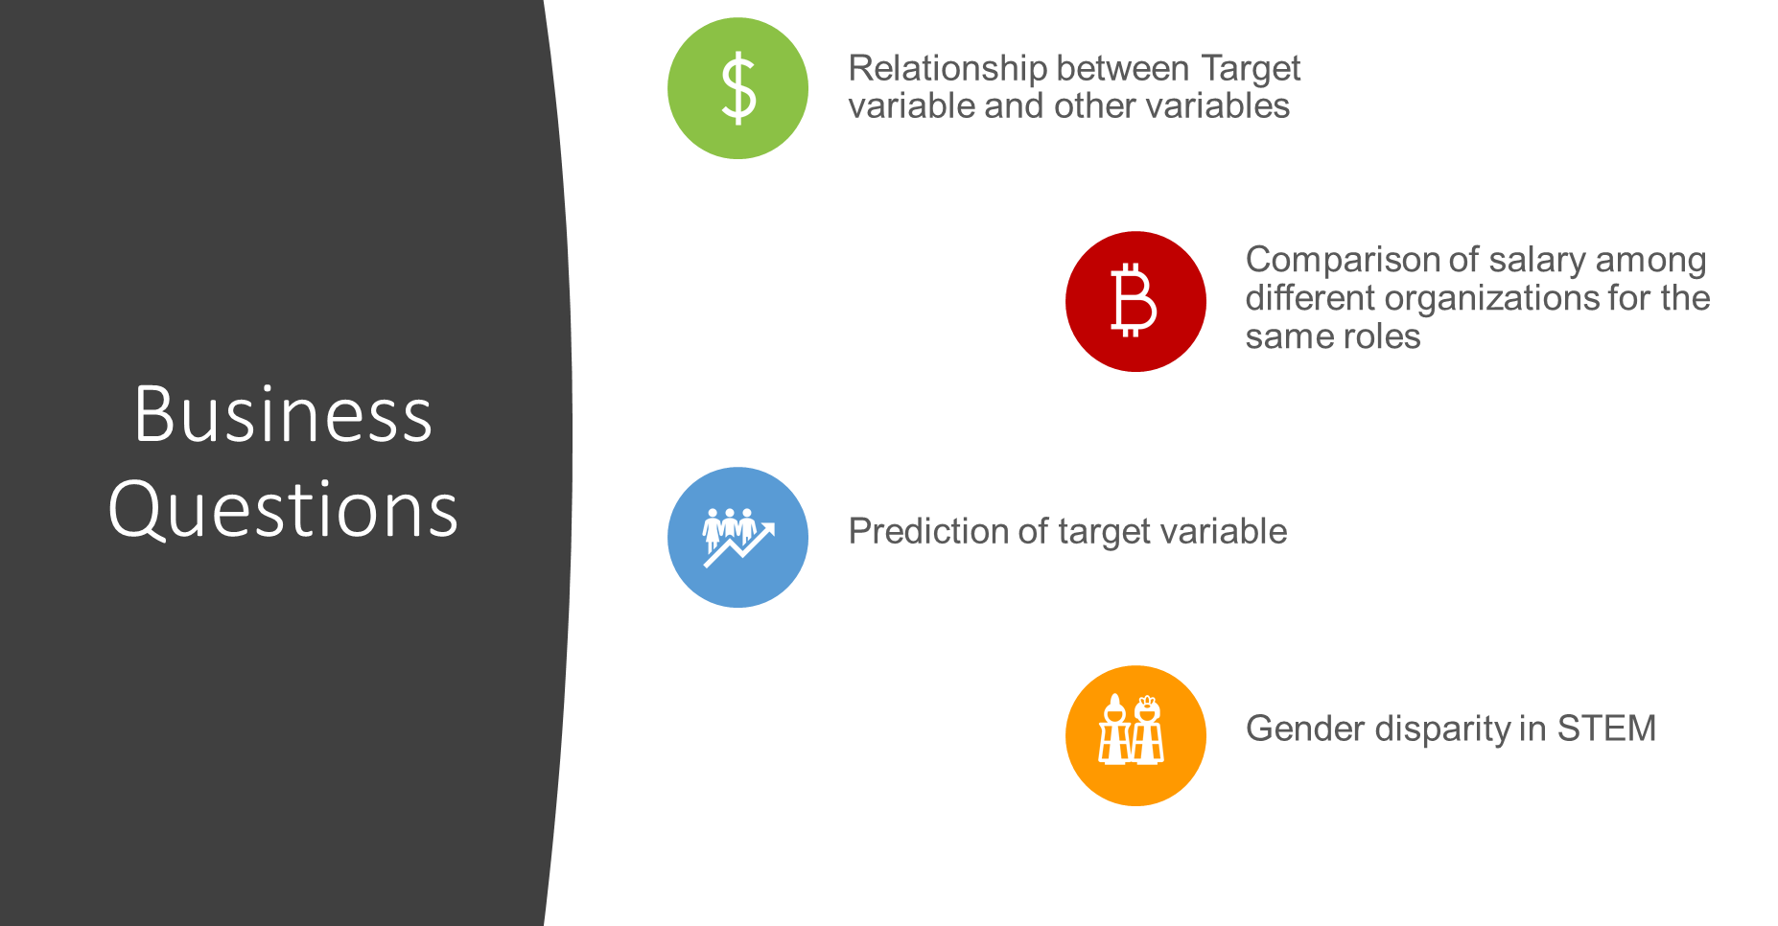
6

Slide 7
Data Transformation

Slide 8
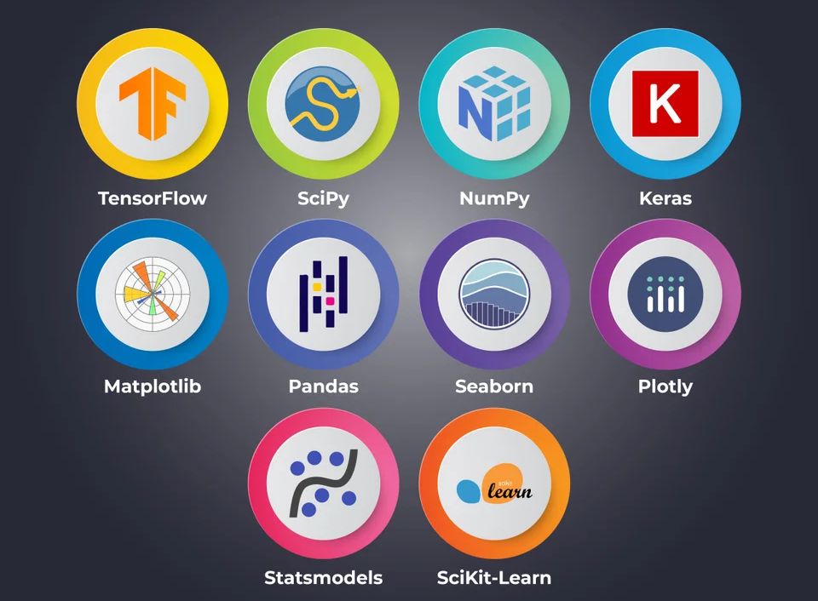
Python Libraries
Used
Pandas
Numpy
Matplotlib
Seaborn
Sklearn
Statsmodels
Scipy
math
8

Slide 9

Data Cleaning
Dimension reduction (dropping of insignificant columns)
Delete rows with base salary is zero
Replacing blank fields in Race, Education and Gender with N/A
Rounding off years of experience and years at company to closest natural number
Splitting the location data to give both the area and the country
9

Slide 10
Data Exploration

Slide 11
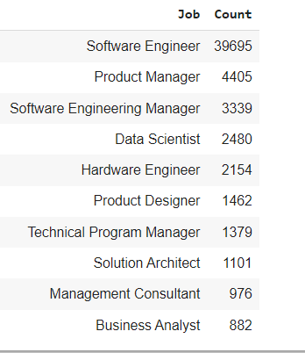
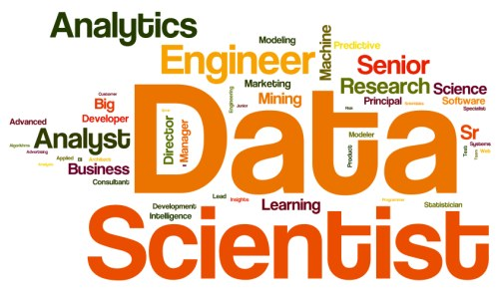
Top 10 Job Profiles
11

Slide 12

Data explorations shared on
Colab & Tableau
Total yearly compensation of job roles
Total yearly compensation of Software Engineer, Data Scientists, Solution Architects
Total yearly compensation in top 8 companies
Distribution of Top 8 companies
STEM jobs across US cities
STEM Jobs in US, UK, India, Canada and Germany
Total yearly compensation across all education levels among genders
Gender disparity in STEM jobs across 4 countries.
STEM jobs spread across US
Heat map of STEM job profiles with their average base salary those who have bachelor's or higher-level education degrees.
12

Slide 13
Data Modeling

Slide 14

Modeling
Model | R^2
Linear Regression | 0.6063
Decision Tree | 0.4632
KNN | 0.48059
Best Model - Linear Regression
14

Slide 15
Insights
From the different models we conclude that the companies tend to pay higher salary to external candidate in comparison to internal candidate.
Working on Tableau we found that there is gender inequality in workforce in STEM related jobs, we can see a clear trend difference between developing and developed countries, US is the leader in the field.
From the analysis we saw that the most STEM related job opportunities are open at Amazon, thought the highest paying company is Facebook.
15
Notes:
Better compensation to employees with diverse background

Slide 16
Conclusion
From the observation we would suggest the candidates to look for new opportunities in the market rather than trying to find them in the current organization.
As a female candidate for better opportunities, it is more probable to secure a job in US than the rest of the world.
To aim for a job in leading firms, it is easier to get into amazon as the number of opportunities are more but for maximizing yearly compensation Facebook is the best option.
16

Slide 17
Q/A

Slide 18
References
https://nycdatascience.com/blog/student-works/job-salary-prediction-with-python/
https://www.projectpro.io/article/data-scientist-salary-the-ultimate-guide-for-2021/218

