Slide 1
Economic Epidemiology of Malaria and Economic Growth
Lakshmi K. Raut
Partially funded by the World Bank #Budget RPO 683-32. The findings, interpretations, and conclusions expressed in this paper are entirely those of the author. They do not necessarily represent the views of the World Bank, its Executive Directors, or the countries they represent.

Slide 2
Plan of the presentation
Basic Facts about Malaria
  Global incidence, and significance
Biology of Malaria Parasites
  Life cycle (requires both human and vector as hosts to complete its life cycle)
  Symptoms and Health Consequences
  Treatment
  Drug resistance
  Vaccines
Economics of Malaria Disease (main purpose of this paper) (next slide)

Slide 3
Plan of the presentation continued
Main purpose:
I model the disease dynamics and its effects on income growth using human capital approach to demand for health, I.e., based on economic calculations.
Predictions of this economic model differ from the purely epidemiological model in terms of the short-run and long-run behavior of the disease, its effect on economic growth, welfare losses, timing of drug-resistance, and implications for public policies - for example, the extent to which public control programs could be privatized through tax-subsidy policies or community level incentives, educating population about the real effects of malaria
The model generates Malthusian poverty trap all over again.
Lets begin with the basic facts (next slide)

Slide 4
Basic facts about Malaria
Malaria is a public health problem today in more than 90 countries, inhabited by a total of some 2 400 million people -- 40% of the world's population.
Worldwide prevalence of the disease is estimated to be in the order of 300-500 million clinical cases each year.
More than 90% of all malaria cases are in sub-Saharan Africa.
Mortality due to malaria is estimated to be over 1 million deaths each year. The vast majority of deaths occur among young children in Africa, especially in remote rural areas with poor access to health services.
Malaria kills one child every 30 seconds. In absolute numbers, malaria kills 3 000 children per day under five years of age.

Slide 5
Basic Facts (continued)
Other high-risk groups are women during pregnancy, and non-immune travelers, refugees, displaced persons and laborers entering endemic areas.
Malaria epidemics are caused by political upheavals, Global warming" and other climatic events such as "El Niño“, International travels and migration and labor mobility, irrigation projects.
Malaria is endemic in a total of 101 countries and territories: 45 countries in WHO's African Region, 21 in WHO's Americas Region, 4 in WHO's European region, 14 in WHO's Eastern Mediterranean Region, 8 in WHO's South-East Asia Region, and 9 in WHO's Western Pacific Region.

Slide 6
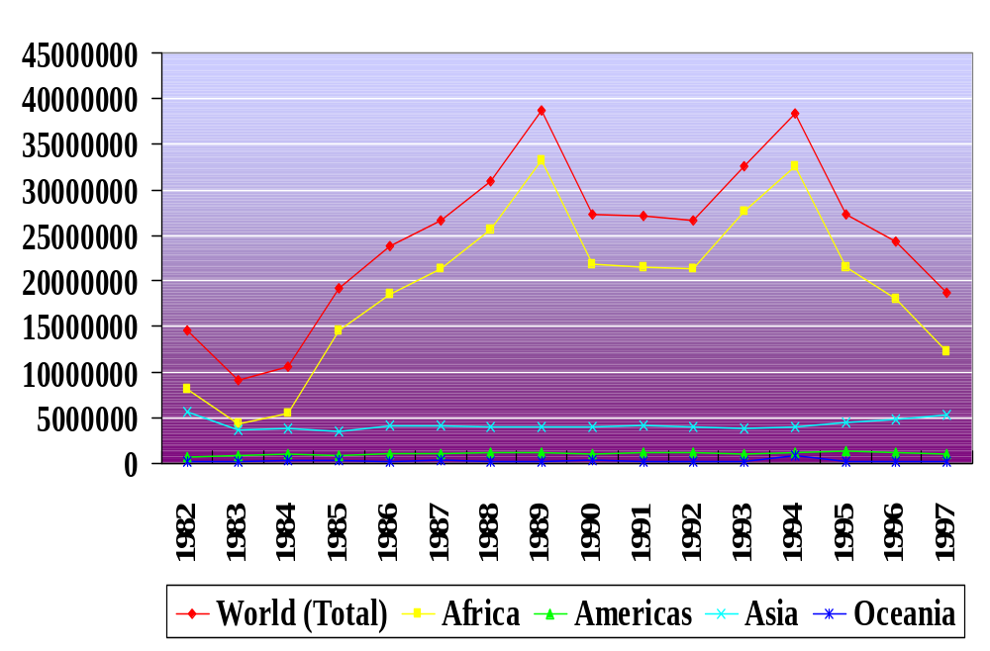
World incidence of Malaria over time

Slide 7
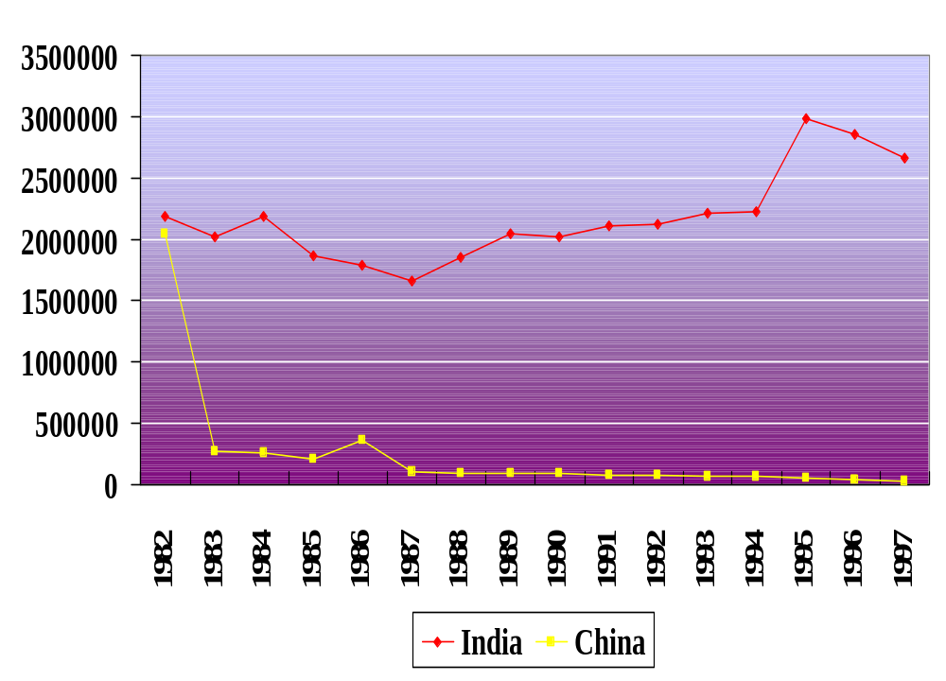
China and India

Slide 8
Malarial species (Four Serious ones)
P. falciparum (the grim reaper)
  Lethal disease.
  Wide distribution (Especially Sub Saharan Africa & Melanesia)
P. vivax
  Chronic, more benign infection
  Americas, N Africa, Middle East, India
P. ovale (W Africa)
P. malariae (Africa and elsewhere)

Slide 9
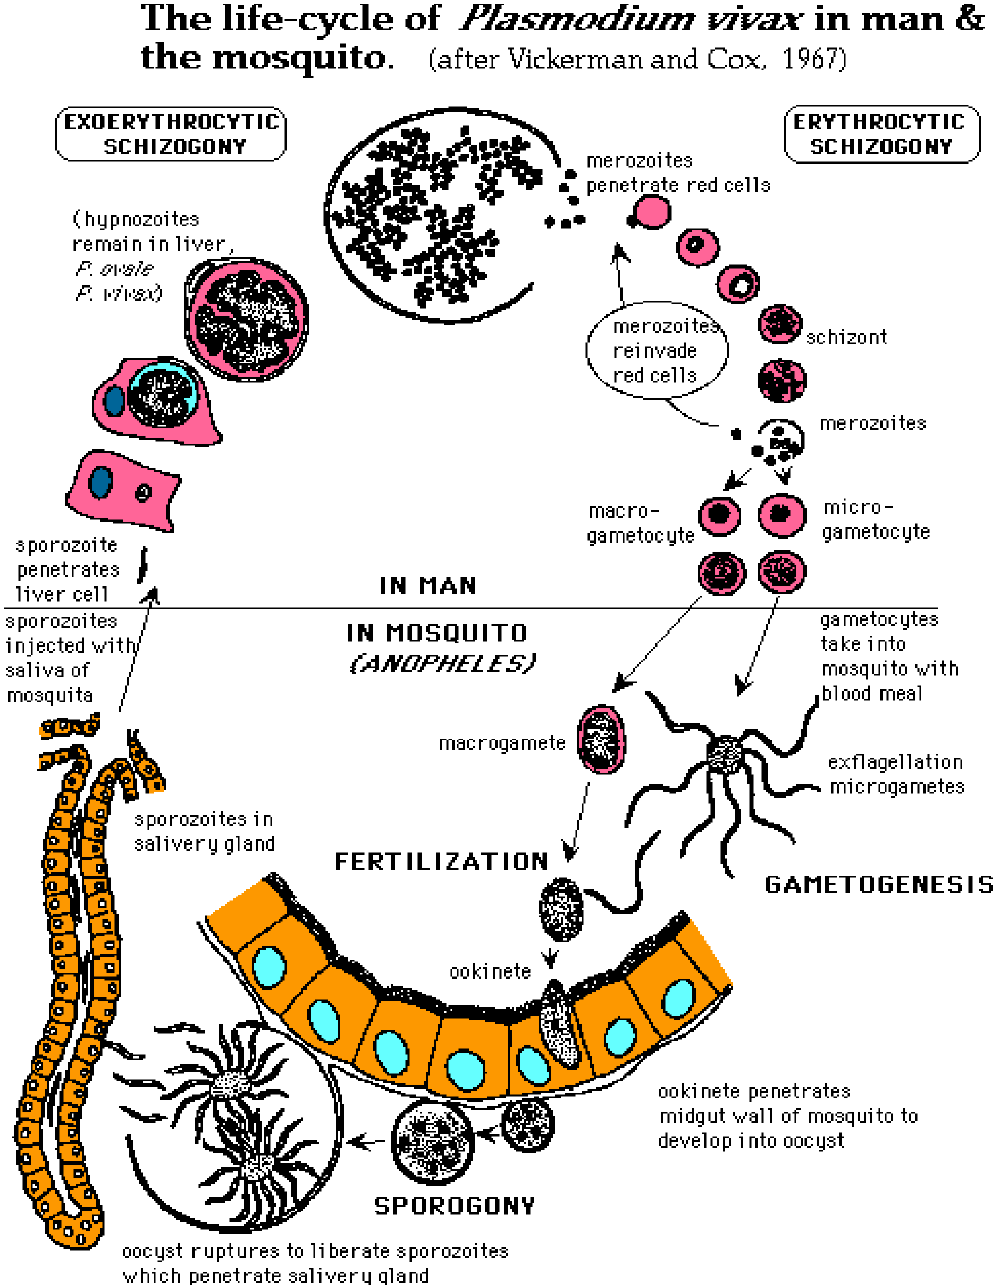
Parasite’s life-cycle (in man and female mosquito)

Slide 10
Symptoms and Health Consequences
As the shizonts mature in the liver, huamn host gets high fever (maybe above 41ºC), shivering, pain in the joints, headache, repeated vomiting, convulsions and coma.
P. falciparum (acute sequestration)
  Cerebral malaria (fits, coma, death)
  Hypoglycaemia (kids), lactic acidosis
  Severe anaemia (haemolysis)
  Renal failure, multi-organ failure
P. vivax, P. malaria, P. falciparum (chronic disease)
  Tropical splenomegaly, splenic rupture, Immune
  complex glomerulonephritis
During Pregnancy (next slide)

Slide 11
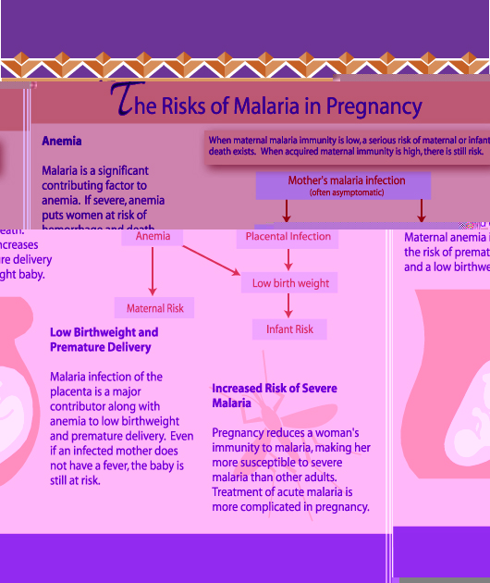
Lives at risk (pregnant women)

Slide 12
Treatment: Preventive care
insecticide impregnated mosquito nets (most cost effective)
prophylactic drugs (expensive and meant for occasional use)
Some substance from coconut tree, throwing those in ponds can kill mosquito larva (yet at development stage)
Replacing world mosquito population with genetically engineered mosquito having high resistance towards reproductive cycle stage of P. falciparum in mosquito (still at research stage).
Vaccines (one at clinical trial, and other ones under development). For details, see the vaccine slide.
Notes:
Preventive care: Ref for (4), Nchinda for ref
(3):

Slide 13
Treatment: Curative care
Antimalarial drugs:
chloroquine oldest medicine but widespread drug-resistance
Sulfadoxine/pyrimethamine
Artemisnins, right now the drug of the last resort and P.falciparum, has not yet developed drug resistance

Slide 14
Vaccines Development
Vaccines are at clinical testing stage. Different vaccines target different stages of life cycle of P.falciparum
Pre-erythrocytic vaccines
  Prevent sporozoite from entering or developing within liver cells (currently one vaccine is under field trial in the Gambia).
Asexual blood stage vaccines
  Prevent the merozoite from entering or developing within red blood cells.
  Would not prevent people from getting infected, but would provide immunity for the symptom causing blood stage.
Transmission-blocking vaccines
  Inhibit development of sexual stages of parasite (currently undergoing clinical trials)

Slide 15
Economics of Malaria- household demand Preventive and curative care
Human Capital approach to investment in health:
Agent, α : vary according to age, a, schooling level s, stock of health capital hª and thus parental income level.
Malaria season is at the beginning of each period. The likelihood of malaria infection if one does not use the malaria prevention package depends on the malaria prevalence rate i_{t} at the beginning of the period. Uncertainty about malaria infection is resolved at the beginning of a period.
In each period t given his health stock, financial assets, and the malaria infection rate i_{t} at the beginning of the period, an individual decides whether to invest in malaria preventive care package, after the malaria period is over, he goes to work and decide how much to save.
If he is infected with malaria, he has to spend x^{c} curative care, he loses 0 < T <1 hours of work, and 0< H <1 fraction of his health capital.
Then decisions are guided by expected utility maximization.

Slide 16

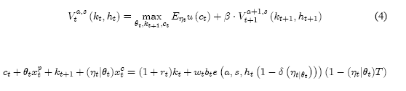




General Model:

Slide 17
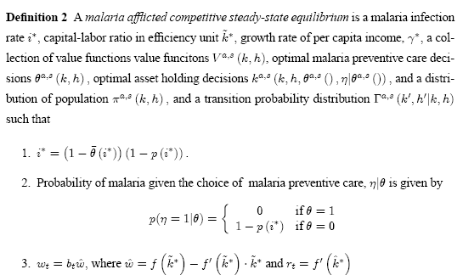
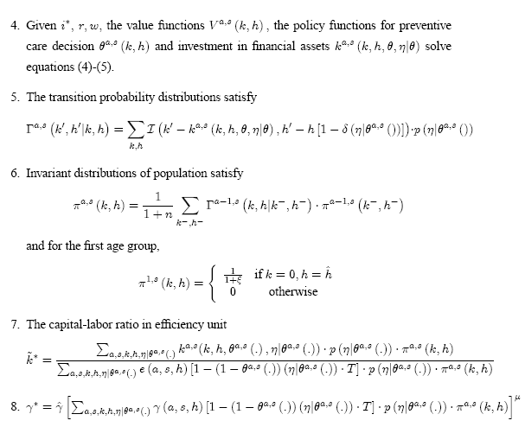

Slide 18
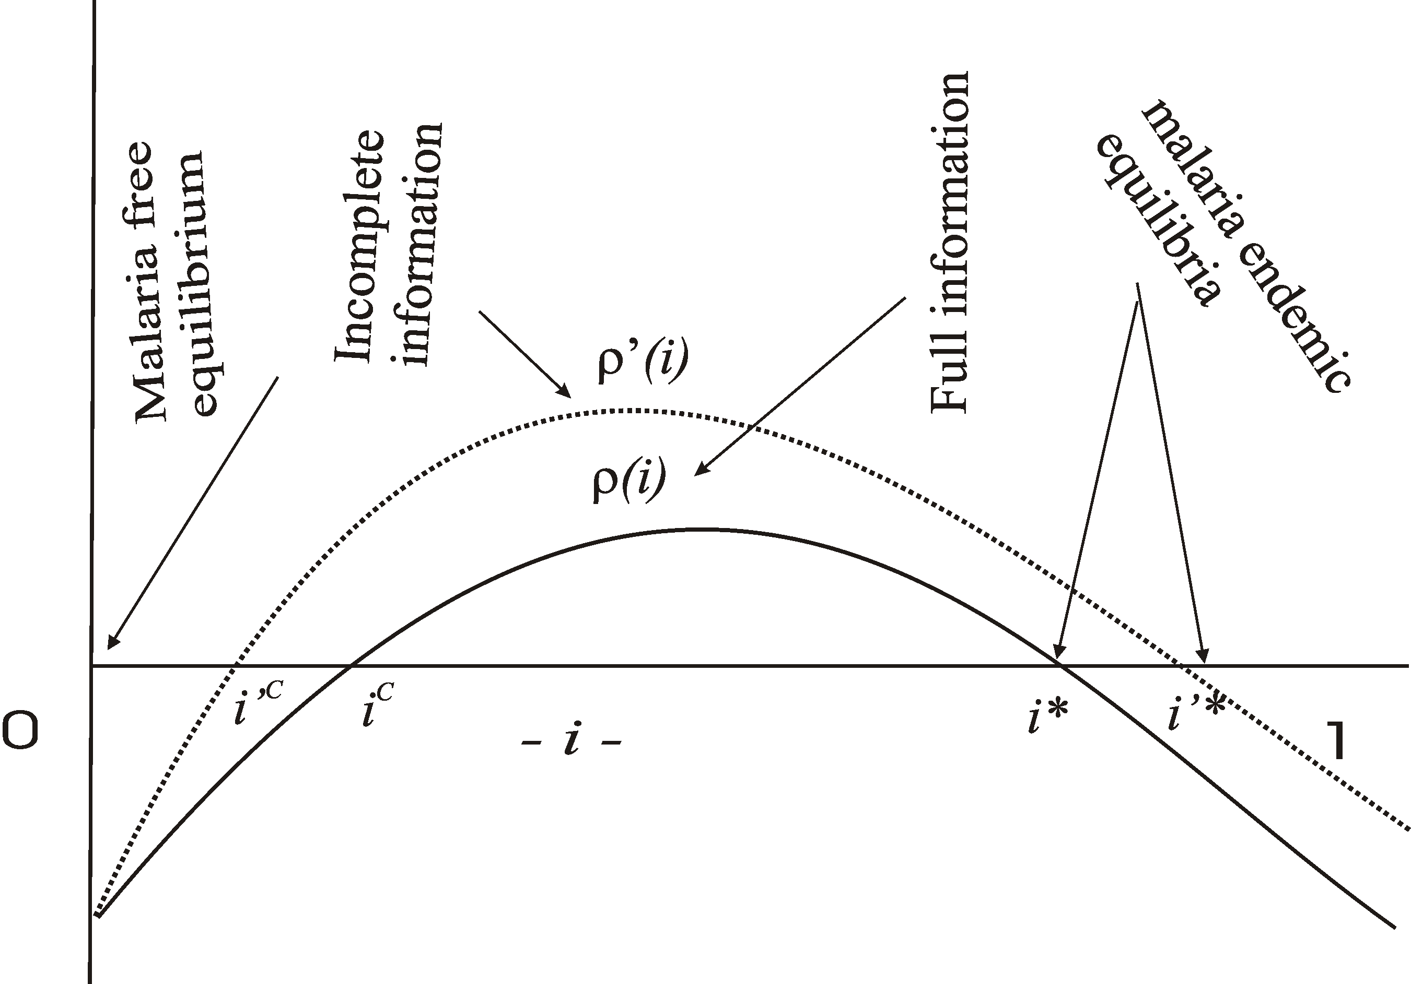

Slide 19
The End
Thank you for your comments and for coming

