Slide 1
Intergenerational Long Term Effects of Preschool -Estimates from a Structural Dynamic Programming Model
James Heckman, University of Chicago
and
Lakshmi K. Raut, Social Security Administration
Based on Heckman and Raut[2016, J. Econometrics,191:164-175, NBER 2013}, Raut{2003]
Notes:
1

Slide 2
Disclaimer
Dr. Lakshmi K. Raut is an Economist at the Social Security Administration (SSA). This paper is prepared at his personal time, and the analysis and conclusions expressed are those of the authors and not necessarily those of SSA.

Slide 3
Summary
Economic Issues:
Skills such as social, motivational and cognitive skills are important for school and labor market success. Inequality in these skills could be an important source of inequality and social mobility.
Where are they produced? Role of preschool inputs.
Children of poor SES lack those skills, leading to lack of demand for higher education.
Methodology:
Equilibrium Markov Process arising from an altruistic model of parental preschool investment within a structural dynamic programming framework, featuring stochastic production processes of various skills and individual choices. Use nationally representative survey dataset NLSY79
Policy: We estimate the effect of a publicly provided preschool to disadvantaged children as a “social contract” for every generation, especially
Within generation effect: educational and labor market achievements, earnings distribution
Intergenerational effect: Social (lifetime earnings) mobility and schooling mobility.
Estimate general equilibrium tax burden of such a social contract policy.
Findings:
Preschool has significantly positive effects on production of social, motivational and cognitive skills.
These skills have significantly positive effects on school and labor market outcomes.
The conventional estimate of the rate of returns to schooling without including the other skills overestimates it by around one percent.
The gains to the society exceed the cost of such a policy.
The positive effects on social mobility, college mobility and income inequality are not dramatic but significant. The estimates are based on the qualities of preschools in the sixties. Higher economy-wide returns expected from better quality preschool programs such as Perry and Abecedarian preschool programs.

Slide 4
Outline
First I show a few stylized facts about growing inequality and low social mobility, high premium for college graduation in the labor market. Questions:
In spite of high premiums for college, why children from poor SES do not complete college?
What skills are important for labor market and school success?
Then I will show that personality skills such as Big Five including social, motivational and cognitive skills are important for school and labor market success.
Sources of Inequality: Globalization, Labor market practices, our focus is on inequality at birth in terms of development in health, and human capital including cognitive and non-cognitive skills.
We formulate the production process of these skills, parental choice problem and estimation method and the results.

Slide 5
Notes:
http://www.oecd.org/unitedstates/Tackling-high-inequalities.pdf

Slide 6
Notes:
Figure 6 in
http://www.oecd.org/unitedstates/Tackling-high-inequalities.pdf
OECD_2014

Slide 7
Source: Autor [2014, Science]
Notes:
Autor_2014, Fig1
http://dx.doi.org/10.1126/science.1251868

Slide 8
Important Skills: Cognitive and Personality traits
Cognitive Skills:
Intelligence, schooling level
Big Five Personality skills :
Self-control, Executive Function (EF), Social and Motivational skills
Evidence on the effects of these skills
Stanford Marshmallow Test (see Walter Mischel, 2014 book )
U.S.Census Bureau interviewed 3,000 employers (1 to 5 very important): skill credentials - 3.2, years of schooling - 2.9, scores on employer given test and academic performance- each 2.5, attitude - 4.6 and communication - 4.2.(see Bowles et al (2001, JEL)
Our empirical evidence using the NLSY 79 data

Slide 11
Boosting personality and cognitive skill formations with preschool intervention
Brain Development is a dynamic process – Interaction of genetic programs and experience-dependent plasticity, see, Noble et al (2012, Developmental Science
fMRI shows effects of language & stress on development of regions of prefrontal cortex
Perry Preschool (see Schweinhart, 2002,Online Res. Bulletin)
The Mind Tools Program (see Diamond et al, 2007)
Evidence from NLSY, I present the findings from our paper, Heckman and Raut [2016] and my earlier paper Raut[2003].

Slide 13
An altruistic Model of parental preschool investment, Raut[2003] and Heckman and Raut[2016]
Observable states of an individual:
x = (τ, σ, μ, η, φ, s)
τ : talent,
σ : socialization,
μ : motivation,
η : Self-esteem (Rosenberg measure),
φ : Internal self-control (Perlin measure)
S : Schooling level
z = (x, ε), ε : taste shifter and random factors affecting permanent income, school outcome given observable inputs.

Slide 14
Structural Dynamic Programming Model
Parent of type (x, ε), earns w (x, ε), decides preschool investment a in A(x). -> Determines
Consumption c (w, a) = w – θ a, a = 0, 1.
Transition probability : p(x’,dε’|x, ε,a)
Bellman equation of the choice problem:
Optimal solution: a(x, ε).
Structural Parameters: where ξ_{p} : parameters characterizing transition probabilities
Data:

Slide 15
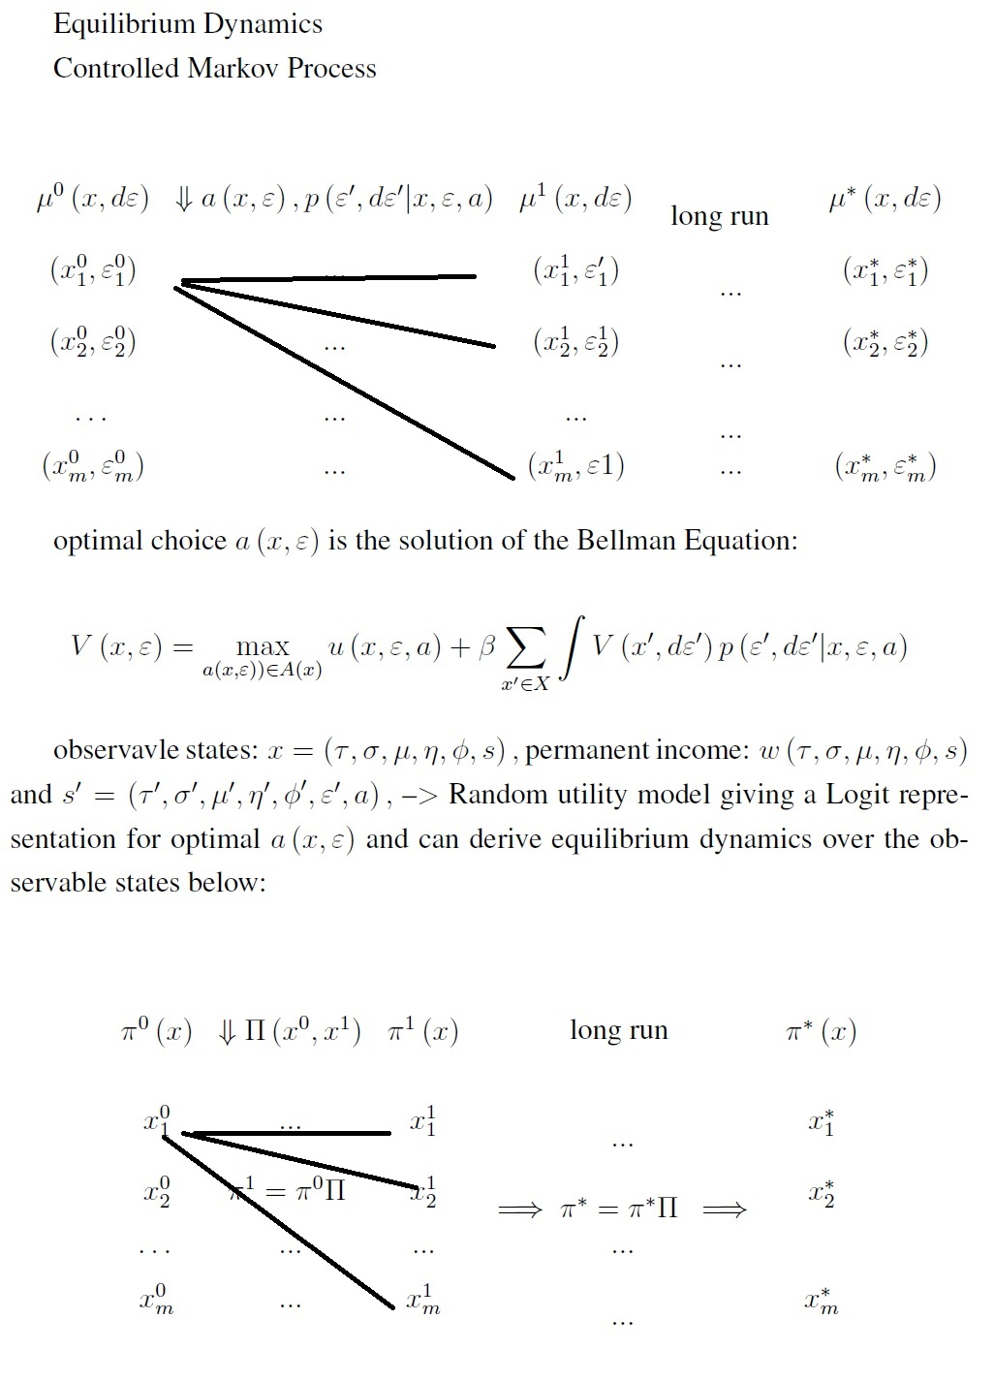

Slide 17

Intergenerational Effects of Free preschool to children of poor SES
From estimated optimal transition probability matrix p(x’|x,a(x)), x in X, calculated Intergenerational mobility measure: 1- λ_{max:} Invariant population distribution
College Mobility:
Before:
After Policy:
Social mobility:
before the policy: 0.5945
After the policy: 0.6465
Income Inequality (Gini Coefficient):
Before the policy:0.2363, percent in poor SES: 36 , w = 5622
After the policy: 0.2335, percent in poor SES: 30, w = 5735
Tax Burden of the Social Contract
Per capita gain in average after tax earnings == $113

Slide 18
Thank you…

