Slide 1
Preschool Investment, Earnings Inequality and Social Mobility
Also Heckman and Raut[2013] and Raut[2003] results
Lakshmi K. Raut, Social Security Administration

Slide 2
Disclaimer
Dr. Lakshmi K. Raut is an Economist at the Social Security Administration (SSA). This paper is prepared at his personal time, and the analysis and conclusions expressed are those of the author and not necessarily those of SSA.

Slide 3
Outline
First show stylized facts about growing inequality and low social mobility, high premium for college graduation in the labor market but children from poor SES lagging fails to complete college and have low earnings
Personality skills such as Big Five including social, motivational and cognitive skills are important for school and labor market success
Where are they produced? → Home, neighborhood → role of preschool inputs
Draw from various studies including Neuroscience Approach to Brain Development, I will show how children of poor SES are adversely affected:
I will then present the evidence from Heckman and Raut[2013, NBER] to show preschool has positive effect on reducing earnings inequality and improving social mobility.
Providing quality Preschool to children of poor SES is important for Inequality, Social Mobility

Slide 7
Source: Autor [2014, Science]

Slide 8
Sources of Inequality
Globalization,
Skill biased technological change, knowledge based technology
Policy induced,
China (Hukou and decentralization education financing
India, subsidies for Higher Education, encouraging education for the elite class that British created)
Poverty breeds poverty

Slide 9
Important Skills: Cognitive and Personality traits
Cognitive Skills:
Intelligence, schooling level
Big Five Personality skills :
Self-control, Executive Function (EF), Social and Motivational skills
Evidence
Stanford Marshmallow Test (see Walter Mischel, 2014 book )
Perry Preschool (see Schweinhart, 2002,Online Res. Bulletin)
U.S.Census Bureau interviewed 3,000 employers (1 to 5 very important): skill crentials - 3.2, years of schooling - 2.9, scores on employer given test and academic performance- each 2.5, attitude - 4.6 and communication - 4.2.(see Bowles et al (2001, JEL)
The Mind Tools Program (see Diamond et al, 2007)
Evidence from NLSY, I present the findings from Raut[2003] and Heckman and Raut [2013] for Head Start see Currie and Thomas (1995)

Slide 10
Table 1: Determinants of earnings -- role of cognitive and non-cognitive skills

Slide 11
Table 2: Determinants of schooling

Slide 12
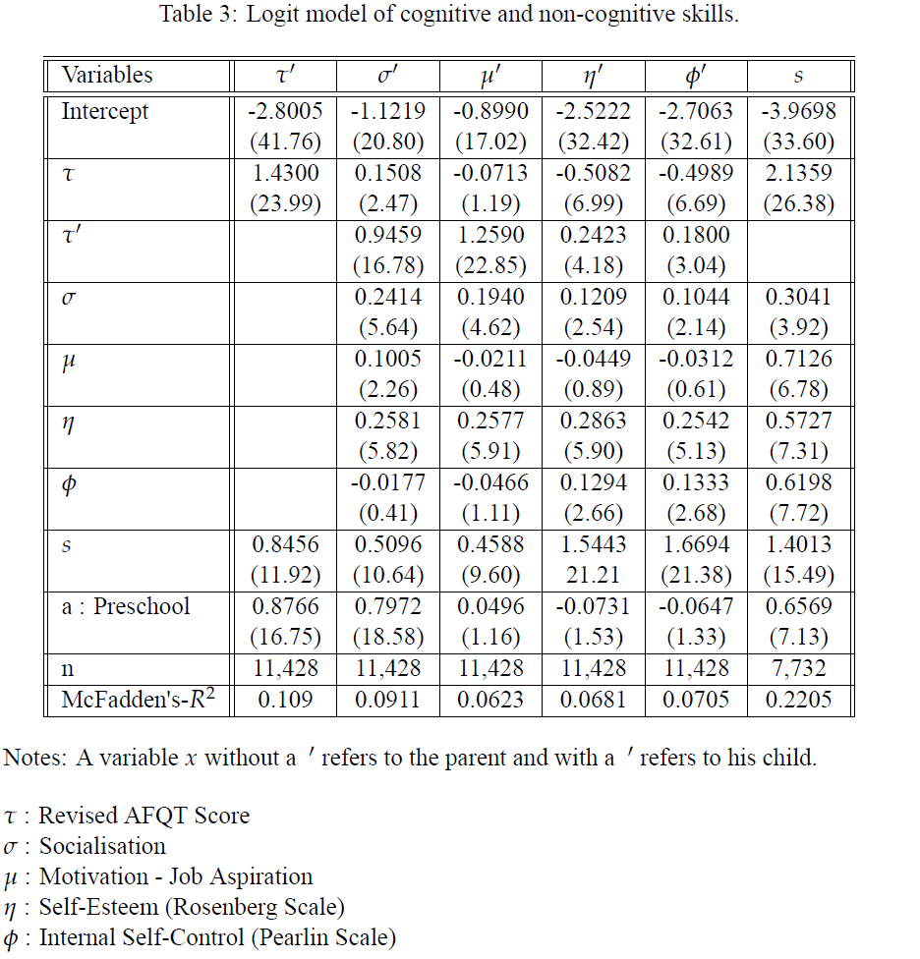

Slide 13
Why Preschool? Mechanism of personality and cognitive skill formations: Neuroscience Research (see, Noble et al (2012, Developmental Science)
Cognitive Neuroscience Approach to brain development:
It is known that human brain develops between age 0-8 and almost at the speed of light between age 2-3. The stimulus that is given to a child during this time is most important for the child’s later development.
Brain Development is a dynamic process – Interaction of genetic programs and experience-dependent plasticity
fMRI shows effects of lang & stress on development of regions of prefrontal cortex

Slide 14
An altruistic Model of parental preschool investment, Raut[2003] and Heckman and Raut[2013]
Observable states of an individual:
x = (τ, σ, μ, η, φ, s)
τ : talent, σ : socialization,
μ : motivation,
η : Self-esteem (Rosenberg measure),
φ : Internal self-control (Perlin measure)
z = (x, ε), ε : taste shifter and random factors affecting permanent income, school outcome given observable inputs.

Slide 15
Structural Dynamic Programming Model
Parent of type (x, ε), earns w (x, ε), decides preschool investment a in A(x). -> Determines
Consumption c (w, a) = w - θ (a), utility: u(x, ε,a)
Transition probability : p(x’,dε’|x, ε,a)
Bellman equation of the choice problem:
Structural Parameters: where ξ_{p} : parameters characterizing transition probabilities
Data:

Slide 16
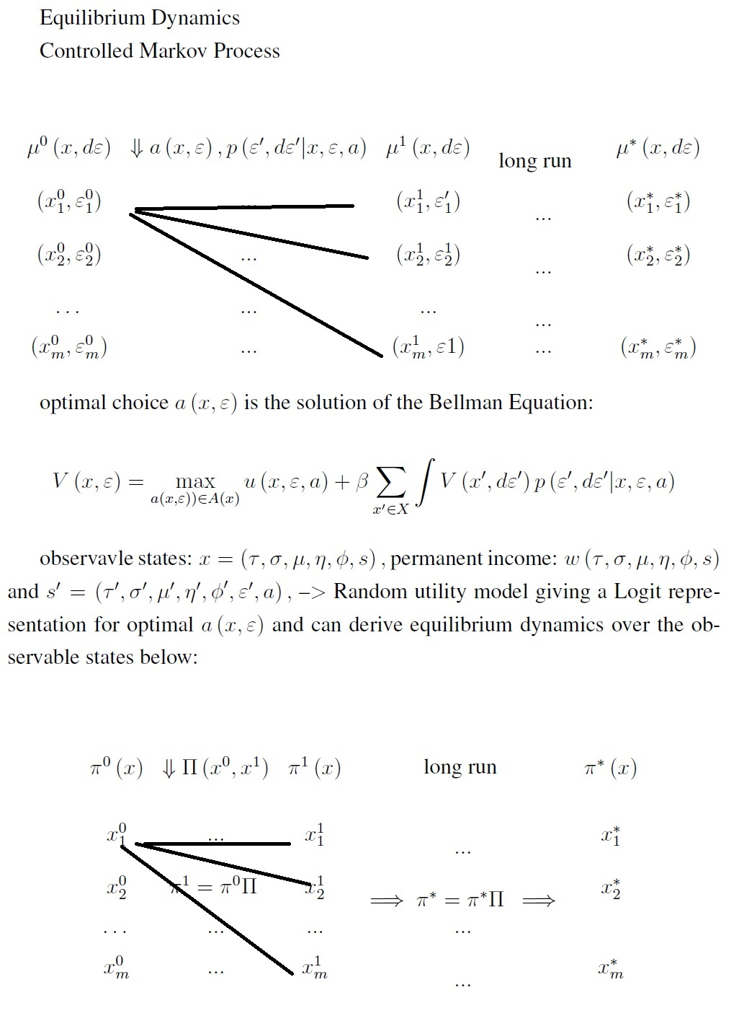

Slide 17

Intergenerational Effects of Free preschool to children of poor SES
From estimated optimal transition probability matrix p(x’|x,a(x)), x in X, calculateed Intergenerational mobility measure: 1- λ_{max:} Invariant population distribution
College Mobility:
Before:
After Policy:
Social mobility:
before the policy: 0.5945
After the policy: 0.6465
Income Inequality (Gini Coefficient):
Before the policy:0.2363, percent in poor SES: 36 , w = 5622
After the policy: 0.2335, percent in poor SES: 30, w = 5735
Tax Burden of the Social Contract
Per capita gain in average after tax earnings == $113

Slide 18
Thank you…

