Slide 1

Professor Lakshmi K. Raut
Visiting Fellow, University of Chicago,
and
Visiting Professor,
Indian Institute of Management - Udaipur
lakshmiraut@gmail.com

Slide 2
Many factors are responsible for growing income inequality around the world
  capital outflow, relocation of jobs, declining labor union, i.e., declining bargaining power of the labor, poor regulation of financial institutions, corruption, and all-encompassing globalization (Bourguignon, 2015; Piketty, 2014; Stiglitz, 2015).
For the 99% population, the main source is earnings.
Determinants of earnings-effects of labor market phenomena
  Earlier literature: Cognitive abilities -> IQ, schooling
  Recent literature: Adds emotion (affect) dysregulation-> personality skills
Where are they produced?
  Home, neighborhood, role of early childhood inputs from primary caretaker (generally mother) -- (Bowlby (1982), NICHD Early Childhood Network (2004)
  More recent neuroscience research on Brain Development.
Show empirical evidence from Heckman and Raut[2016]
Asymmetric information and labor market education signaling model

Slide 3
Important Skills: Cognitive and Personality traits
Cognitive Skills:
  Intelligence, schooling level →Bell Curve controversy etc.
Emotion or Affect regulation -> Big Five Personality skills
  Self-control, Executive Function (EF), Social and Motivational skills
Evidence
  Stanford Marshmallow Test (see Walter Mischel, 2014 book )
  Perry Preschool (see Schweinhart, 2002,Online Res. Bulletin)
  U.S.Census Bureau interviewed 3,000 employers (1 to 5 very important): skill crentials - 3.2, years of schooling - 2.9, scores on employer given test and academic performance- each 2.5, attitude - 4.6 and communication - 4.2.(see Bowles et al (2001, JEL)

Slide 4
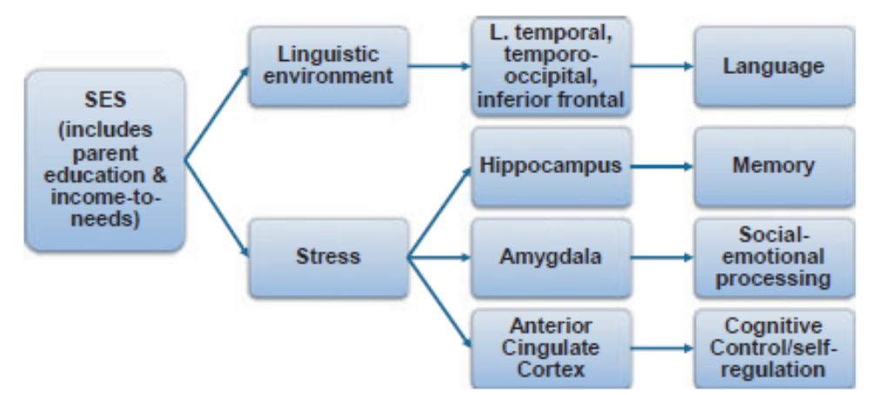
Emotion or Affect Dysregulation: Neuroscience Approach
Human brain develops between age 0-8 and almost at the speed of light between age 0-2.
Poor quality interaction of the primary care-taker -> affect dysregulation with long-term effects on cognition and emotion
Apart from quality of parenting, prenatal care, post natal care, and home environments, Other effects of poor SES on neural development.
  Toxin exposure: higher levels of lead affect IQ and reading ability.
  Nutrition: low intakes influence cognition and emotion.
  Stress: stress in family leads to affect dysregulation and language
fMRI shows effects of language & stress on development of regions of prefrontal cortex

Slide 5
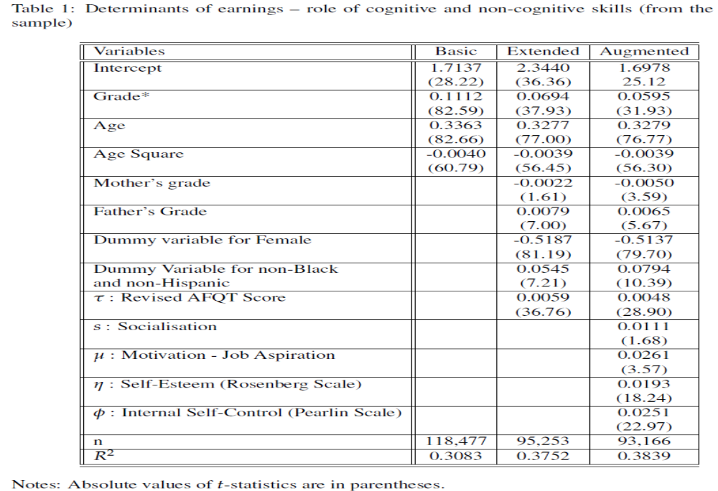
Table 1: Determinants of earnings -- role of cognitive and non-cognitive skills

Slide 6
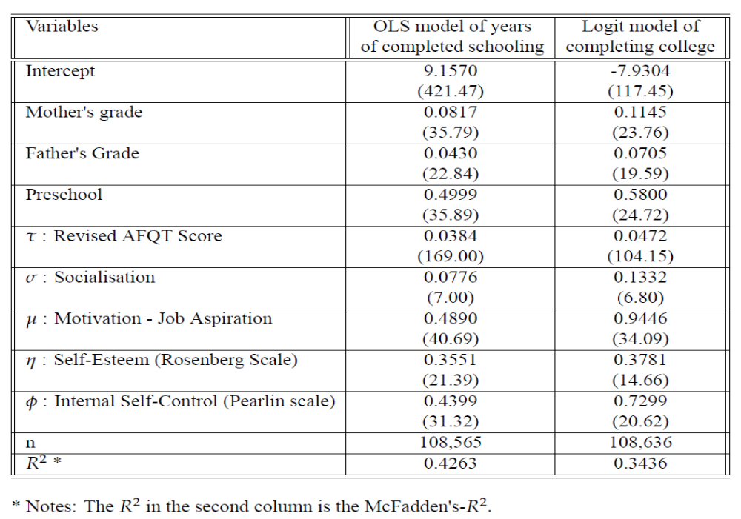
Table 2: Determinants of schooling

Slide 7
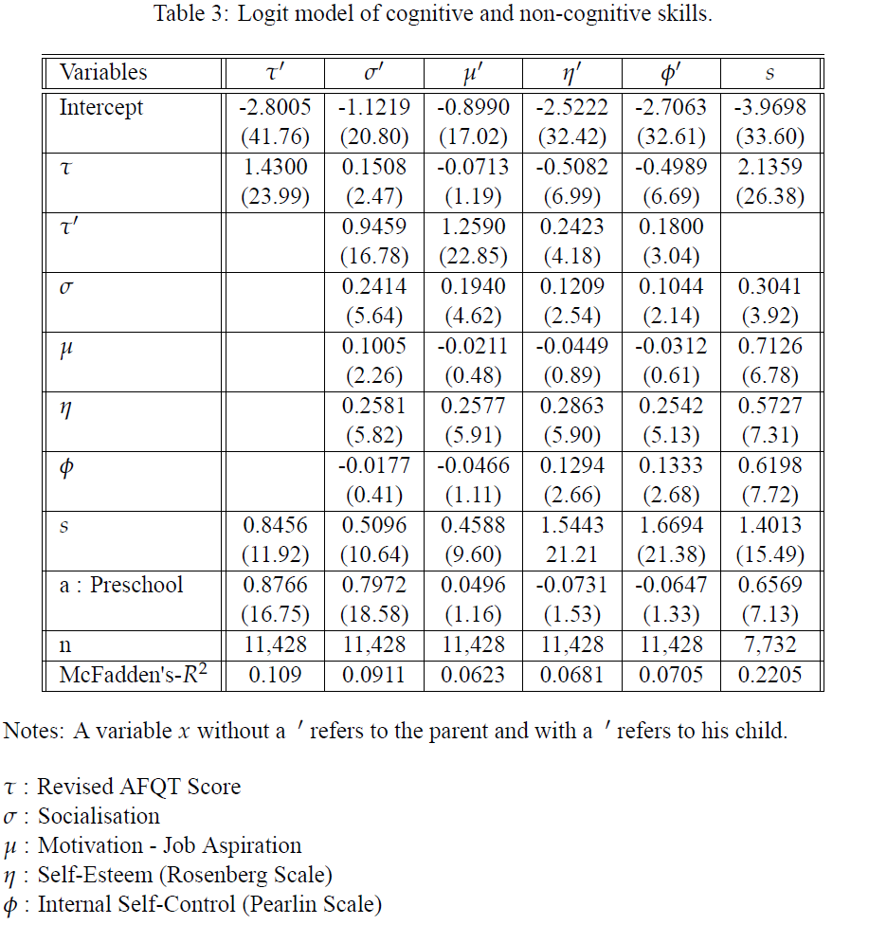

Slide 8
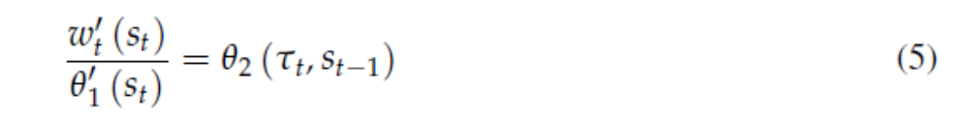
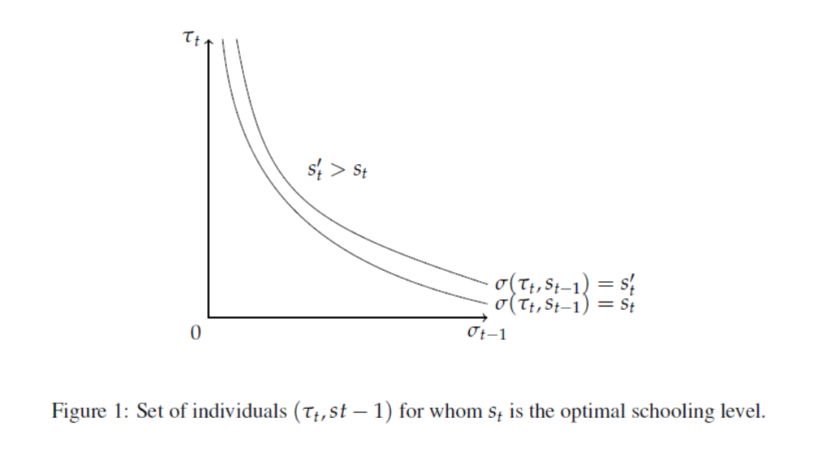
Education Signaling Model of Income Inequality
At time t, individuals (τ_{t}, s_{t-1})

Slide 9




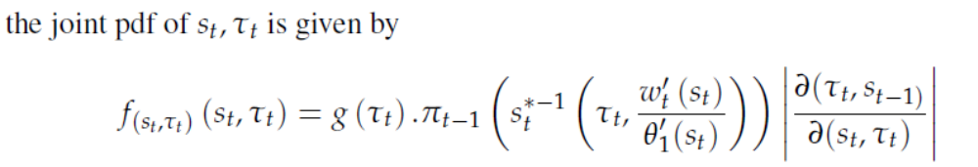
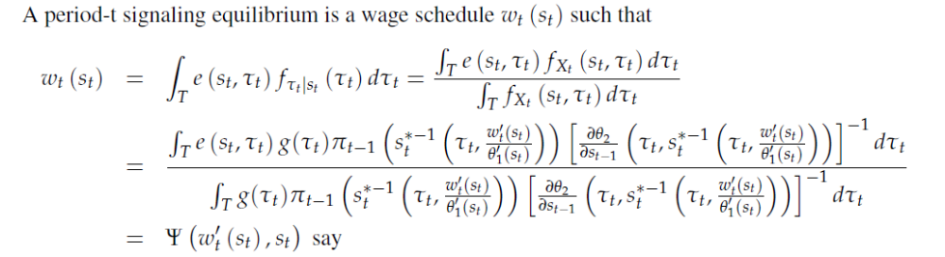
Signaling Equilibrium
Given the distribution of education in period and the distribution of cognitive ability assumed to be independent of , and the above equation,

Slide 10
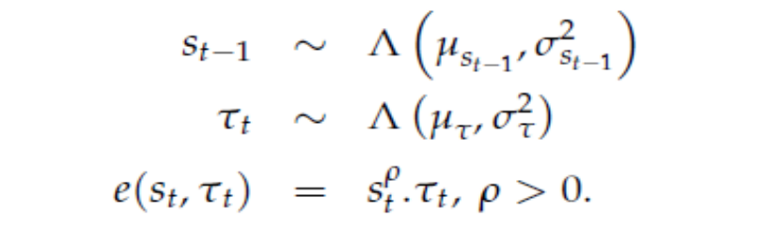

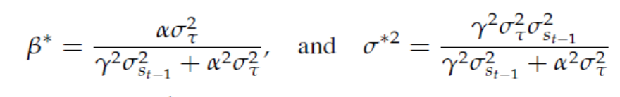
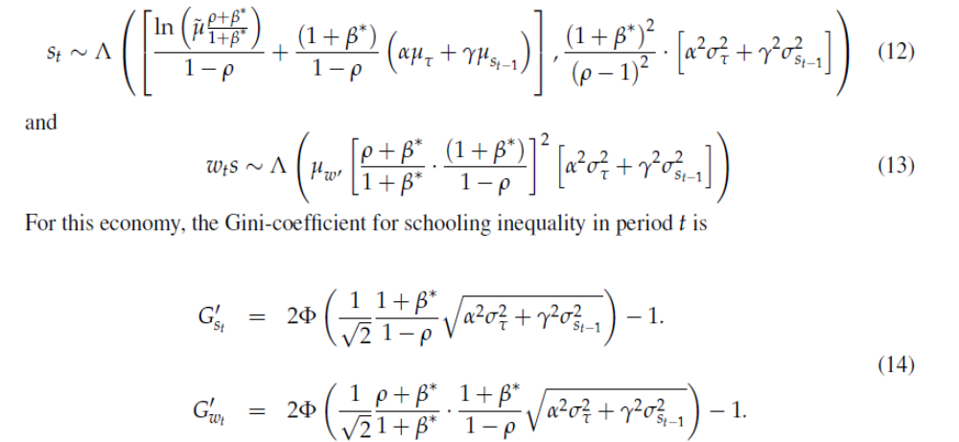
Two Lognormal economies

Slide 11
Conclusions
Given asymmetric information about cognitive ability, education is used as a signal for ability. If education cost depends on family background, we have pooling equilibrium ➔ lower within generation earnings inequality and lower social mobility
Reducing inequality in schooling level of parents will reduce schooling (and hence earnings) inequality of their children. Have not worked out the effect on social mobility yet.
The channel for the above relationship is from the dependence of education cost (i.e., signaling cost) on family background (i.e., schooling levels of parents) under the assumption that cognitive ability of a child is independent of family background and parents’ cognitive ability.
More realistically, when cognitive ability of a child depends on parents’ cognitive ability and family background as the neuroscience and child development literature suggest, we expect the effects to be stronger. I am doing the analytical derivations for this general case.

Slide 12
Thank you…

