Slide 1

Multivariate Analysis of Physicochemical Properties for Wine quality dataset
RAVURI LAKSHMI

Slide 2

DATA PREPROCESSING
Dataset Overview:
Two datasets: red wine and white wine
Red Wine Dataset:
Observations: 1599
Variables: 12
White Wine Dataset:
Observations: 4898
Variables: 12
Variables assumed as Independent
Numeric Variables
No Missing Values
Approached as both classification and regression.

Slide 3
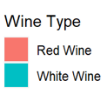
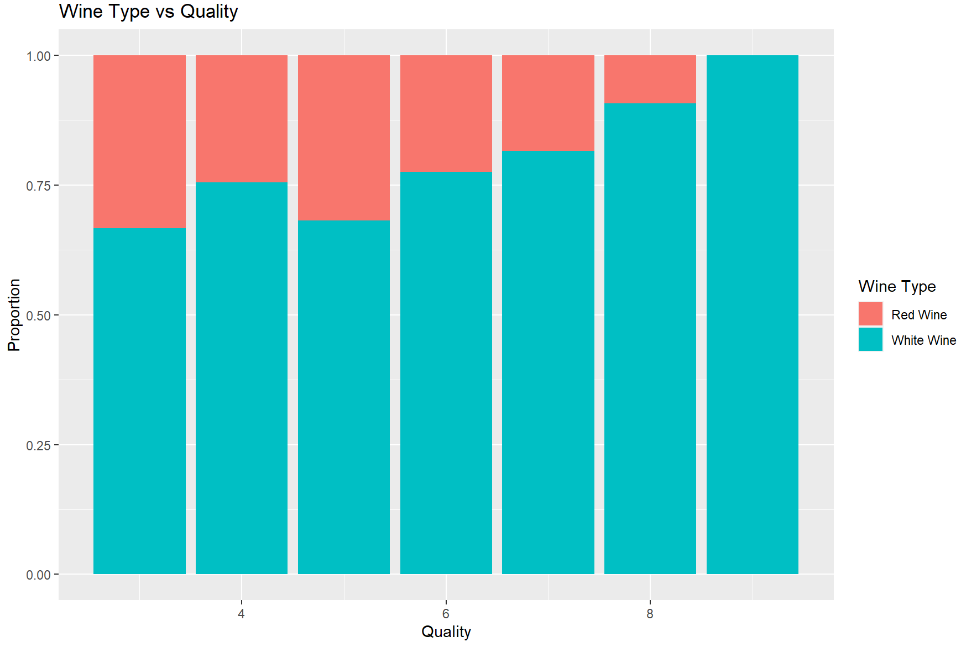
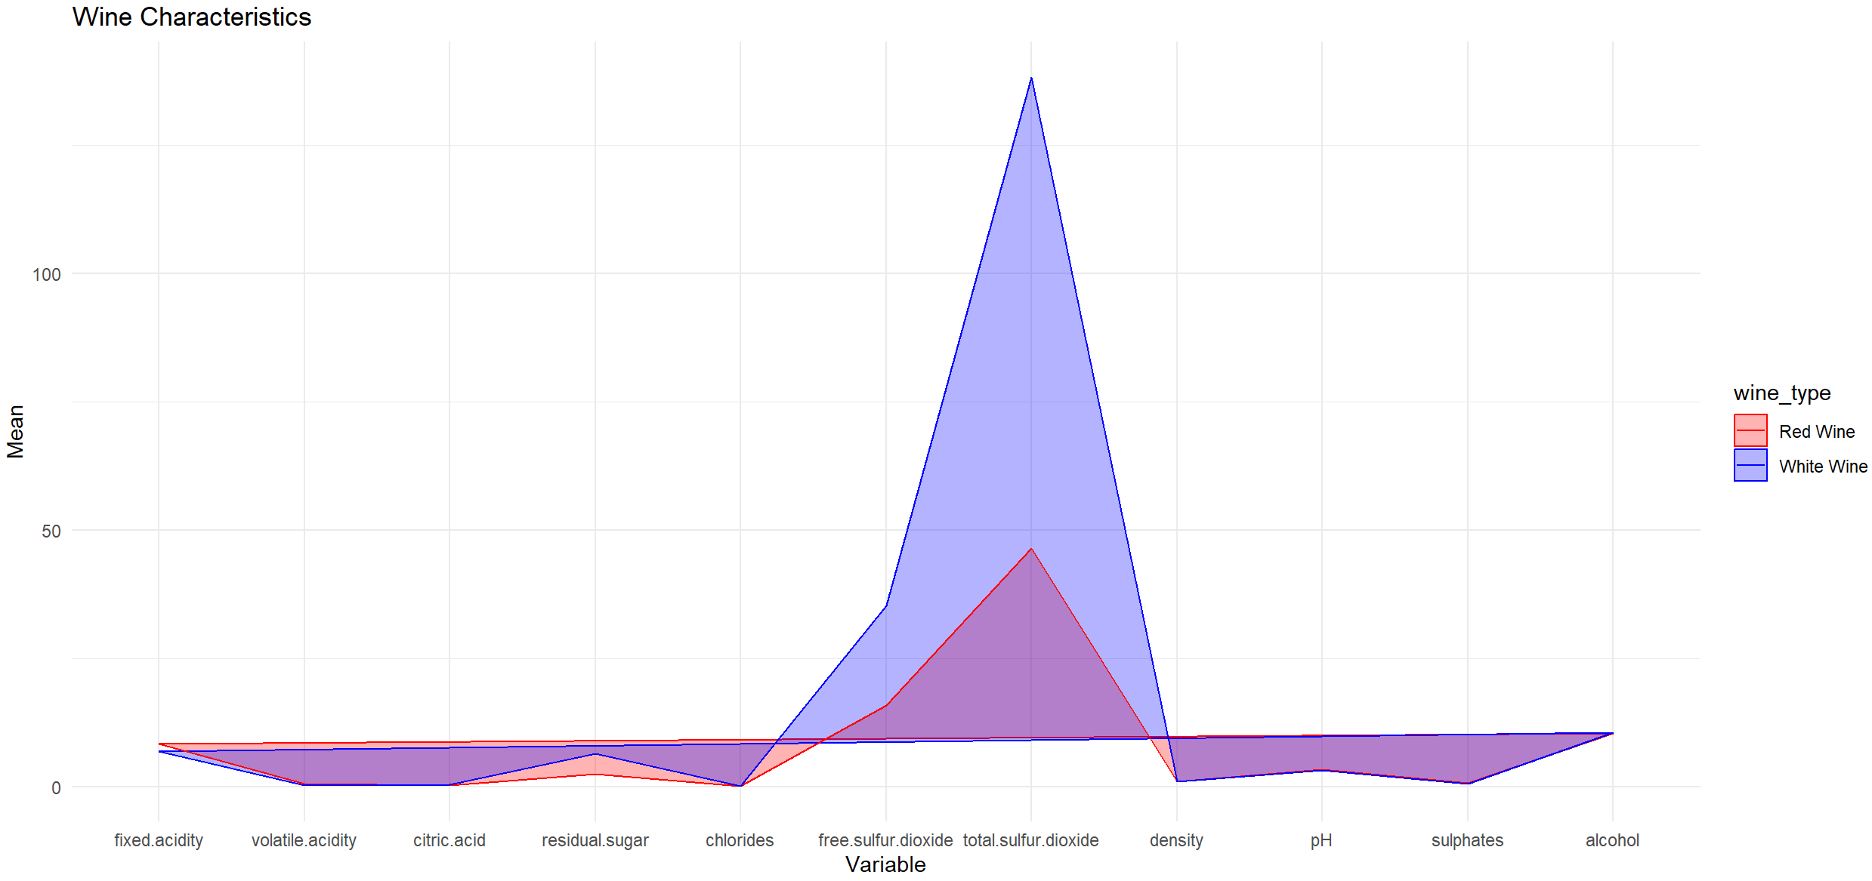
DATA VISUALIZATION
Mosaic plot
Line plot

Slide 4
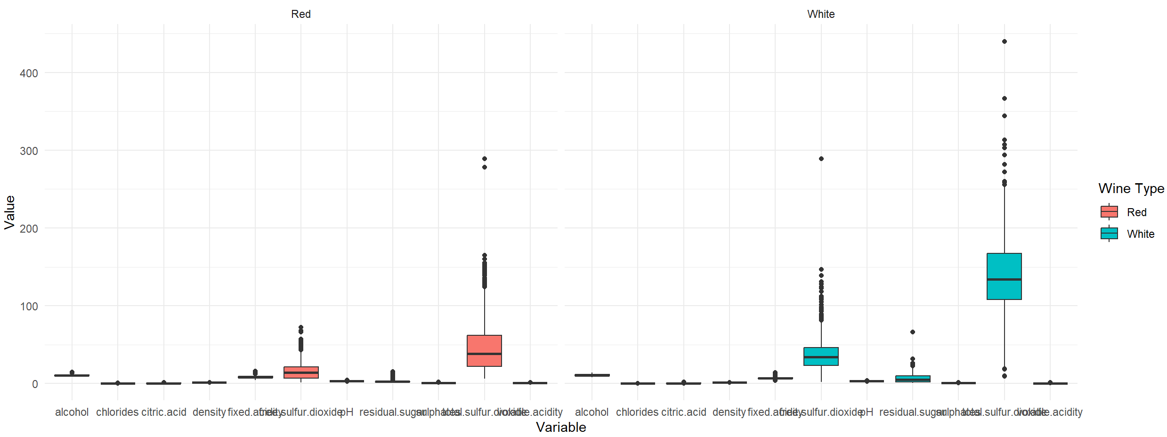
OUTLIER DETECTION
Univariate:

Slide 5
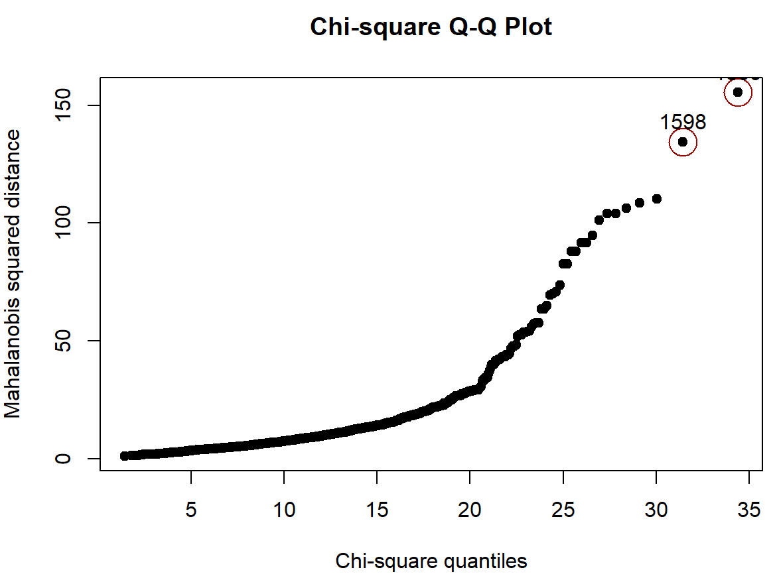
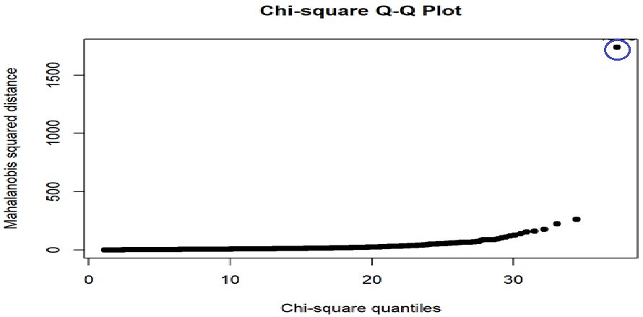
Multivariate:
Red wine dataset- Royston test
White wine dataset- mardia test
152
2782
259

Slide 6
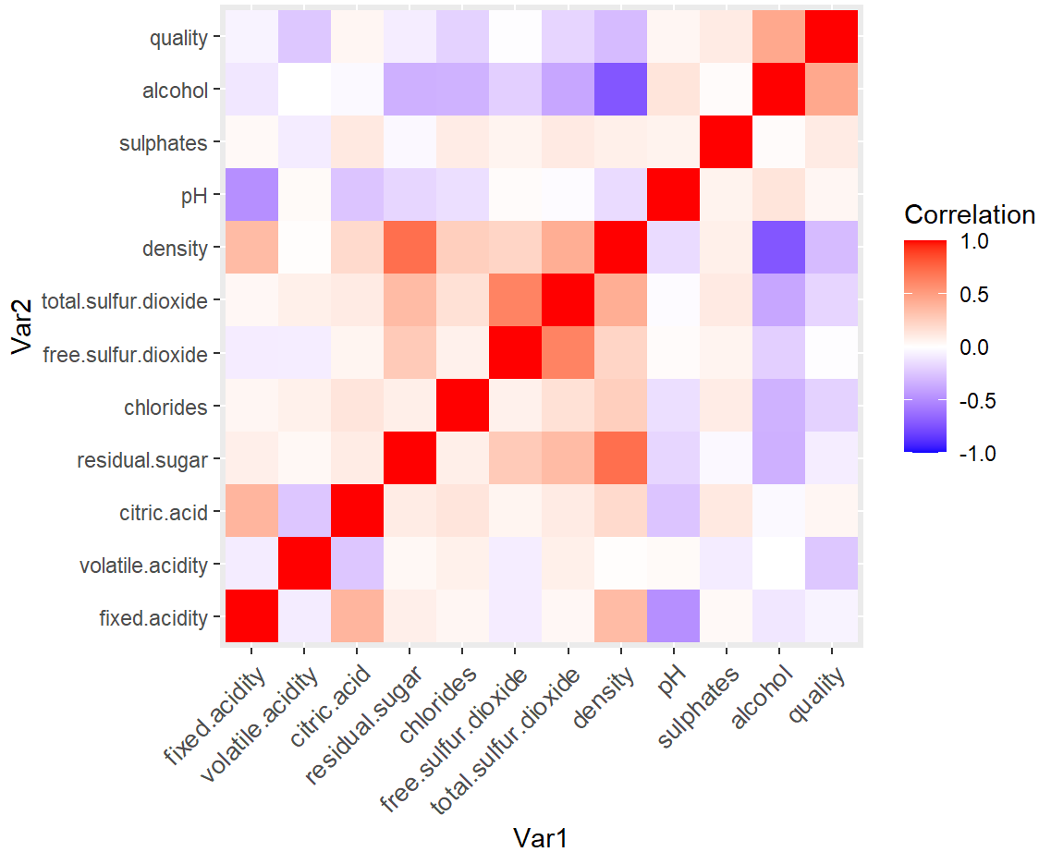
Multicollinearity
There are High non-negative and negative correlations are present showing high multicollinearity
High linear relationship:
Density and Alcohol – High negative
Density and Residual Sugar – High positive
No linear relationship:
Alcohol and volatile acidity
Density and volatile acidity
pH and volatile acidity
Sulphates and alcohol

Slide 7
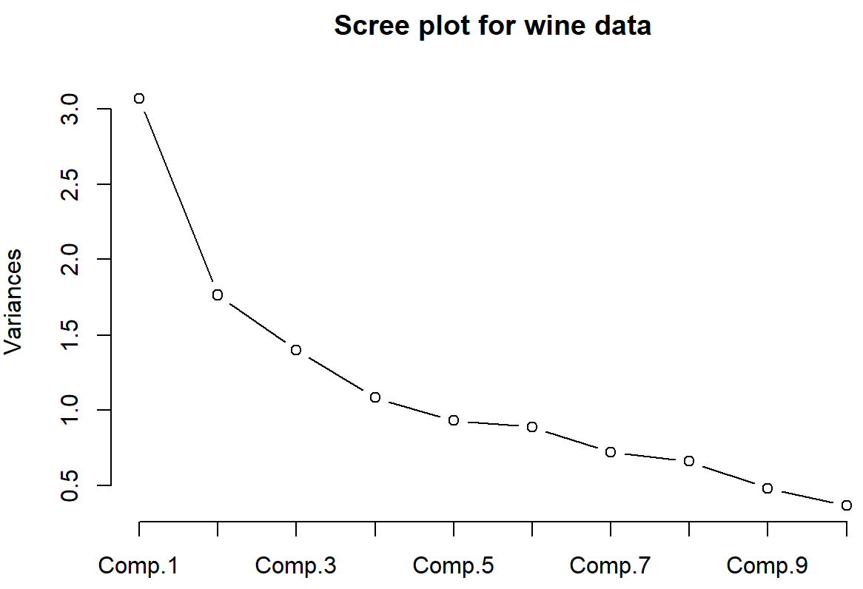
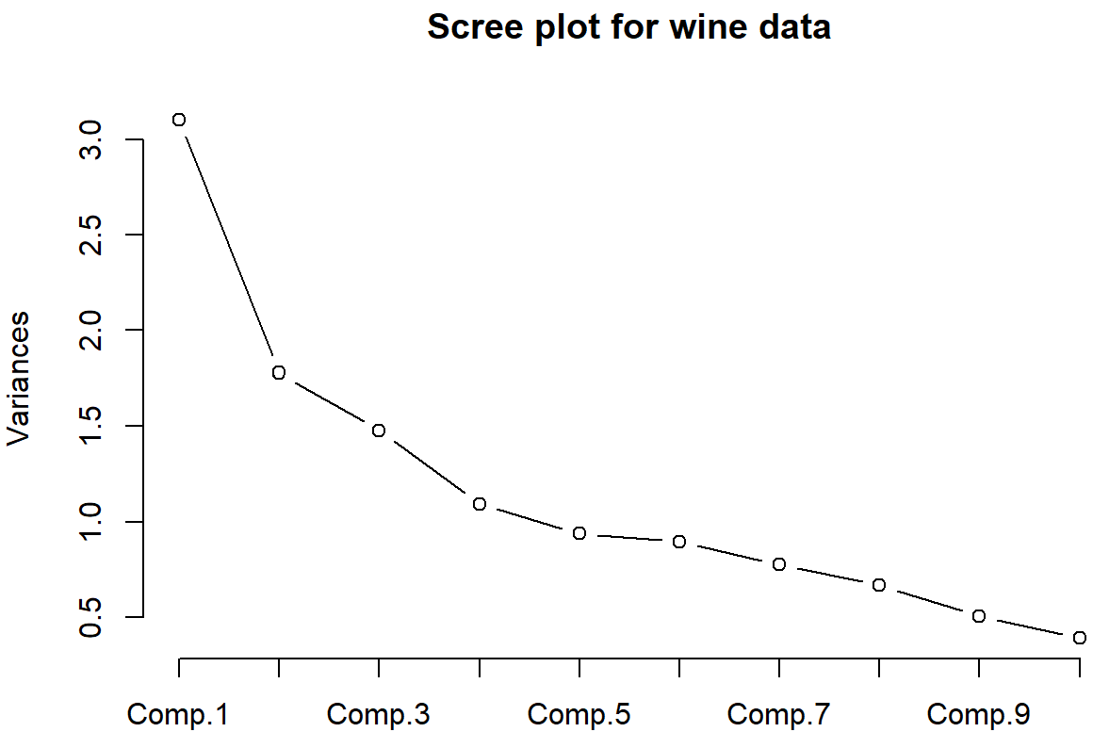
Principal Component Analysis (Dimensionality reduction)
Using 11 variables (excluding quality)
Using 12 variables
Component 6:
Standard deviation - 0.94572281
Cumulative Proportion - 0.77398018
Component 6:
Standard deviation - 0.94309984
Cumulative Proportion - 0.77772465

Slide 8
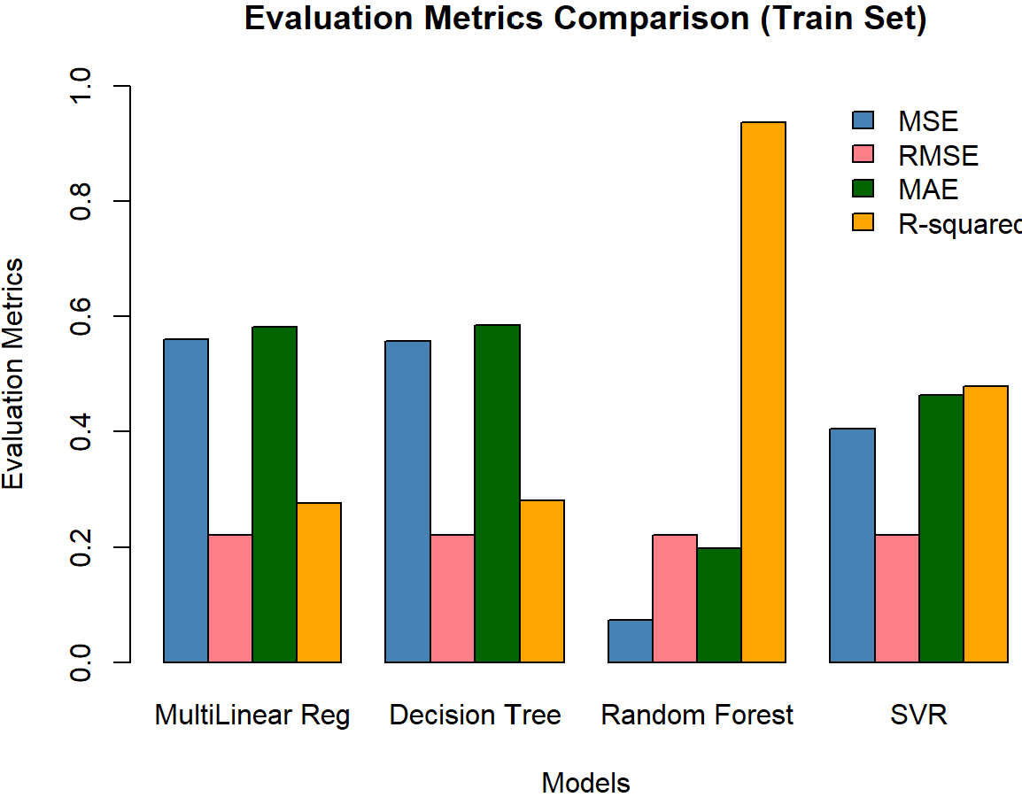
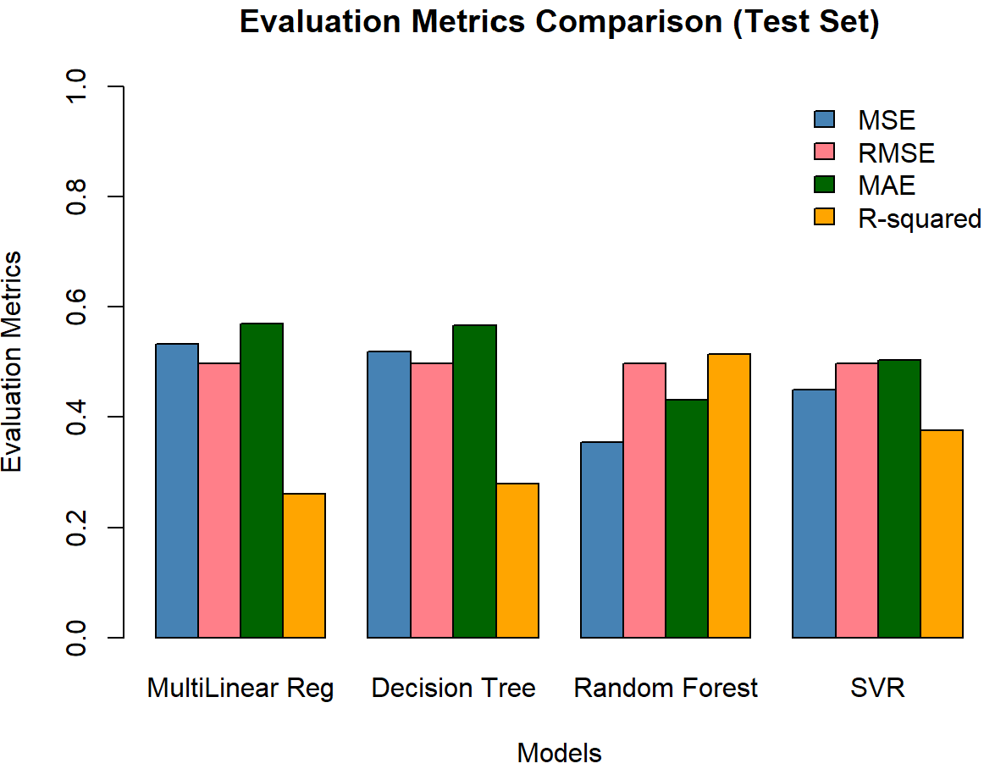
Without PCA:
Regression
The datasets consist of 11 physicochemical properties as input variables
The quality rating of the wine is the 12th variable, which serves as the output variable
Only random forest model gave better performance

Slide 9
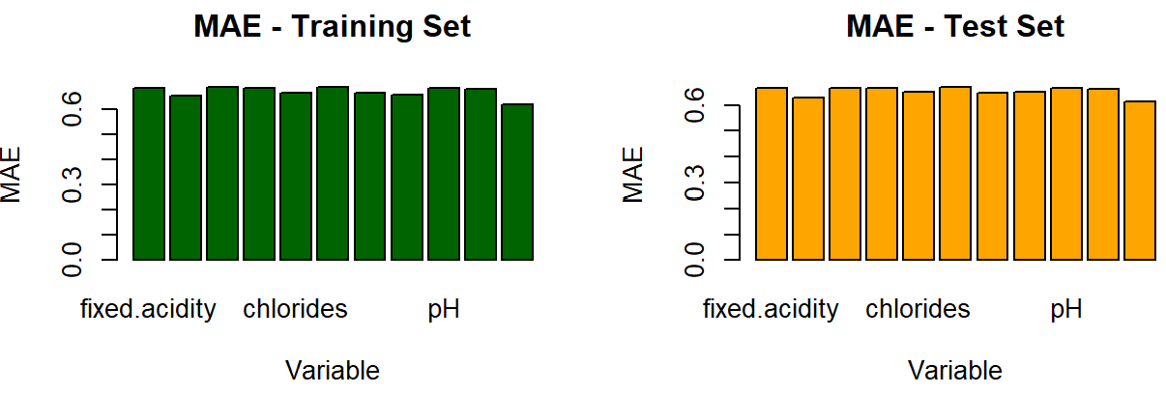
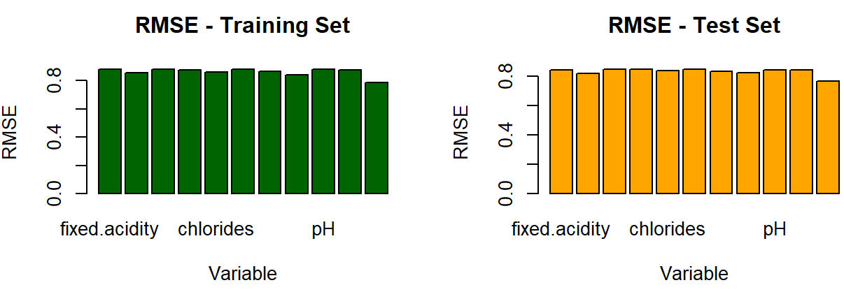
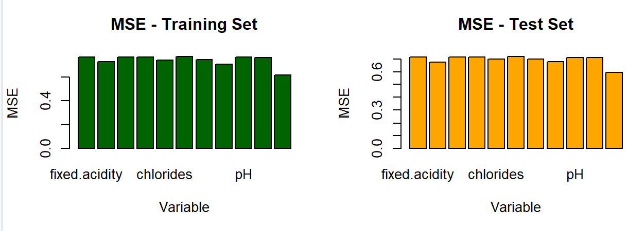
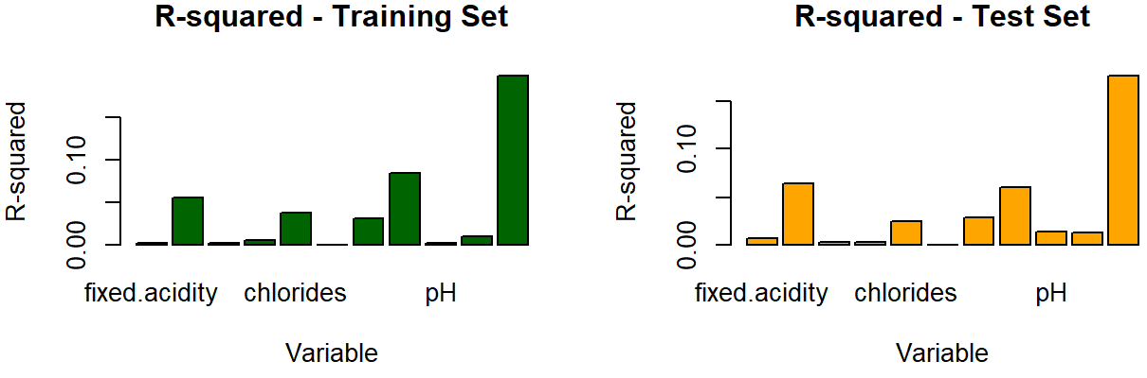
Linear regression – 11 variables
Alcohol had a significant relationship with quality comparatively, but even that is negligible

Slide 10
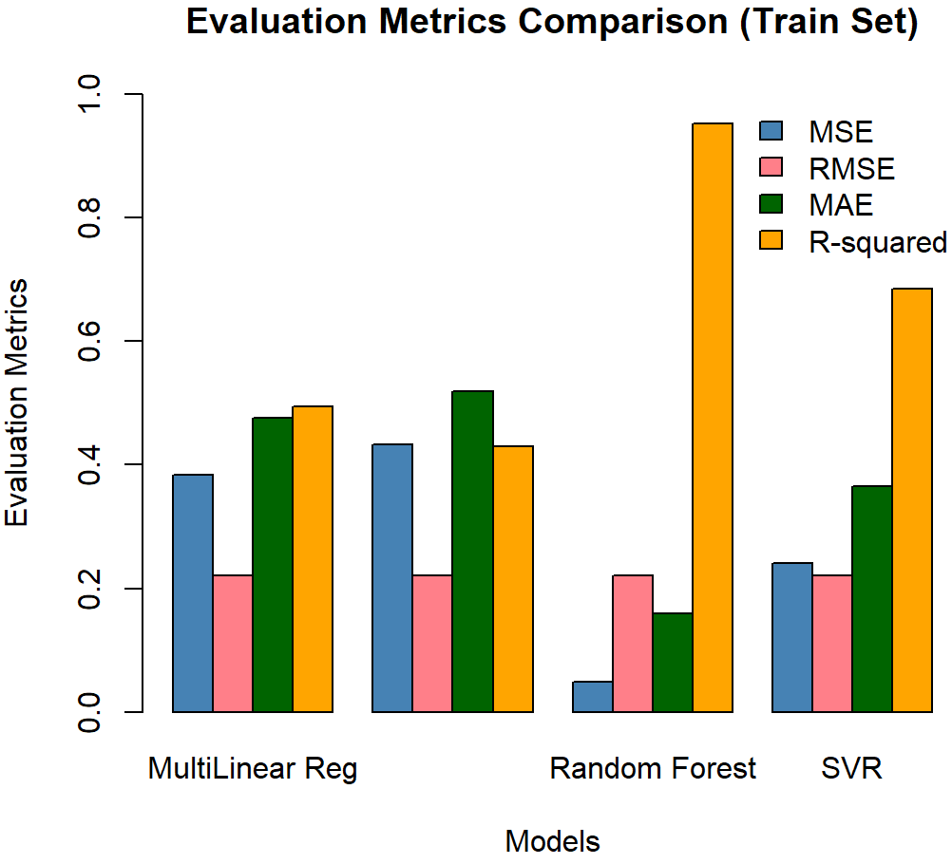
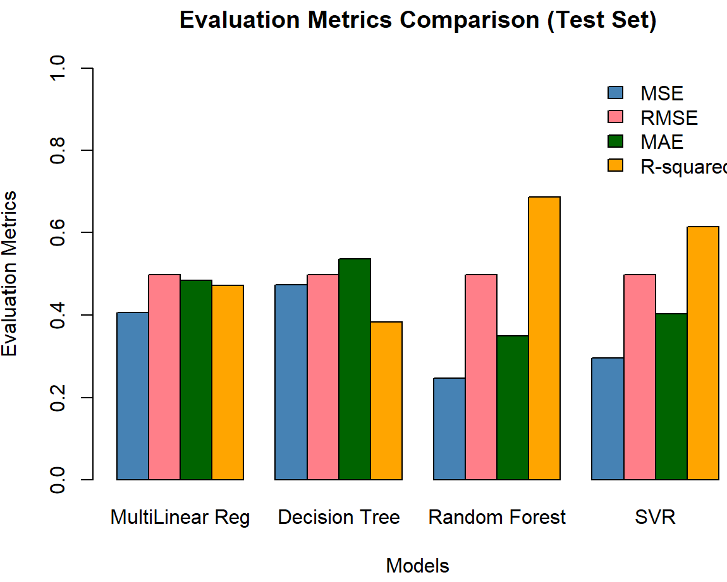
With PCA
Random forest model worked better
Comparing without PCA and PCA, using PCA gave a better model

Slide 11
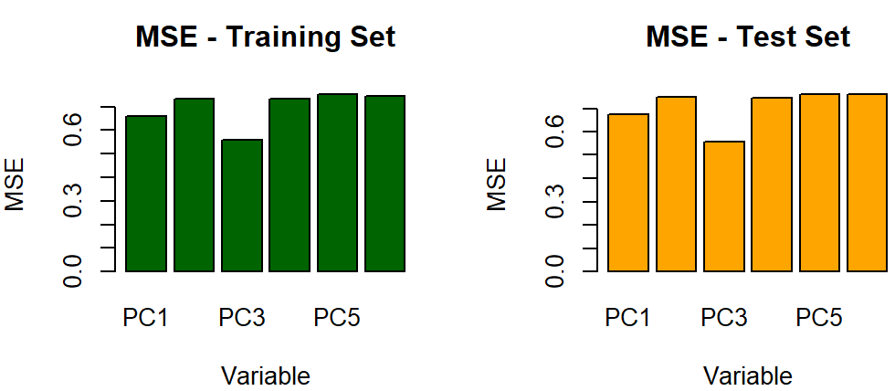
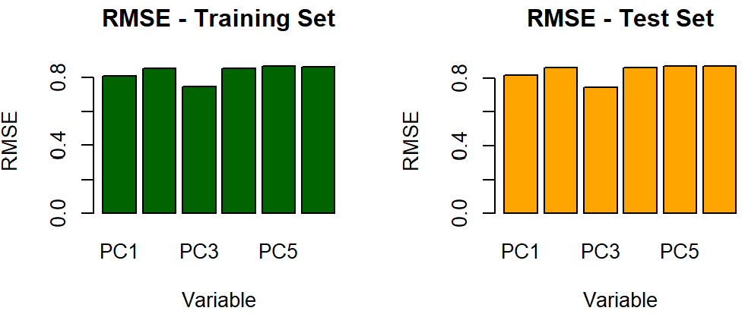
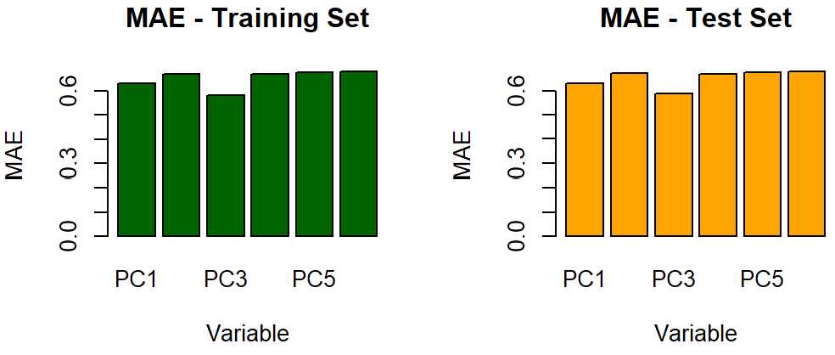
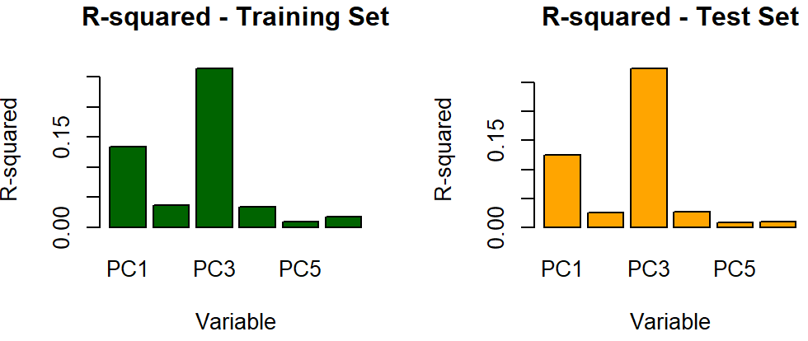
Linear regression
6 principal components
PC3 had a significant relationship with quality comparatively, but even that is negligible

Slide 12

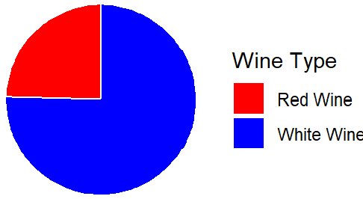
The datasets consist of 12 physicochemical properties as input variables
The output variable is the type of wine (red wine or white wine)
Classification
Classes are imbalanced. Weights assigned:
3 for red 1 for white

Slide 13
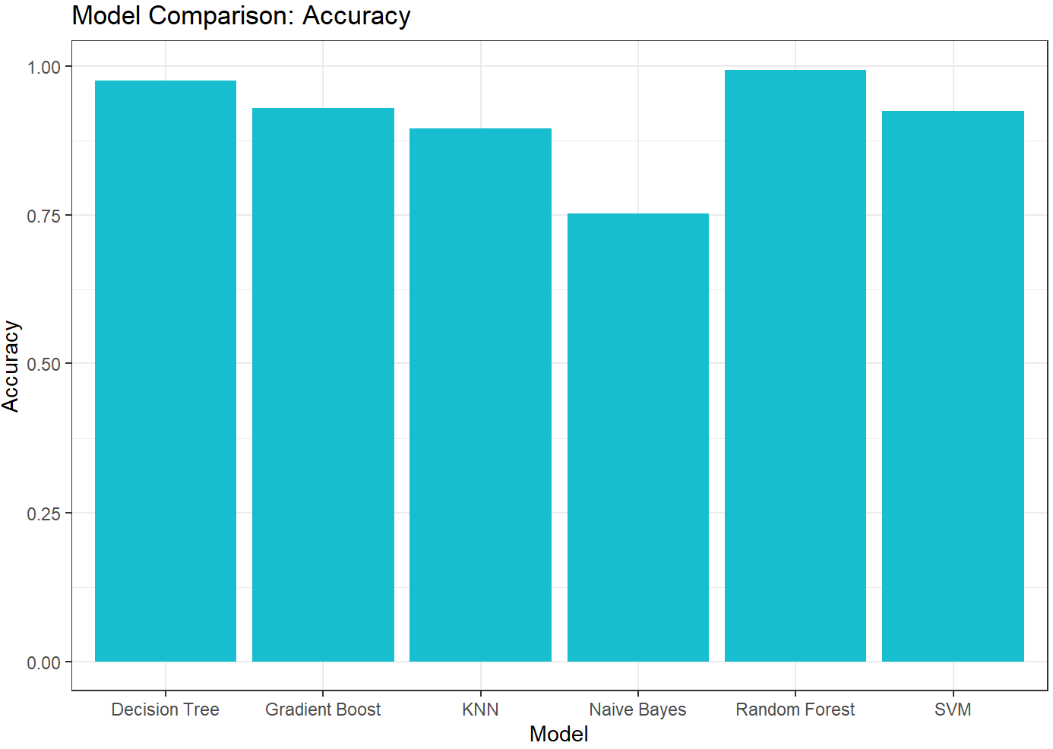
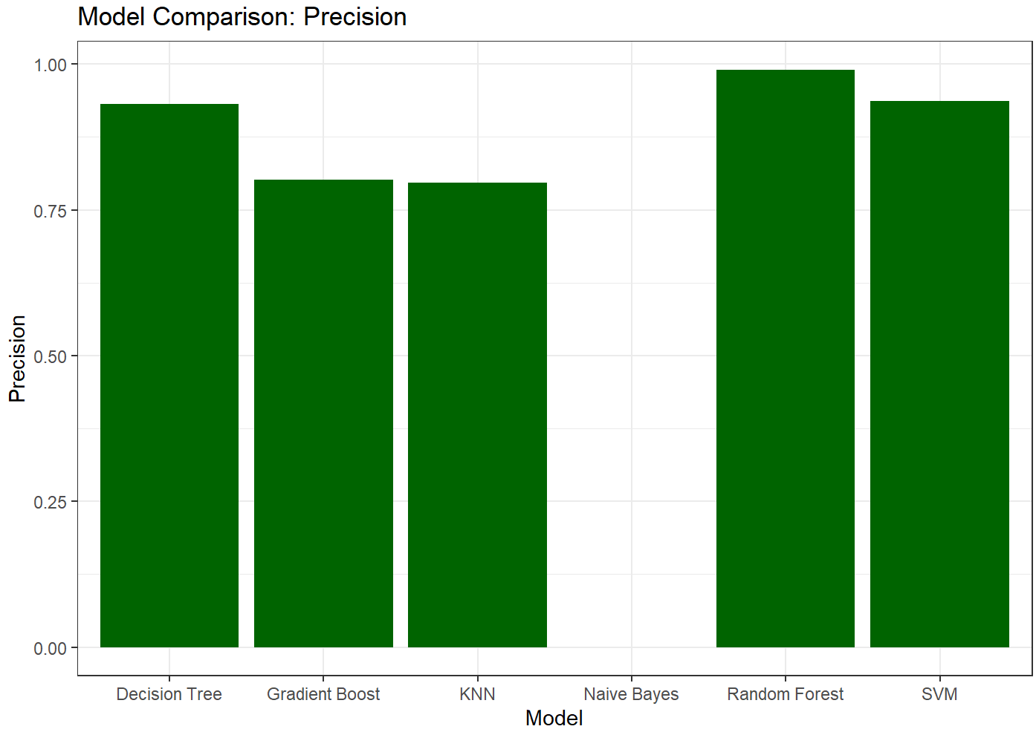
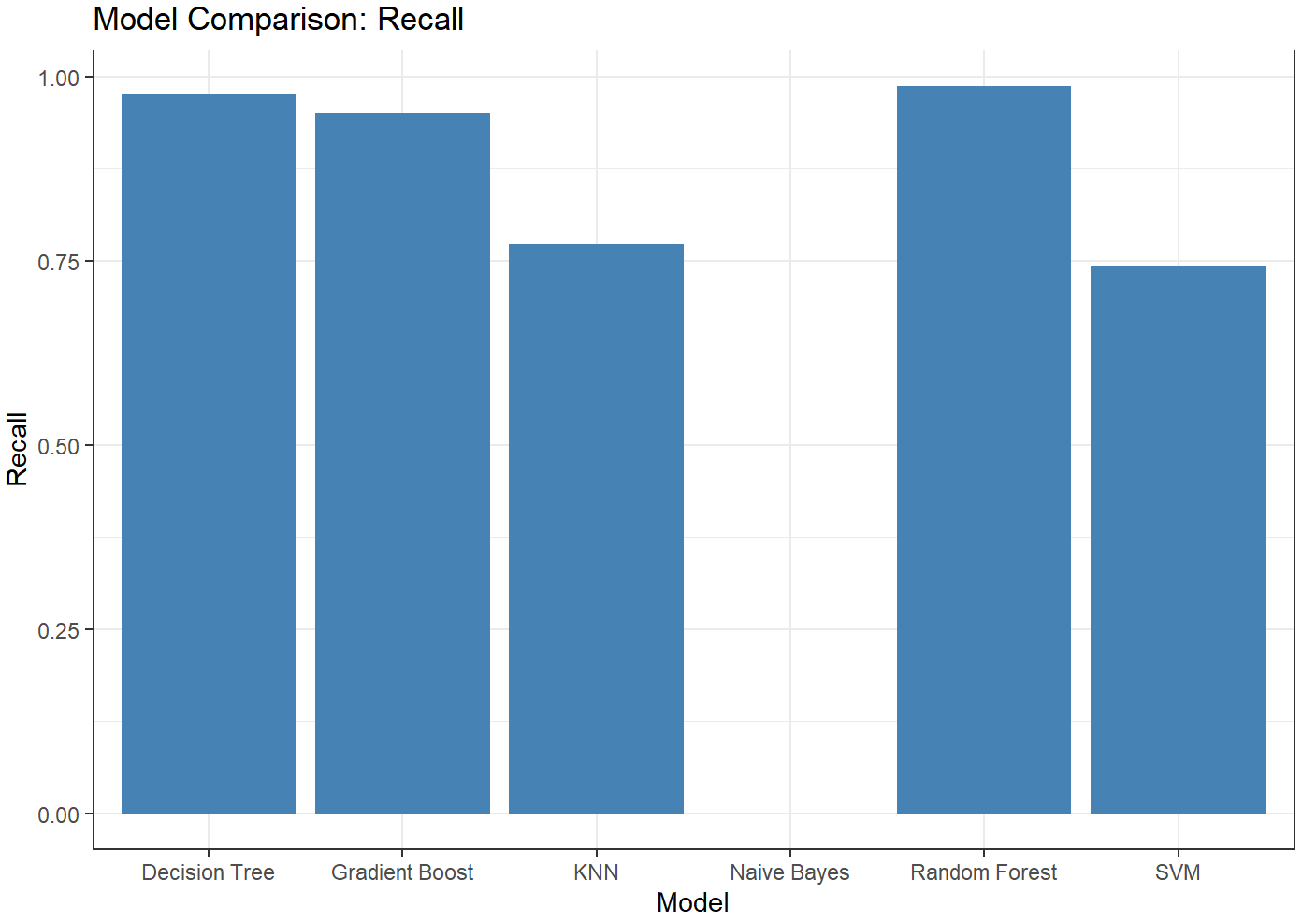
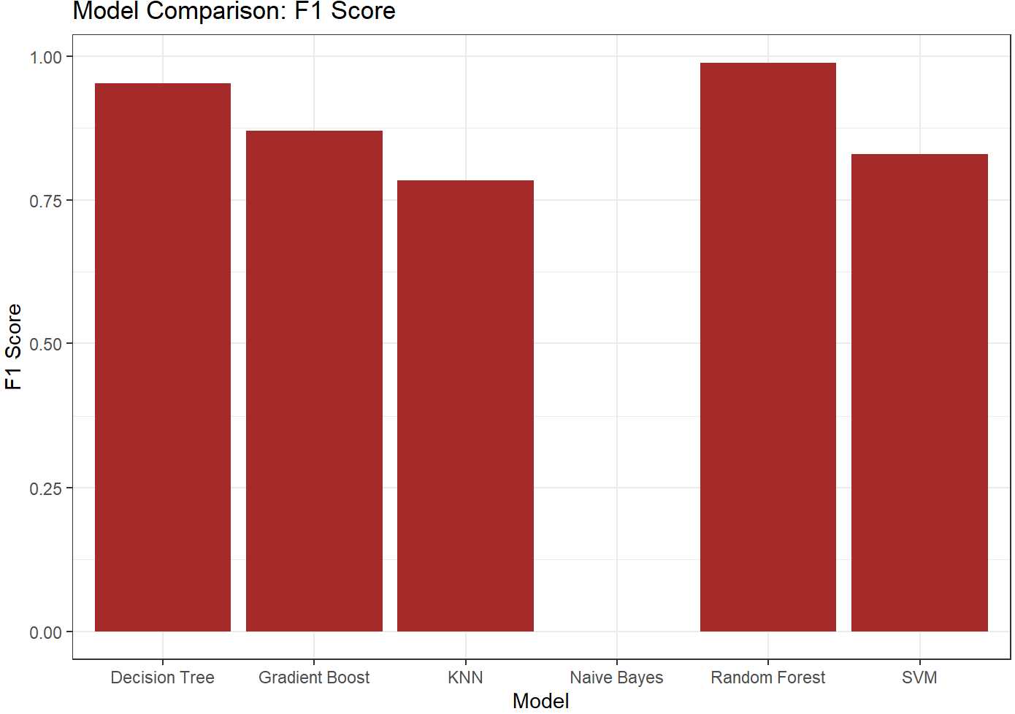
Without PCA
random forest performed best and naïve bayes worst

Slide 14
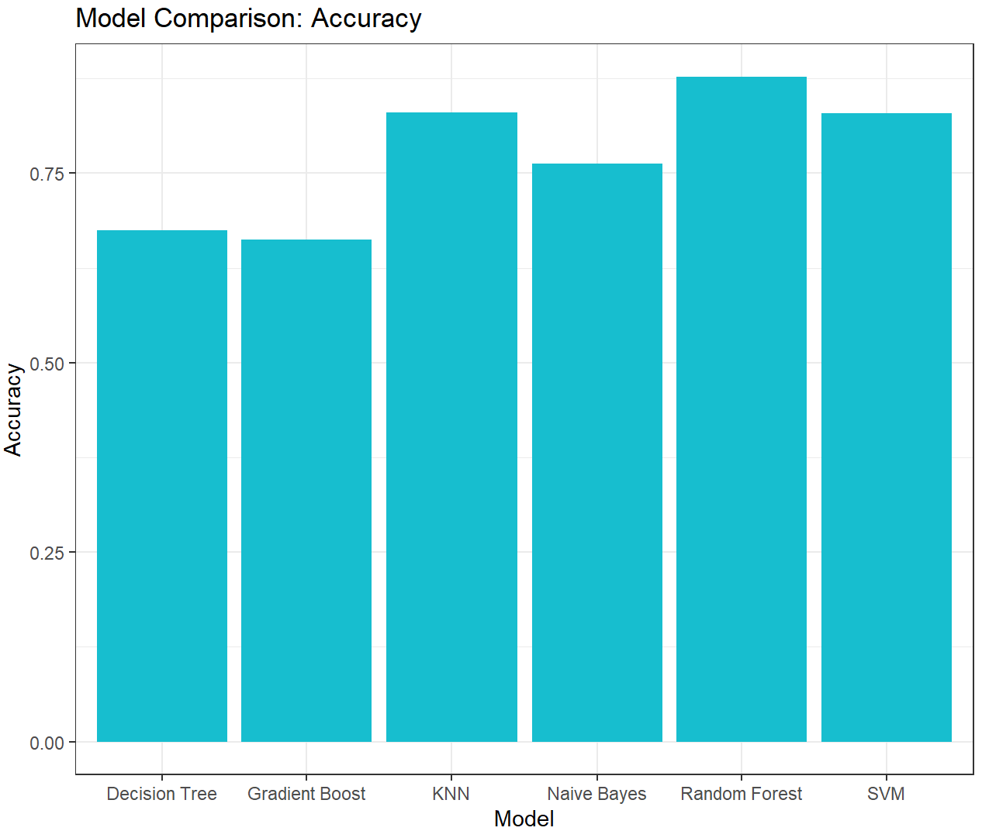
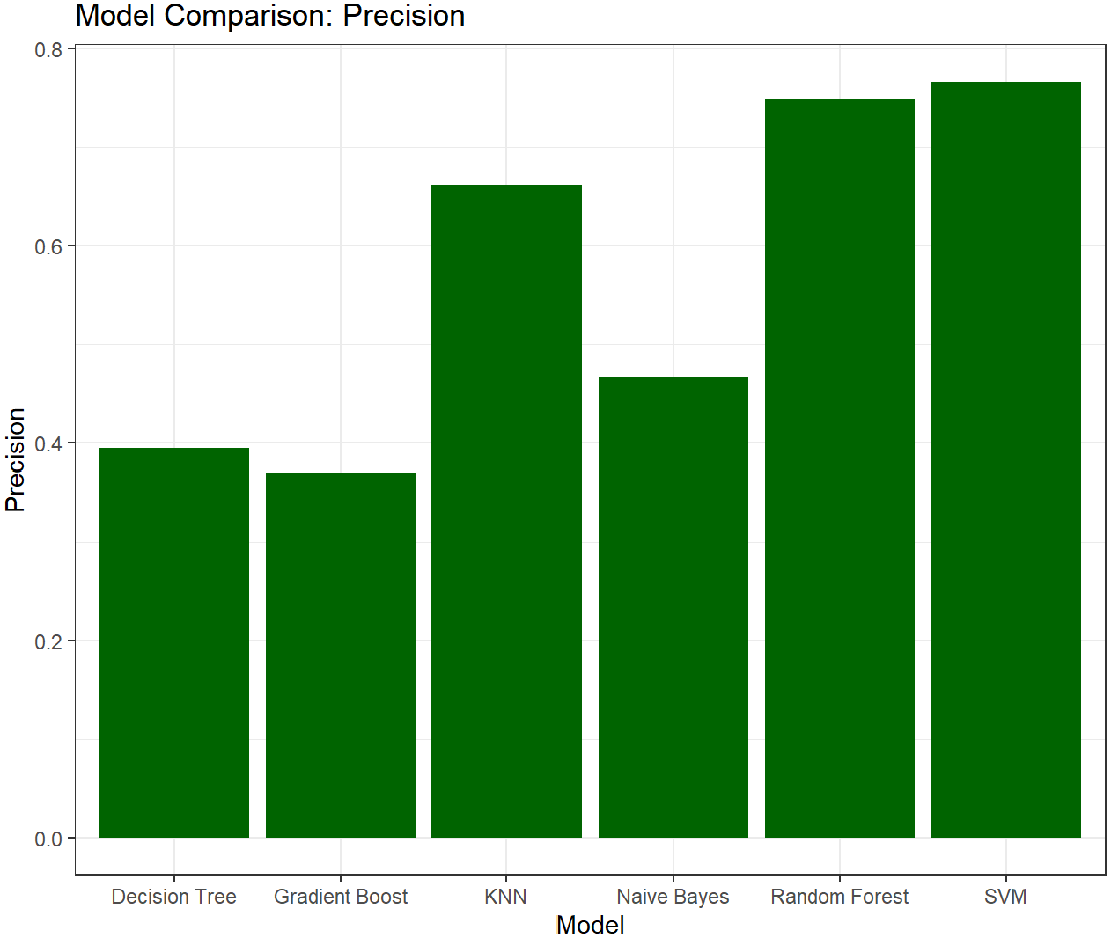
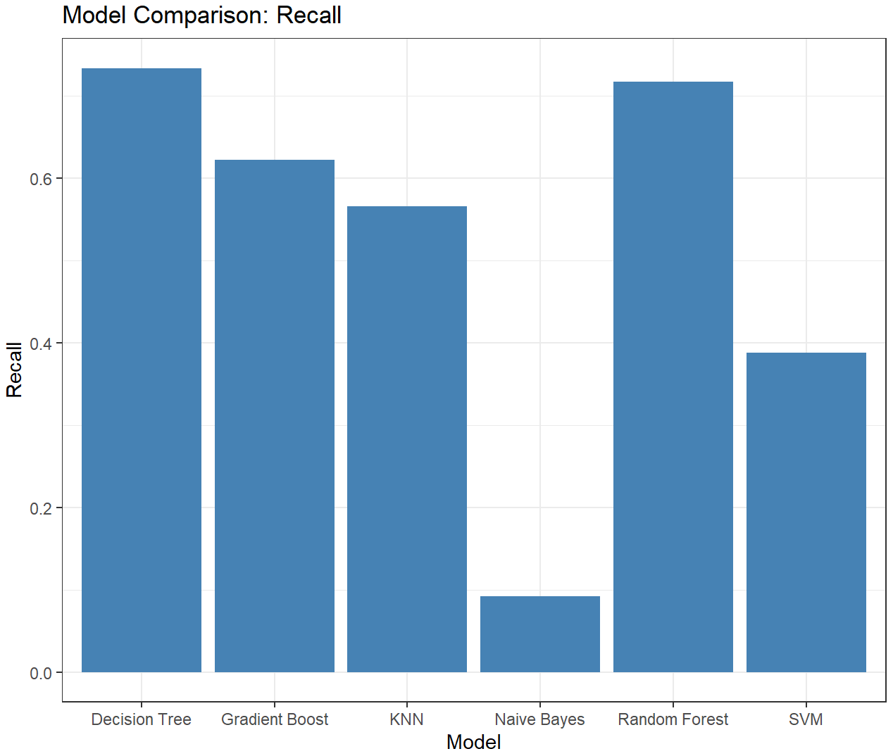
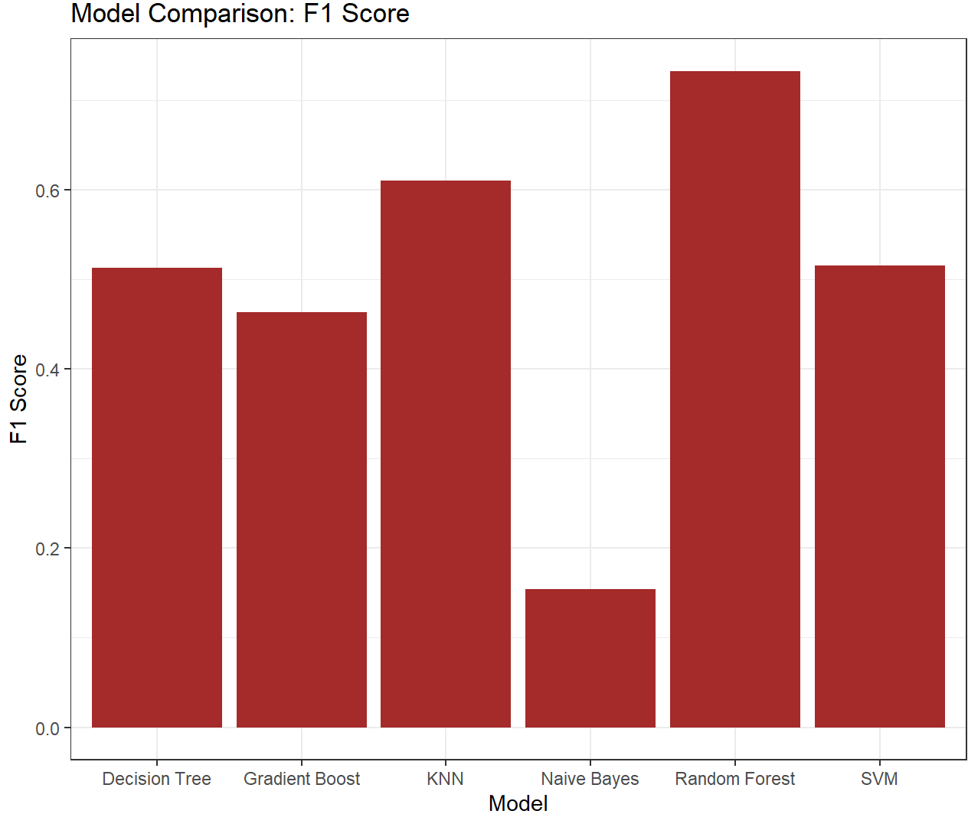
With PCA
Random forest and svm performed better
Naïve bayes also gave some performance
Similar to without PCA
Reducing dimensions did affect the model performances

Slide 15
Accuracies for random forest (without PCA- 0.995, with PCA- 0.88 )
The random forest model in regression(r2 without PCA – 0.514, r2 with PCA – 0.684)
PCA showed better performance in regression compared to using all variables
Random forest model performed well in both regression and classification
However, PCA had a slightly negative effect in classification
Overall, PCA demonstrated a positive impact on regression analysis
PCA can be an effective technique to address multicollinearity
Random forest model shows promise in dealing with multicollinearity
Conclusions

Slide 16

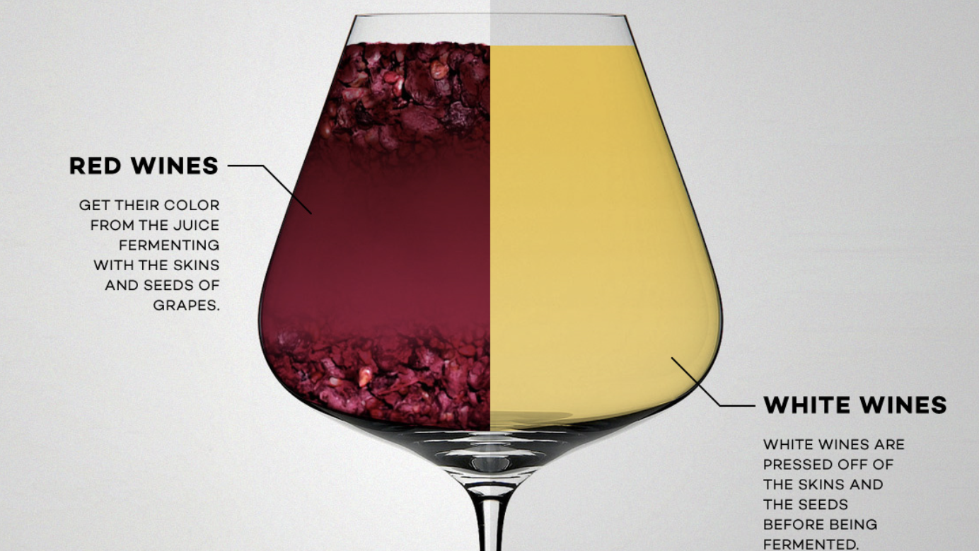
THANK YOU
Any questions?

