Slide 1

Microsoft Fabric
-The data platform for the era of AI
Group - 9:
Lakshmi Ravuri

Slide 2
Introduction
Microsoft Fabric is a comprehensive analytics solution designed for business enterprises. This platform encompasses a wide array of services, including data engineering, data integration, and data lakes, centralized in a single, cohesive environment.
By using Fabric, enterprises no longer have to rely on multiple, disparate services from various vendors. Instead, they get to experience a unified, straightforward, and user-friendly product aimed at streamlining their analytics processes.
Built on a Software as a Service (SaaS) foundation, Fabric emphasizes ease of integration and simplicity, significantly enhancing the user experience in enterprise analytics.

Slide 3

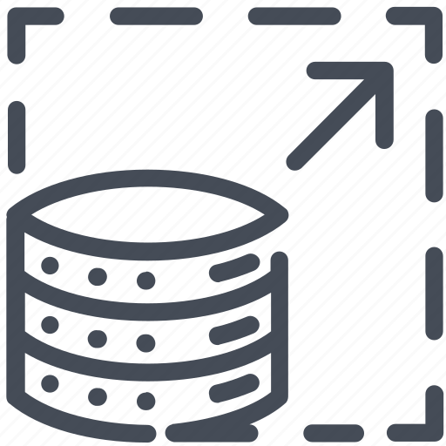

Pros
Secure and Compliant: Microsoft Fabric ensures top-notch data security and compliance, featuring robust security measures like resiliency and conditional access for comprehensive data protection.
Scalable: Microsoft Fabric is scalable and can be used by organizations of any size. Organizations can scale up and down their resources based on changing needs with a pay-as-you-go model.
User-Friendly: Microsoft Fabric is intended to be simple to use, even for users with limited technical knowledge. It is an excellent choice for organizations that want to get started quickly and easily with data and analytics. One of the major issues it addresses is the consolidation of disparate services into a single product.

Slide 4

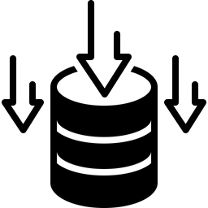


Unified Platform: Microsoft Fabric integrates various data and analytics functions, streamlining the process from data movement to BI in one platform.
OneLake Storage: Centralizes data storage in a single unified data lake, enhancing data management and reducing duplication.
Real-Time Analytics: It offers Synapse Real-Time Analytics for dynamic, real-time data analysis and insights, ideal for complex and varied data sources.
Cost-Effective: Microsoft Fabric is a cost-effective solution, as it reduces storage and implementation costs, with pricing based on actual computing and storage and usage. This significantly reduces costs for organizations and eliminates the need for separate charges for different services.

Slide 5
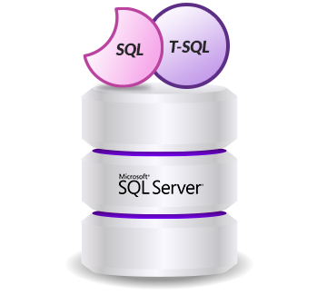

Cons
Limited T-SQL Functionality: There are limitations in T-SQL functionality within Microsoft Fabric, and certain commands can lead to warehouse corruption. This limitation might affect users who rely heavily on T-SQL for their data operations.
Geographical Limitations: Microsoft Fabric does not currently support data warehousing in multiple geographies, which could be a significant drawback for globally distributed organizations.

Slide 6






Popular companies using Microsoft fabric
Microsoft Fabric is a popular tool among various leading companies, especially those seeking integration with Microsoft's extensive ecosystem.
Key customers include:
Microsoft Ferguson T-Mobile Aon
Accenture Avanade

Slide 7
Final thoughts Microsoft Fabric showcases an advanced and comprehensive analytics tool, especially appropriate for companies whose operations heavily rely on the Microsoft environment. It is a perfect tool for large-scale data analysis and business intelligence with a complete set of tools and integration to AI. However, its entire set of features works best within this particular framework, its maximum usefulness is confined to businesses with significant investments in Microsoft technologies. For smaller-scale projects or companies that utilize a more diverse range of technologies, alternative solutions that offer greater flexibility and broader compatibility might be more suitable.

Slide 8

References
https://learn.microsoft.com/en-us/fabric/get-started/microsoft-fabric-overview
https://azure.microsoft.com/en-us/blog/introducing-microsoft-fabric-data-analytics-for-the-era-of-ai/
https://atlan.com/microsoft-fabric/

