Slide 1


Dogecoin price comparison with Elon musk and random people tweets
This Photo by Unknown Author is licensed under CC BY-SA-NC

Slide 2
Over view
In this project we analysed, how Elon musk’s tweets is affecting dogecoin price.
Here we compared Elon musk and random people tweets about dogecoin with the dogecoin price.
We have also given Visualizing plots for price up and down of dogecoin, moving averages, volatility, market capitalization, price volume and price comparison.

Slide 3
Block diagram
Dogecoin data
Visualizing price up and down
Elon musk and random people tweets
Visualizing moving averages
Visualizing market capitalizing
Data preprocessing
Visualizing volatility
Visualizing price volume
Join tweets and dogecoin data
Visualizing price comparison

Slide 4
Importance of your problem.
Knowing the percentage of increase or decrease will help the investors in investing in that firm
We compared the relations between dogecoin price, normal person tweet and Elon musk tweets, so that It will give a glance about the effects of tweets on dogecoin

Slide 5
Problem solving approach
The primary task is extracting the Dogecoin data. For that we used techniques like
Here we extracted the dogecoin opening price on a particular date, High, low value, close value and adjusted price it reached on that date. Also, the volume of dogecoin on that date.

Slide 6
Extracting random people’s and Elon musk’s tweets
Random people’s data about dogecoin is extracted using the twitter API by using dogecoin search term
10,000 random post’s were extracted
Elon musk’s tweets about dogecoin were also extracted using twitter API

Slide 7
Data preprocessing
We cleaned the twitter data by removing all the special characters.
Also, made word clouds with that to check our extracted twitter data.

Slide 8
Joining dogecoin and random people’s posts and visualized price up and price down
The tweet’s data and dogecoin data is joined using pandas
This is visually represented using plotly.
This graph gives a view of price up and down

Slide 9
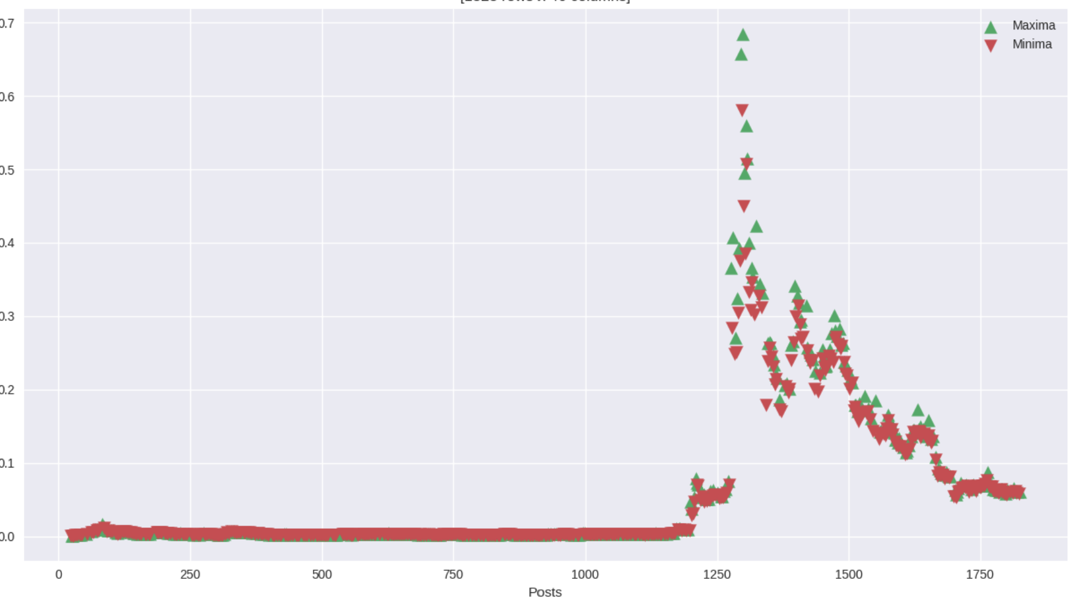
Joining dogecoin and Elon musk’s posts and visualized price up and price down
Similarly, joined the data and tweets using pandas and represented using plotly
This shows that there is an
impact of elon musk’s tweets
on dogecoin price
Where minima represents the
low price of dogecoin on that
date and maxima represents the
high price

Slide 10
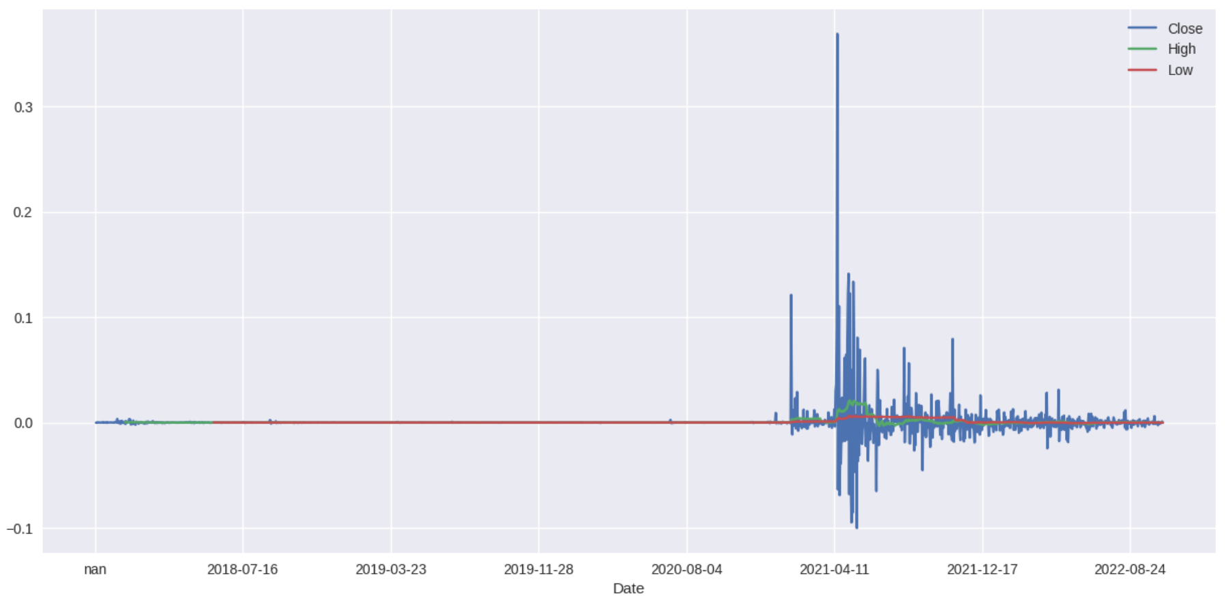
The dogecoin data and the data of random people Post's Moving Averages.
Calculated the average price over the period from 2018 to 2022.
From the period of 2021 there is a rapid effect on the price of dogecoin.

Slide 11
The dogecoin data and The data of Elon Musk's Post's Moving Averages

Slide 12
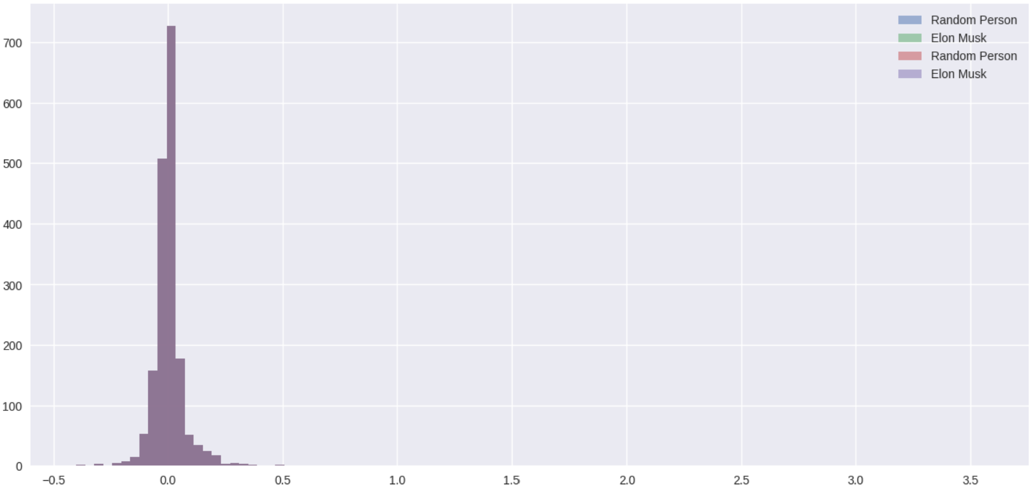
Volatility for Random Person's Post VS Elon Musk's Post for Dogecoin
This shows that elon musk tweets had a liability to change the high price of dogecoin rapidly

Slide 13
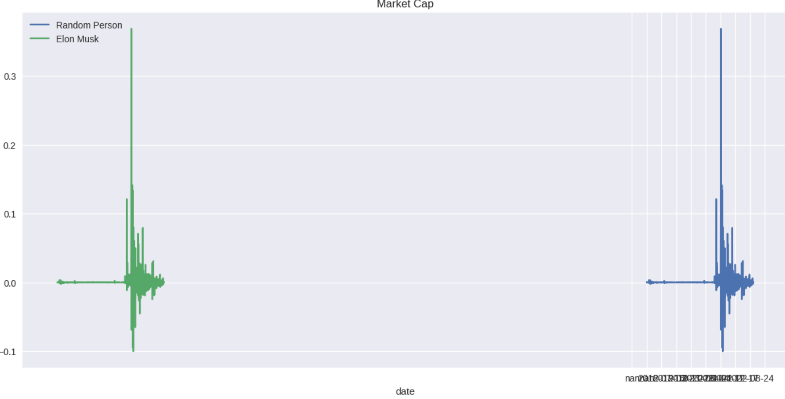
Market Capitalization for Random Person's Post VS Elon Musk's Post for Dogecoin
There is no change in market capitalization based on tweets

Slide 14
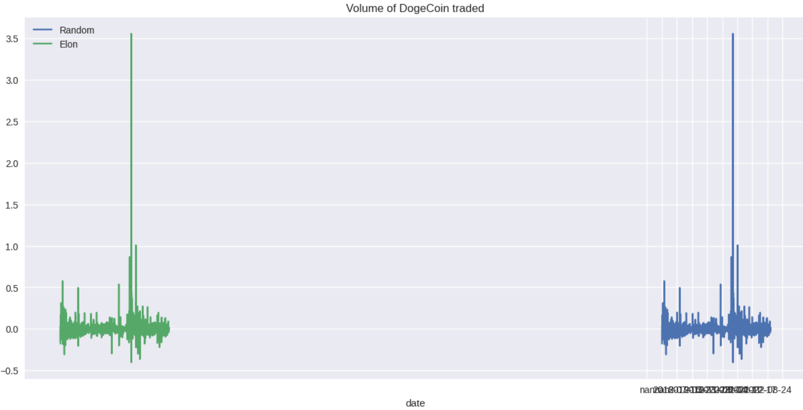
Low Price Volume for Random Person's Post VS Elon Musk's Post for Dogecoin
Similar to the market capitalization, tweets don’t affected the low price volume of dogecoin

Slide 15
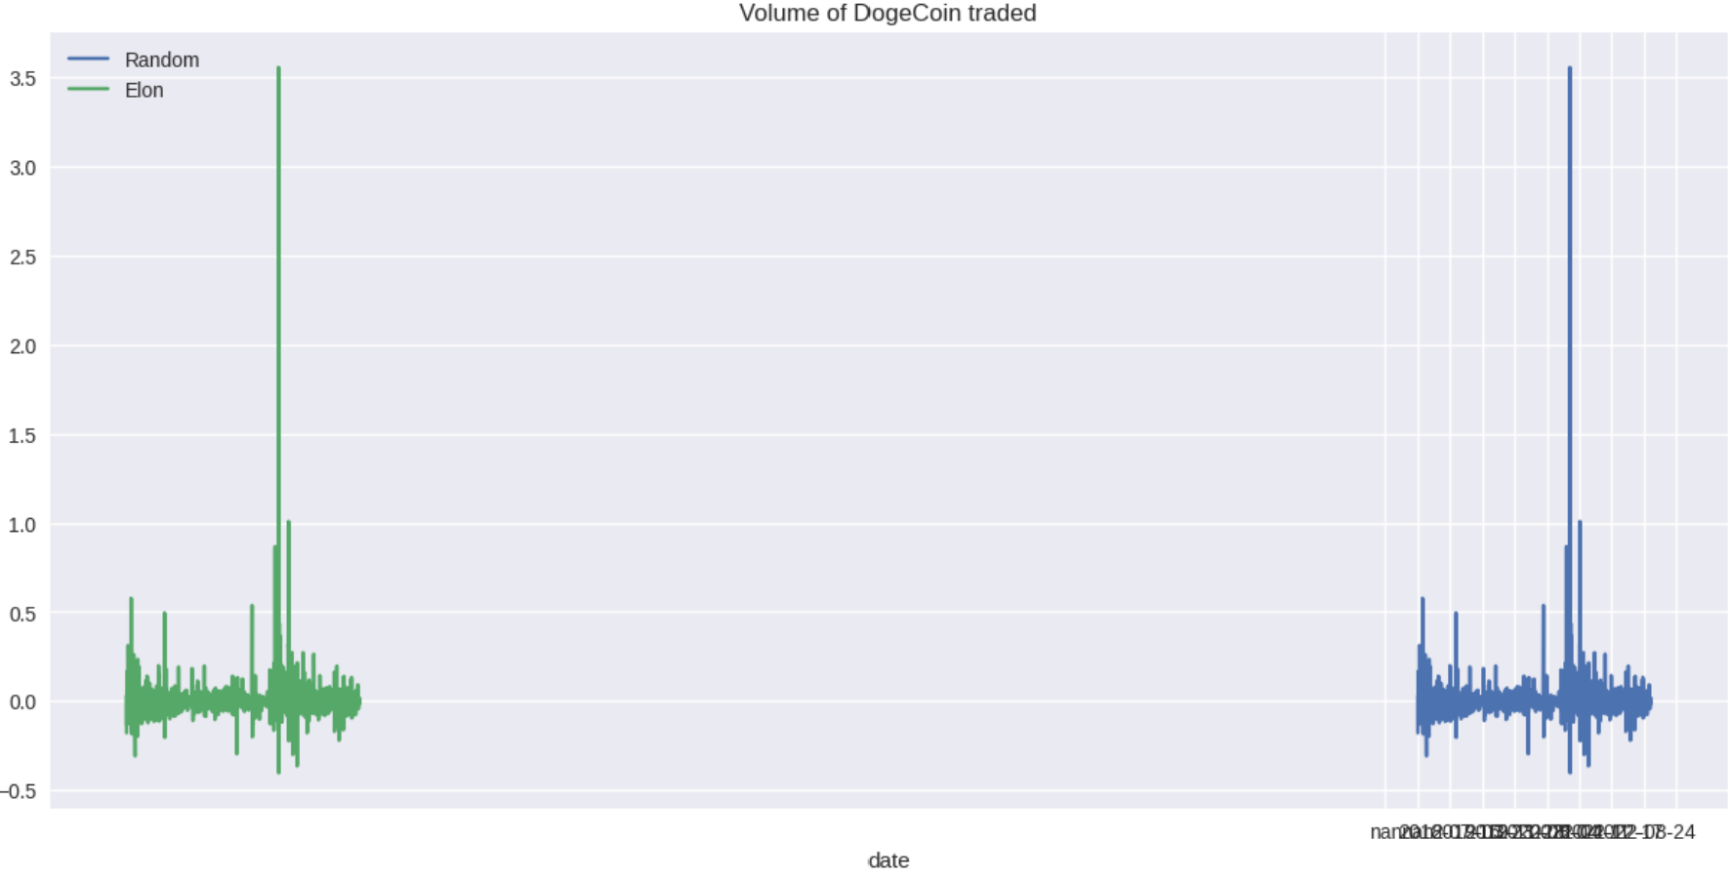
High Price Volume for Random Person's Post VS Elon Musk's Post for Dogecoin
Tweets did not cause any changes to the high price volume of dogecoin traded.

Slide 16
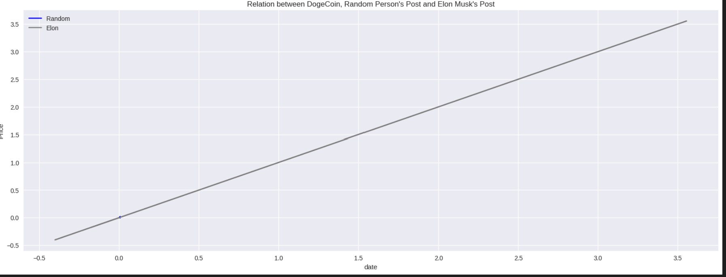
Price Comparison After Elon Musk's Post Random People's Post
There is an Increase of dogecoin when elon musk tweets

Slide 17
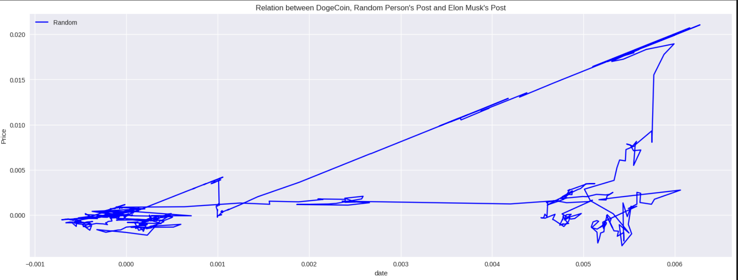
Price Comparison after Random People's Post
When a random people tweets, the change is not consistent.

Slide 18
Originality
We

Slide 19
Conclusion
Tweets effect on dogecoin price is determined

Slide 20





THANK YOU

