Slide 1

MASTER BOOTCAMP
Database Management System (DBMS)
Powered By

Slide 2
Learning Outcomes
Define a database and a database management system
Explain logical database design and the relational database model
Define the components of a database management system
Summarize recent trends in database design and use
Explain the components and functions of a data warehouse
Describe the functions of a data mart
Define business analytics, and describe its role in the decision-making process
Explain big data and its business applications

Slide 3
Databases
Database
Collection of related data that is stored in a central location or in multiple locations
Data hierarchy
Structure and organization of data involving fields, records, and files
Database management system (DBMS)
Software for creating, storing, maintaining, and accessing database files
Makes using databases more efficient

Slide 4
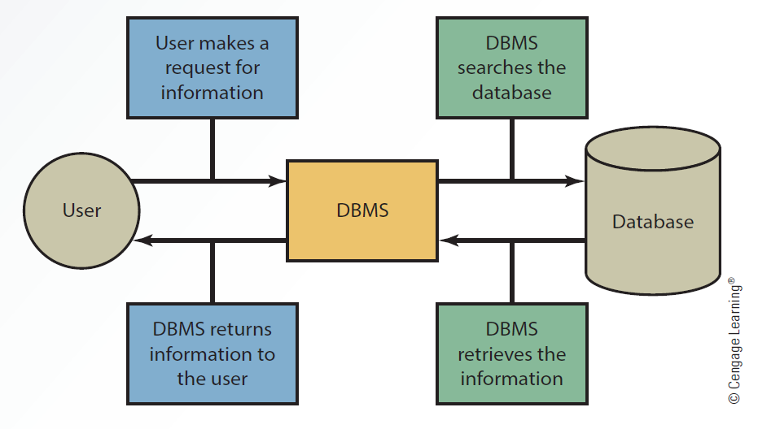
Interaction Between the User, DBMS and Database

Slide 5
Types of Data in a Database
Internal
Collected from within an organization
Stored in the organization’s internal databases
External
Comes from a variety of resources
Stored in a data warehouse

Slide 6
Methods For Accessing Files
Sequential access file structure
Records are organized and processed in numerical or sequential order
Organized based on a primary key
Social Security numbers or account numbers
Used for backup and archive files as they rarely need updating
Random access file structure
Records can be accessed in any order irrespective of the physical locations in storage media
Fast and very effective when a small number of records need to be processed daily or weekly
Records are stored on magnetic tapes

Slide 7
Methods For Accessing Files
Indexed sequential access method (ISAM)
Records are accessed sequentially or randomly depending on the number being accessed
Random access is used for a small number
Sequential access is used for a large number
Uses an index structure and has two parts
Indexed value
Pointer to the disk location of the record matching the indexed value

Slide 8
Logical Database Design
Physical view
Involves how data is stored on and retrieved from storage media
Hard disks, magnetic tapes, or CDs
Logical view
Involves how information appears to users and how it can be organized and retrieved
Includes more than one logical view of data, depending on the user
Data model
Determines how data is created, represented, organized, and maintained
Contains
Data structure
Operations
Integrity rules
Hierarchical model
Relationships between records form a treelike structure

Slide 9
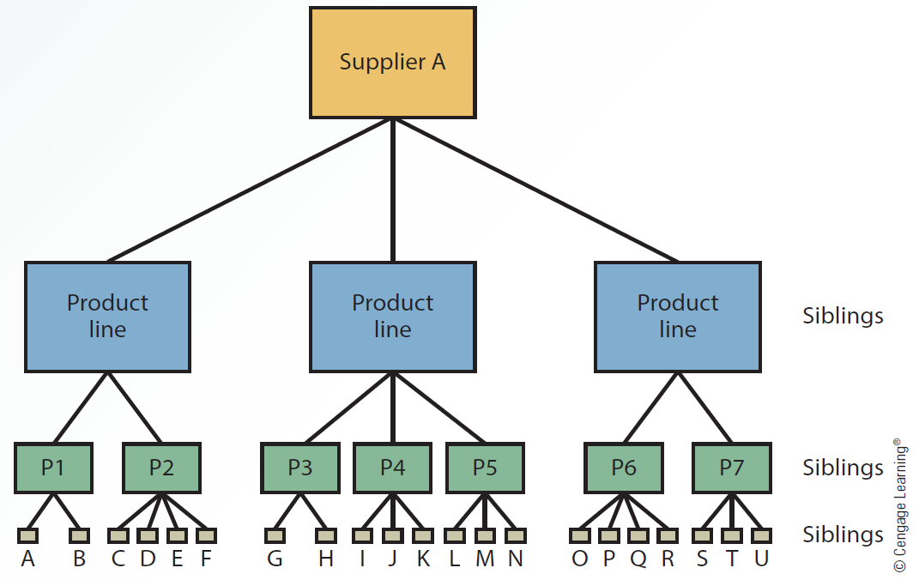
A Hierarchical Model

Slide 10
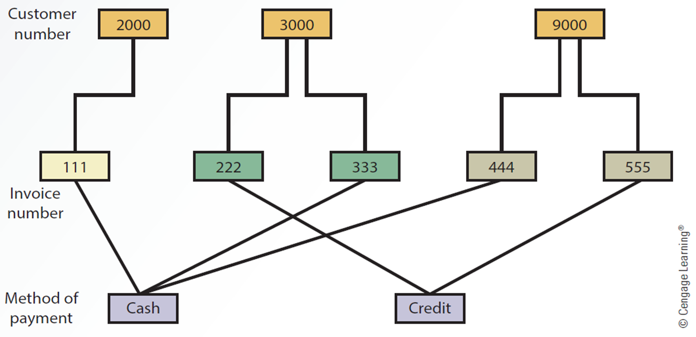
Logical Database Design
Network model
Similar to the hierarchical model but records are organized differently
Includes multiple parent and child records

Slide 11
Relational Model
Uses a two-dimensional table of rows and columns of data
Rows are records
Columns are fields
Data dictionary: Stores definitions
Data types for fields, default values, and validation rules for data in each field
Primary key
Uniquely identifies every record in a relational database
Foreign key
Field in a relational table that matches the primary key column of another table
Used to cross-reference tables

Slide 12
Relational Model
Normalization
Improves database efficiency by eliminating redundant data
Ensures that only related data is stored in a table
Goes through different stages from first normal form (1NF) to fifth normal form (5NF)
Retrieves data from tables using operations that pick and combine data from one or more tables
Select
Project
Join
Intersection
Union
Difference

Slide 13
Components of a DBMS
Database engine
Data definition
Data manipulation
Application generation
Data administration

Slide 14
Database Engine
Heart of DBMS software
Responsible for data storage, manipulation, and retrieval
Converts logical requests from users into their physical equivalents
By interacting with other components of the DBMS
Data Definition
Creates and maintains the data dictionary
Defines the structure of files in a database
Makes changes to a database’s structure
Adding and deleting fields
Changing field size and data type

Slide 15
Data Manipulation
Used to add, delete, modify, and retrieve records from a database
Uses a query language
Structured Query Language (SQL)
Standard fourth-generation query language that consists of several keywords specifying actions to take
Query by example (QBE)
Involves requesting data from a database by constructing a statement formed by query forms

Slide 16
Application Generation
Designs elements of an application using a database
Data entry screens
Interactive menus
Interfaces with other programming languages
Used by IT professionals and database administrators
Data Administration
Used for the tasks backup and recovery, security, and change management
Used to determine who has permission to perform certain functions
Summarized as create, read, update, and delete (CRUD)

Slide 17
Data Administration
Used for the tasks backup and recovery, security, and change management
Used to determine who has permission to perform certain functions
Summarized as create, read, update, and delete (CRUD)
Database administrator (DBA)
Handles database design and management
Setting up database
Establishing security measures to determine users’ access rights
Developing recovery procedures when data is lost or corrupted
Evaluating database performance
Adding and fine-tuning database functions

Slide 18
Recent Trends in Database Design and Use
Data-driven website
Interface to a database
Retrieves data and allows users to enter data
Improves access to information
Gives users more current information from a variety of data sources
Distributed database: Stores data on multiple servers throughout an organization
Approaches to setting up a DDBMS
Fragmentation: Addresses how tables are divided among multiple locations
Replication: Each site stores a copy of the data in the organization’s database
Allocation: Combines fragmentation and replication, with each site storing the data used most often
Object-oriented database: Single object contains data and their relationships
Object consists of attributes and methods that can be performed on the object’s data
Encapsulation: Grouping objects along with their attributes and methods into a single unit
Inheritance: New objects can be created faster and easily by entering new data in attributes

Slide 19
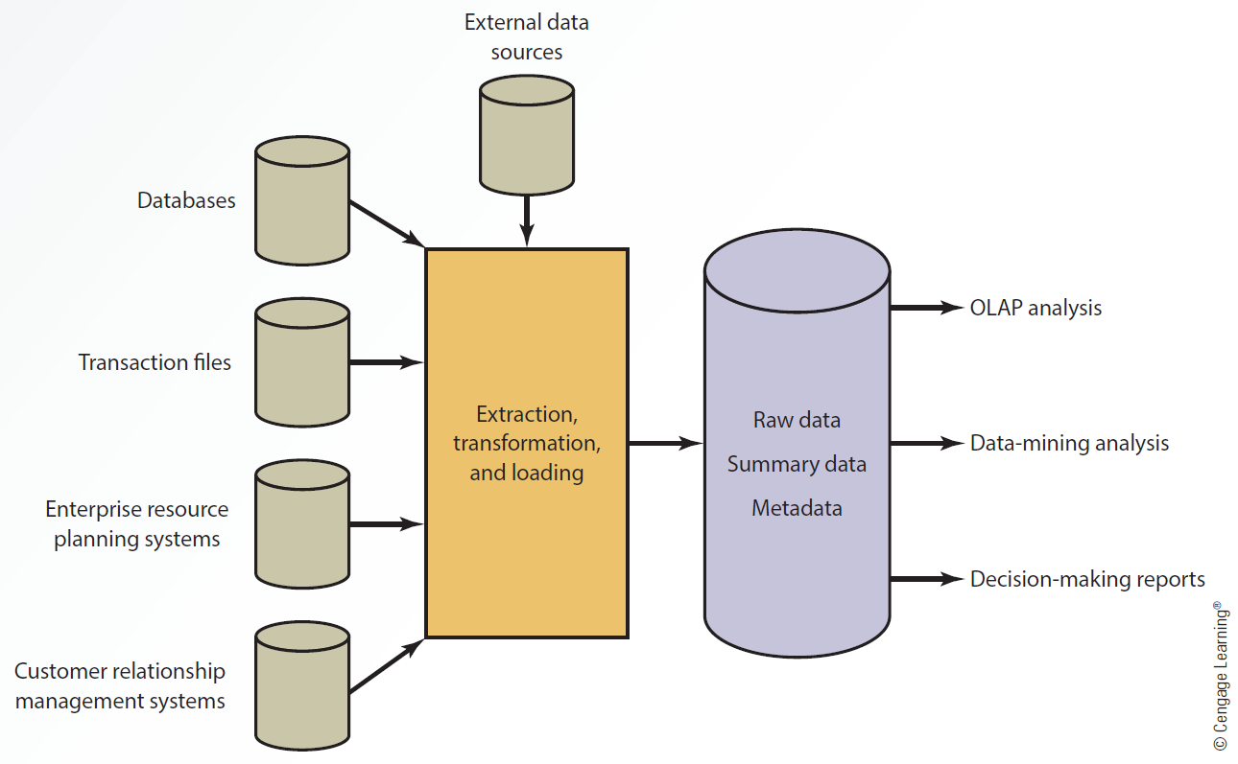
Data Warehouses
Collection of data from a variety of sources
Used to support decision-making applications and generate business intelligence
As they store multidimensional data, they are called hypercubes
Characteristics of data in a data warehouse
Subject oriented
Comes from a variety of sources
Categorized based on time
Captures aggregated data
Used for analytical purposes
Data Warehouse Configuration

Slide 20
Input
Different sources of data together provide input for a data warehouse to perform analyses and generate reports
External data sources
Databases
Transaction files
Enterprise resource planning (ERP) systems
Customer relationship management (CRM) systems
Extraction, Transformation, and Loading (ETL)
Processes used in a data warehouse
Extracting data from outside sources
Transforming data to fit operational needs
Loading data into the database or data warehouse

Slide 21
Storage
Collected information is organized in a data warehouse as:
Raw data: Information in the original form
Summary data: Gives users subtotals of various categories
Metadata: Information about data’s content, quality, condition, origin, and other characteristics

Slide 22
Output
Online transaction processing (OLTP)
Facilitates and manages transaction-oriented applications
Uses internal data and responds in real time
Online analytical processing (OLAP)
Generates business intelligence
Uses multiple sources of information and provides multidimensional analysis
Viewing data based on time, product, and location
Data-mining analysis: Discovers patterns and relationships
Data warehouses help generate various types of information and reports for decision making
Cross-reference segments of an organization’s operations for comparison purposes
Generate complex queries and reports faster and easier
Generate reports efficiently using data from a variety of sources
Find patterns and trends that can’t be found with databases
Analyze large amounts of historical data quickly
Assist management in making well-informed business decisions
Manage high demand information from many users with different needs and decision making styles

Slide 23
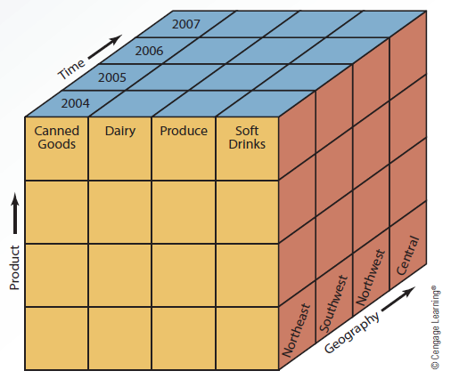
Slicing and Dicing Data

Slide 24
Data Mart
Smaller version of data warehouse, used by single department or function
Advantages over data warehouses
Access to data is faster due to their smaller size
Response time for users is improved
Easy to create because they are smaller and simple
Less expensive
Users are targeted better
Has limited scope

Slide 25
Business Analytics (BA)
Uses data and statistical methods to gain insight into the data
Provides decision makers with information to act on
TYPES OF BA METHODS
Descriptive analytics
Reviews past events
Analyzes the data
Provides a report indicating what happened over a given period of time and how to prepare for future
Reactive strategy
Predictive analytics
Prepares decision maker for future events
Proactive strategy

Slide 26
Big Data Era
Big data: Voluminous data which the conventional computing methods are unable to efficiently process and manage
Involves dimensions known as 3 Vs
Volume: Quantity of transactions
Variety: Combination of structured and unstructured data
Velocity: Speed with which data needs to be gathered and processed
WHO BENEFITS FROM BIG DATA?
Industries benefit and gain a competitive advantage in areas like:
Retail
Financial services
Advertising and public relations
Government
Manufacturing
Media and telecommunications
Energy
Healthcare

Slide 27
Factors in the Growth and Popularity of Big Data
Mobile and wireless technology
Popularity of social networks
Enhanced power and sophistication of smartphones and handheld devices

Slide 28
Key Terms
Allocation
Big data
Business analytics
Create, read, update, and delete (CRUD)
Data dictionary
Data hierarchy
Data mart
Data model
Data warehouse
Database
Hierarchical model
Indexed sequential access method (ISAM)
Inheritance
Logical view
Object-oriented databases
Online analytical processing (OLAP)
Online transaction processing (OLTP)
Physical view
Network model
Database administrator (DBA)
Database management system (DBMS)
Data-driven website
Data-mining analysis
Distributed database management system (DDBMS)
Encapsulation
Extraction, transformation, and loading (ETL)
Foreign key
Fragmentation
Primary key
Query by example (QBE)
Random access file structure
Relational model
Replication
Sequential access file structure
Structured Query Language (SQL)
Normalization

Slide 29
Summary
In a database system, all files are integrated
Retrieving data from a database is much faster
Files are accessed by using a sequential, random, or indexed sequential method
Components of a DBMS
Database engine, data definition, data manipulation, application generation, and data administration
Recent trends in database design and use include data-driven websites, natural language processing, distributed and object-oriented databases
Data marts focus on business functions for a specific user group in an organization
Industries benefit from big data analytics and gain a competitive advantage

Slide 30
THANK YOU!

