Slide 1

Analyze NYC-Flight Data
by
Lakshmi Reddy Kishtipati

Slide 2
NYC DATA ANALYSIS
BUSINESS PROBLEM
UNDERSTANDING DATA
DATA CLEANING/WRANGLING
GRAPHS/PLOTS
INSIGHTS

Slide 3
Business problem
1.) Flight Delay is one of the main concern for the Airport Authorities and Passengers. Analysis done on flight delay w.r.to the following parameters.
Origin Airport
Carrier/ Air Lines
Month
Day
Time

Slide 4
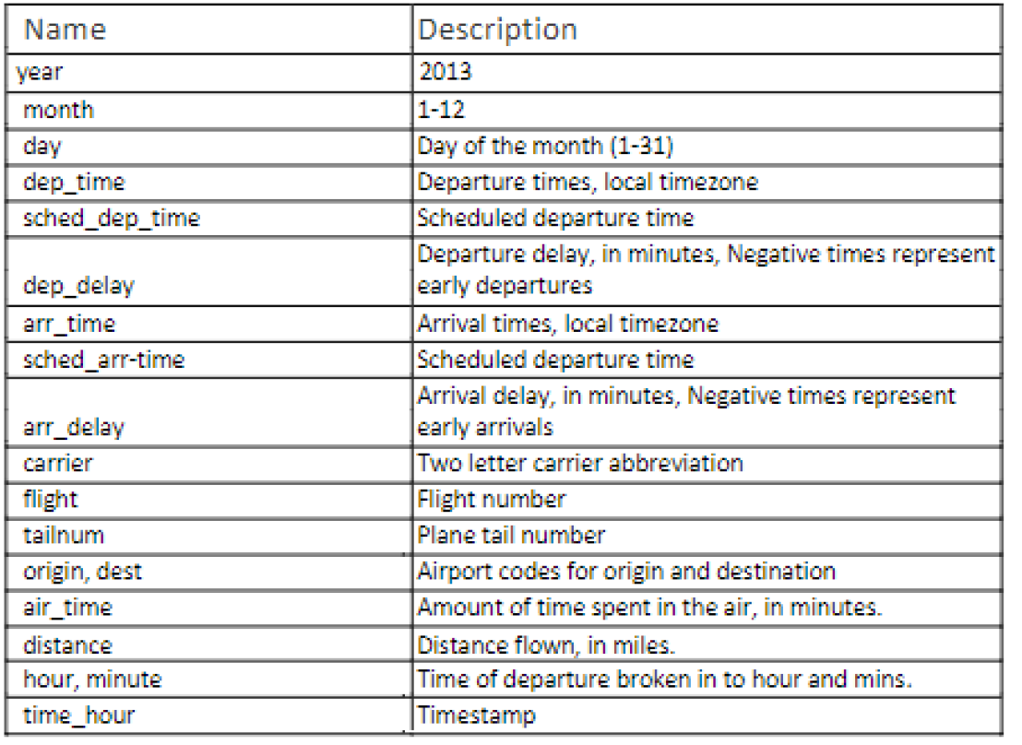
Understanding Data

Slide 5
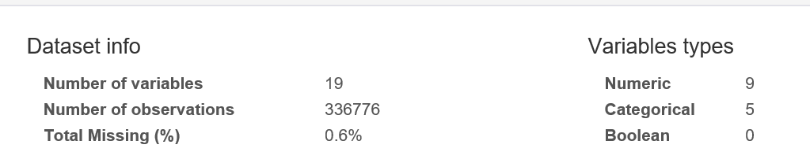
Understanding Data

Slide 7
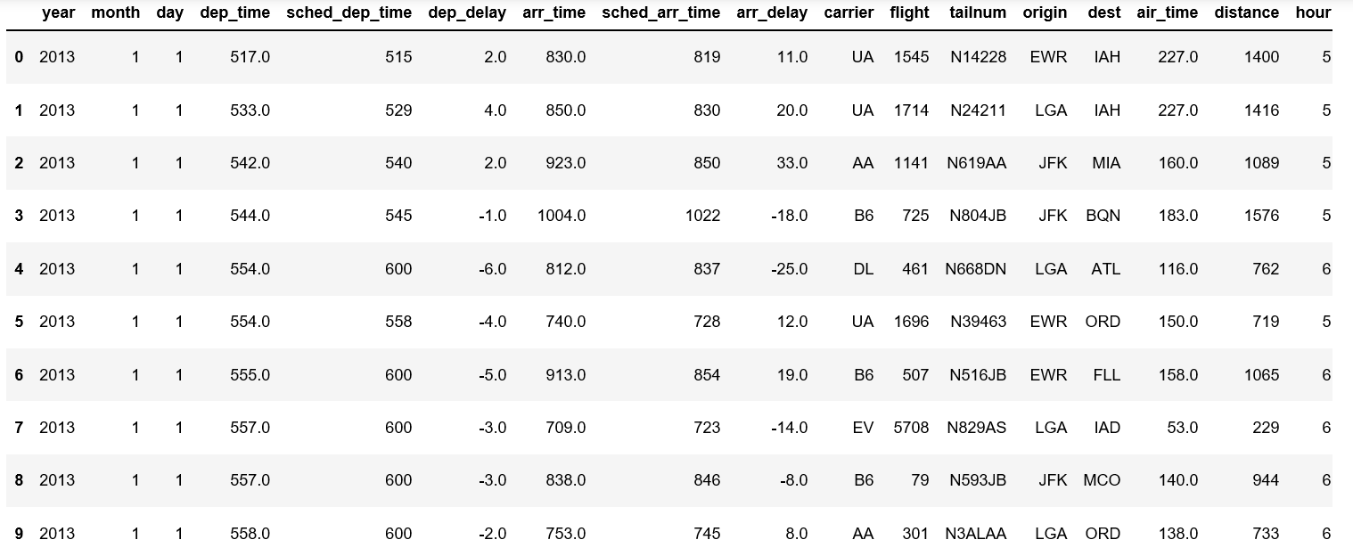
Understanding Data

Slide 8
Understanding Data
Origin Airports
EWR (Newark International)
JFK (John F. Kennedy International)
LGA (LaGuardia)

Slide 9
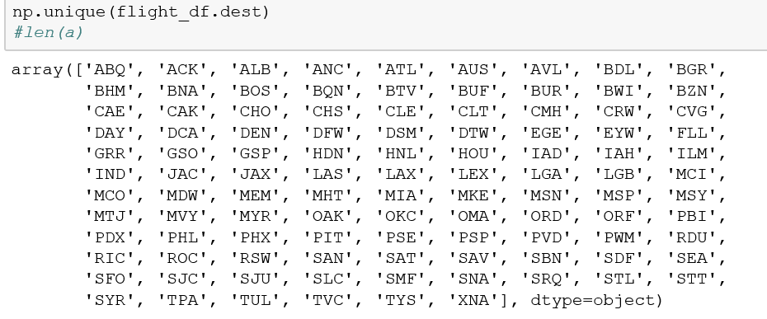
Understanding Data
Departure Airports

Slide 10
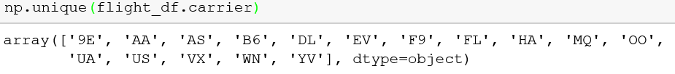
Understanding Data
Carriers or Airlines

Slide 11
Assumptions
There are no cancelled flights and all the missing data is due to loss of information.
All the times(departure time and arrival time) have been calculated on same time zone.

Slide 12
DATA Wrangling

Slide 13

DATA Wrangling
Identifying Missing Data
1. dep_time : 8255 missing values
2. dep_delay : 8255 missing values
3. arr_time : 8713 missing values
4. arr_delay : 9430 missing values
5. tailnum : 2512 missing values
6. air_time : 9430 missing values

Slide 14
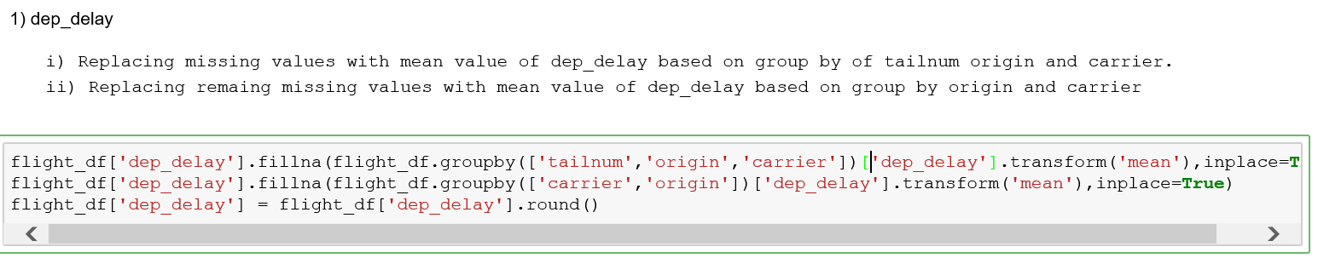
Deal with Missing Data
dep_time :

Slide 15
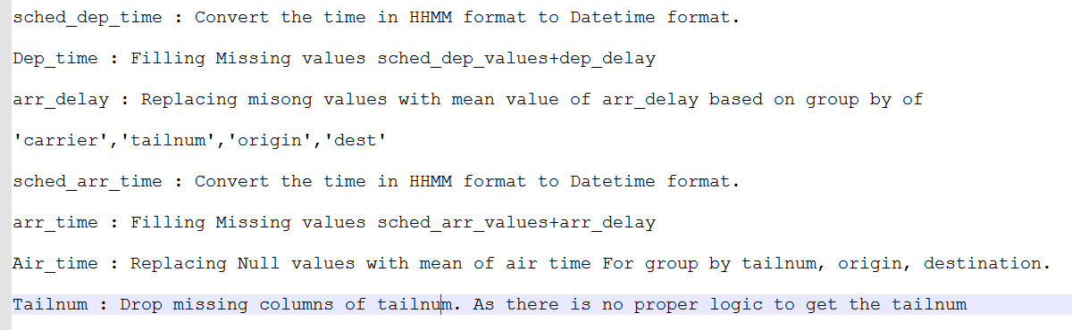
Data Wrangling

Slide 16
GRAPHS/PLOTS

Slide 17
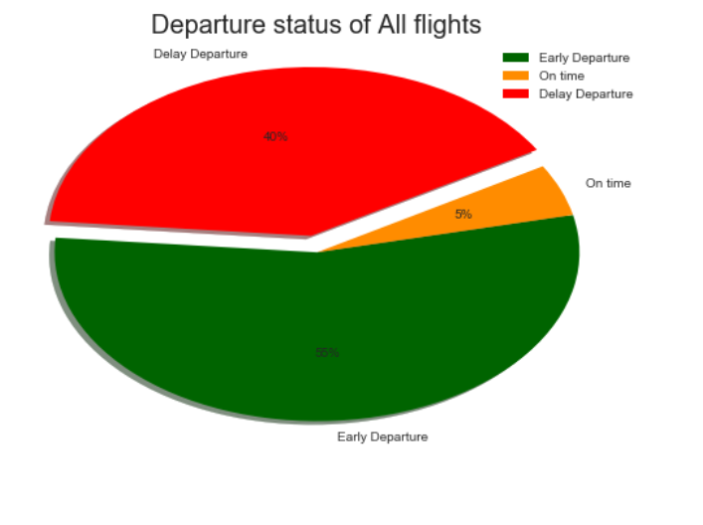

Slide 18
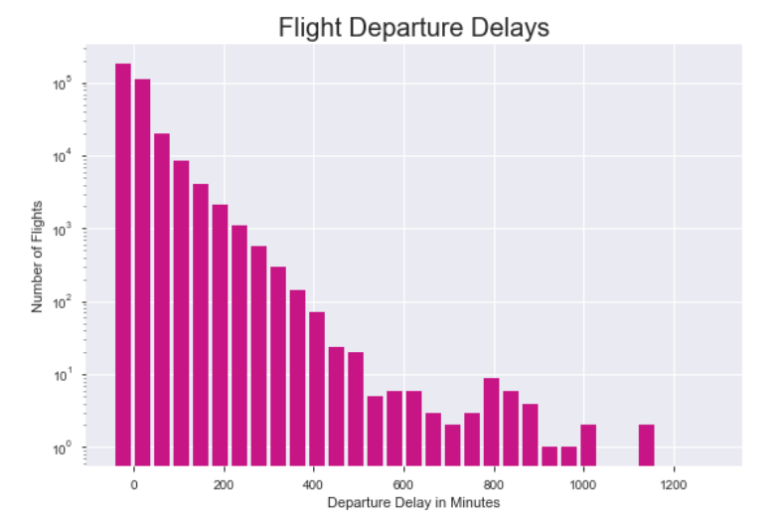

Slide 19
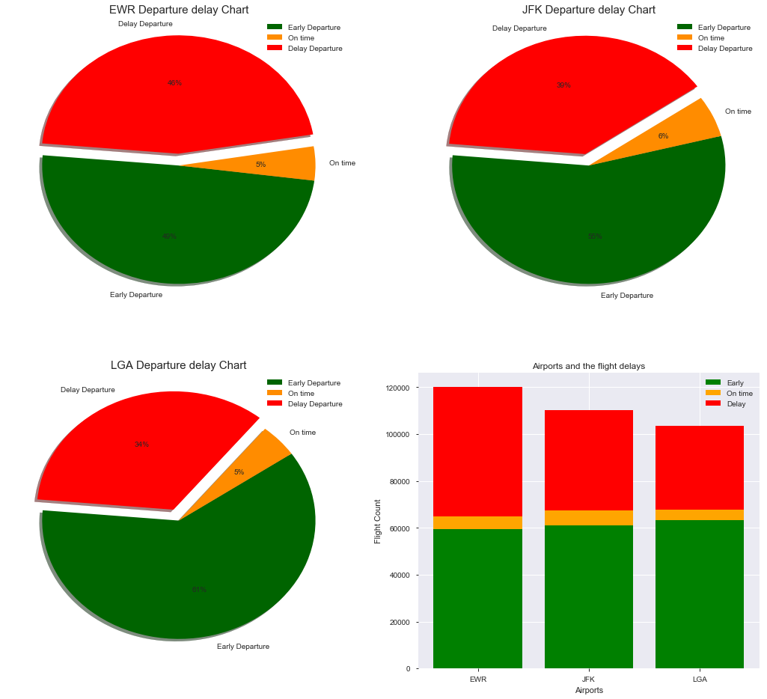

Slide 20
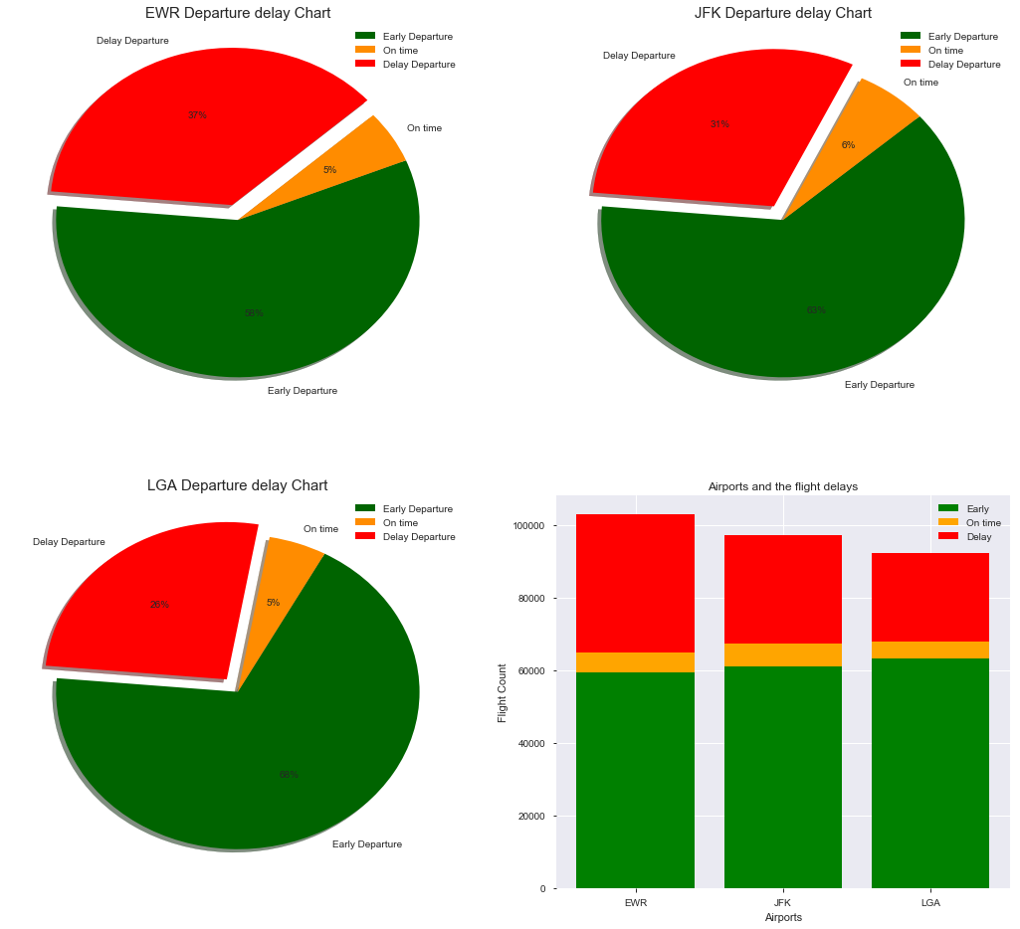

Slide 21
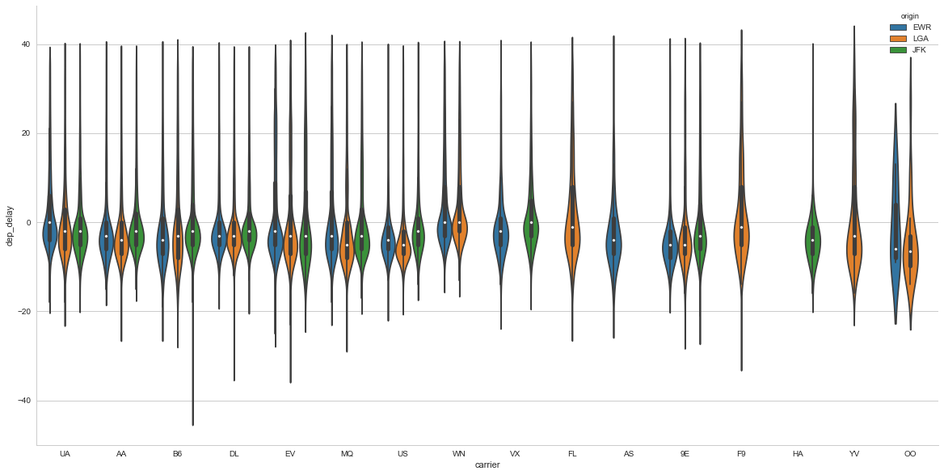

Slide 22
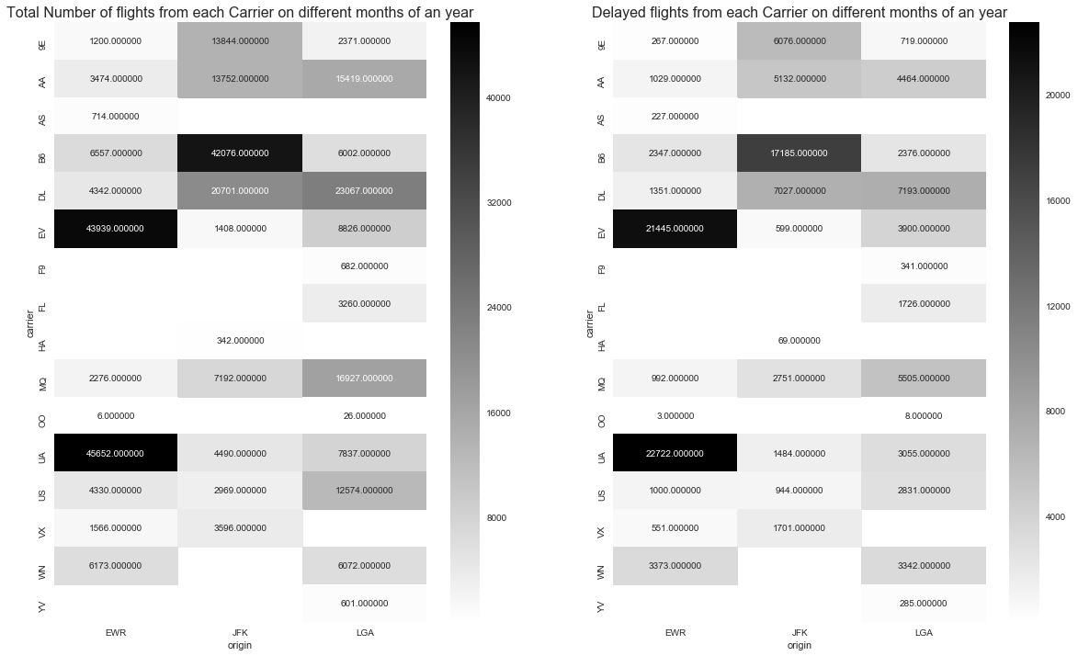

Slide 23
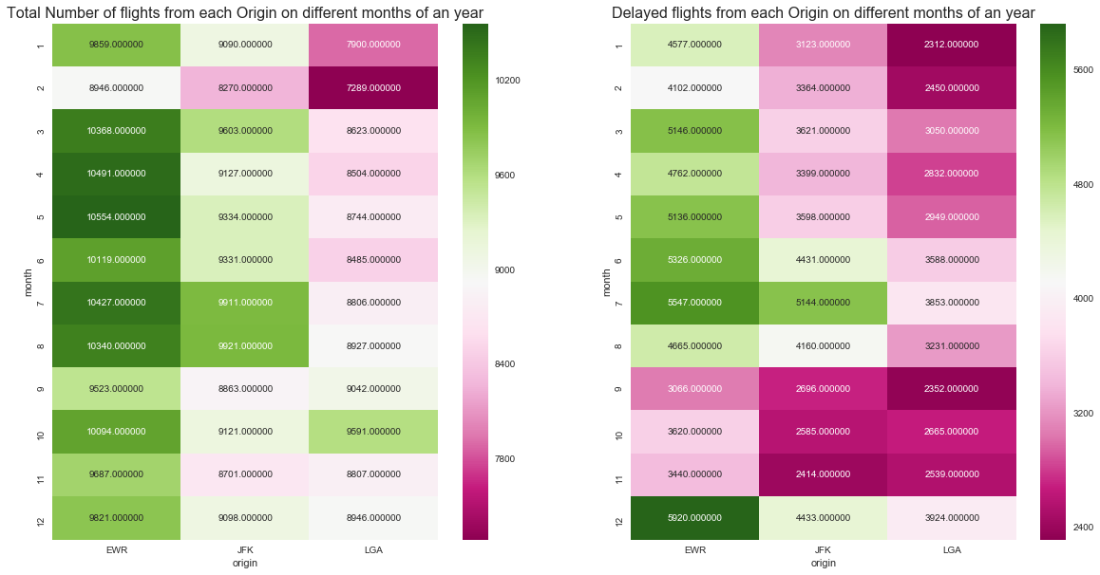

Slide 24
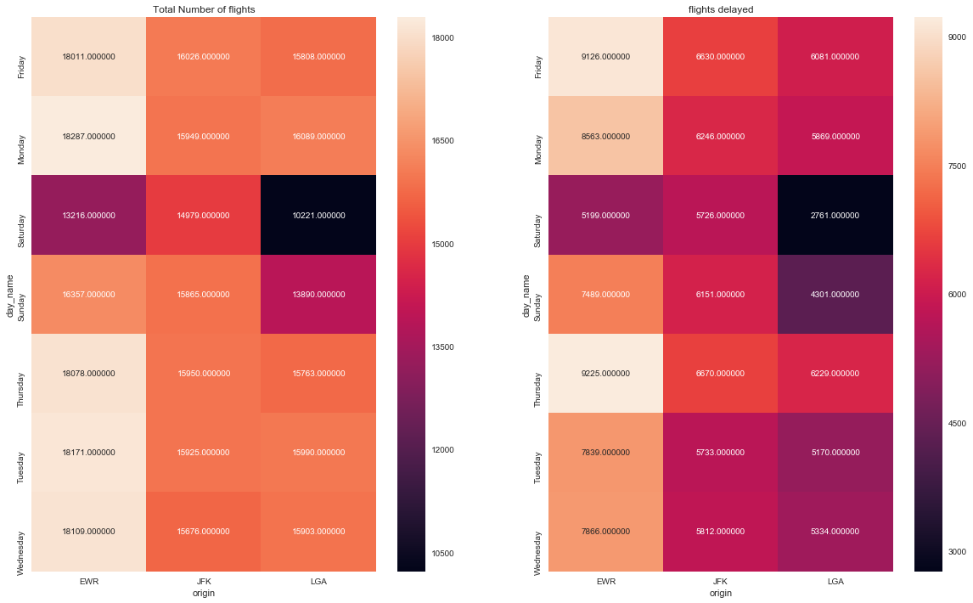

Slide 25
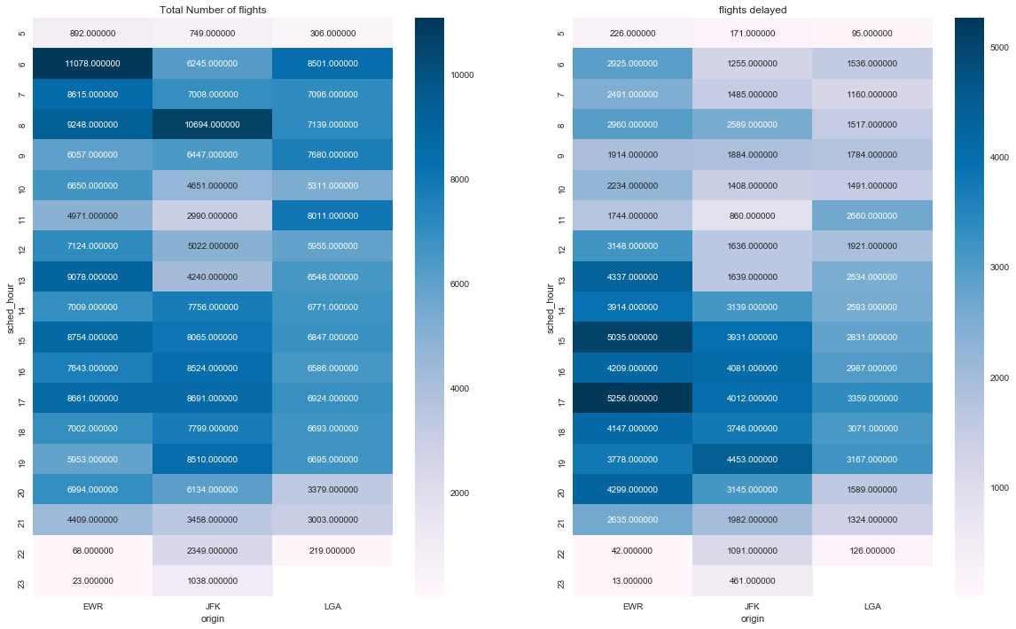

Slide 26
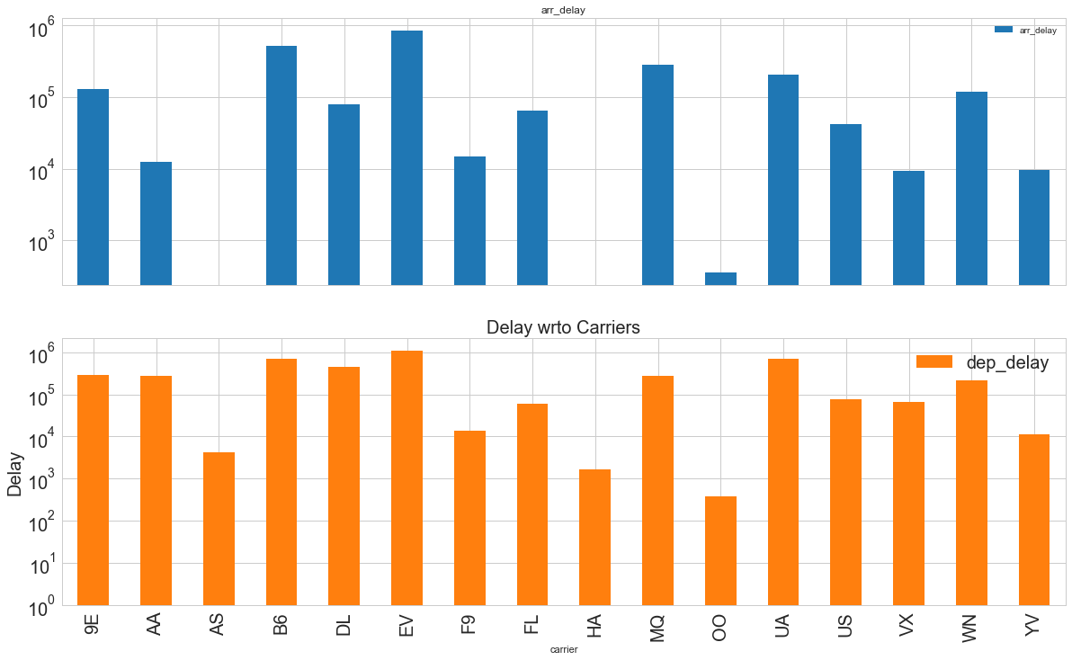

Slide 27
INSIGHTS
> 40% flights getting delayed in a year
EWR delay rate is >56%
JFK and LGA can try for improvement
Airlines UA,WN,VX, FL, F9 needs some improvements w.r.to departure delay.
In JFK and LGA airports, December month is the peak period
EWR is the busiest airport and has some less delays only in September, October and November months

Slide 28
INSIGHTS
Thursday tops in the delayed flight count, where as Friday is the second most.
Airports are free on Sunday
3PM-4PM and 5PM-6PM is busiest time in the airports

Slide 29
Further Work
Velocity w.r.to season, session for different airlines for different for different routes.
Arrival delay w.r.to departure delay, season and time.
Most flights towards a destination.

Slide 30
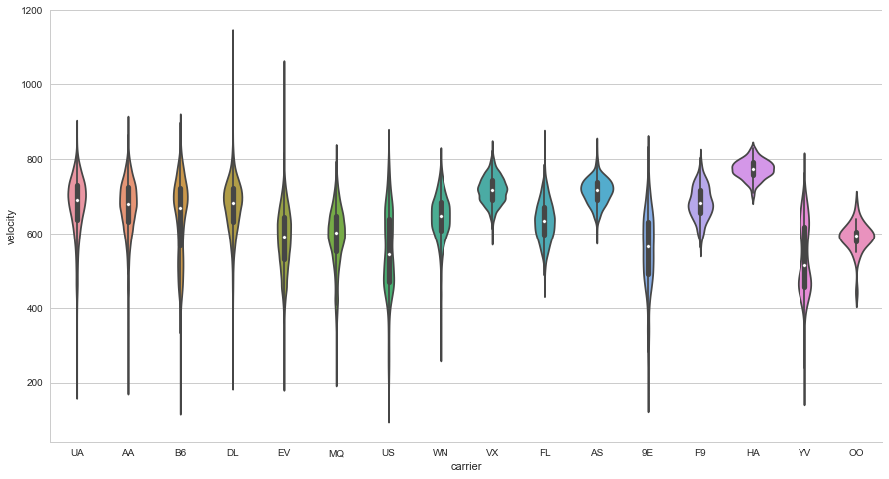

Slide 31
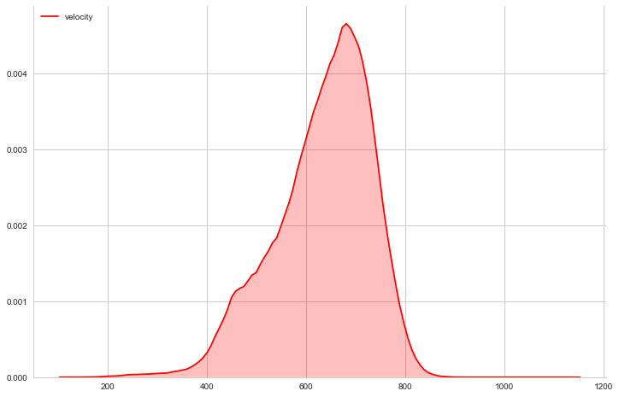

Slide 32
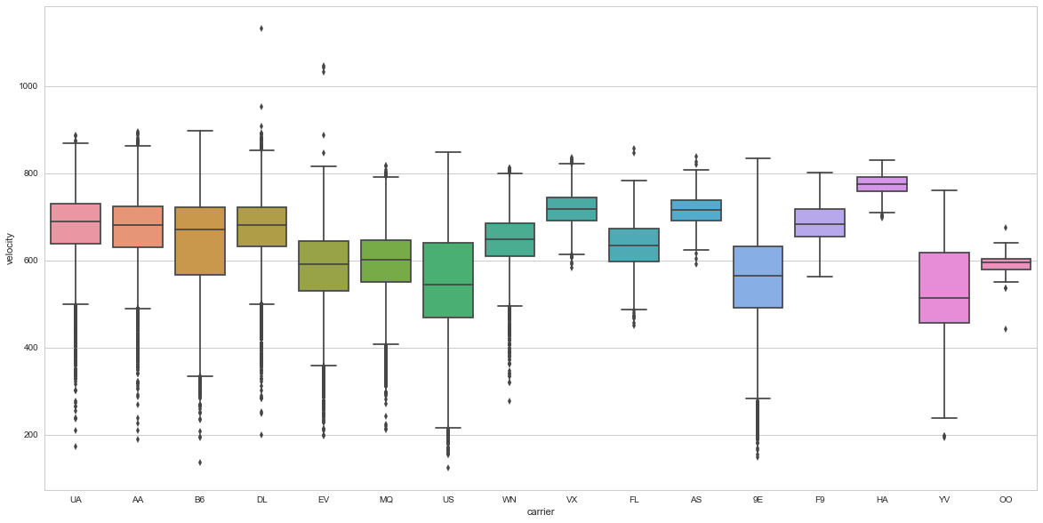

Slide 33
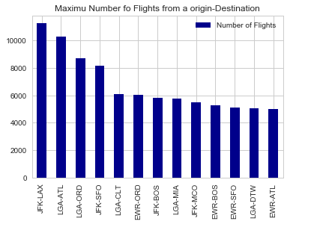

Slide 34
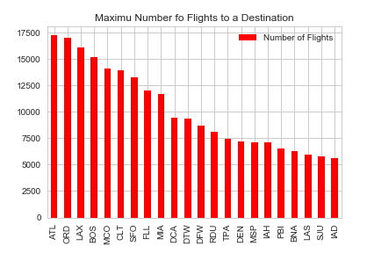

Slide 35
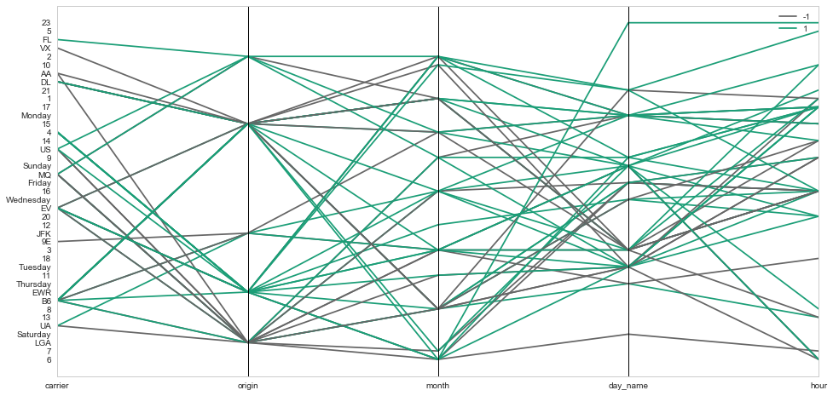

Slide 36


