Slide 1
CLASSROOM PROJECT
Restaurant Order,
Kitchen & Billing System
Project team
Sai Pranathi
Hithesree
Sahasra

Slide 2
THE IDEA(ABSTRACT)
One system connects the order, kitchen and bill
A restaurant needs one connected workflow from order entry to payment. It captures customer choices, sends clear item details to the kitchen, then uses the same order information to prepare the bill.
01
02
03
Capture
Prepare
Bill
Record the customer’s order accurately at the point of service.
Send the right items to the kitchen in a clear sequence.
Generate a reliable bill after preparation and service.

Slide 3
INTRODUCTION
What the Restaurant System Manages
The system connects menu data, customer orders, kitchen work, and billing in one clear flow.
What the system manages
Main modules
Java concepts used
Order module
Kitchen module
Billing module
Scanner gets user input
Arrays store menu data
Methods organize each module
Loops and conditions guide decisions
Operators handle calculations
Switch selects menu choices
Menu items
Customer orders
Kitchen status
Bills

Slide 4
EXISTING PROCESS
The existing process is slow and error-prone
ORDER ENTRY
KITCHEN HANDOFF
BILLING
Manual or verbal
Updates can be missed
Information is scattered
Orders may be written manually or communicated verbally, risking missed details.
Kitchen staff may miss updates or misunderstand item details.
Scattered order information makes billing take extra time.

Slide 5

PROPOSED SYSTEM
The proposed system keeps every step in one flow
One connected workflow reduces repeated entry and confusion.
The kitchen receives clearer preparation information.
Billing uses the same order data for a consistent total.

Slide 6
RAPTOR FLOWCHART · RESTAURANT ORDER, KITCHEN & BILLING SYSTEM
How the restaurant system works
Start
Enter customer order
Return to
order entry
Select menu items and quantity
Validate the order
No
Invalid order
Is the order valid?
Yes
Send valid order to kitchen
Calculate bill
Display / print bill
End

Slide 7
CO1 and CO2 control the system logic
CO1 · Input & validation
CO2 · Repetition & decisions
Scanner class: input.
Arithmetic operators: totals.
Comparisonal operators: validation.
For loop: multiple items.
if, if-else and else-if: decisions.
Switch conditions: menu actions.

Slide 8
PROGRAMMING TOPICS
CO3 organizes reusable logic and data
REUSABLE LOGIC
ORGANIZED DATA
Methods
Arrays
Separate ordering, kitchen display and billing tasks.
Store menu items, quantities and prices.
Together, these topics make the program easier to read, test and extend.

Slide 9
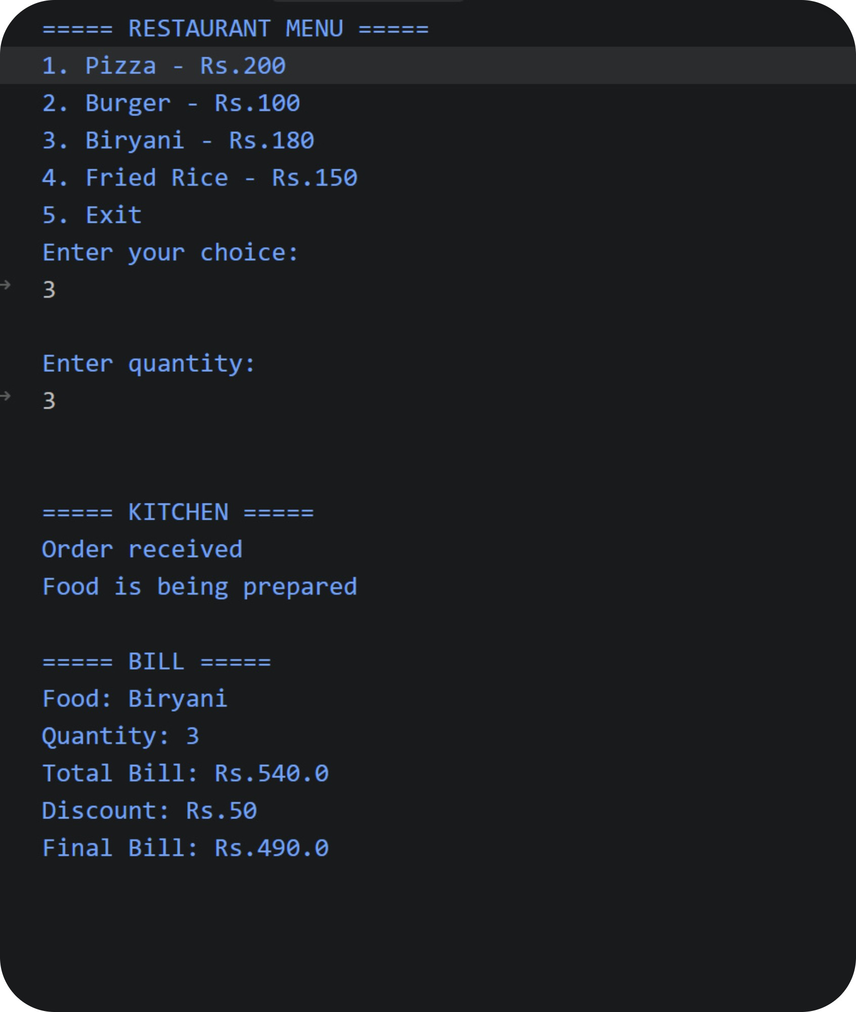
OUTPUT:

Slide 10
DINING · HOSPITALITY · SERVICE
✦ BON APPÉTIT ✦
Thank You
Thank you for your attention
A smoother service, from order to table

