Slide 1
IBM University Engagement Project Submission
“Exploring the Power of Machine Learning with IBM Cloud”

Slide 2

Project Tile – [BreastCare AI : Breast Cancer Prediction AI]
Domain of Project – [ Healthcare ]
Student Name | Recent Passport Photo | Email ID | Mobile number [WhatsApp]
Ande Lakshmi Satwika |  | lakshmisatwika28@gmail.com | 8639133564

Slide 3
Problem Statement -
Breast cancer is one of the most common cancers affecting women worldwide and remains a major cause of cancer-related deaths. Early detection is critical for improving treatment outcomes and increasing survival rates. However, accurately diagnosing breast cancer requires the analysis of multiple diagnostic features, making the process complex and time-consuming.
Delays in diagnosis or incorrect classification of tumors can affect timely medical intervention and patient care. Therefore, there is a growing need for an intelligent system that can assist healthcare professionals in analyzing diagnostic data and accurately classifying breast tumors as Benign or Malignant, enabling faster, more reliable, and data-driven clinical decision-making.

Slide 4
Proposed Solution -
(IBM watsonx.ai Studio – AutoAI):
We propose an AI-powered Breast Cancer Prediction System using IBM watsonx.ai Studio, AutoAI and IBM Bob.
The Breast Cancer Wisconsin Diagnostic Dataset is uploaded to IBM Cloud, where IBM AutoAI automatically performs data preprocessing, feature engineering, model selection, and hyperparameter optimization. Multiple machine learning models are trained and evaluated to identify the best-performing model for accurate breast cancer prediction.
The selected model is then deployed and integrated into a responsive web application generated using IBM watsonx BoB. Users can enter diagnostic parameters through an intuitive interface to receive real-time predictions indicating whether a tumor is Benign or Malignant, along with confidence scores.
.

Slide 5
The application also includes interactive data visualizations, prediction history, educational information on breast cancer, prevention guidelines, and risk factor awareness, making it an informative and user-friendly healthcare platform that supports early detection and informed decision-making.

Slide 6
Technology Used
IBM Cloud – IBM Cloud served as the primary cloud platform for developing and managing the project. It was used to upload the Breast Cancer Wisconsin Diagnostic Dataset, create AI resources, and securely deploy the trained machine learning model, providing a scalable and reliable environment for the application.
IBM watsonx.ai Studio: AutoAI -- IBM AutoAI automated the complete machine learning workflow by performing data preprocessing, feature engineering, algorithm selection, model training, evaluation, and hyperparameter optimization. It generated multiple machine learning pipelines and selected the best-performing model for accurate breast cancer prediction.
IBM Bob -- IBM BoB was used to generate the complete web application, including both the frontend and backend. It seamlessly integrated the trained machine learning model

Slide 7
into a modern, responsive interface, enabling users to interact with the AI system through an intuitive dashboard.​
ML Algorithm/ Model Used: Snap Logistic Regression (AutoAI Best Pipeline – P8)
Accuracy Obtained: 98.4%
Enhancements and Hyperparameter Tuning:
Automatic Feature Engineering (FE)
Hyperparameter Optimization (HPO-1)
Hyperparameter Optimization (HPO-2)
Automated Model Selection using IBM watsonx.ai AutoAI

Slide 8
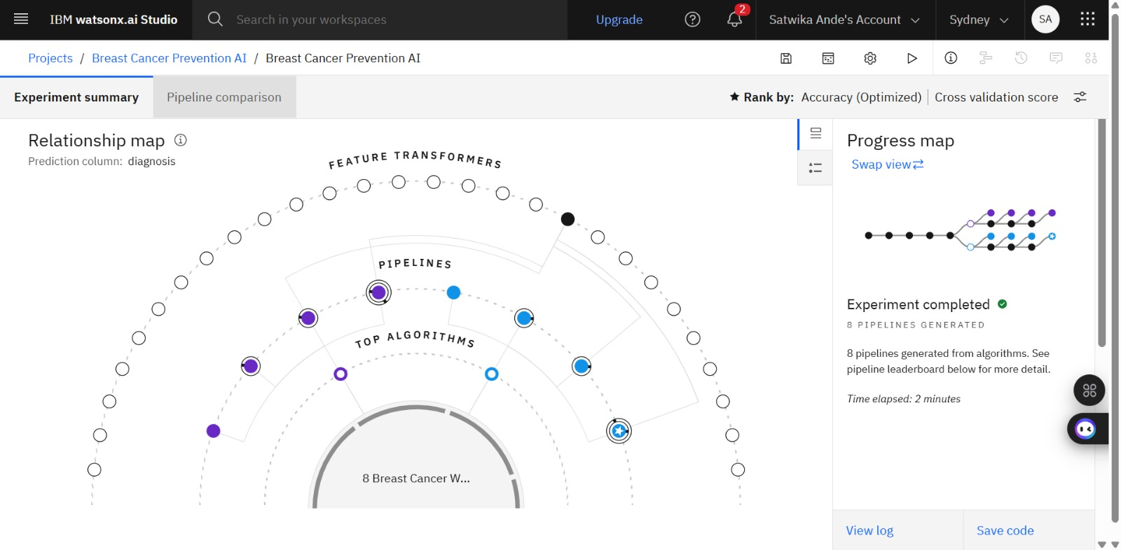
Training Screenshots-

Slide 9
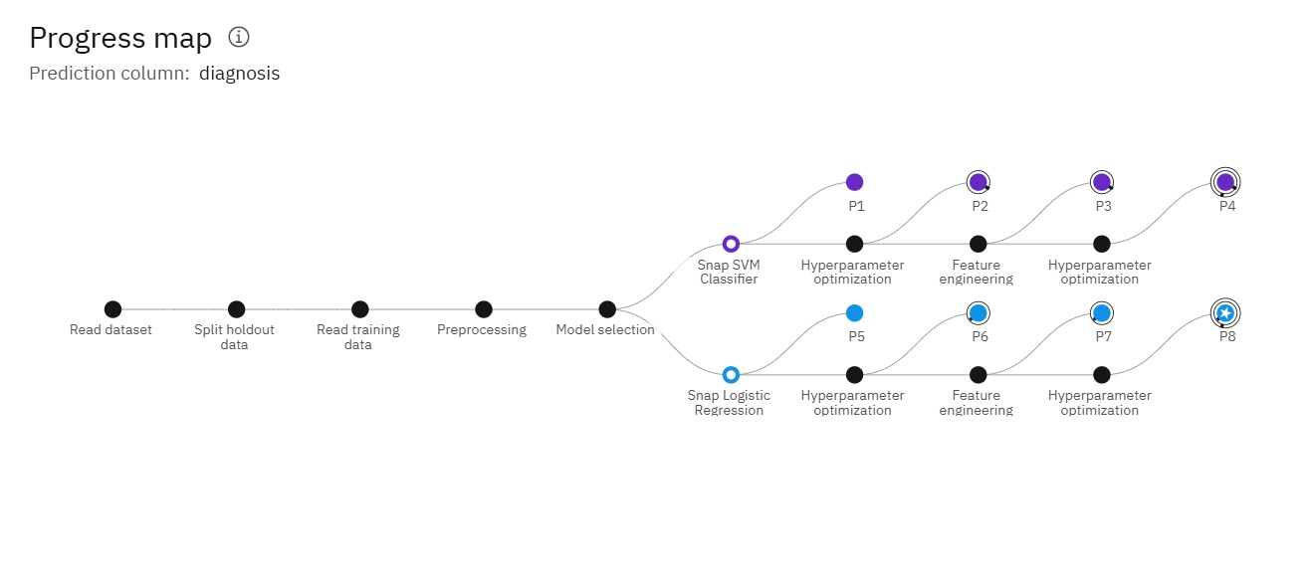
Progress map-

Slide 10
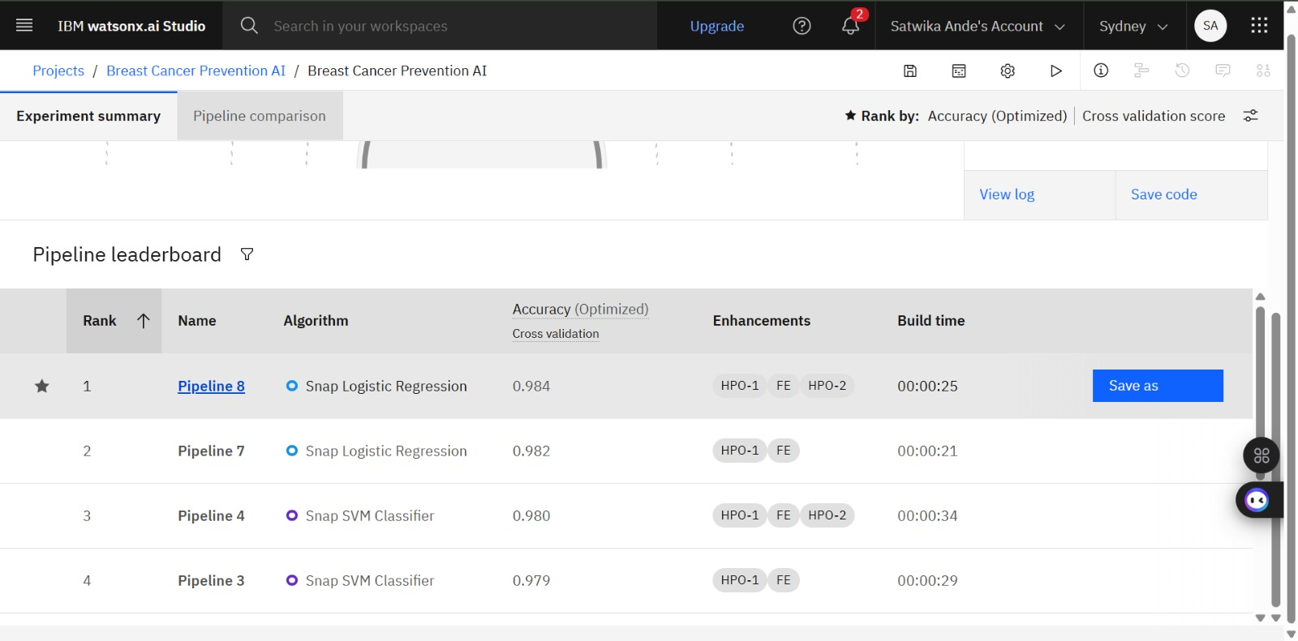
Best Model Screenshot:

Slide 11
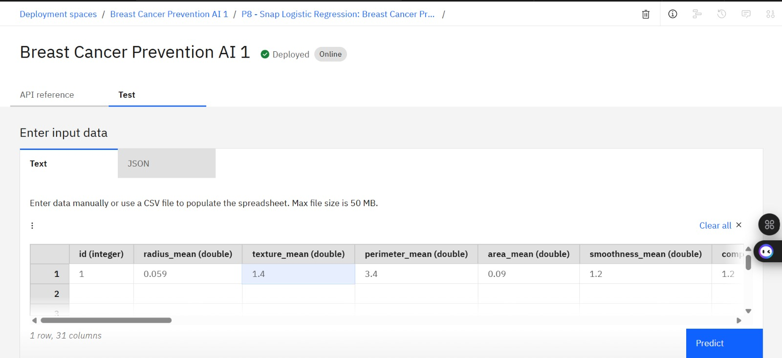
Testing Screenshot:

Slide 12
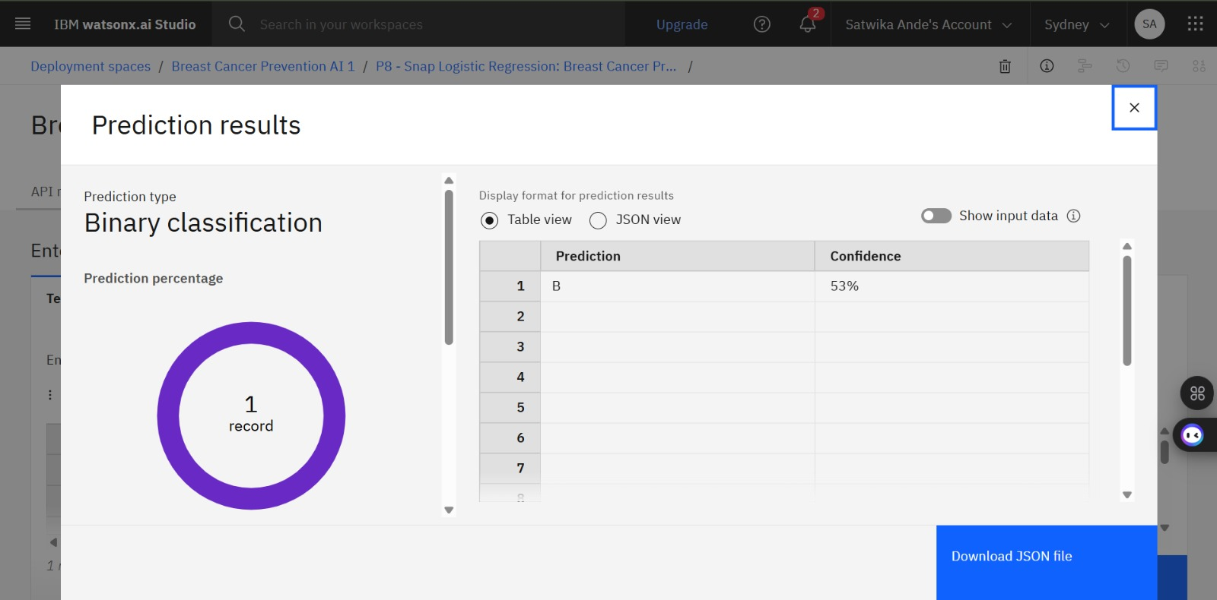
Testing Screenshot:

Slide 13
How IBM BoB was Used
Generated the complete frontend and backend of the BreastCare AI web application.
Built a modern, responsive interface with animations, interactive dashboards, and prediction pages.
Integrated the deployed IBM AutoAI machine learning model into the application.
Enabled users to receive real-time breast cancer predictions with confidence scores through an intuitive interface.
Connecting AutoAI with IBM BoB
Trained and deployed the best AutoAI model on IBM Watson Machine Learning.
Added the IBM API Key, IBM WML URL, Deployment Space ID, and Deployment ID in the .env file.
Used the Watson Machine Learning API to connect the deployed model with the Flask application.

Slide 14
User inputs are sent to the deployed model, and the prediction results are displayed instantly on the website.
Get the Required IDs
IBM API Key → Generated from IBM Cloud IAM.
Deployment Space ID → Copied from the Deployment Space.
Deployment ID → Copied from the deployed AutoAI model.
IBM WML URL → Region endpoint (Sydney: https://au-syd.ml.cloud.ibm.com).
Create the .env File
Copy the .env.example file and rename it to .env.
Fill in the required IBM Cloud credentials such as API Key, Space ID, Deployment ID, and WML URL.
Run the Application
Install the required dependencies using requirements.txt and run python app.py.

Slide 15
IBM Bob Prompt-
Create an AI-powered Breast Cancer Prevention and Risk Prediction web application using Python Flask, IBM Cloud, and IBM AutoAI. Use the Breast Cancer Wisconsin Diagnosis dataset, where the target/output column is diagnosis, with M meaning Malignant and B meaning Benign. Exclude id and Unnamed: 32 from model training.
Build a responsive healthcare-focused frontend where users can enter tumor cell measurement values and receive an ML-based prediction result from the AutoAI model. The website should show whether the case is predicted as Benign or Malignant, along with confidence/probability if available.
Add a dashboard explaining key features such as radius, texture, perimeter, area, smoothness, compactness, concavity, symmetry, and fractal dimension. Include prevention awareness sections, early detection tips, risk factors, and a disclaimer that this tool is for educational purposes only and not a medical diagnosis.

Slide 16
Integrate IBM Cloud and AutoAI deployment securely using a .env file for API keys, deployment endpoint, project/space ID, and model credentials. Generate complete backend code, frontend templates, CSS, JavaScript, requirements.txt, .env.example, README.md, and deployment instructions.​
​Use modern UI design with Bootstrap, animations, cards, charts, dark mode, mobile responsiveness, and a clean medical theme. Add proper error handling, form validation, prediction history, and clear user-friendly explanations of the ML result.​

Slide 17
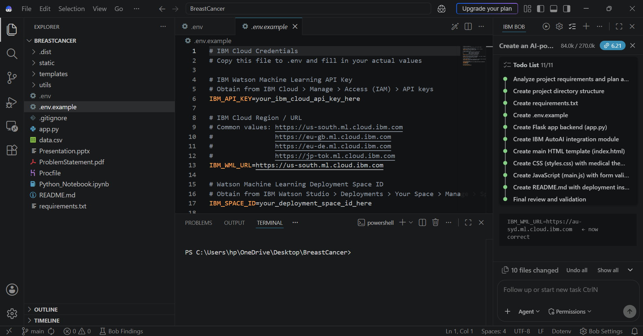
IBM BOB TO-DO TASKS-

Slide 18
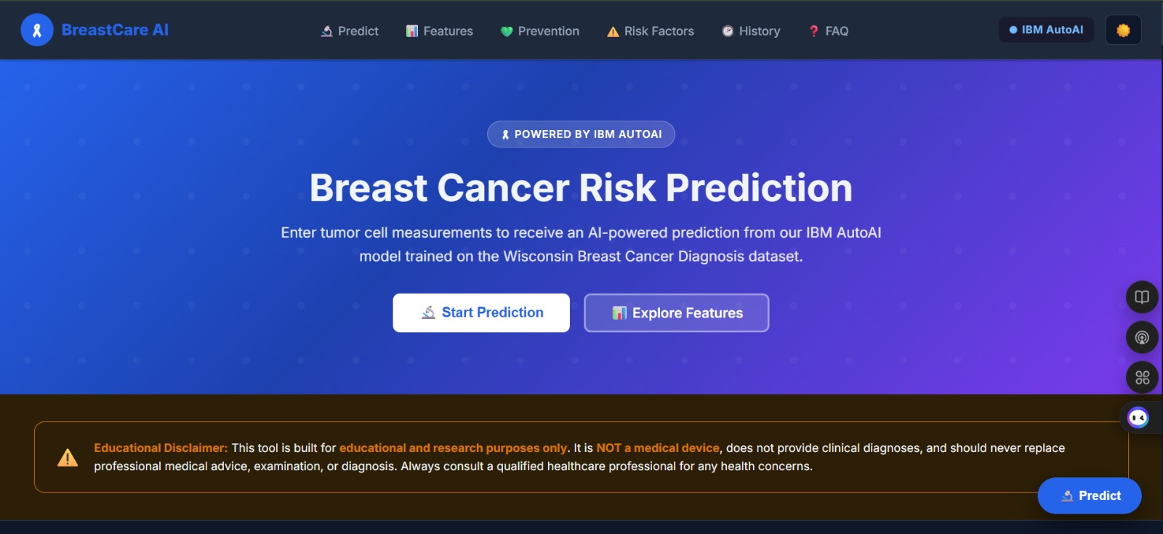
Web Page Images (Screenshots)

Slide 19
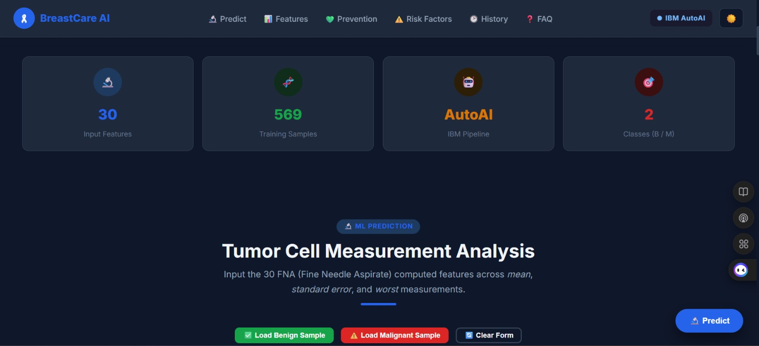

Slide 20
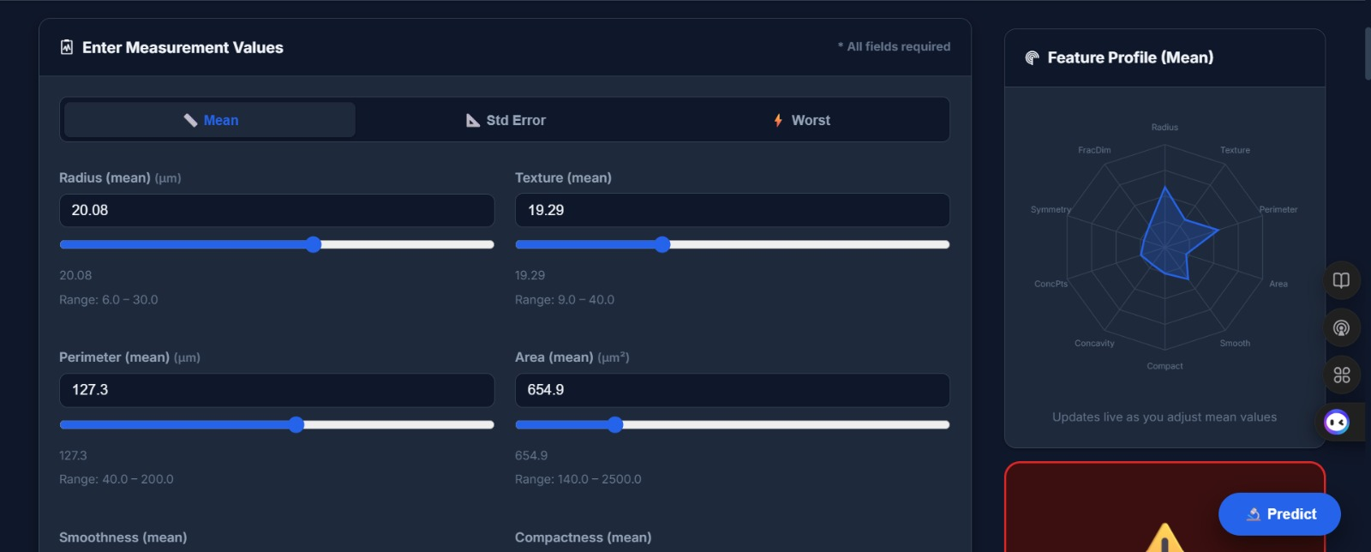

Slide 21
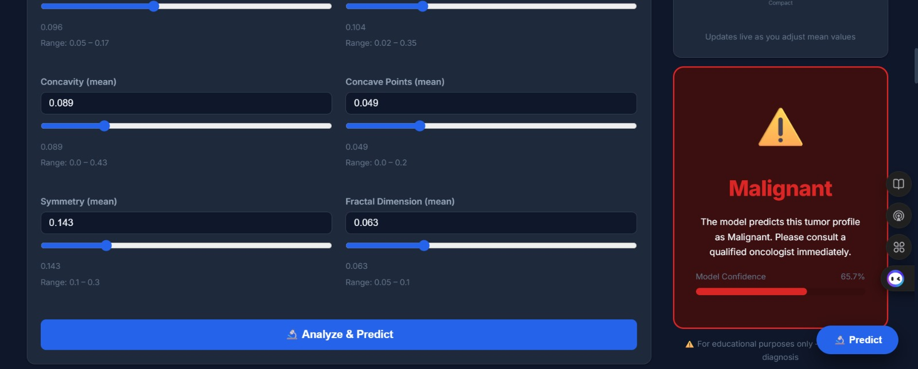

Slide 22
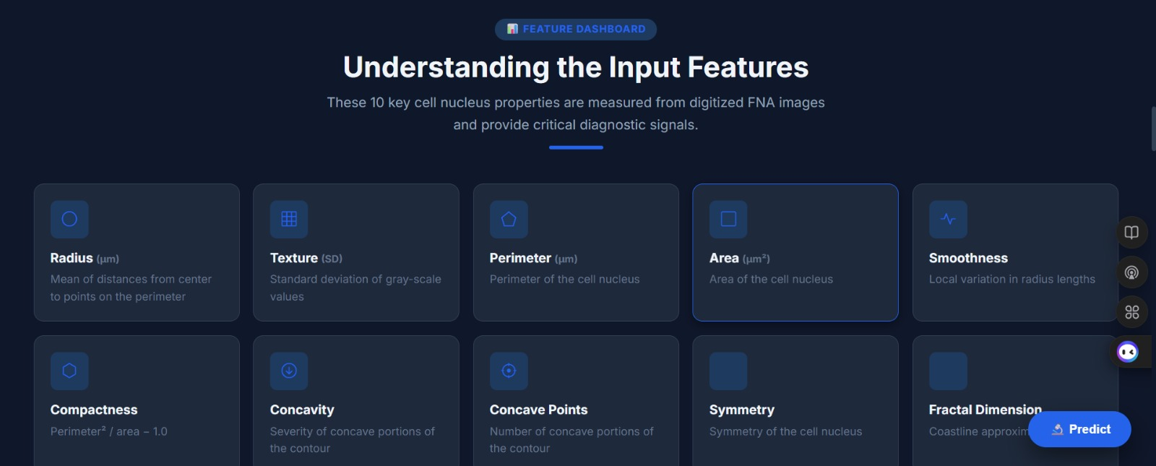

Slide 23
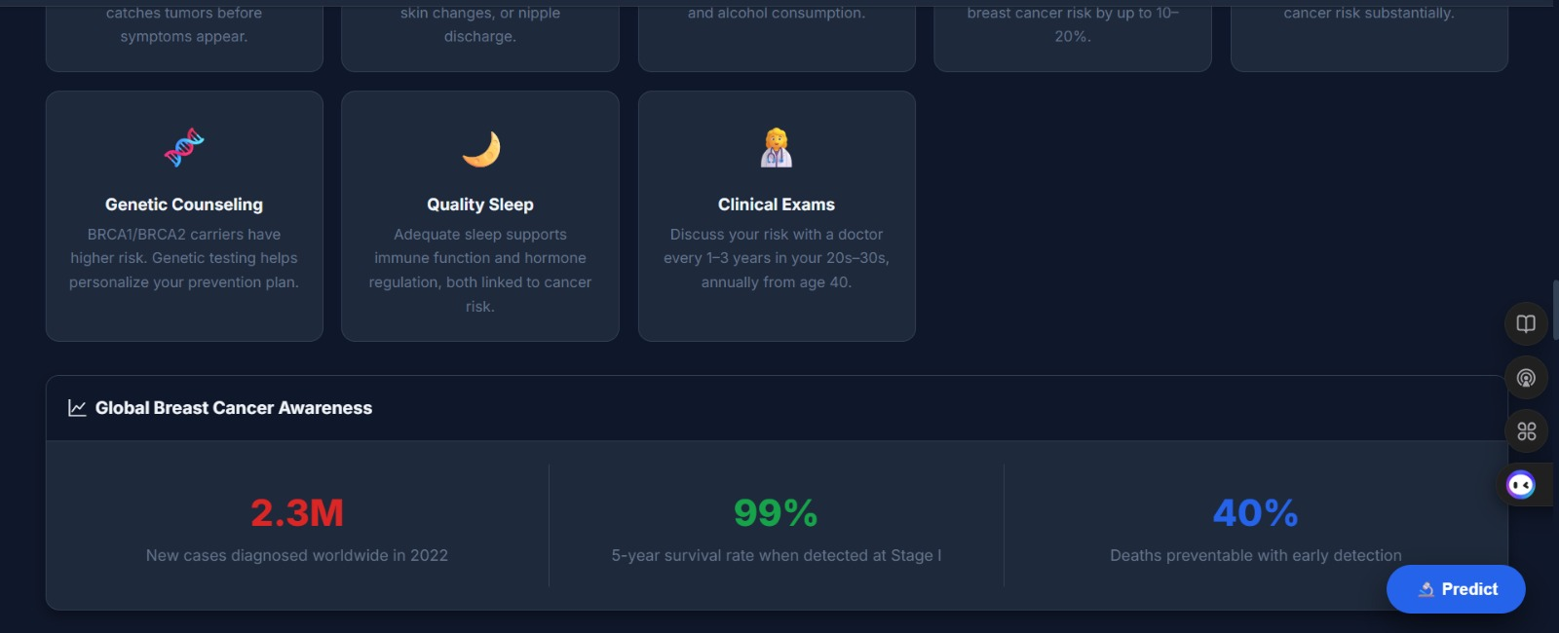

Slide 24
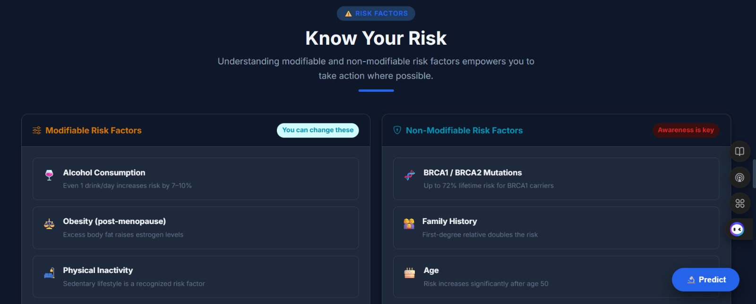

Slide 25
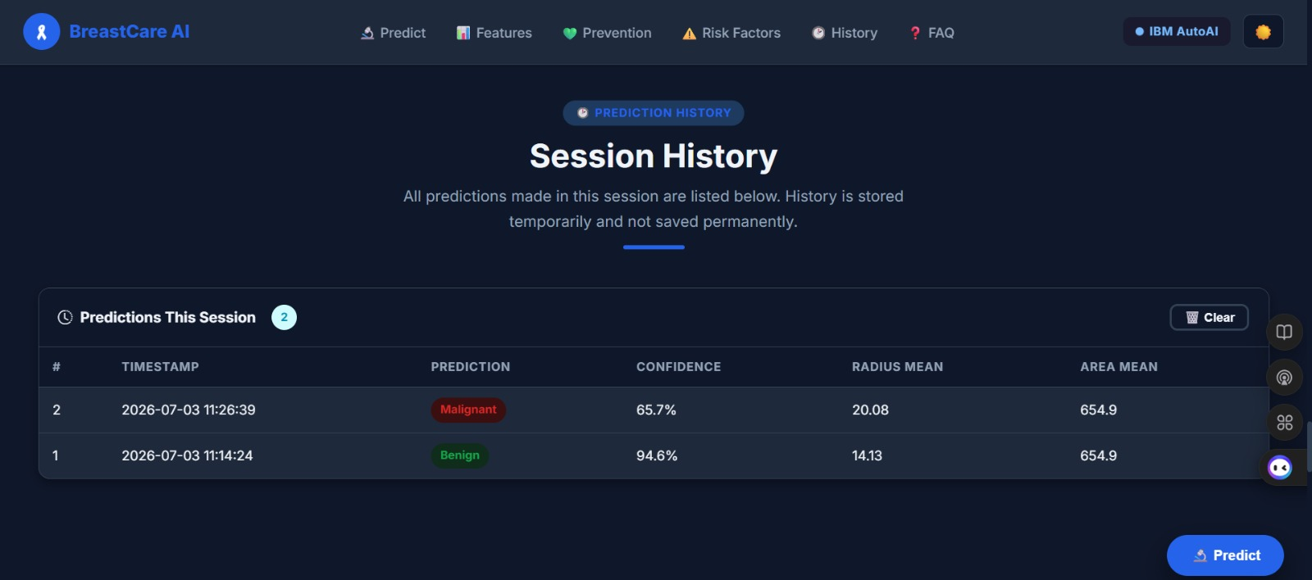

Slide 26
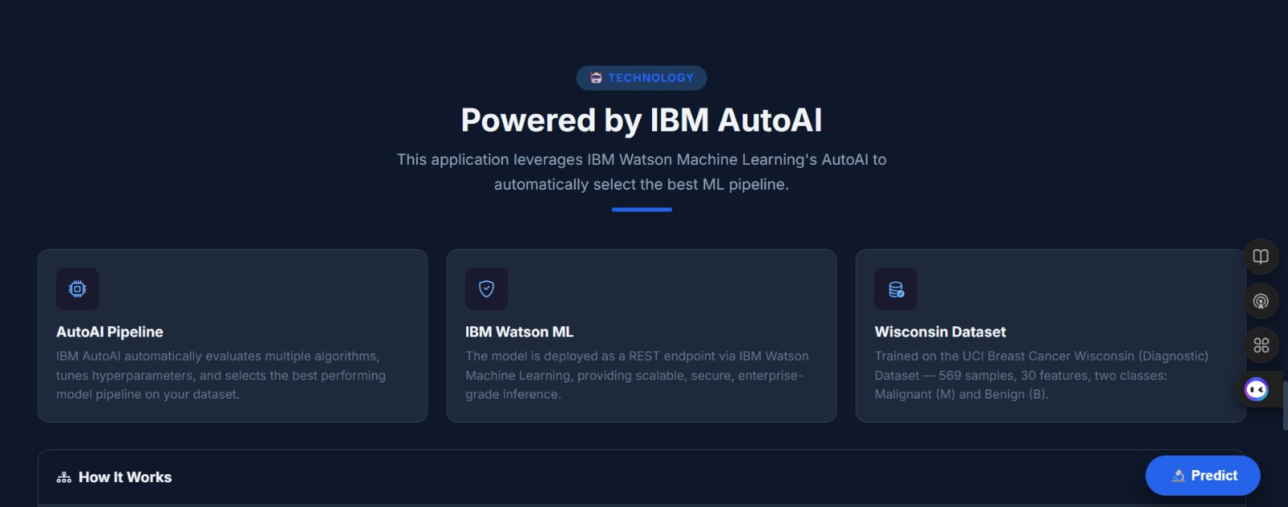

Slide 27
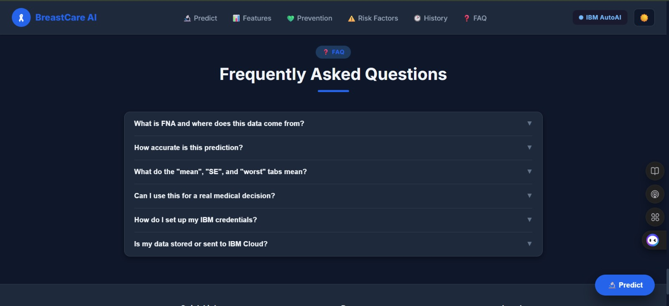

Slide 28
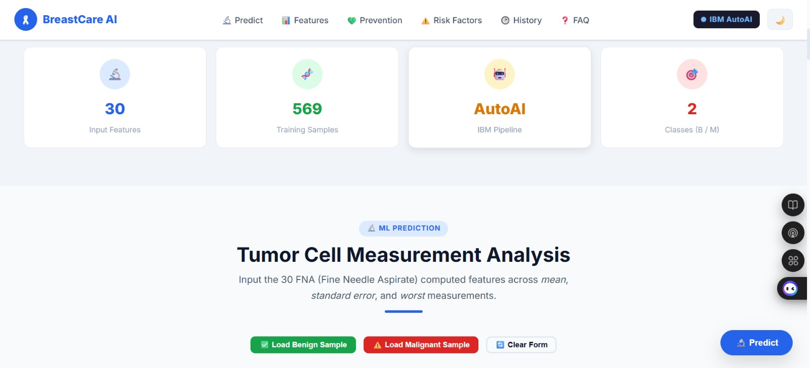
Light mode

Slide 29
Novelty and Uniqueness
Developed an AI-powered Breast Cancer Prediction system using IBM Cloud, IBM AutoAI, and IBM watsonx BoB.
Utilizes IBM AutoAI to automatically preprocess data, optimize hyperparameters, and select the best-performing machine learning model.
Delivers real-time predictions with confidence scores through a modern, responsive, and user-friendly web interface.
Includes interactive dashboards, radar chart visualizations, and prediction history to enhance user understanding and experience.
Promotes breast cancer awareness by providing prevention tips, risk factors, and educational information alongside predictions.
Demonstrates a complete end-to-end AI solution, from dataset upload and model deployment on IBM Cloud to a fully integrated intelligent web application.

Slide 30
Git Hub Link
https://github.com/lakshmisatwika28-lang/Breast-Cancer-Prediction-AutoAI.git
·
·
·

Slide 31
Future Scope
Assist healthcare professionals by providing quick and reliable preliminary breast cancer predictions, reducing diagnostic time.
Promote early detection and timely medical intervention, improving treatment success rates and patient survival.
Increase breast cancer awareness by educating users about risk factors, symptoms, and preventive measures.
Be integrated into hospitals, diagnostic centers, and healthcare systems as an AI-assisted decision support tool.
Improve healthcare accessibility by enabling remote breast cancer risk assessment, especially for people in rural and underserved areas.
Support doctors by acting as a clinical decision-support system, reducing
·
·
·

Slide 32
manual effort and assisting in data-driven diagnosis.
Expand into a comprehensive healthcare platform capable of predicting multiple diseases using advanced AI and machine learning models.
Contribute to the advancement of AI-powered healthcare, making medical screening faster, more accurate, and accessible to a larger population.

Slide 33
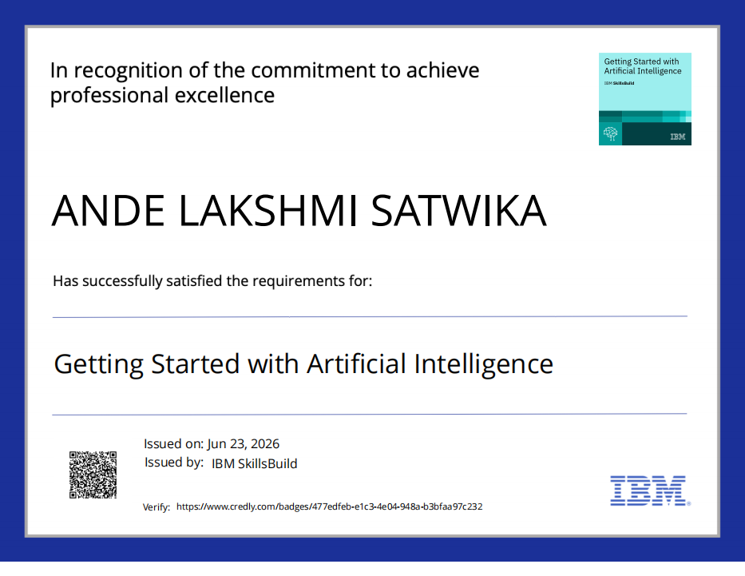
Certificates Earned:

Slide 34
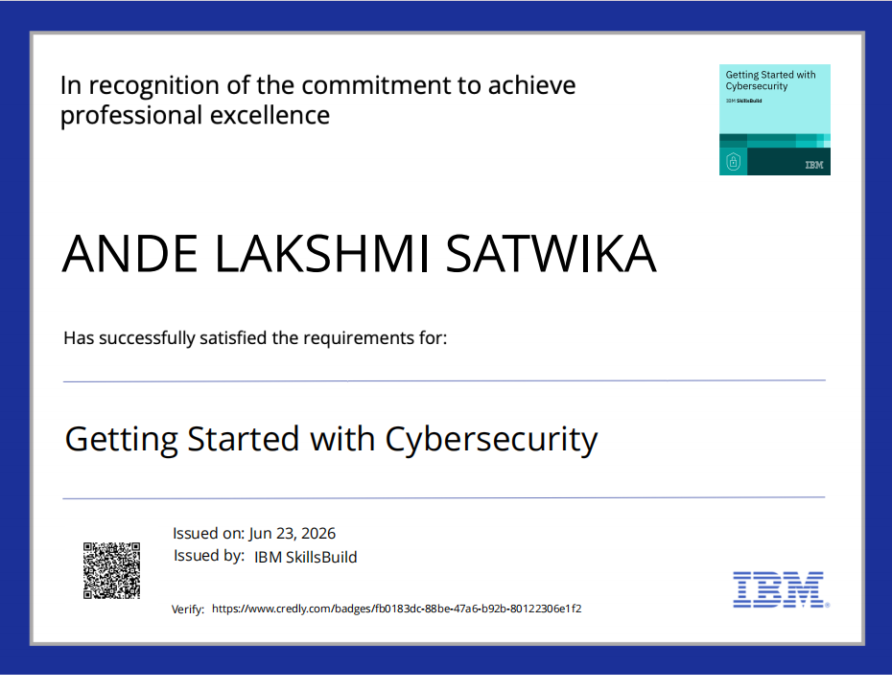

Slide 35
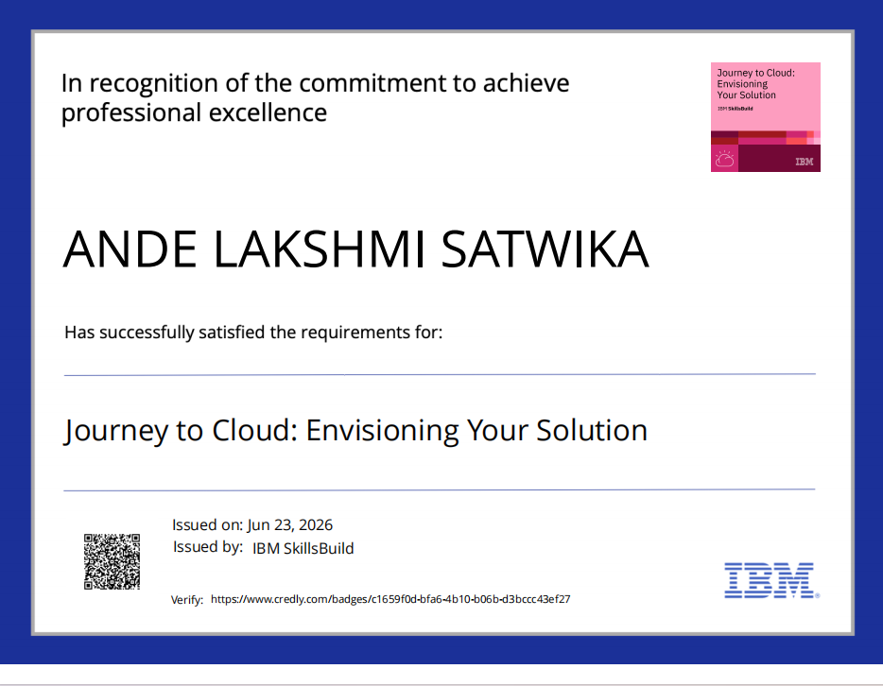

Slide 36
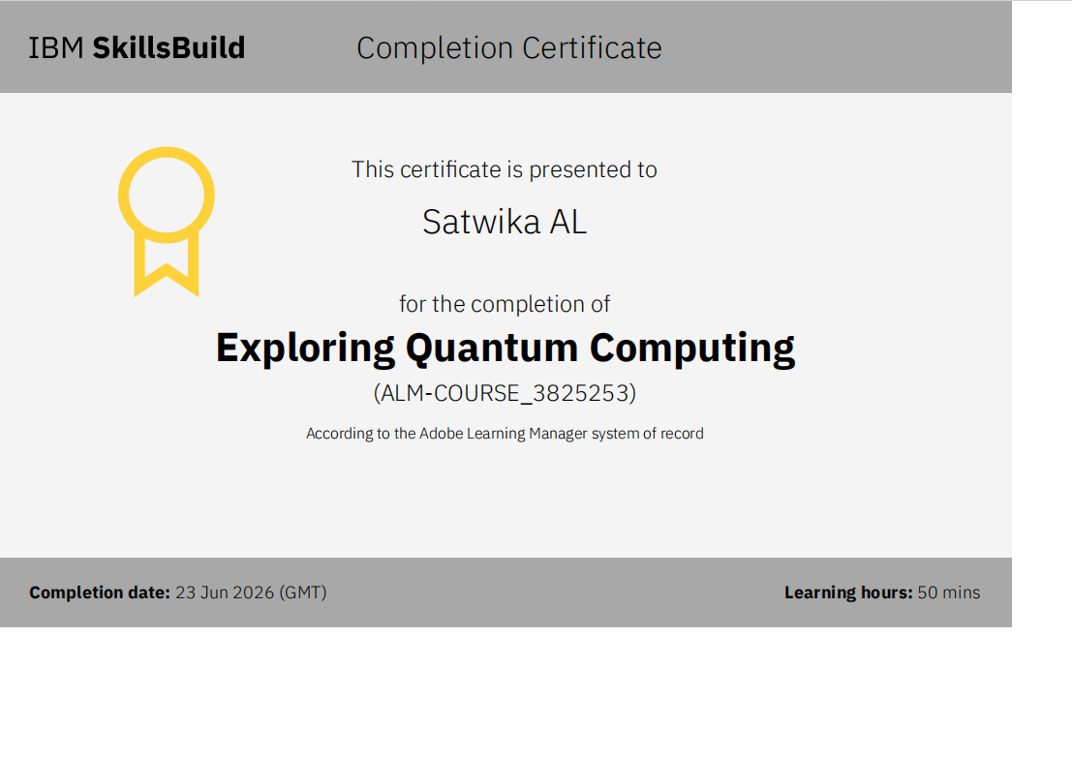

Slide 37
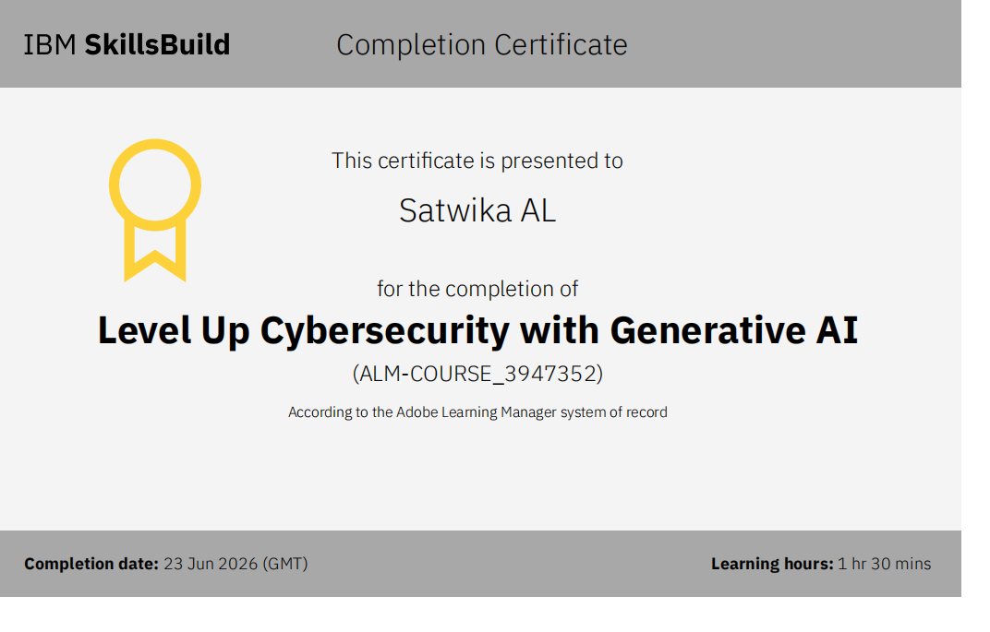

Slide 38
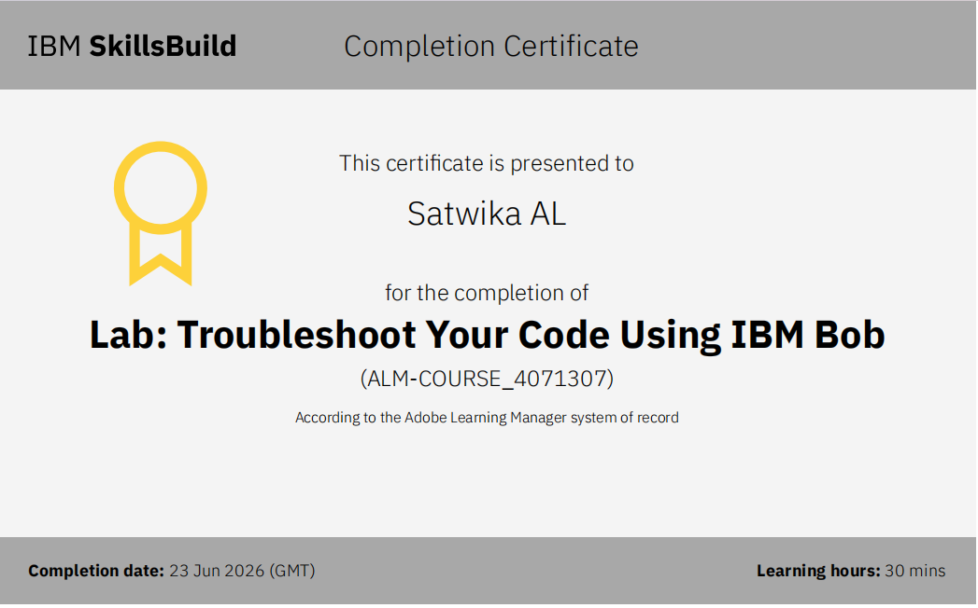

Slide 39


