Slide 1
College management system
Project Presented by:
Lakshmi Sneha

Slide 2






Technologies Used!:
Frontend
Backend

Slide 3
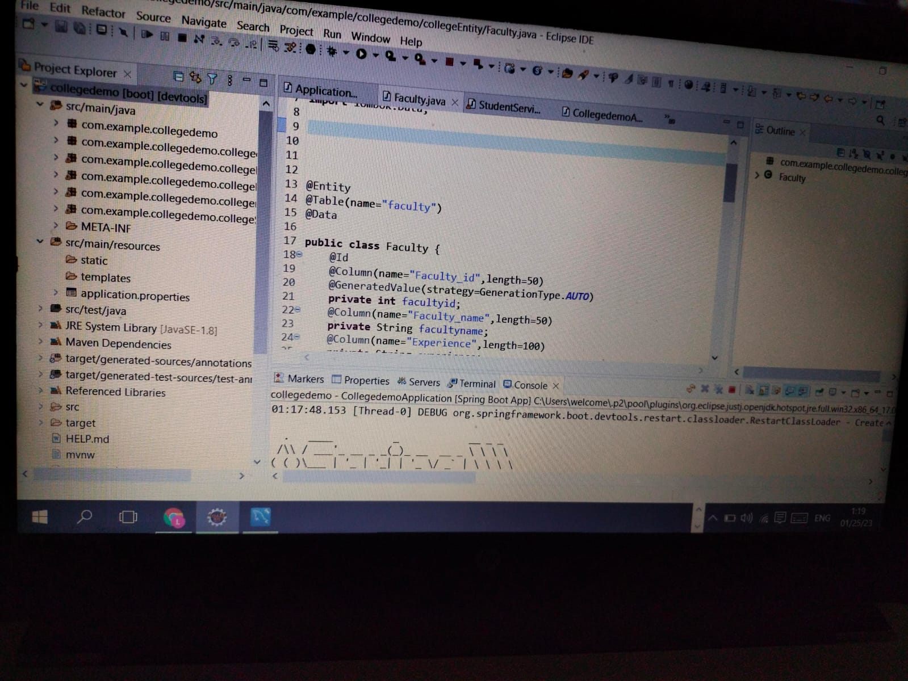

Slide 4
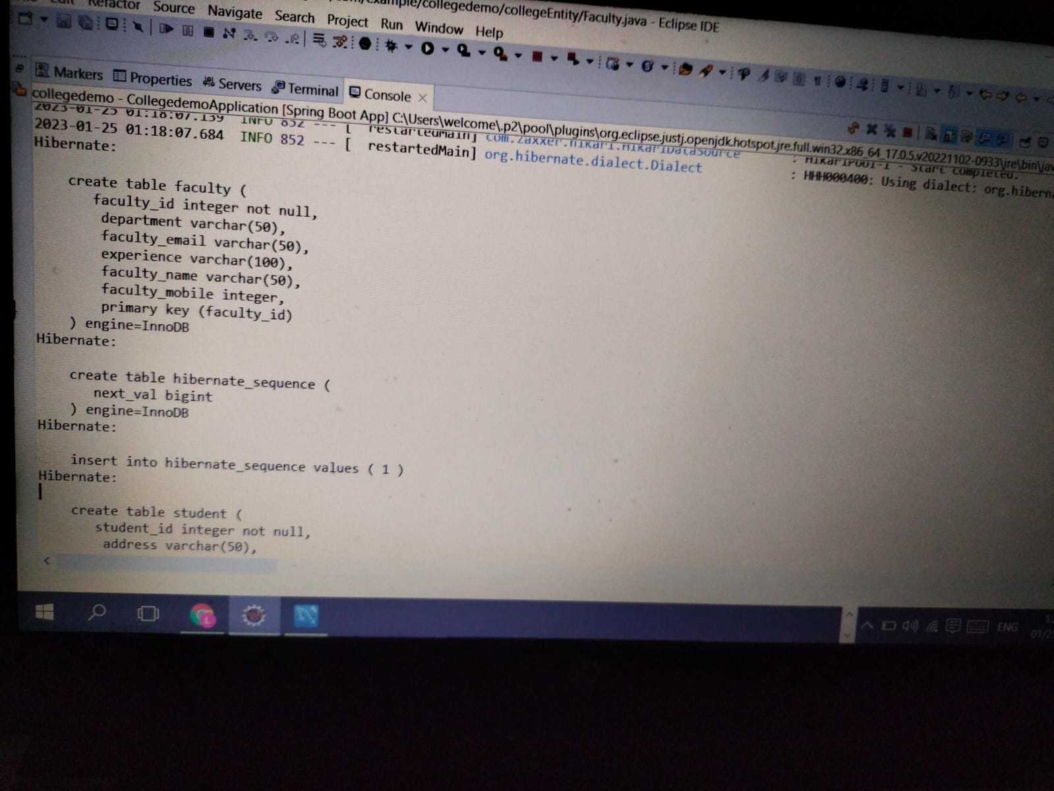

Slide 5
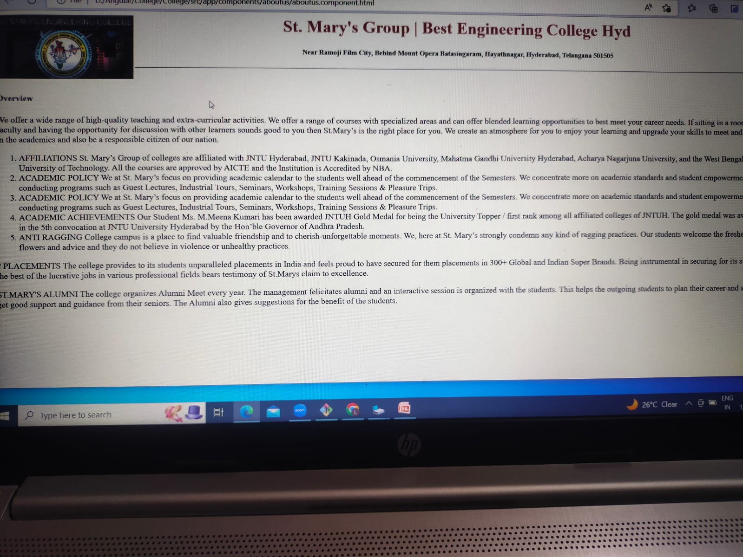

Slide 6
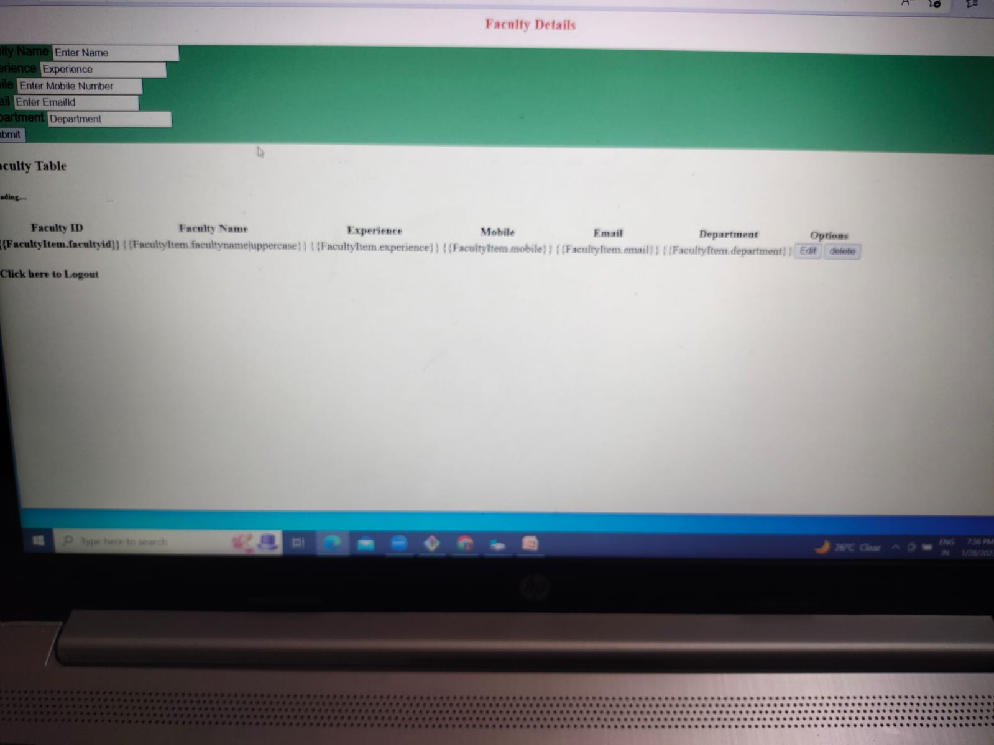

Slide 7


