Slide 1
Function Generators
Generators

Slide 2
Generators:
In JavaScript, generators provide a new way to work with functions and iterators.
Using a generator,
you can stop the execution of a function from anywhere inside the function
and continue executing code from a halted position

Slide 3
Generators:
Syntax:
//defining generator function
function* generatorfun() { } (or) function *generatorfun() { }
// creating a generator called obj
const obj=generatorfun();

Slide 4
Generators:
Yield:
We can pause the execution of a generator function without total executing the whole function body.
We use the “yield” keyword and call it to yield expression.
Once a generator has yield-paused itself, it cannot resume on its own. An external control must be used to restart the generator.
To call the next execution after yield
obj.next()

Slide 5
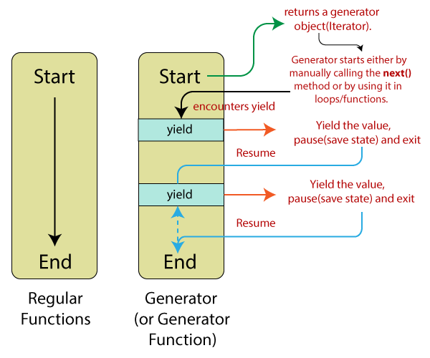

Slide 6
Example1:
function* display() {
console.log("CVR college");
console.log("CSE Department");
console.log("III Year CSE");
}
const obj = display();
console.log(obj.next());

Slide 7
Example2:
function* display() {
console.log("CVR college");
yield;
console.log("CSE Department");
yield;
console.log("III Year CSE");
}
const obj = display();
console.log(obj.next());
console.log(obj.next());
console.log(obj.next());

Slide 8
Generators
A generator object named ”obj” is created.
When obj.next() is called, the code up to the first yield is executed. When the yield is encountered, the program returns the value and pauses the generator function.
Note: You need to assign generator objects to a variable before you use it.

Slide 9
Generator function instance creation
function* display() {
yield 10;
yield "How are you";
}
const obj = display();
console.log(obj.next());
console.log(obj.next());
console.log(obj.next()); // {value: undefined, done: true}

Slide 10
Using return keyword
function* display() {
yield 10;
yield "How are you";
return 20;
}
const obj = display();
console.log(obj.next());
console.log(obj.next());
console.log(obj.next()); // {value: 20, done: true}

Slide 11
using for..of
function* genfun() {
yield 1;
yield 2;
yield 3;
yield 4;
yield 5;
return 6;
}
for (a of genfun()) {
console.log(a);
}

Slide 12
using for..of
Note: if we use return at the time of calling generator using for..of loop, it will return final return keyword value only.
Note: iterator created for the generator will run until done: false, once it is true it will not do anything even return value also.

