Slide 1

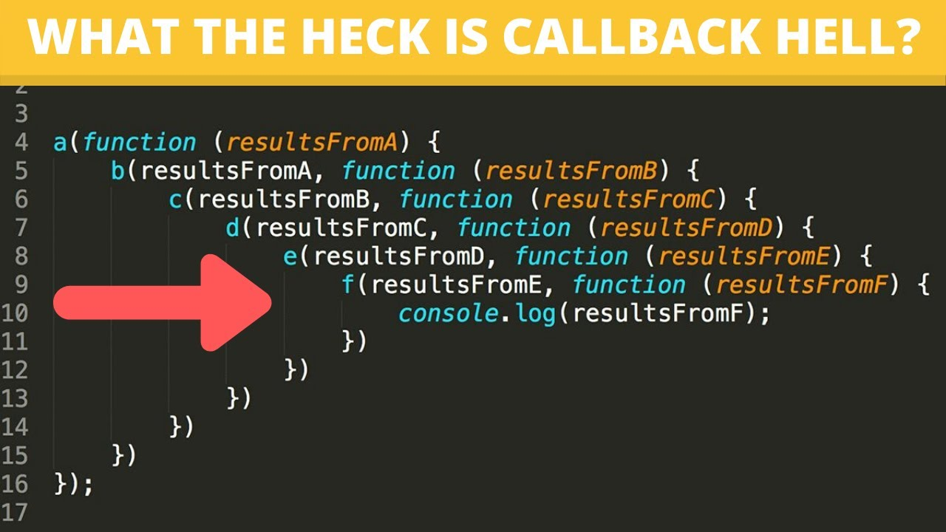

Slide 2
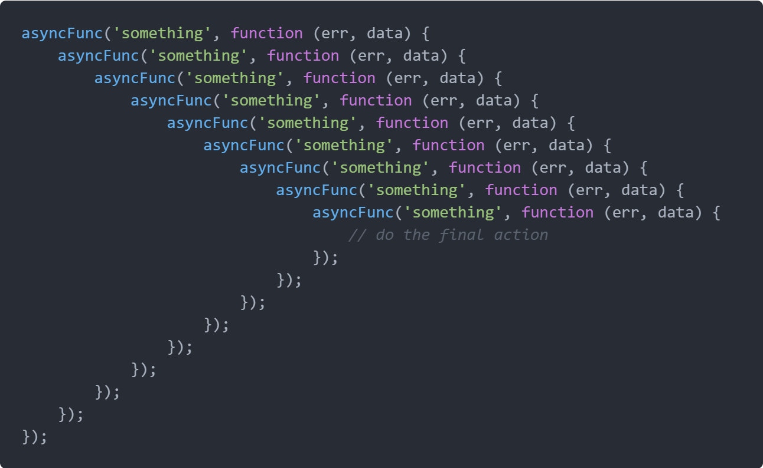

Slide 3
Callback Hell
This is a big issue caused by coding with complex nested callbacks. Here, each and every callback takes an argument that is a result of the previous callbacks. In this manner, The code structure looks like a pyramid, making it difficult to read and maintain. Also, if there is an error in one function, then all other functions get affected.

Slide 4



Promise
Asynchronous JavaScript

Slide 5



Promise
A Promise is used to handle the asynchronous result of an operation.
It defers the execution of a code block until an asynchronous request is completed.
This way, other operations can keep running without interruption.
A Promise has 3 states:
- Pending : It means the operation is going on.
- Fulfilled : It means the operation was completed.
- Rejected : It means the operation did not complete and an error can be thrown.

Slide 6
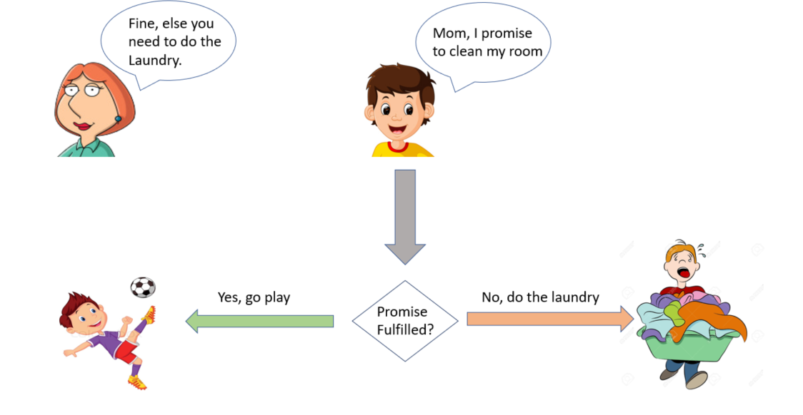

Slide 7
A Promise in short:
Imagine your mom promises you that she'll get you a new phone next week.
You don't know if you will get that phone until next week. Your mom can either buy you a brand new phone or stand up and withhold the phone if she is unhappy.
That is a promise. A promise has three states. They are:
Pending: You don't know if you will get that phone
Fulfilled: Your mom is happy; she buys you a brand-new phone
Rejected: Your mom is not happy; she withholds the phone

Slide 8
Creating a promise
The constructor syntax for a promise object is:
let promise = new Promise(function(resolve, reject) {
// executor
// call resolve() when the operation is complete
// call reject() when the operation is failed.
});
The function passed to Promise is called the executor.
When the promise is created, this executor function runs automatically.

Slide 9
Creating a promise
The resulting promise object has internal properties:
state — initially "pending", then changes to either "fulfilled" or "rejected",
result — an arbitrary value of your choosing, initially undefined.

Slide 10
Creating a promise
When the executor finishes the job, it should call one of the functions that it gets as arguments:
resolve(value) — to indicate that the job finished successfully:
sets state to "fulfilled",
sets result to value.
reject(error) — to indicate that an error occurred:
sets state to "rejected",
sets result to error.

Slide 11
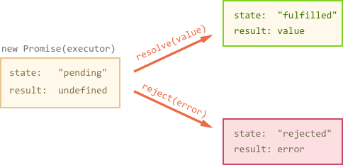
Creating a promise

Slide 12
Promise Example
Here's an example of a Promise constructor and a simple executor function with its "producing code" (the setTimeout):
let promise = new Promise(function(resolve, reject) {
// the function is executed automatically when the promise is constructed
// after 1-second signal that the job is done with the result "done!"
setTimeout(function(){
resolve("done!")},1000);
});

Slide 13

Creating a promise
That was an example of a successful job completion, a "fulfilled promise".

Slide 14
Promise Example
And now an example of the executor rejecting the promise with an error:
let promise1 = new Promise(function(resolve, reject) {
// after 1 second signal that the job is finished with an error
setTimeout(function(){
reject(“not done!”)}, 1000);
});

Slide 15

Creating a promise

Slide 16
Creating a promise
To summarize, the executor should do a job (something that takes time usually) and then call resolve or reject to change the state of the corresponding Promise object.
The Promise that is either resolved or rejected is called "settled", as opposed to a "pending" Promise.

Slide 17
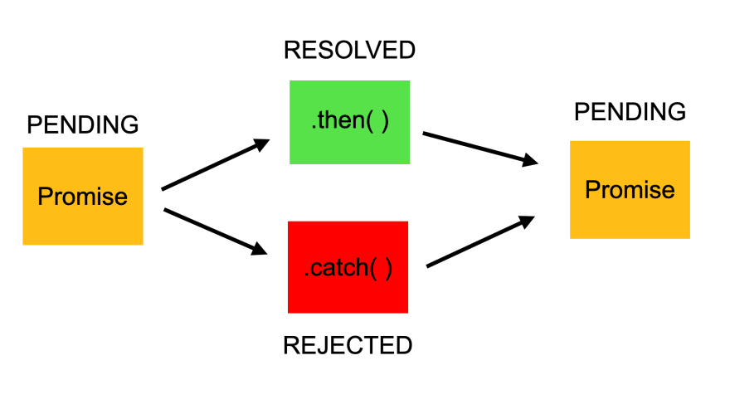
Promise then() and catch() methods
then() method is called when the resolve() is executed.
It receives data passed in the resolve() method as arguments.
catch() method is called when the reject() method is executed.
It receives the data passed in the reject() method as arguments.

