Slide 1
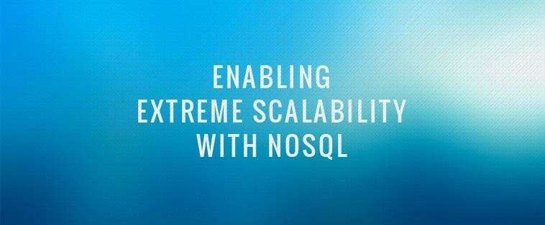



1

Slide 2


1
Introduction
Database - Organized collection of data
DBMS
- Database Management System:
a software
package with computer programs that creation, maintenance and use of a database
controls the
Databases are created to operate large quantities of information by inputting, storing, retrieving, and managing that information.

Slide 3

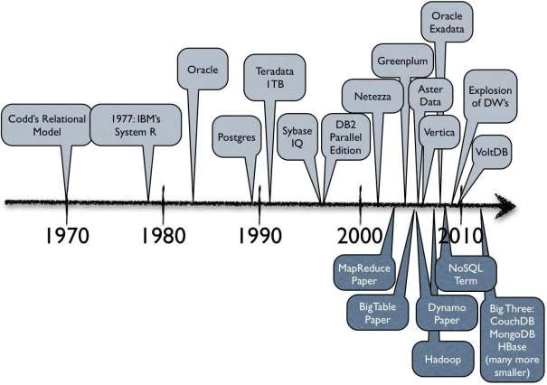
A brief history
2

Slide 4
3
Relational databases
Benefits of Relational databases:
Designed for all purposes
ACID
Strong consistency, concurrency control and , recovery
management.
Mathematical background
Structured Query language (SQL)
Lots of tools to use with i.e: Reporting services, entity frameworks, ...

Slide 5

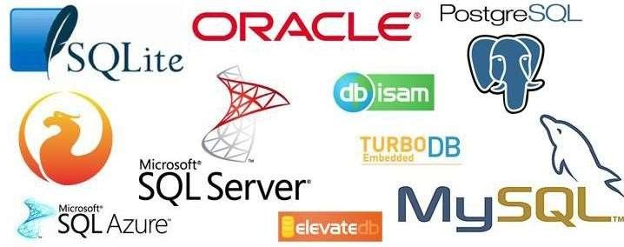
Relational Databases
4

Slide 6

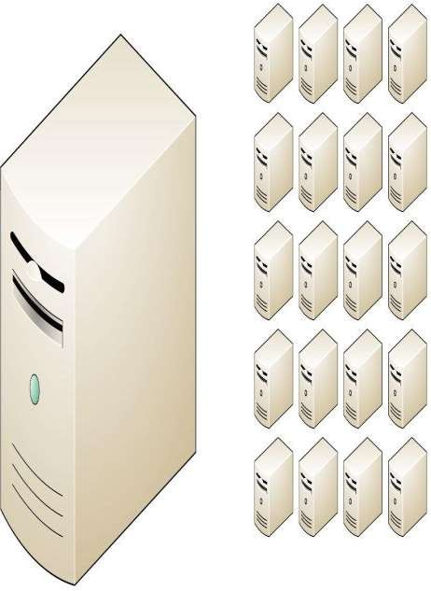
6
NoSQL why, what and when?
But...
Relational databases were not built
for distributed applications.
Because...
Joins are expensive
Hard to scale horizontally
Impedance mismatch occurs (when you need to map objects used in an application to tables stored in a Relational Database)
Expensive (product cost, hardware,
Maintenance)

Slide 7
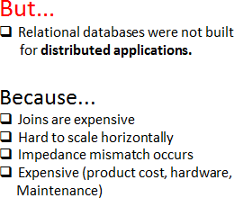
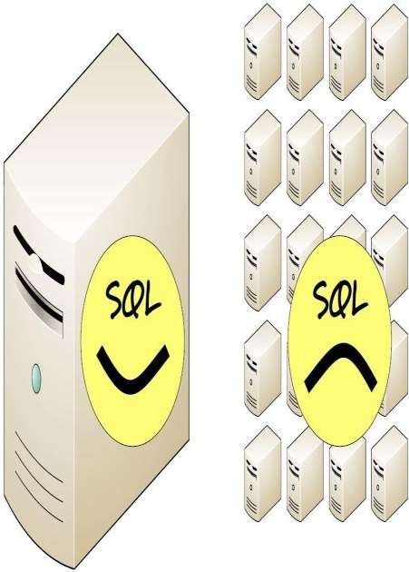
7
NoSQL why, what and when?
And....
It’s weak in:
Speed (performance)
High availability
Partition tolerance

Slide 8
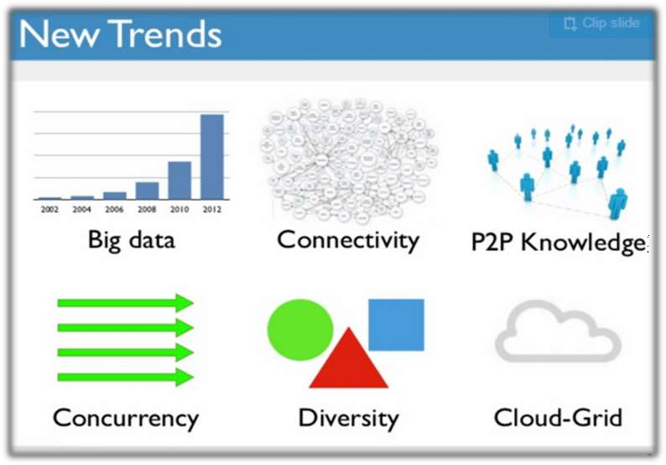
Why NOSQL now??
Ans. Driving Trends
8

Slide 9
NoSQL
10
NoSQL Database is a non-relational Database Management System, that does not require a fixed schema.
It avoids joins and is easy to scale.
The major purpose of using a NoSQL database is for
distributed data stores with humongous data storage needs.
NoSQL is used for Big data and real-time web apps.
Companies like Twitter, Facebook, and Google collect
terabytes of user data.
Carl Strozzi introduced the NoSQL concept in 1998.

Slide 10



What is NoSQL?
11
A No SQL database provides a mechanism
for storage and
retrieval of data that employs less constrained consistency
models than traditional relational database
No SQL systems are also referred to as "NotonlySQL“ to emphasize that they do in fact allow SQL-like query languages to be used.

Slide 11
Brief History of NoSQL Databases
12
Carl Strozzi use the term NoSQL for his lightweight, open- source relational database
The research paper on Amazon Dynamo is released
Google BigTable is
launched
The term NoSQL
was reintroduced
2000
2005
2008
1998
2004
2007
2009
Graph database Neo4j is launched
CouchDB is launched
Facebooks open sources the Cassandra project

Slide 12
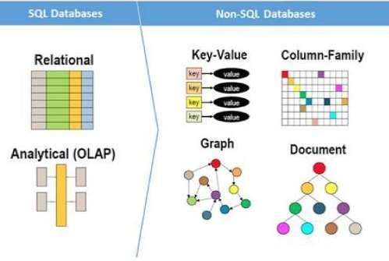
NoSQL
13
Instead, a NoSQL database system encompasses a wide range of database technologies that can store structured, semi-structured, unstructured and polymorphic data.
Traditional RDBMS uses SQL syntax to store and retrieve data for further insights.

Slide 13
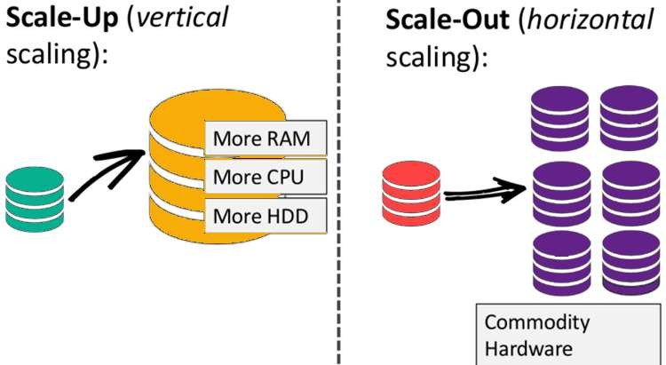
Why NoSQL?
14
The concept of NoSQL databases became popular with Internet giants like Google, Facebook, Amazon, etc. who deal with huge volumes of data.
The system response time becomes high when you use RDBMS for
massive volumes of data.
To resolve this problem, we could "scale up" our systems by
upgrading our existing hardware. This process is expensive.
The alternative for this issue is to distribute database load on multiple hosts whenever the load increases. This method is known as "scaling out."

Slide 14
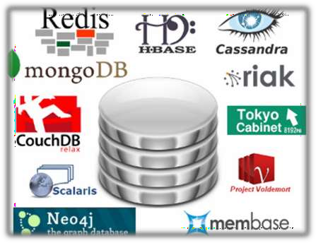
Characteristics of NoSQL databases
15
NoSQL avoids:
▶ Overhead of ACID transactions
▶ Complexity of SQL query
▶ Burden of up-front schema design
▶ DBA presence
▶ Transactions (It should be handled at
application layer)
Provides:
▶ Easy and frequent changes to DB
▶ Fast development
▶ Large volumes of data (eg. Google)
▶ Schemaless

Slide 15
Features of NoSQL databases
16
Non-relational
Schema-free
Simple API
Distributed

Slide 16
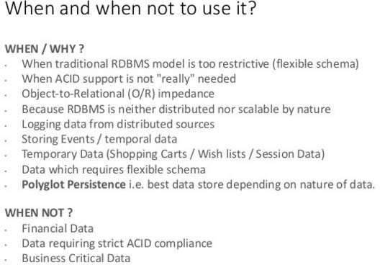
NoSQL why, what and when?
20

Slide 17
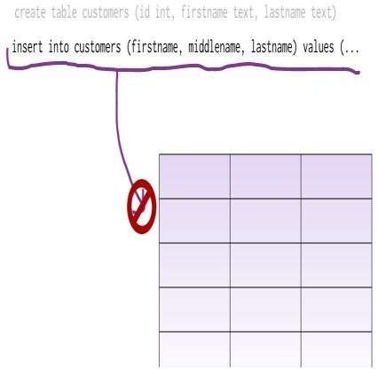
What is a schema-less datamodel?
22
In relational Databases:
▶ You can’t add a record which does
not fit the schema
▶ You need to add NULLs to unused
items in a row
▶ We should consider the datatypes.
i.e : you can’t add a string to an
interger field
▶ You can’t add multiple items in a field (You should create another table: primary-key, foreign key, joins, normalization, ... !!!)

Slide 18
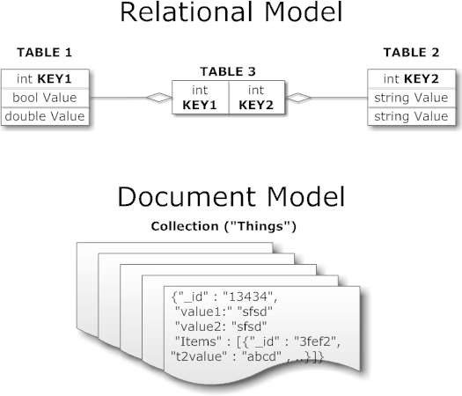
What is a schema-less datamodel?
23
In NoSQL Databases:
▶ There is no schema to consider
▶ There is no unused cell
▶ There is no datatype (implicit)
▶ Most of the considerations are done
at application layer
▶ We gather all items in an aggregate (document)

Slide 19

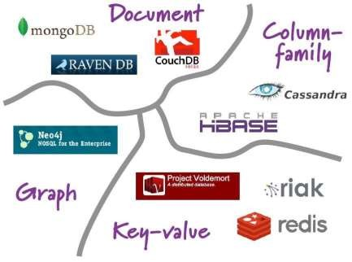
Different types of NoSQL Databases
24
NoSQL databases are classified into four major data models:
Key-value
Document-Based
Column family
Graph-Based
Each DB has its own query language

Slide 20
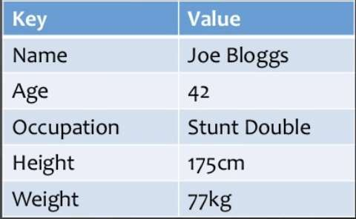



Key-value Data model
25
Simplest NOSQL databases
Data is stored in key/value pairs.
The main idea is the use of a hash table
Access data (values) by strings called keys
Data has no required format
Basic Operations: Insert(key,value), Fetch(key), Update(key), Delete(key)
Data may have any format
Data model: (key, value) pairs

Slide 21
Key-value Data model
26
When to use?
When you are dealing with bytes or string data.
If your data is not highly related.
If your need is basic CRUD operations.
When not to use?
If you need relationships among data.
If you need to query by value.
It is not suitable for complex querying.

Slide 22

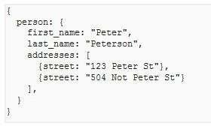
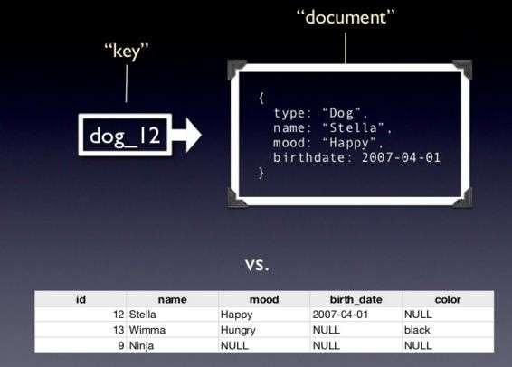
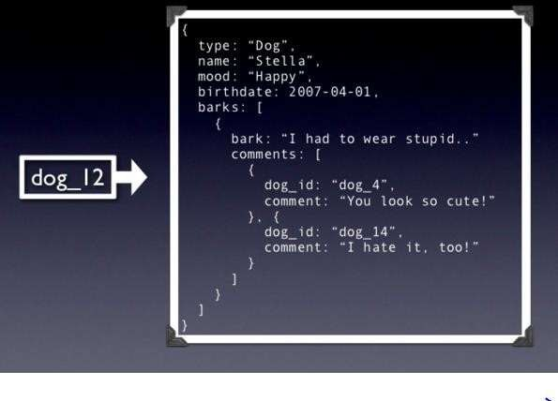
Document based data model
27
It is based on the concept of documents.
Pair each key with complex data structure known as document.
Documents can contain many different key- value pairs, or key-array pairs, or even nested documents.

Slide 23

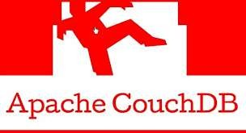
Document based data model
28
It stores and retrieves various documents in formats, such as XML,
JSON (JavaScript Object Notation) or, BSON (Binary JSON).
It stores documents in the value part of the key-value database.
You can consider the document databases as key-value stores
where you can examine the values.

Slide 24
Document based data model
29
When to use?
If you don’t know much about schema.
Schema is likely to change often.
Web Analytics and Real-time analytics.
Blogging platforms and eCommerce.
When not to use?
If Data is highly related.
If efficiency is preferred over consistency.

Slide 25
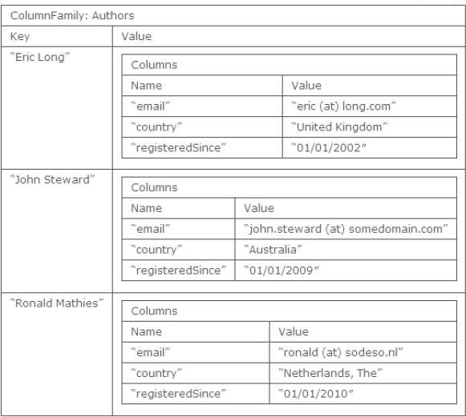
Column family data model
30
Column-based databases store data in
column families as rows.
These rows contain multiple columns
associated with a row key.
Column families are groups of related
data that is accessed together.
The column is lowest/smallest instance of data.
It is a tuple that contains a name, a
value and a timestamp

Slide 26


Column family data model
31
When to use?
If you need very fast column operations including aggregation.
Need for compression or versioning.
To store event logging.
Content management system, Blogging platforms.
When not to use?
If you need column family design changes.
Key design is complex

Slide 27

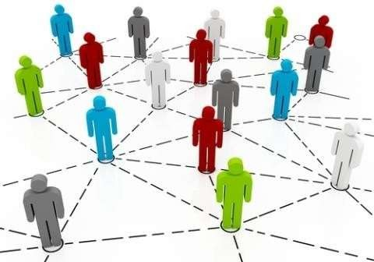

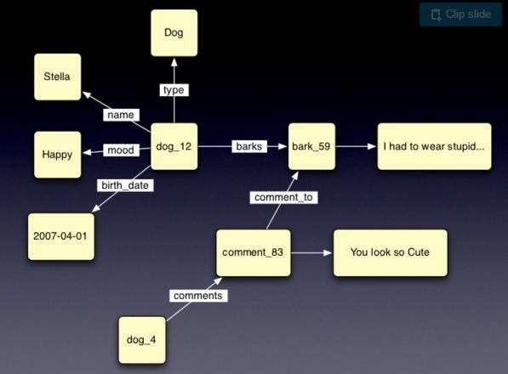


Graph data model
32
Based on Graph Theory.
Scale vertically, no clustering.
You can use graph algorithms easily
Transactions
ACID

Slide 28
Graph data model
33
When to use?
If your data looks more like a graph.
Location-based services.
Routing, dispatch.
When not to use?
Operations will involve whole graph.
It does not scale well horizontally.
Updating all or subset of entities.

Slide 29
SQL vs NOSQL
SQL | NoSQL
SQL databases are relational | NoSQL are non-relational
SQL databases use structured query language and have a predefined schema. | NoSQL databases have dynamic schemas for unstructured data.
SQL databases are vertically scalable | NoSQL databases are horizontally scalable.
SQL databases are table based | whereas NoSQL databases are document, key-value, graph, or wide-column stores.
SQL databases are better for multi-row transactions | NoSQL are better for unstructured data like documents or JSON.
Follows ACID property | Follows CAP (consistency, availability, partition tolerance)
These databases are best suited for complex queries | These databases are not so good for complex queries
34

Slide 30
What we need ?
35
We need a distributed database system having such features:
Fault tolerance
High availability
Consistency
Scalability
Which is impossible!!!
According to CAP theorem

Slide 31
CAP theorem or Brewer's theorem
36
CAP theorem also named Brewer's theorem after computer scientist Eric Brewer, states that it is impossible for a distributed data store to simultaneously provide more than two out of the following three guarantees:
Consistency, Availability, and Partition tolerance

Slide 32
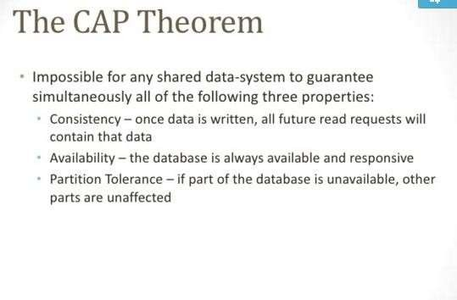
CAP theorem or Brewer's theorem
37

Slide 33
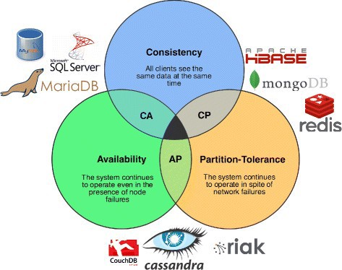


CAP theorem or Brewer's theorem
37
We cannot achieve all the three items in distributed database systems (center)

Slide 34
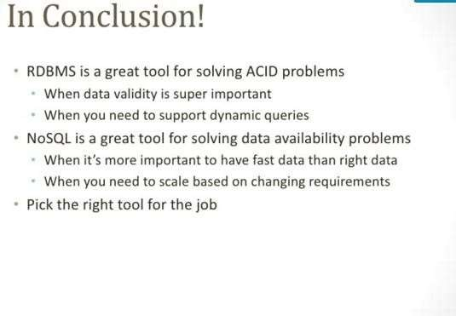
Conclusion….
38

Slide 35



39

