Slide 1

+++++++++++
AUTOMATED PLANT WATERING SYSTEM USING ARDUINO

Slide 2

TEAM MEMBERS
LAKSHMI - CB.SC.U4AIE24116
SRINIVAS - CB.SC.U4AIE24140
MYAGI - CB.SC.U4AIE24143
SRI SHANMATHI - CB.SC.U4AIE24152

Slide 3
INTRODUCTION
Plants require regular watering to stay healthy.
Manually watering plants can be inconvenient.
This system automates watering based on soil moisture levels.
Uses Arduino, soil moisture sensor, relay module, and LCD display.

Slide 4
OBJECTIVE
Automated Irrigation: Implement an intelligent system that autonomously waters plants based on real-time soil moisture readings, ensuring optimal hydration.
Efficient Water Management: Develop a smart water distribution mechanism that minimizes wastage and prevents overwatering through precise control.

Slide 5
COMPONENTS
Arduino Uno (Microcontroller)
Soil Moisture Sensor (Detects moisture level in soil)
Relay Module (Controls water pump)
Water Pump (Pumps water to the plant)
LCD Display (16x2) (Shows moisture level and system status)
Breadboard & Jumper Wires (For connections)
Power Supply

Slide 6
Connections
Component | Pin | Connected To (Arduino/Others) | Why this connection?
Power Rails | + (Positive) | 5V (Arduino) | Provides power to all components
 | - (Negative) | GND (Arduino) | Completes the circuit ground
DHT Sensor | VCC | 5V (Arduino) | Powers the sensor
 | GND | GND (Arduino) | Completes the circuit ground
 | A0 | A0 (Arduino) | Sends temperature & humidity data to Arduino
LCD Display | VCC | 5V (Arduino) | Powers the display
 | GND | GND (Arduino) | Completes the circuit ground
 | SDA | A4 (Arduino) | Sends data to display
 | SCL | A5 (Arduino) | Sends clock signal to display

Slide 7
Component | Pin | Connected To (Arduino/Others) | Why this connection?
Battery | + (Positive) | Common Terminal of Relay | Provides power to the pump
 | - (Negative) | Negative of Pump | Completes the pump circuit
Relay Module | VCC | 5V (Arduino) | Powers the relay
 | GND | GND (Arduino) | Completes the circuit ground
 | IN | Digital Pin 7(Arduino) | Controls the relay switching
Pump | Positive Wire | Open Terminal of Relay | Activates the pump when relay is switched

Slide 8
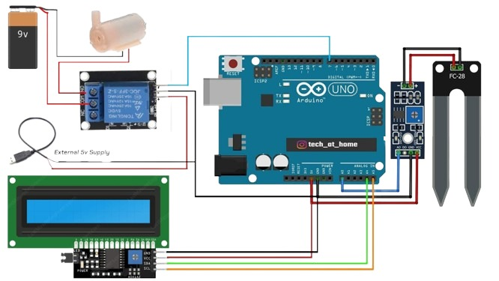
CIRCUIT DIAGRAM

Slide 9
METHODOLOGY
The system uses a soil moisture sensor connected to an Arduino to monitor soil conditions. The sensor readings (0–1023) are averaged.
Based on threshold values, the system determines the soil status. If the reading is above 950 (dry), the Arduino turns ON the water pump via a relay.
If it's between 500 and 950 (medium), the pump runs for 2 seconds.
If it's below 500 (wet), the pump remains OFF.
An I2C LCD displays the moisture value and pump status in real time.
This cycle repeats every second to ensure consistent soil moisture.

Slide 10
FUTURE WORKS
Integration with IoT platforms for remote monitoring and control.
Development of a mobile app interface for real-time moisture data and manual override.
Incorporating weather prediction APIs to optimize watering schedules.
Scaling the system for use in larger agricultural setups.

Slide 11
FUTURE WORKS
Integration with IoT platforms for remote monitoring and control.
Development of a mobile app interface for real-time moisture data and manual override.
Incorporating weather prediction APIs to optimize watering schedules.
Scaling the system for use in larger agricultural setups.

Slide 12
LITERATURE REVIEW
This paper An automated plant watering system designed to reduce manual intervention and optimize water usage for home gardens and agricultural fields. The system is built around an ATmega328 microcontroller, which monitors real-time soil moisture using a sensor and controls a water pump through a relay module. When the moisture level drops below a defined threshold, the pump is triggered to water the plant. Additionally, the system includes a mobile application that notifies users about the system’s status and alerts them to refill the water tank when needed. With its scheduled watering capability and sensor-based control, the system ensures efficient irrigation while maintaining plant health and minimizing water wastage. [1]
In this paper An automated plant watering system designed to improve irrigation efficiency and reduce manual labor. The system utilizes an Arduino UNO R3 and a soil moisture sensor to monitor soil moisture levels in real-time. When the soil dries out, a relay-controlled submersible pump is triggered to irrigate the plants

Slide 13
The system can target specific areas of a field using multiple sensors and includes a rain detection feature to prevent unnecessary watering during rainfall. Additionally, a mobile interface allows farmers to control and monitor the system, promoting water conservation and smarter farming practices, particularly in areas with labor shortages or inconsistent rainfall. [2]
In this paper An Arduino Nano-based automated gardening system using a soil moisture sensor, relay module, and water pump to maintain optimal soil moisture. The system automatically waters the plant when dryness is detected and stops when sufficient moisture is reached. Simulation in Proteus ensured system reliability, and the authors emphasized its potential for sustainable agriculture and future integration with AI. [3]

Slide 14
REFERENCES
*[1] D. Divani, P. Patil, and S. K. Punjabi, “Automated plant watering system,” in 2016 International Conference on Computation of Power, Energy, Information and Communication (ICCPEIC). IEEE, 2016, pp. 180–182
[2] M. G. Raghunadh, K. T. Kim, N. B. Manas, and R. S. Kanth, “Automated plant watering system,” International Journal of Creative Research Thoughts (IJCRT), vol. 9, no. 5, pp. 354–358, 2021. [Online].Available: https://www.ijcrt.org/papers/IJCRT2105145.pdf
[3] P. P. Sheikh, A. H. Akash, M. Rahman, and T. I. Khan, “An Arduino based automated gardening system for efficient and sustainable plant growth,” International Research Journal of Modernization in Engineering Technology and Science (IRJMETS), vol. 6, no. 2, pp. 571–577, 2024.[Online]. Available: https://www.researchgate.net/publication/378204719

Slide 15


