Slide 1






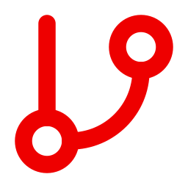
THE IDEA
An AI Agent for Our Robot Framework Test Suite
Index keywords and APIs once, then let an agent discover, de-duplicate and write tests.
Keyword Discovery
Duplicate Analysis
Test Generation
Impact Analysis
Ask in plain English; get the right keyword, arguments and a usage example.
Exact, structural and semantic matching finds keywords that do the same job.
Drafts new tests from onboarding API specs, reusing keywords that already exist.
A call graph shows every test affected before a keyword or API change ships.
Outcome: Reuse, not rewrite
Outcome: Ranked cleanup list
Outcome: Faster authoring
Outcome: Safer changes
How it works
Index once code and API specs
Dry-run checked before review
Human approved before merge
Notes:
The idea: build a code graph of keywords and API specs once, then let an agent answer questions, find duplicates, draft tests and show change impact.

Slide 2
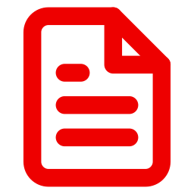



STEP 1 · AUTO-ONBOARD THE APIS
Auto-Onboard New APIs into Robot Framework
Point the agent at an API spec; it builds the keyword layer and test scaffolding.
Ingest the Spec
Reuse Keywords
Generate Keywords
Draft Scenarios
Reads OpenAPI, Postman or an endpoint list: operations, schemas, auth, status codes.
Matches each endpoint to current request and auth keywords in the code graph.
Creates missing API keywords that follow your naming and argument conventions.
Builds happy path, negative and boundary cases straight from the schema.
Outcome: One source of truth
Outcome: No duplicate wrappers
Outcome: Consistent style
Outcome: Coverage from day one
You provide
An API spec or endpoint list
Business rules for expected results
Test data and environment details
Notes:
Auto-onboarding: spec in, keywords and test scaffolding out. Business rules and test data still come from the team; a dry run proves validity, not behaviour.

Slide 3




STEP 2 · THE AGENTIC SOLUTION
The Agentic Solution: Plan, Act, Verify
Search returns a list. An agent plans, calls tools, checks its own work and explains.
Understands Intent
Plans the Work
Self-Corrects
Human Control
Turns a request like 'onboard a customer' into the right keywords and APIs.
Chains search, comparison, drafting and checking in one run via MCP tools.
Runs robot --dryrun and repairs unknown keywords or wrong arguments itself.
Shows what was reused or created and why; nothing merges unreviewed.
Outcome: Plain-language access
Outcome: One request, full draft
Outcome: Valid before review
Outcome: Transparent output
MCP tools
search_keywords get_keyword
find_duplicates callers / callees
get_api_operation dry_run_validate
Notes:
Why an agent: it interprets intent, chains several tool calls, uses dry-run feedback to fix itself, and leaves the final decision to a human.

